Slide 1

Research methods I
Master thesis seminar
21.11.2023

Slide 2
Content
Research principles
Critically reviewing the literature
Data – information - knowledge
Using secondary data
Collecting primary data

Slide 3
1
Research principles

Slide 4
Research
Research is about systematically obtaining and analysing data to increase a knowledge about a topic in which we are interested. In undertaking research, we are trying to answer a question or address a problem, this often being referred to as ‘meeting the research aim’ or ‘addressing the research objectives’.
Rojon a Saunders, 2012

Slide 5


Data = evidence
No fortune telling
No philosophical views

Slide 6
You cannot solve a problem where there is not one!

Slide 7
Well defined problem is half solved!

Slide 8
Research question
It is a central theme of any research.
Every aspect of research must aim to answer it.
It determines the research strategy not the other way around!
It goes beyond the horizon of identifying the subject and object of research.

Slide 9
Research question examples
What?
  What make our employees leave for our competition?
When?
  When do our customers repeat their purchase?
Where?
  Where exactly should we build our new store?

Slide 10
Research question examples
Who?
  Who spreads negative sentiment about government online?
How?
  How railway services rebranding influenced attitudes of general public?
Why?
  Why do companies outsource marketing research?

Slide 11
If you have a question, you can start searching for answers.
First step in master thesis is to look into literature.

Slide 12
2
Critically reviewing the literature

Slide 13

References, references, references…

Slide 14
Literature review purpose
To discover explicit recommendations for further research. These can provide you with a superb justification for your own research question(s) and objectives;
to help you to avoid simply repeating work that has been done already;
to discover and provide an insight into research approaches, strategies and techniques that may be appropriate to your own research question(s) and objectives.
Saunders et al., 2009. Research methods for business students

Slide 15
What is to be critical
To criticize normally means something negative:
  The flood situation is critical
  Critically endangered antelope species
  The patient's condition is critical
  Diplomats criticize Obama's actions
All science is built on the ability of people (peer reviewers) to critically evaluate other people‘s work.

Slide 16
What is to be critical
Ability to assess the validity and strength of arguments
Ability not to take information as automatically true and valid
Ability to see the wider context
Ability to critique using counter-arguments and provide effective feedback
Ability to critically evaluate one's own work

Slide 17
3
Data – information - knowledge

Slide 18
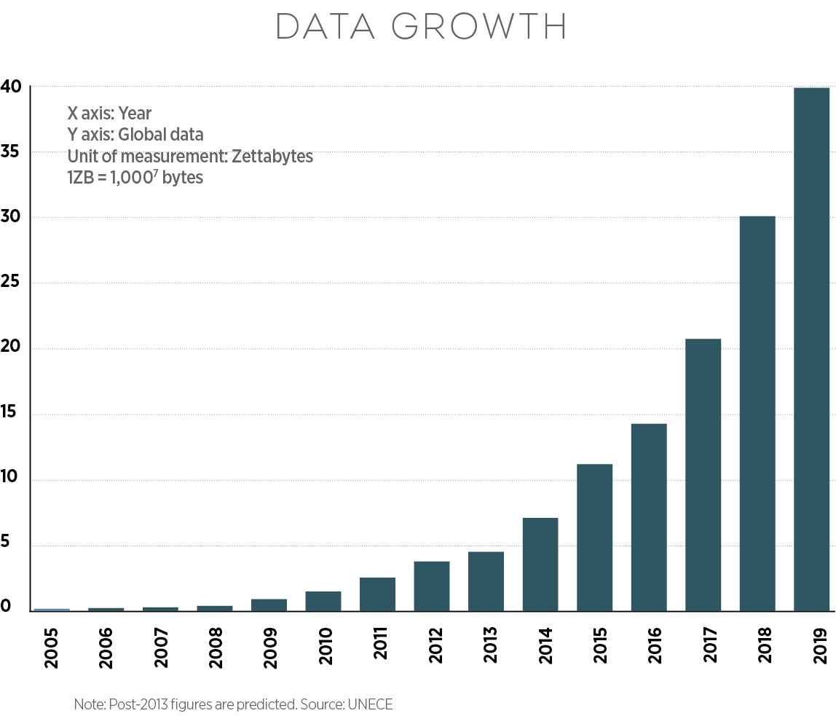
Data, information, knowledge

Slide 19
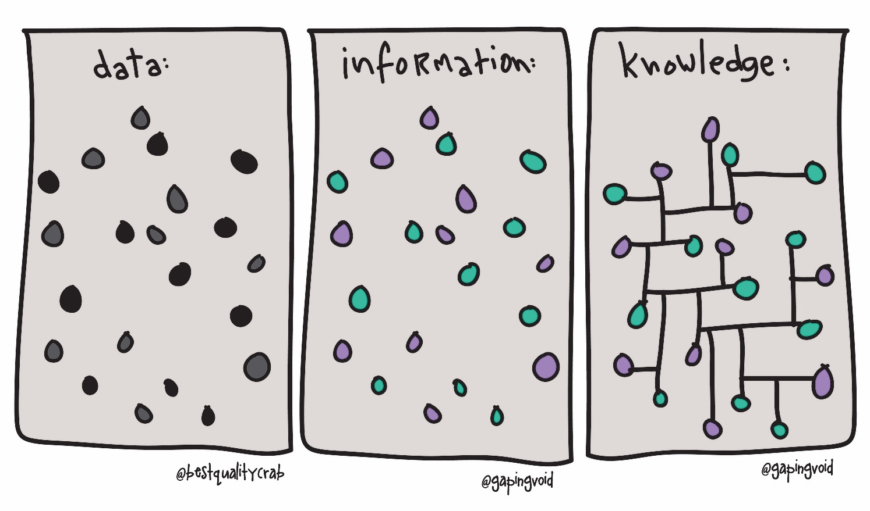

Slide 20
Data and information differences
Data is the most basic form of knowledge, e.g. the brand of butter sold to a particular customer in a certain town. This statistic is of little worth in itself but may become meaningful when combined with other data.
Information is a combination of data that provide decision-relevant knowledge, e.g. the brand preferences of customers in a certain age category in a particular geographic region.

Slide 21
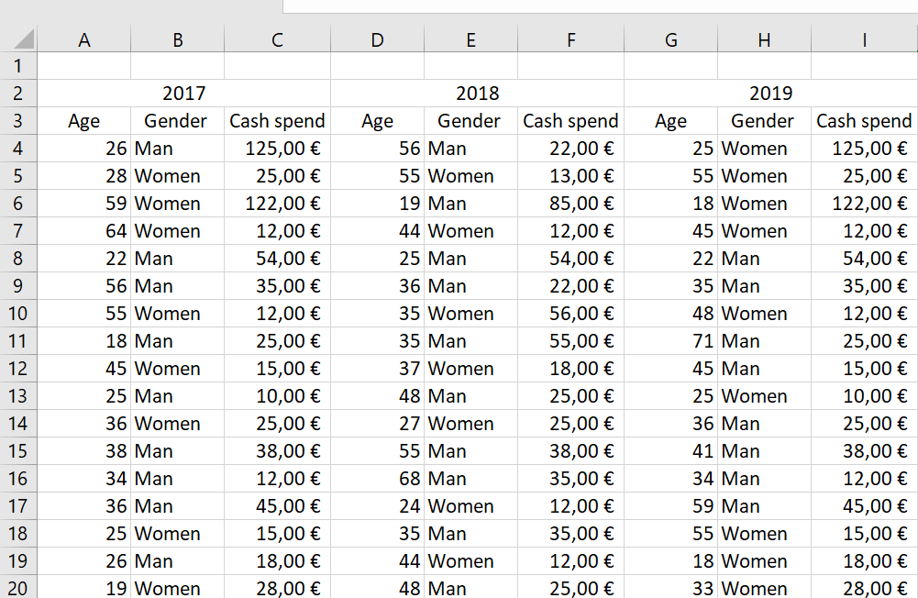
Can we make decision based on these customer data?

Slide 22
Age | 2017 | 2018 | 2019
18-29 | 15% | 10% | 6%
30-39 | 18% | 13% | 13%
40-49 | 26% | 22% | 15%
50-59 | 18% | 24% | 21%
60-69 | 15% | 18% | 25%
70+ | 8% | 13% | 20%

Slide 24
Notes:
Propojením informací vznikají znalosti.
Informace je základní stavební kámen komunikace

Slide 25
Research data types
Primary data
  Do not exist at the beginning of the research project
  Data collected throughout the project
Secondary data
  Data already existing
  Reports, statistical data, business data, reused data, analytical data.

Slide 26
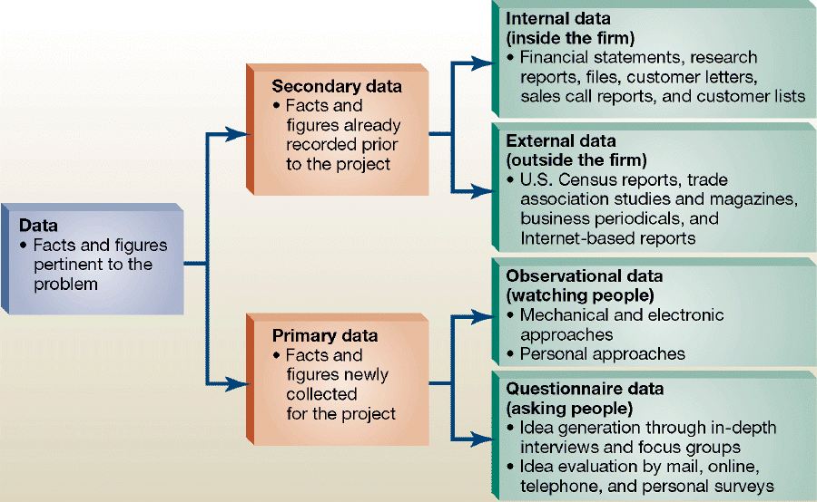

Slide 27
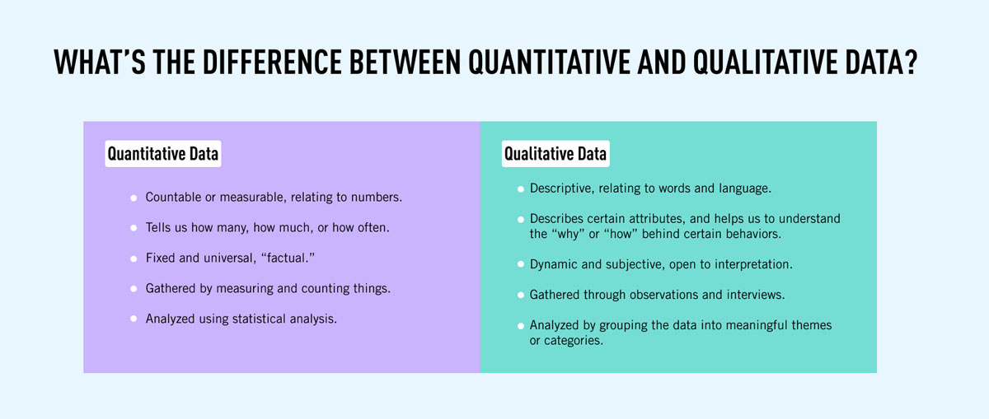

Slide 28
4
Using secondary data

Slide 29
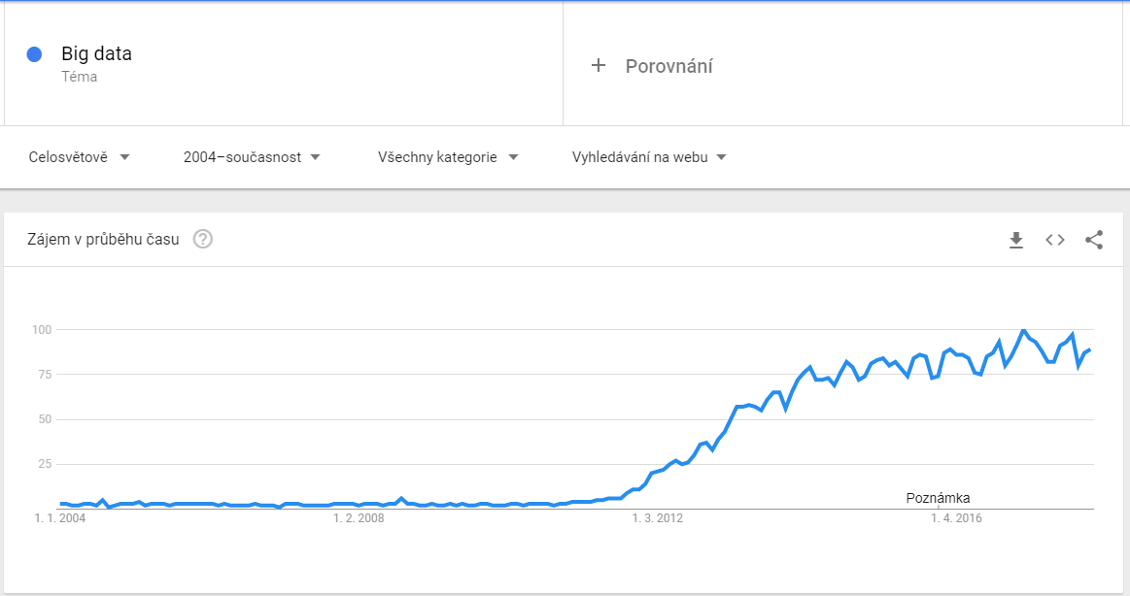

Slide 30
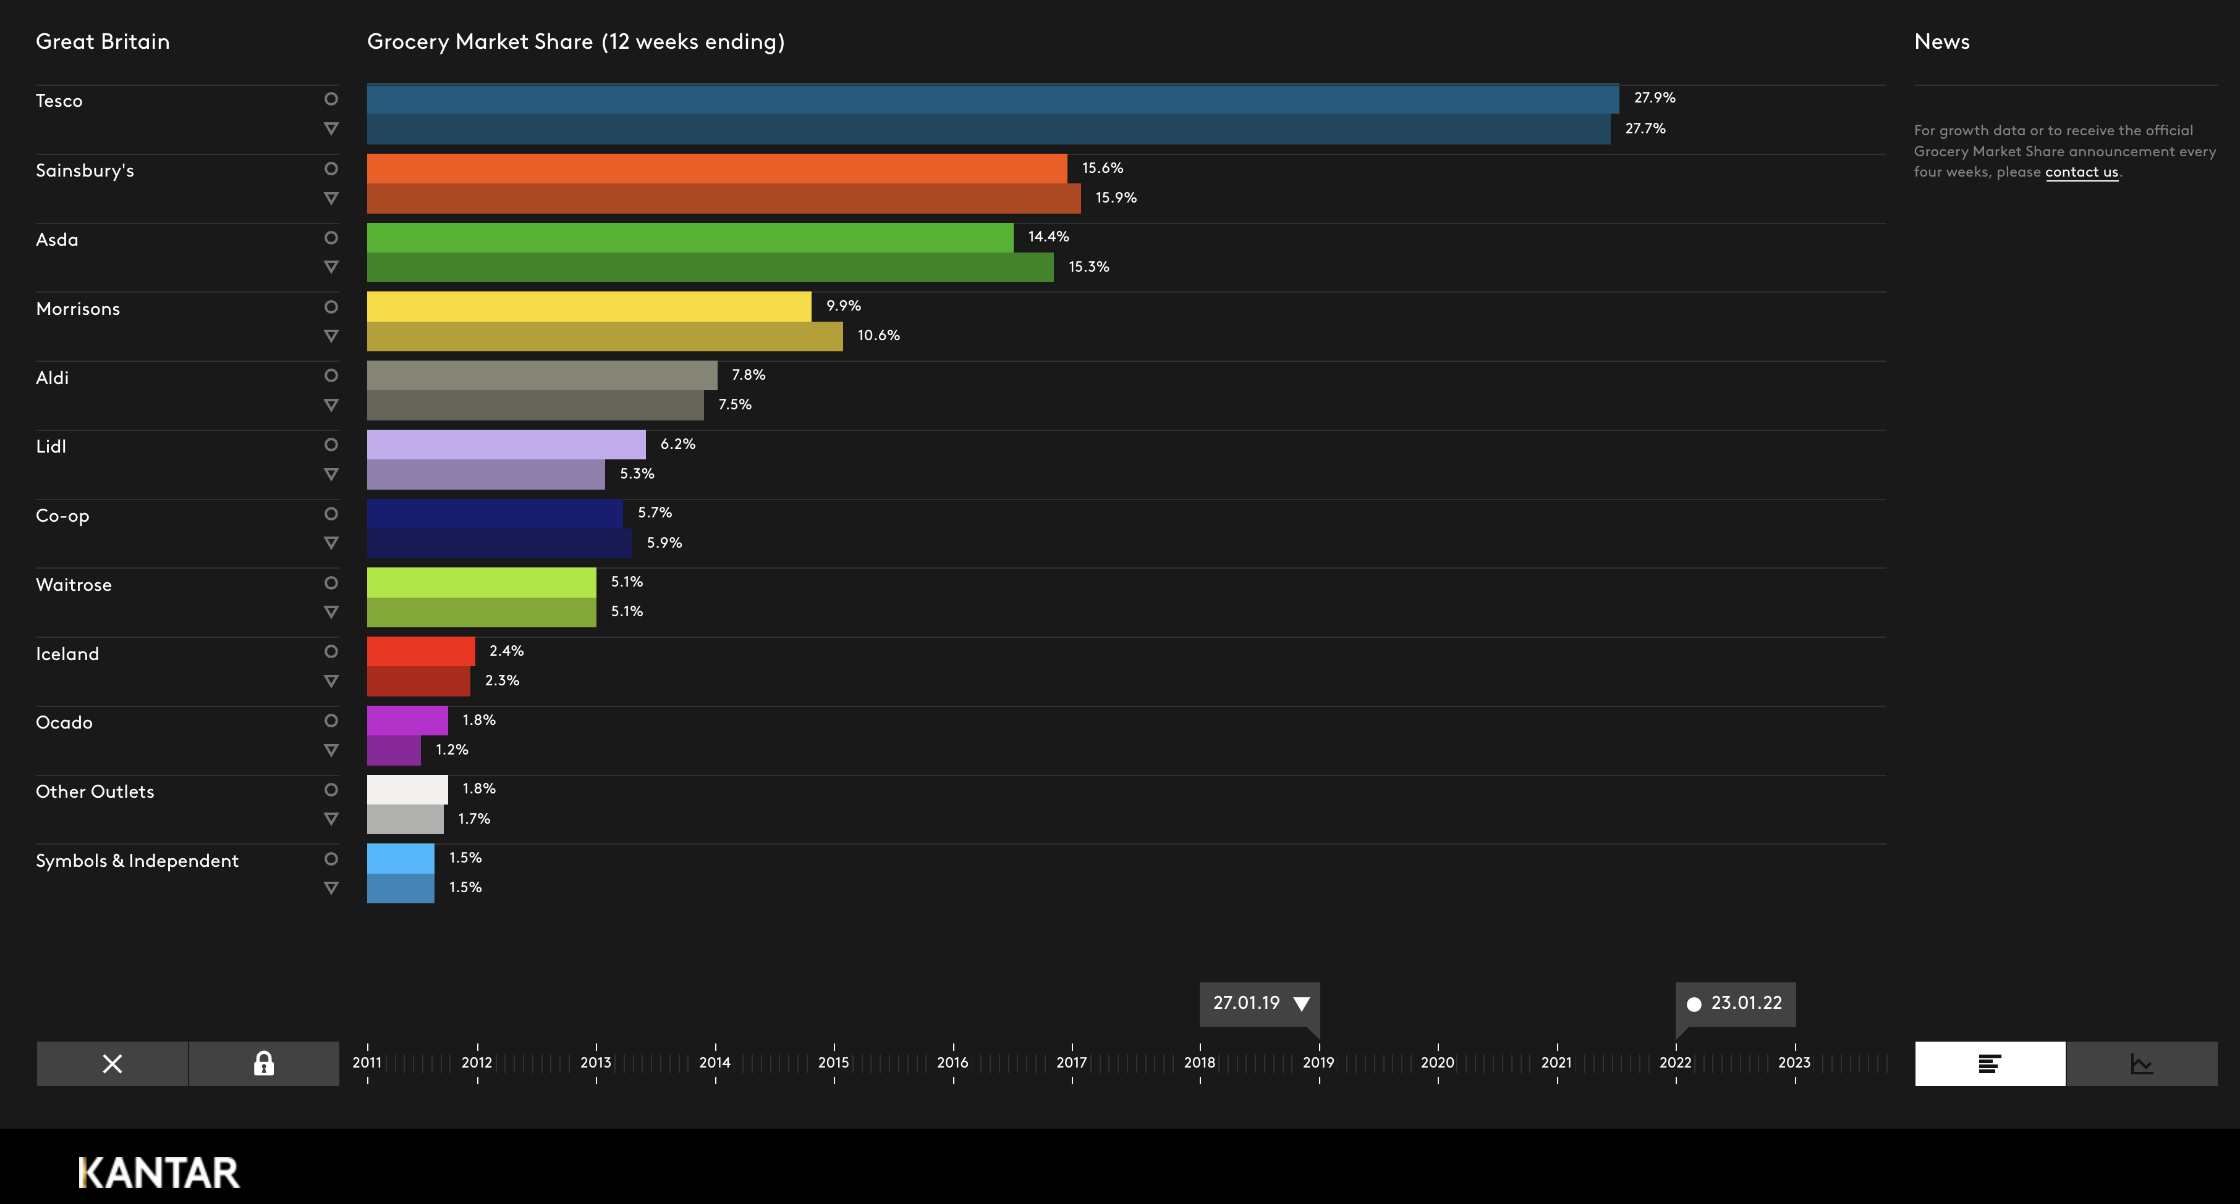
https://www.kantarworldpanel.com/

Slide 31
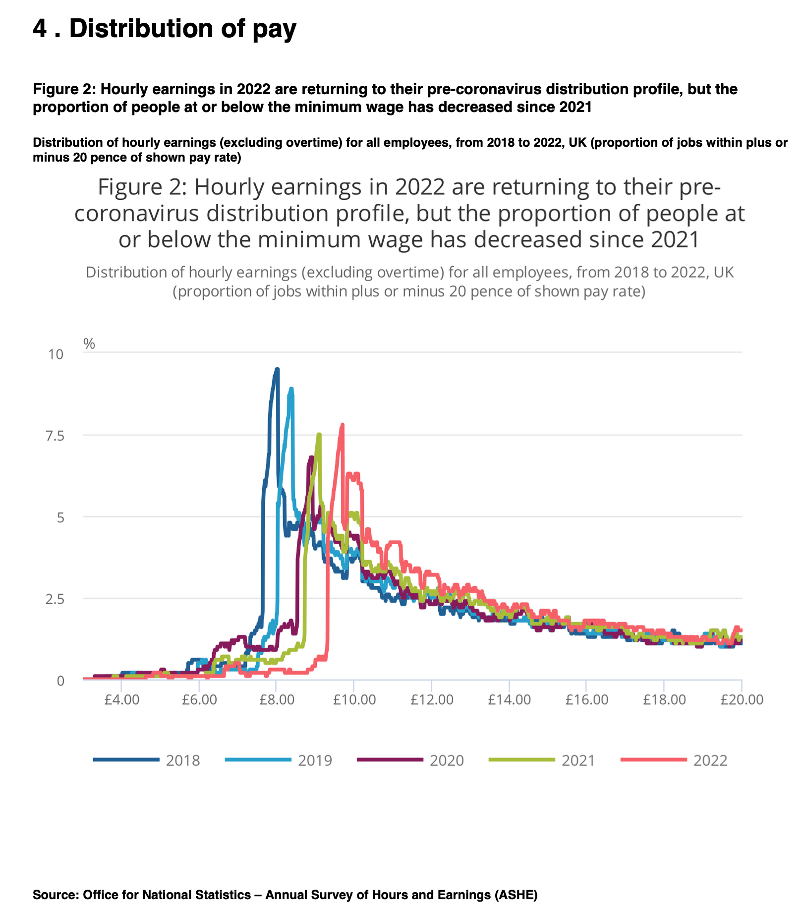
https://www.ons.gov.uk/employmentandlabourmarket/peopleinwork/earningsandworkinghours/bulletins/lowandhighpayuk/2022

Slide 32
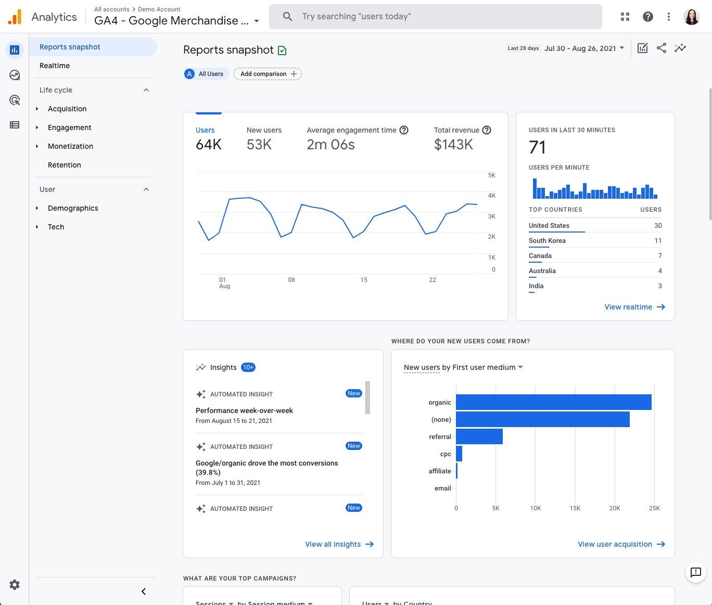

Slide 33


Slide 34
Advantages of secondary data
Cost and Time Efficiency:
Secondary data is typically less costly and quicker to obtain than primary data. Since it's already collected and often readily accessible, researchers can save significant resources in terms of both time and money.

Slide 35
Advantages of secondary data
Broad Scope and Variety:
Secondary data can provide a broad perspective that primary data might not be able to offer. It often includes a wide range of information collected for various purposes that can be useful for comprehensive research.

Slide 36
Advantages of secondary data
Longitudinal Analysis:
It enables researchers to conduct longitudinal studies, examining trends and developments over time, which would be resource-intensive or impossible to do using primary data.

Slide 37
Advantages of secondary data
Comparative Studies and Benchmarking:
Secondary data allows for comparisons across different studies, sectors, or countries. It can be used for benchmarking against industry standards or competitors.

Slide 38
Advantages of secondary data
Feasibility and Preliminary Insights: It helps in assessing the feasibility of research projects. Researchers can use secondary data to gain preliminary insights into a topic, which can guide the design and approach of primary research.
Supporting Primary Data: Secondary data can complement and reinforce findings from primary research, adding depth and context to the analysis.

Slide 39
Disadvantages of secondary data
Relevance Issues: The data may not be entirely relevant to the current research objectives or questions, as it was collected for a different purpose.
Quality and Accuracy Concerns: The accuracy and reliability of secondary data can be questionable, especially if the sources are not credible or the data collection methods were flawed.
Outdated Information: Secondary data might be outdated, making it less useful for current studies, particularly in fast-changing fields.

Slide 40
“Data collection methods were flawed…”
How do you know?
How can you critically evaluate secondary data?
By understanding the methods of primary data collection.

Slide 41
5
Collecting primary data

Slide 42
Sample and sample size
Sample is a part of population which, when collected properly, can produce results which are generalizable.
Greater the sample size more reliable the results are.
Reality = Parametr + Error
Population
People
Data
Statistics
Parametr
Sample

Slide 43
Sample and sample size
Two questions we need to adress:
  Who?
  How much?
Population
People
Data
Statistics
Parametr
Sample

Slide 44
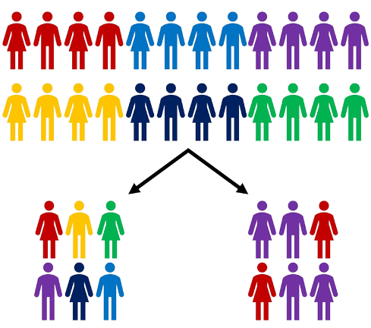

Slide 45
Ideal sample size

Slide 46
Favourite colour example
In a class, teacher ask students what is their favourite colour.
The realtime results goes like this:
Respondent | Answer | Results PINK in % | Results GREEN in % | Change
1 | Pink | 100 | 0 | No data
2 | Green | 50 | 50 | 50%
3 | Green | 33,5 | 66,5 | 16,5%
4 | Pink | 50 | 50 | 16,5%
5 | Green | 40 | 60 | 10%
6 | Green | 33,5 | 66,5 | 6,5%
7 | Green | 28 | 72 | 5,5%
8 | Pink | 37 | 63 | 9%
9 | Pink | 44 | 56 | 7%
10 | Pink | 50 | 50 | 6%

Slide 47

Sample size in qualitative studies
The data collection takes place as long as there is no condition in which further examination of the selected sample does not bring new substantial information.
Theoretical saturation
The goal of qualitative research is not generalization, so it is not the aim of the results to relate to the whole population but to reveal the connections and causes of a certain behavior of customers.

Slide 48
Primary data collection methods
Survey
  Interview
  Questionnaire
Observation
Experiment

Slide 49
Data collection techniques - qualitative
Deep interviews
Focus group discussions
Expert consultations
Observation

Slide 50
Data collection techniques - quantitative
Face to face interviews
Telephone interviews
Postal survey
Electronic survey
Observation
Experiment

Slide 51

Validity
Valid questions are those that give us answers exactly what we ask - what is the main goal of research.

Slide 52
Reliability
It expresses the degree of sustainability of research tools.
To what extent the question remains reliable and still valid in further iterations - for example, in other time, social and cultural conditions.

Slide 53
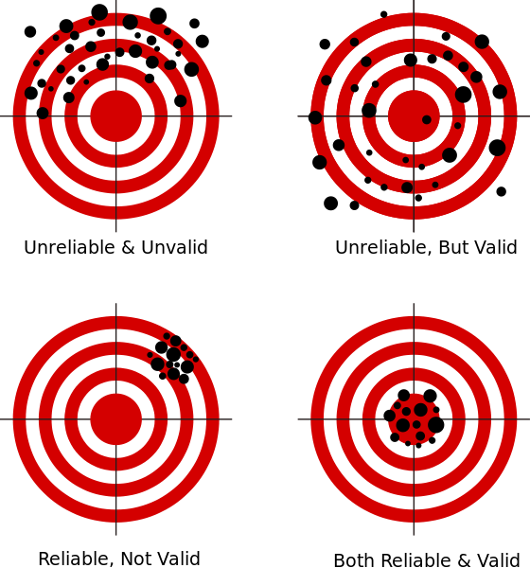

Slide 54
Type of questions
Open
Complete open
Open ended
Categorical
Scales
Dichotomic
Multiple
Labeled
Unlabeled
One answer
Multiple

Slide 55
Case Example

Slide 56
Defining the Research Question: You start by clearly defining your research question: "Do students who study a little every day score higher on tests compared to those who cram the night before?"
Literature Review: You do some background research by looking up existing studies or articles about study habits and academic performance. This helps you understand what's already known and how your research could add to it.
Hypothesis Formation: Based on your background research, you form a hypothesis, like "Students who study regularly will have higher test scores than those who cram."
Designing the Methodology: You decide how you will conduct your research. You choose to survey your classmates, asking about their study habits and recent test scores.

Slide 57
Data Collection: You systematically collect data by distributing your survey to a representative sample of students in your school.
Data Analysis: Once the surveys are returned, you analyze the data, looking for patterns and correlations between study habits and test scores.
Interpreting Results: Based on your analysis, you draw conclusions. For example, you might find that regular study leads to better scores, supporting your hypothesis.
Reporting: You prepare a report or presentation summarizing your research process, findings, and conclusions.
Reflecting on Limitations: You also consider any limitations of your study (like sample size or self-reported data) and suggest areas for further research.

Slide 58
Thank you

