Slide 1
Legal forms of Business

Slide 2
Types of Businesses
A corporation is a form of business where shares of ownership have been issued in the form of stock. Owners of the stock have limited liability, but are open to double taxation. There can be a few, or millions of owners of the company.
A sole proprietorship is a form of business where there is one owner and no stock has been issued. The owner of the company faces unlimited liability, but only single taxation.
A partnership is just like a sole proprietorship, except there is more than one owner.

Slide 3
Liability
Liability means responsibility. Entrepreneurs as owners of firms are responsible for the bills of the firm. How much responsibility depends on the legal form the business takes.
Limited liability means the responsibility of the owner(s) is limited to the amount invested in the business. If financial obligations are larger than this, then the owner is not obligated to cover the obligation. For instance, personal assets could not be taken to meet the obligation.
Unlimited liability means the responsibility of the owner(s) is unlimited. If financial obligations are more than the owner has invested in the company, then the owner could have to give up personal assets, like a car, in order to satisfy the financial obligation.

Slide 4
Strategies for success
Life cycle of business,

Slide 5
A firm’s strategy is the path by which it seeks to provide its customers with value, given the competitive environment and within the constraints of the resources available to the firm.

Slide 6
Each strategy need to answer core issues:
Who are your customers?
How are you going to provide value to those customers?
Who are your current and future competitors?
What are your resources?
How are you going to use these resources?

Slide 7
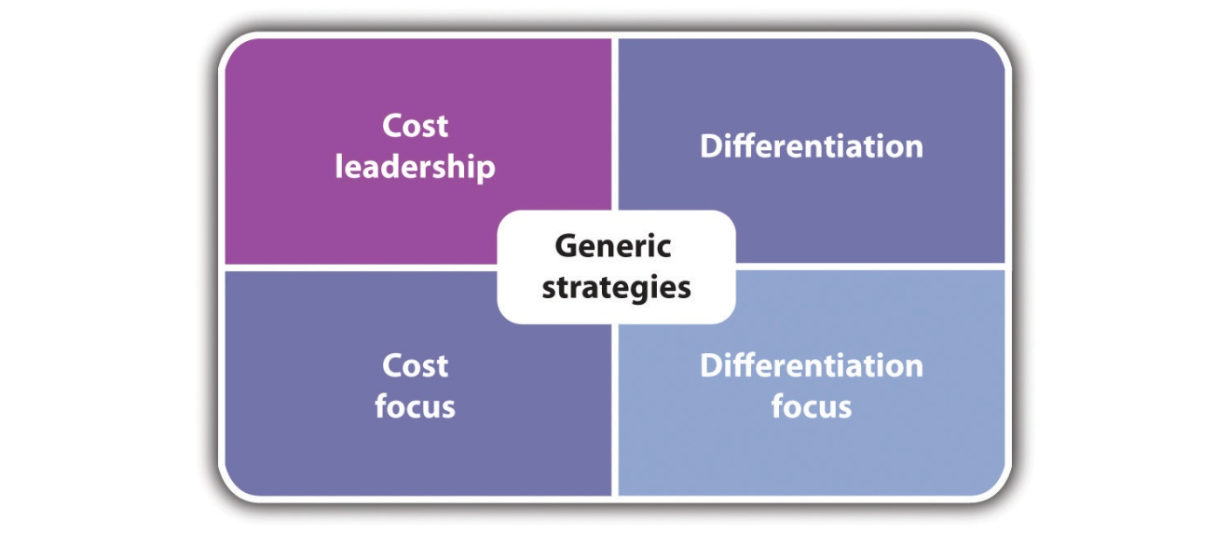
Porter´s generic strategies

Slide 8
Generic Strategy | Required Activities | Issues
Cost leadership | Economies of scale Reduce overhead costs Lower cost of supplies Capital investment in technology to reduce cost Labor cost reduction through supervision, outsourcing, and work design Low-cost distribution Reduce cost of manufacturing or providing service Tight financial control Operate in lower cost environments Production-based incentives | Product or service becomes a commodity with no brand loyalty Changing technology cuts your cost advantage New entrants can produce at even lower costs (e.g., China) Focus on cost reduction means that you miss changing customer tastes
Differentiation | Unique or highly improved products or services Brand image Creative approach to marketing Reputation for quality and product or service innovation Ability to attract creative personnel Effective coordination among R&D, marketing, and operations | Qualitative difference between you and low-cost producer may not be enough to sustain sales Differentiating factor may no longer be attractive to customers Imitation narrows perceived differences
Focus—low cost | Reduce overhead costs Lower cost of supplies Labor cost reduction through supervision, outsourcing, and work design Low-cost distribution Tight financial control Operate in lower cost environments Production-based incentives | Cost advantage of focused firms is lost with respect to broader competitors Differentiation advantage with a focused market is lost Competitors find even smaller markets to focus on
Focus—differentiation | Unique or highly improved products or services Creative approach to marketing Reputation for quality and product/service innovation Ability to attract creative personnel Effective coordination among R&D, marketing, and operations | Cost advantage of focused firms is lost with respect to broader competitors Differentiation advantage with a focused market is lost Competitors find even smaller markets to focus on
Generic Strategy | Required Activities | Issues
Cost leadership | Economies of scale Reduce overhead costs Lower cost of supplies Capital investment in technology to reduce cost Labor cost reduction through supervision, outsourcing, and work design Low-cost distribution Reduce cost of manufacturing or providing service Tight financial control Operate in lower cost environments Production-based incentives | Product or service becomes a commodity with no brand loyalty Changing technology cuts your cost advantage New entrants can produce at even lower costs (e.g., China) Focus on cost reduction means that you miss changing customer tastes
Differentiation | Unique or highly improved products or services Brand image Creative approach to marketing Reputation for quality and product or service innovation Ability to attract creative personnel Effective coordination among R&D, marketing, and operations | Qualitative difference between you and low-cost producer may not be enough to sustain sales Differentiating factor may no longer be attractive to customers Imitation narrows perceived differences
Focus—low cost | Reduce overhead costs Lower cost of supplies Labor cost reduction through supervision, outsourcing, and work design Low-cost distribution Tight financial control Operate in lower cost environments Production-based incentives | Cost advantage of focused firms is lost with respect to broader competitors Differentiation advantage with a focused market is lost Competitors find even smaller markets to focus on
Focus—differentiation | Unique or highly improved products or services Creative approach to marketing Reputation for quality and product/service innovation Ability to attract creative personnel Effective coordination among R&D, marketing, and operations | Cost advantage of focused firms is lost with respect to broader competitors Differentiation advantage with a focused market is lost Competitors find even smaller markets to focus on

Slide 9
I. Business cycle

Slide 10
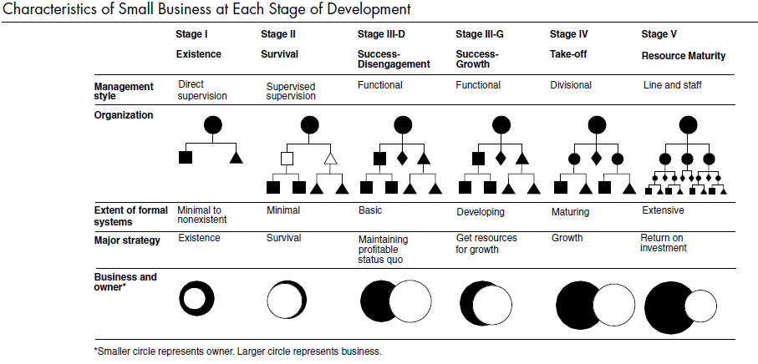

Slide 11
Stage I: Existence. This is the beginning. The business is up and running. The primary problems will be obtaining customers and establishing a customer base, producing products or services, and tracking and conserving cash flow. The organization is simple, with the owner doing everything, including directly supervising a small number of subordinates. Systems and formal planning do not exist. The company strategy? Staying alive. The companies that stay in business move to Stage II.
Stage II: Survival. The business is now a viable operation. There are enough customers, and they are being satisfied well enough for them to stay with the business. The company’s focal point shifts to the relationship between revenues and expenses. Owners will be concerned with (1) whether they can generate enough cash in the short run to break even and cover the repair/replacement of basic assets and (2) whether they can get enough cash flow to stay in business and finance growth to earn an economic return on assets and labor. The organizational structure remains simple. Little systems development is evident, cash forecasting is the focus of formal planning, and the owner still runs everything.
Stage III: Success. The business is now economically healthy, and the owners are considering whether to leverage the company for growth or consider the company as a means of support for them as they disengage from the company. There are two tracks within the success stage. The first track is the success-growth substage, where the small business owner pulls all the company resources together and risks them all in financing growth. Systems are installed with forthcoming needs in mind. Operational planning focuses on budgets. Strategic planning is extensive, and the owner is deeply involved. The management style is functional, but the owner is active in all phases of the company’s business. The second track is the success-disengagement substage, where managers take over the owner’s operational duties, and the strategy focuses on maintaining the status quo. Cash is plentiful, so the company should be able to maintain itself indefinitely, barring external environmental changes. The owners benefit indefinitely from the positive cash flow or prepare for a sale or a merger. The first professional managers are hired, and basic financial, marketing, and production systems are in place.
Stage IV: Take-off. This is a critical time in a company’s life. The business is becoming increasingly complex. The owners must decide how to grow rapidly and how to finance that growth. There are two key questions: (1) Can the owner delegate responsibility to others to improve managerial effectiveness? (2) Will there be enough cash to satisfy the demands of growth? The organization is decentralized and may have some divisions in place. Both operational planning and strategic planning are being conducted and involve specific managers. If the owner rises to the challenges of growth, it can become a very successful big business. If not, it can usually be sold at a profit.
Stage V: Resource Maturity.The company has arrived. It has the staff and financial resources to engage in detailed operational and strategic planning. The management structure is decentralized, with experienced senior staff, and all necessary systems are in place. The owner and the business have separated both financially and operationally. The concerns at this stage are to (1) consolidate and control the financial gains that have been brought on by the rapid growth and (2) retain the advantage of a small size (e.g., response flexibility and the entrepreneurial spirit). If the entrepreneurial spirit can be maintained, there is a strong probability of continued growth and success. If not, the company may find itself in a state of ossification. This occurs when there is a lack of innovation and risk aversion that, in turn, will contribute to stalled or halted growth. These are common traits in large corporations.

Slide 12
II. Marketing and product cycle

Slide 13
Marketing Mix
Product
Design, sizes, colours
Materials, quality
Specification
After-sales service
Price
List price
Discounts, special offers
Payment terms
Service & spares prices
People
Service
Advice
Support
Relationships
Promotion
Advertising
Point-of-sale displays
Leaflets, brochures etc.
Personal selling
Telephone, internet, post
Place
Location
Layout, design
Channels of distribution
Routes to market: telephone, internet, post

Slide 14
The Product Life Cycle
Sales
Introduction
Low sales
Low growth
Low profits or losses as costs are high
Few competitors
Growth
Increasing sales
Rapid growth
High profits as costs come down
Competitors emerging & competition intensifying
Maturity
Static but high sales
Static but high profits
Focus on cost reduction
Fight for market share
Established competitors
Decline
Declining sales
Declining profits or losses
Competitors exiting
Time
0
Innovators
Early adopters
Middle & late majority
Laggards

Slide 15
Introduction Phase:
Elements of Marketing Strategy
Basic product
Price low for repeat purchase where trial is important or price high where novelty or uniqueness is valued, particularly if repeat purchase is infrequent
Promote aggressively
Explain product benefits
Build awareness, encourage early adoption
Selective distribution

Slide 16
Growth Phase:
Elements of Marketing Strategy
Develop product extensions & service levels
Price competitively to combat competition & penetrate market
Promote aggressively
Build brand
Intensive push on distribution
Limited trade discounts

Slide 17
Maturity Phase:
Elements of Marketing Strategy
Wide range of products but expansion slows
Modify & differentiate product
Develop next generation of product
Price defensively – meeting or beating competition – to ensure maximum return
Emphasise brand
Promote selectively, based on special offers or promotions and trade discounts
Intensive push on distribution

Slide 18
Decline Phase:
Elements of Marketing Strategy
Product range narrows, drop weak products
Price high if fewer competitors means high demand, price low when demand dips so s to dispose of stocks
Minimum promotion required to maintain loyalty, emphasising low price
Selective distribution phasing out weak outlets

Slide 19
Life Cycle and Competitive Position
Grow fast
Attain cost leadership
Defend position
Attain cost ldshp. Review
Defend posn.
Renew Grow with industry
Dominant
Grow fast
Differentiate
Grow fast
Grow fast
Catch up Differentiate
Reduce costs
Differentiate
Grow with ind.
Hold niche
Grow with ind.
Harvest profit
Strong
Differentiate
Focus
Grow fast
Differentiate
Focus Grow with industry
Harvest profit Find niche
Grow with ind.
Consolidate
Cut costs
OK
Competitive Position
Focus
Grow with industry
Harvest
Catch-up
Hold niche
Harvest profit
Turn around Find niche Consolidate
Divest
Weak
Find niche
Grow with industry
Turn-around
Consolidate
Withdraw
Divest
Withdraw
Very weak
Start-up
Growth
Maturity
Decline

Slide 20
The Boston Matrix
High
Star
Problem Child
Introduction
Growth
Product / Service launch
Market Attractiveness
Failure
Maturity
Decline
Cash Cow
Dog
Low
High
Low
Market Strength

Slide 21
Directional Policy Matrix
INVEST FOR GROWTH
Penetrate market
Accept moderate short-term profits
Sell and promote aggressively
Expand geographically
Extend product range
Differentiate product/ service
DEVELOP OPPORTUNITIES
Be critical of prospects
Invest heavily in selective products/services
Specialise in strengths
Shore up weaknesses
Problem Child
Star
MANAGE FOR EARNINGS
Maintain market position with successful products/services
Differentiate products/ services to keep share of key segments
Prune less successful products/ services
Stabilise prices, except where a temporarily aggressive stance is required to deter competitors
CLOSE DOWN
Prune aggressively
Maximise cash flow
Raise prices at expense of volume
Minimise expenditure
Cash Cow
Genuine Dog

Slide 22
The Boston Matrix
Star
Problem Child
Niche
Cash Cow
Dog

Slide 23
The Boston Matrix
Star
Problem Child
Niche
Commodity
Cash Cow
Dog

Slide 24
The Boston Matrix
Star
Problem Child
Niche
Commodity
Commodity
Cash Cow
Dog

Slide 25
Product Life Cycle Management
Star
Problem Child
Product expansions
Product modifications
Cash Cow
Dog

Slide 26
Product Life Cycle Management
Star
Problem Child
Product expansions
Product extensions
Product modifications
Cash Cow
Dog

Slide 27
The Boston Matrix - Cash Flow
High
Star
Problem Child
Revenue
+ + +
Revenue
+
Expenditure
- - -
Expenditure
- - -
_________
_________
Cash flow
neutral
Cash flow
- -
Cash Cow
Dog
Revenue
+ + + +
Revenue
+
Expenditure
- -
Expenditure
-
_________
_________
Cash flow
+ +
Cash flow
neutral

