Slide 1

Selected Initiatives and Instruments Relevant to CSR
INTRODUCTION THE MOST IMPORTANT GUIDELINES TO CSR
Ing. Pavel Adámek, Ph.D.
CORPORATE SOCIAL RESPONSIBILITY/PEM-NACSR

Slide 2
Selected Initiatives and Instruments Relevant to CSR
Outline of the lecture
A classification of existing private CSR initiatives
The United Nations Global Compact
OECD Guidelines for Multinational Enterprises
ISO 26000 Guidance Standard on Social Responsibility
National Action Plan on CSR
Other Guidelines and standards

Slide 3
Selected Initiatives and Instruments Relevant to CSR
INTRODUCTION
Many companies of all sizes, in both developed and developing countries, have long engaged in CSR activities rooted in the values of the company.
However, CSR as a very conscious and public activity, motivated at least in part by external expectations, particularly concerning supply-chain management, monitoring and reporting, is a recent phenomenon.
The first obligation of business is obeying laws and regulations. Responsible business conduct also entails responding to societal expectations that may be communicated through channels other than law.
Some initiatives aim to raise awareness of the importance of CSR in general; others promote a particular code of conduct; still others focus on providing tools such as reporting guidelines or services, e.g., certification and labelling schemes.

Slide 4
Selected Initiatives and Instruments Relevant to CSR
INTRODUCTION
Some private CSR initiatives address a wide range of issues, including human rights and labour rights, community development, consumer rights, the use of security forces, bribery and corruption, health and safety issues and environmental standards.
Other initiatives focus on one or a few of these issues, usually in more depth; and either address issues specific to organisations’ own operations or challenges facing a specific sector.
Some CSR initiatives have been developed with solely the business sector in mind (e.g. the International Chamber of Commerce Guidance on Supply Chain Responsibility), while others are designed for use by all organisations, whether private or public (e.g. The proposed ISO 26000 Social Responsibility Guidance Standard, the UN Global Compact, or the Global Reporting Initiative Guidelines).

Slide 5
Selected Initiatives and Instruments Relevant to CSR
1. A classification of existing private CSR initiatives
Corporate Codes of Conduct
Codes of conduct are directive statements which provide guidance and prohibit certain kinds of conduct. Some are used to guide a company’s own environmental and social impacts; others focus on the impacts of their suppliers; still others apply to both.
Codes directed at suppliers may contain provisions for monitoring compliance.
The highest concentration of companies with codes of conduct tends to be in the consumer goods, food, retail and extractive industries.
Examples - https://i-sight.com/resources/18-of-the-best-code-of-conduct-examples/

Slide 6
Selected Initiatives and Instruments Relevant to CSR
1. A classification of existing private CSR initiatives
Multi stakeholder Initiatives
Multi stakeholder initiatives involve cooperation in varying degrees between many social partners, including companies, worker and employer organizations, NGOs, governments, or some combination thereof.
Such an initiative may address a specific issue (i.e. labour, environment, bribery, etc.) or encompass the whole range of CSR issues.
Some multi stakeholder initiatives focus on promotional activities to build awareness; others have a code of conduct to which their members must comply, and may be required to undergo monitoring and certification carried out by either a “social auditing” firm or an NGO.
Example: Multi-stakeholder platform on SDGs https://ec.europa.eu/info/strategy/international-strategies/sustainable-development-goals/multi-stakeholder-platform-sdgs_en

Slide 7
Selected Initiatives and Instruments Relevant to CSR
1. A classification of existing private CSR initiatives
Certification and Labelling
Certification and labelling initiatives aim to provide purchasers (consumers and businesses) with what is viewed as reliable information to make purchasing decisions.
These initiatives usually cover a single issue, such as child labour, fair trade or forest conservation, but may also address a range of issues. Certification is subject to social auditing, which is carried out by accredited audit companies.
In areas where non compliance has been detected, remediation steps are often undertaken with the opportunity for companies to demonstrate improvement through continuous monitoring.
Examples: ecolabelling http://www.ecolabelindex.com/ecolabels/
Ekologicky setrny vyrobek / Environmentally Friendly Product http://www.ecolabelindex.com/ecolabel/environmentally-friendly-product-czech-republic

Slide 8
Selected Initiatives and Instruments Relevant to CSR
1. A classification of existing private CSR initiatives
Model Codes
Model codes are codes of conduct set forth by a multistakeholder initiative, NGO, trade union or other actor, which companies can build on in developing their own codes.
Model codes aim to establish a minimum list of standards that all codes of conduct covering certain issues ought to address.
In addition to providing a reference for companies looking to create codes, this type of initiative is often meant to assist trade union organisations in negotiations with companies and in working with NGOs in campaigns involving codes of conduct.
They are often used as a benchmark for evaluating unilaterally adopted codes of labour practice.

Slide 9
Selected Initiatives and Instruments Relevant to CSR
1. A classification of existing private CSR initiatives
Model Sectoral Initiatives
Sector or industry wide initiatives aim to address widespread challenges in a specific sector (within a country, regionally or internationally) and provide a common approach in direct operations.
These codes typically address management of global supply chains, which are often long and complicated. When companies share suppliers, an industry wide standard allows companies to work more effectively with suppliers to ensure compliance.
Sectoral initiatives provide a type of uniformity across the industry, setting one standard for many companies as opposed to each company having its own code, which may lead to contradictions in codes, confusion and unnecessary monitoring costs among suppliers.
Examples of Private Initiatives (Annex 6.A1) https://www.oecd.org/corporate/mne/40889288.pdf

Slide 10
Selected Initiatives and Instruments Relevant to CSR
1. A classification of existing private CSR initiatives
International Framework Agreements
International Framework Agreements (IFAs) are negotiated jointly by national trade unions and global union federations with multinational companies. They aim at ensuring that the company concerned respects the same labour standards in all the countries where it operates as well as throughout its supply chain.
These agreements are designed to be used in conjunction with national labour policies and serve as a basis for further negotiation at the national level.
Since IFAs result from negotiations between trade unions and companies / management, they put workers in a stronger position to ensure compliance with a company’s stated commitments.

Slide 11
Selected Initiatives and Instruments Relevant to CSR
1. A classification of existing private CSR initiatives
Socially Responsible Investment (SRI)
Initiatives are also being developed in the financial sector. Historically, these initiatives have focused on financial institutions’ own operations, but increasingly, initiatives are focusing on social responsibility concerning investment decisions.
On the lending side, this is being stimulated largely by the International Financial Corporation (IFC), the private sector lending arm of the World Bank, which has adopted Performance Standards to guide its investments.
On the equity side, socially responsible investment (SRI) incorporates elements of CSR in what is often termed the “triple bottom line” approach.
The adoption of the UN Principles for Responsible Investment, which give guidance to fund managers and other investors, has given new impetus to this movement.

Slide 12
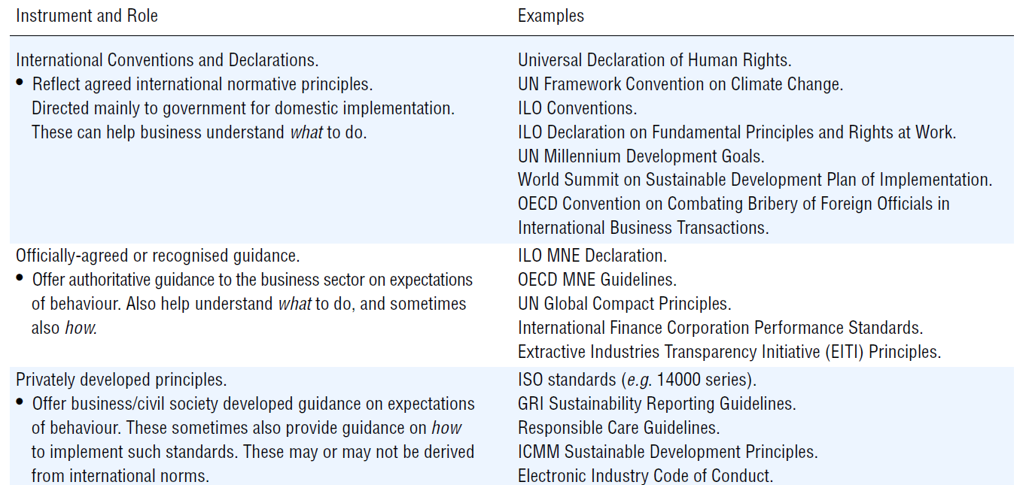
Selected Initiatives and Instruments Relevant to CSR
1. A classification of existing private CSR initiatives
Role and realationship of internationally recognised norms, government-recognised guidance, and privately-developer principles relevatn to CSR

Slide 13
Selected Initiatives and Instruments Relevant to CSR
1. A classification of existing private CSR initiatives
There are four channels by which governments have endorsed standards relevant to CSR:
International instruments developed and formally agreed by governments, and also having formal support from business and labour organisations.
In this category, there are two leading instruments, namely the ILO Declaration and the OECD Guidelines. For its part, the ILO is unique in so far as it is the only universal body with a tripartite membership. While the membership of the OECD is not universal (only for members), the MNE Guidelines have several “universal” characteristics.
2. International initiatives developed by intergovernmental bodies.
This category includes prominently the UN Global Compact - has been recognized on a number of occasions by the UN General Assembly as well as by all Heads of States and Governments in the World Summit Outcome document.

Slide 14
Selected Initiatives and Instruments Relevant to CSR
1. A classification of existing private CSR initiatives
There are four channels by which governments have endorsed standards relevant to CSR:
International initiatives endorsed by governments.
Because of the voluntary nature of private CSR initiatives, governments mostly have not taken an active role in their development.
Nonetheless, there is a category where intergovernmental organisations have played an active role, and/or where governments have recognised essentially non-government initiatives.
Instruments in this category include the International organisation for Standardization (ISO) standards and the Global Reporting Initiative (GRI) Guidelines.

Slide 15
Selected Initiatives and Instruments Relevant to CSR
1. A classification of existing private CSR initiatives
There are four channels by which governments have endorsed standards relevant to CSR:
National initiatives developed and endorsed by government. Some governments have been active at the national level in facilitating the creation of instruments, usually in association with business and civil society. These instruments may attract international attention, and be applied by companies along their supply chain in third countries.
Among these, however, the ILO Declaration, the OECD Guidelines and the UN Global Compact have received prominent recognition by the G8 and the OECD as well as in various UN contexts.

Slide 16
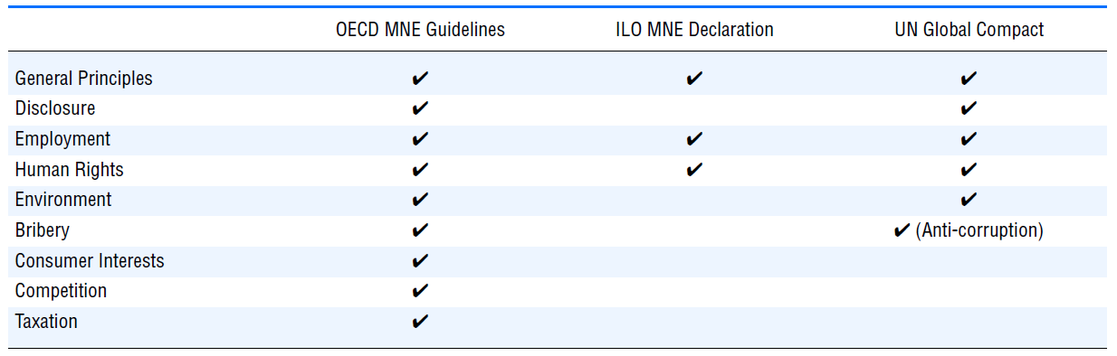
Selected Initiatives and Instruments Relevant to CSR
1. A classification of existing private CSR initiatives
Coverage of Guidelines issues
There are very evident synergies, which might be further developed between the closely connected employment chapter of the OECD Guidelines and the principles of the labour standards enshrined in the ILO Declaration and the UN Global Compact.
Source: Annual Report on the OECD Guidelines for Multinational Enterprises 2009

Slide 17
Selected Initiatives and Instruments Relevant to CSR
2. The United Nations Global Compact
The UN Global Compact (UNGC) contains ten principles and asks companies to adopt a set of core values in the following areas:
Human Rights
  Principle 1: Businesses should support and respect the protection of internationally proclaimed human rights; and
  Principle 2: make sure that they are not complicit in human rights abuses.
Labour
  Principle 3: Businesses should uphold the freedom of association and the effective recognition of the right to collective bargaining;
  Principle 4: the elimination of all forms of forced and compulsory labour;
  Principle 5: the effective abolition of child labour; and
  Principle 6: the elimination of discrimination in respect of employment and occupation.

Slide 18
Selected Initiatives and Instruments Relevant to CSR
2. The United Nations Global Compact
Environment
  Principle 7: Businesses should support a precautionary
  approach to environmental challenges;
  Principle 8: undertake initiatives to promote greater environmental
  responsibility; and
  Principle 9: encourage the development and diffusion of
  environmentally-friendly technologies.
Anti-Corruption
  Principle 10: Businesses should work against corruption in all its forms, including extortion and bribery.

Slide 19
Selected Initiatives and Instruments Relevant to CSR
2. The United Nations Global Compact
Since 2015, the Global Compact Network Czech Republic helps to root the initiative within different national, cultural, and language context.
Its role is to facilitate the progress of companies (both local firms and subsidiaries of foreign corporations) engaged in the Global Compact with respect to implementation of the ten principles, while also creating opportunities for sharing knowledge, learning, collective action, and partnership.

Slide 20
Selected Initiatives and Instruments Relevant to CSR
2. The United Nations Global Compact
Through dialogue, including the political, the network enables participants to influence actively CSR policy in the Czech Republic.
The host entity of Czech local network is the Association of Social Responsibility. Currently, this network has participants including private and public sector.
The Czech Republic has demonstrated a commitment to the UNGPs through the formulation of National Action Plans on Business and Human Rights, which comply with international guidelines.

Slide 21
Selected Initiatives and Instruments Relevant to CSR
3. OECD Guidelines for Multinational Enterprises
They are recommendations providing principles and standards for responsible business conduct for multinational corporations operating in or from countries adhered to the Declaration.
Governments adhering to the OECD Guidelines are obliged to set up National Contact Points (NCPs). Their main role is to further the effectiveness of the Guidelines by undertaking promotional activities, handling enquiries, and contributing to the resolution of issues that arise from the alleged non-observance of the Guidelines in specific instances.

Slide 22
Selected Initiatives and Instruments Relevant to CSR
3. OECD Guidelines for Multinational Enterprises
Basic standards form MNEs:
Encouraging socially-responsible behaviour in supply chain;
Disclosure of information on social and environmental performance, observance of codes of conduct and relationships with stakeholders;
Respect for human rights;
Respect for basic individual and collective labour rights;
Protection of the environment and public health and safety;
Combatting corruption;
Respect for consumer health and safety;
Transfer and diffusion of science and know how, with due regard to the protection of intellectual property rights;
Prevention of anti-competitive practices; and
Contribution to public finances of the host country.

Slide 23
Selected Initiatives and Instruments Relevant to CSR
4. ISO 26000 Guidance Standard on Social Responsibility
ISO 26000 is the standard for social responsibility for all organizations. It was produced by the International Standards Organization in 2010.
ISO 26000 does not offer guidance on social responsibility performance reporting. However, the ISO 26000 content does cover a very similar range of topics to that in the GRI Reporting Guidelines.
The ISO guidance provides a structure for companies to organise their activities, which can then be measured and presented in the company’s report following GRI guidance. No formal accreditation process is available for the ISO 26000 standard.
https://www.iso.org/iso-26000-social-responsibility.html

Slide 24
Selected Initiatives and Instruments Relevant to CSR
4. ISO 26000 Guidance Standard on Social Responsibility
The ISO 26000 standard provides guidance on:
The seven key underlying principles of social responsibility: accountability, transparency, ethical behavior, respect for stakeholder interests, respect for the rule of law, respect for international norms of behavior, and respect for human rights.
Recognizing social responsibility and engaging stakeholders.
The seven core subjects and issues pertaining to social responsibility: organizational governance, human rights, labor practices, the environment, fair operating practices, consumer issues, and community involvement and Development.
Ways to integrate socially responsible behavior into the organization.

Slide 25
Selected Initiatives and Instruments Relevant to CSR
5. National Action Plan on CSR
A wide range of government-led CSR initiatives can be identified in Member States of EU, for example: from ‘softer’ initiatives such as awareness-raising and promotional activities, to ‘harder’, legislative actions.
Despite CSR being considered the responsibility of enterprises for their impacts on society, due to the breath of issues covered under the CSR umbrella, legislation plays a role to varying degrees at Member State level.
In a number of countries, these are follow-up plans from previous strategies, whereas in others the documents constitute the first plan or policy document of its kind.

Slide 26
Selected Initiatives and Instruments Relevant to CSR
5. National Action Plan on CSR
The purpose of the Czech NAP is to help to develop the concept of corporate social responsibility in the Czech Republic and thus to promote the development of society, the economy and the competitiveness of the Czech Republic.
The primary intentions of the strategic document of the National Action Plan for Corporate Social Responsibility in the Czech Republic are: to support the application of social responsibility by organisations; to strengthening the understanding and credibility of the concept of social responsibility in society, and to support CSR in enterprises and other organisations in the Czech Republic by providing the relevant information.

Slide 27
Selected Initiatives and Instruments Relevant to CSR
5. National Action Plan on CSR
The Government is aware of the fact that the CSR is highly relevant topic not only for the big companies but also for small and medium-sized enterprises in the regions, their employees and the community around them as well as for the public administration.
It takes dialogue and cooperation between the CSR stakeholders as essential for ensuring the coherence of procedures and obtaining feedback and for further development of social responsibility in the Czech Republic.
The main objectives of the updated NAP include firstly, enhancing the understanding and credibility of the concept of social responsibility in the society; secondly, supporting the development of social responsibility in organizations; and thirdly, sharing experience and transfer the international know-how.

Slide 28
Selected Initiatives and Instruments Relevant to CSR
5. National Action Plan on CSR
Current state of development of National Action Plans on CSR
Countries with current CSR NAPs | Countries with NAPs close to completion | Countries with NAPs under development | Countries without plans to develop a formal NAP
Belgium, Bulgaria, Cyprus, Czech Republic, Germany, Denmark, Estonia, Finland, France, Italy, Lithuania, the Netherlands, Poland, Sweden, UK | Austria, Ireland, Hungary, Malta, Spain | Croatia, Greece, Latvia, Portugal, Romania, Slovenia, Slovakia | Luxembourg

Slide 29
Selected Initiatives and Instruments Relevant to CSR
6. Other Guidelines and standards
Other frameworks with global impact are: AA 1000 AccountAbility/Assurance Standard; Social Audit Network; ETHIBEL; EFQM; SA 8000 – Social Accountability International; ISO 8000, ISO 9000, ISO 14000; IASE 3000; Corporate Responsibility Index; Corporate Giving Standard; Corporate Community Involvement Index; Dow Jones Sustainability Index; FTSE4GOOD.
For local condition was involved of the Czech Republic (IQNet SR 10) and has implemented an award for CSR and quality management.

Slide 30
Selected Initiatives and Instruments Relevant to CSR
6. Other Guidelines and standards
The differences between separate standards are focused on the stakeholders or it depends on the methodology.
There is the importance to highlight the London Benchmarking Group (LBG), which is implemented in the Czech Republic as “Standard odpovědná firma” (SOF). These is using for data verification into list “TOP Firemní Filantrop” in Czech and Slovak Republic.
A set of Principles for Better Self and Co-Regulation was published in early 2013, and a ‘Community of Practice’ was set up (as an online platform) to facilitate the exchange of knowledge and good practice in this area. For evaluation of CSR the KORP method in the Czech Republic was developed.

Slide 31
Selected Initiatives and Instruments Relevant to CSR
summary of the lecture
Over the past few decades, various international guidelines have been developed by international organisations.
The guidelines are designed to support governments, businesses and other organisations to make progress towards establishing effective CSR practices and to set commonly-recognised standards.
The guidelines are based on research, stakeholder and expert input, and evidence from best practice and consultation with national governments.
Some countries have specifically set out how their National Action Plan and other policies and strategies are aligned to the goals of these internationally recognised guidelines and standards.

