Slide 1


PSYCHOLOGY AND EMOTIONS IN ADVERTISING
Ing. Kateřina Matušínská, Ph.D.
MARKETING COMMUNICATION 2/NAMK2

Slide 2

PSYCHOLOGY AND EMOTIONS IN ADVERTISING
Outline of the lecture
What is advertising?
Psychology in advertising
Selected basic terminology
Emotional appeals in advertising
Neuromarketing

Slide 3
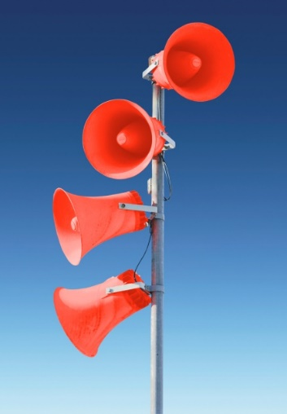
PSYCHOLOGY AND EMOTIONS IN ADVERTISING
1. What is advertising?
The paid form of impersonal presentation.
The advertising is a persuasive process by which the users of products are sought through communication media.
The part of marketing communication mix.
The basic features of advertising:
Mass
Paid
Impersonal

Slide 4

PSYCHOLOGY AND EMOTIONS IN ADVERTISING
Czech people and advertising
TV, leaflets, Internet, billboards, magazines
POS/POP – the place of purchase, samples, testers etc.
Source: Postoj české veřejnosti k reklamě, Factum Invenio, vzorek: 1000 občanů ČR nad 15 let, kontinuální výzkum (since 1993), http://www.mediar.cz/cesi-a-reklama-polarizuji-se-ale-nazor-nemeni/

Slide 5

PSYCHOLOGY AND EMOTIONS IN ADVERTISING
Characteristics of effective advertising
ADVERTISING SHOULD BE:
CREATIVE
SIMPLE
INTERESTING
GOOD APPEALS (EMOTIONS)
SUITABLE MEDIA x TARGET GROUP
THE LESS – THE BETTER
TOILET PAPER - SO EASY!

Slide 6
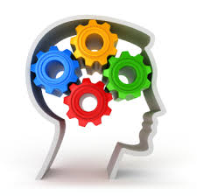
PSYCHOLOGY AND EMOTIONS IN ADVERTISING
2. Psychology in advertising
The role of psychology is included in the definition of advertising and marketing communications:
„Purposeful communication effect, the dissemination of specific initiatives aimed at a specific audience, creating and changing of attitudes, beliefs and customs, leading to desirable actions ....“
The role of psychology: the forms of intentional effect on people leading to communication goals achievement ...

Slide 7

PSYCHOLOGY AND EMOTIONS IN ADVERTISING
Psychology in advertising
Negative effects of advertising in terms of psychology:
Illusory happiness
Socialization of socially harmful values
Limitation of maturation process
Dissatisfaction caused by unrealistic world
Manipulation with people
Consolidating of social structures
Waste of resources

Slide 8
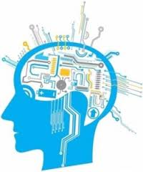
PSYCHOLOGY AND EMOTIONS IN ADVERTISING
3. Selected basic terminology
A. Selective attention - the tendency of humans to register from the many suggestions only those that meet the common needs or those which are expected or different from the others.
Stimuli inducing activation:
intensity stimulus, size and colour,
emotional, rational and moral appeals,
effect of surprise,
novelty of initiative,
uncertainty and conflict.
Use of communication such as "How to look young and fresh?" "How to have the cleanest clothes?" "How to get rid of excess kilos quickly and effortlessly?" "If you order within 24 hours you get a gift!"

Slide 9
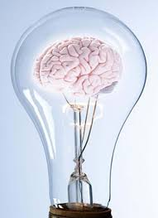
PSYCHOLOGY AND EMOTIONS IN ADVERTISING
Selected basic terminology
B. Perceptual distortion - individuals are exposed to many influences that tend to distort the perceptions and these are: physical appearance, stereotypes first impression (halo effect), hasty conclusions.
C. Selective remember - the message recipient can usually remember only what fits with their mental models and chooses a particular information that supports his or her opinions.
D. Sensory perception
sight (print, TV, outdoor, Internet, POP etc.).
Hearing (Cinema advertising, TV, radio)
smell (POP, part of print advertising – e.g. perfumes, spices)
touch (print ad samples)
Taste (POP - tasting).

Slide 10

PSYCHOLOGY AND EMOTIONS IN ADVERTISING
Selected basic terminology
The colours use
Each colour of the solar spectrum corresponds to a particular wavelength of light.
The red colour has a wavelength of 650-760 nanometers (billionths of a meter), yellow 550-590 nm, 490-550 nm, green, blue 490-430 nm and the colour purple has the lowest wavelength - around 420 nm.
Generally, people are able to distinguish different shades 150-200 monochromatic colours.

Slide 11
PSYCHOLOGY AND EMOTIONS IN ADVERTISING
Selected basic terminology
The colours in marketing communication
COLOUR | PERSONALITY CONNECTION | MARKETING MEANING
BLUE | Respect, authority | Men look for products in blue package.
 |  | Blue houses are not demanded.
 |  | Low calorie skimmed milk
YELLOW | Caution, notaries, temporality, warmth | Eyes react to this colour very quickly.
 |  | The coffee in yellow cup tastes blandly.
 |  | It sells the house.
GREEN | Safety, naturalness, relaxation or carelessness, living things | Good working environment
 |  | Associations with vegetable and chewing gum.
RED | Humanity, excitement, eagerness, passion, strength | The meal has better taste.
 |  | Coffee in red cup is perceived to be stronger.
 |  | Women prefer this colour with the combination with blue colour.
 |  | Men prefer this colour with the combination with yellow colour.
 |  | The special red colour is owned by Coca-Cola.
Source: Vysekalová, Psychologie reklamy, 2002.

Slide 12
PSYCHOLOGY AND EMOTIONS IN ADVERTISING
Selected basic terminology
The colours in marketing communication
COLOUR | PERSONALITY CONNECTION | MARKETING MEANING
BROWN | Informality, relaxation, masculinity, nature | Coffee in dark brown cup is "too strong"
 |  | Men look for the products in brown package.
WHITE | Kindness, purity, innocence, gentleness, politeness, formality | Lower calories
 |  | Clean and healthy products.
 |  | Purity, bath products, femininity
BLACK | Refinement, power, authority, mystery | Elegant dress
 |  | Modern electronic products
GOLD, SILVER, PLATINUM | Elegance, opulence, grandeur | High value
ORANGE | Ability, hedonism, informality | It attracts attention very quickly.
Source: Vysekalová, Psychologie reklamy, 2002.

Slide 13
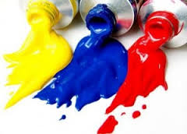
PSYCHOLOGY AND EMOTIONS IN ADVERTISING
Selected basic terminology
The colour use
Travel agency
Law office
Beauty salon
Construction company
Assign the appropriate colour for creating a positive association to a field of business mentioned above!!!

Slide 14

PSYCHOLOGY AND EMOTIONS IN ADVERTISING
Selected basic terminology
Sound use
Use of audio advertising (TV, radio).
Use in POP, where the sound is a signal that attracts the attention of the presented goods.
There is the use of sounds range from 20 (whisper) to 80 decibels (noise of a busy street).
Music and speech are the basic symbolic sound cues.

Slide 15
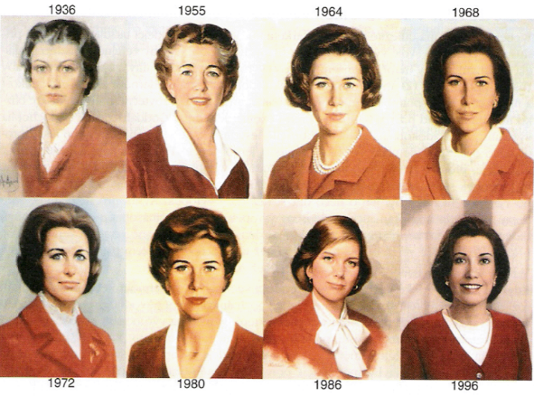
PSYCHOLOGY AND EMOTIONS IN ADVERTISING
Selected basic terminology
E. The discrimination threshold - the minimum difference that can be detected between two similar stimuli is called the discrimination threshold, or just noticeable difference. In some cases it is desirable low discrimination threshold, sometimes high discrimination threshold.
Absolute threshold - the lowest level at which an individual can perceive the stimulus. The point at which a person can tell the difference between "something and nothing „ (i.e. The distance at which a driver may observe a billboard on the highway, is the absolute threshold of the individual).

Slide 16
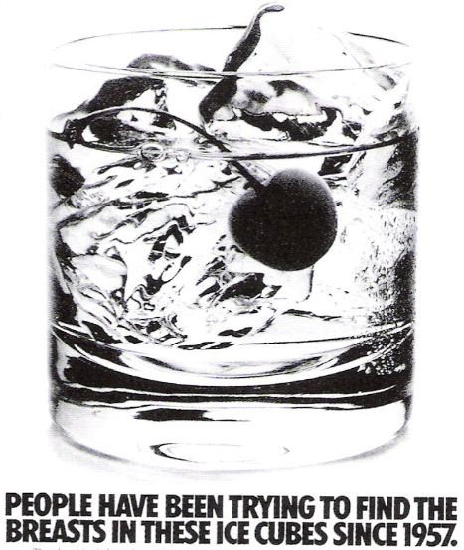
PSYCHOLOGY AND EMOTIONS IN ADVERTISING
Selected basic terminology
F. Subliminal perception - it is not scientifically proven that subliminal perception exists.
Subliminal advertising is prohibited in Czech legislation.
Opponents argue that it is interference in the free choice of man, it could be misused for commercial, political and promotional purposes.
Numerous scientific experiments in this field have been constantly realized.

Slide 17
PSYCHOLOGY AND EMOTIONS IN ADVERTISING
Selected basic terminology
H. Memory, forgetting and repetition
Sensory memory - all data transmitted to us through the senses (smell, colour and touch) and senses remain only a second or two.
Short-term memory - state of real mind in which information is processed and kept only for a short time. If the information is repeated, then is transferred from 2 to 10 seconds into long-term memory. Number of information which may be in short-term memory is 4 to 5.
Long-term memory - information last longer - a few minutes, days, years. Companies want to facilitate the transmission and storage of the product and the brand in the long term memory of customers. Brand visible images help to this process. (Nike - tick, Adidas - three stripes etc.)

Slide 18
PSYCHOLOGY AND EMOTIONS IN ADVERTISING
Selected basic terminology
I. Association - the connection between the perceptions that have left an imprint in the memory. Advertisements must associate product characteristics with the brand. It is best if the name of the product creates the direct association with its characteristics – Dobrá voda (Good Water). Association relates to positioning.
J. Persuasion - change of mind, attitudes or behaviour caused by some communication.
K. Learning - a relatively permanent change in behaviour that is the result of stimuli (behavioural, cognitive and visual learning, classical conditioning).

Slide 19
PSYCHOLOGY AND EMOTIONS IN ADVERTISING
Selected basic terminology
L. Motivation (lat. Mover - motion) - stimuli should cause the human activity - mainly the purchase of a commodity. Among the sources of motivation belong:
Habits (innovators, conservative) - interests and overall lifestyle (e.g. interest in tennis) - idols (celebrities, what they dress, what they eat) and values.
Among the values ​​belong: value for money (a bargain, economical package, discounts, bulk purchases) - the time value (products that save time - the willingness to pay more) - the value of differentiation, uniqueness (custom production, the unique characteristics of the product, higher price) - health value (shoes, textiles, food, cars) - the value of love (buying gifts for others, parties organizing, celebrations) - the value of technical maturity (purchase of the most advanced technology) - the value of environmental protection (recyclable packaging) - the value of animal protection (vegetarians , rejection of fur and products tested on animals) – value of conformity (products which are not too outdated or too modern).

Slide 20
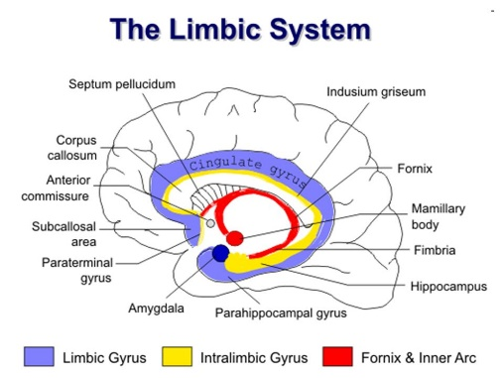
PSYCHOLOGY AND EMOTIONS IN ADVERTISING
4. Emotional appeals in advertising
Emotional appeals attempt to stir up some negative or positive emotions that will motivate purchase.
Emotions are formed in the limbic system of the brain.
The basic dimensions of emotions:
Pleasantness - unpleasantness
Excitement - satisfaction
Tension - release
6 basic emotions: anger, disgust, fear, happiness, sadness, surprise.
Negative emotional appeals: fear, quilt, shame,… X Positive emotional appeals: humour, love, pride, joy, erotic, music, warmth,…
The primary emotions - common to all people (anger, sadness, joy ....) X Secondary emotions - felt by all people, but their interpretations and manifestations are influenced by culture (guilt, jealousy, pride, ...)

Slide 21
PSYCHOLOGY AND EMOTIONS IN ADVERTISING
The importance of Emotional appeals in advertising
Advantages of emotions in advertising:
Receivers are involved in the plot of commercial message. They forget that they watch commercial advertising.
Receivers can remember emotions better than logical arguments.
Emotions require less receivers´ effort. They don´t have to concentrate a lot.
They do not cause an automatic defensive reaction.
Disadvantages of emotions in advertising:
Invoking of emotions can be so strong that the recipient does not perceive the essence of the message - vampire effect.
Inappropriate emotions can damage brand image.
Negative emotions can lead to rejection of the product (brand).
The conviction that emotions are abused (Benetton - Toscani).

Slide 22
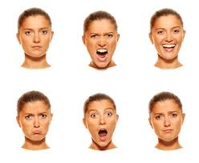
PSYCHOLOGY AND EMOTIONS IN ADVERTISING
Selected Types of emotional appeals in advertising
Humour
Erotic
Fear (sometimes shockvertising – BESIP)
Music
Warmth – Love
Small children, animals, …

Slide 23

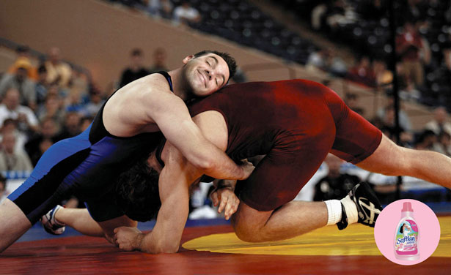
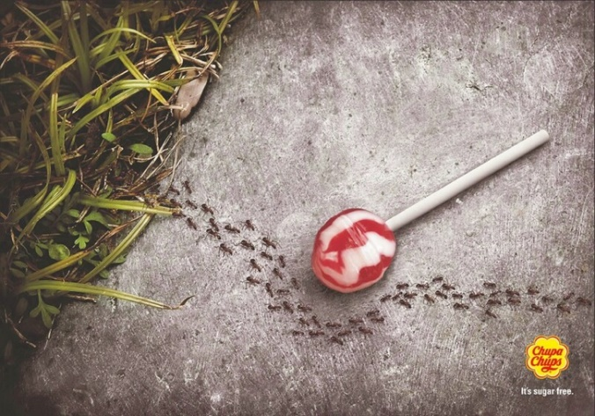
PSYCHOLOGY AND EMOTIONS IN ADVERTISING
Humour in advertising
Type of product
Existing or new product
The effectivity of humour in advertising
Type of humour
Image of brand
80 % of Czech population requires humour in advertising!

Slide 24



PSYCHOLOGY AND EMOTIONS IN ADVERTISING
Erotic in advertising
Part or all nakedness.
Physical contact among adults.
Provocative clothes.
Provocative or lustful expression.
Suggestive speaking or sexy music.
Effectiveness only in case of connection with the products!

Slide 25



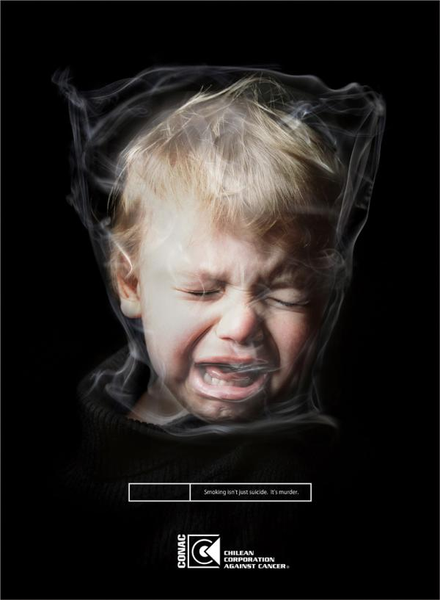
PSYCHOLOGY AND EMOTIONS IN ADVERTISING
Fear in advertising
The aim is to warn customers of risks which could be eliminated if they buy (insurance, …) or not buy some product (cigarettes, alcohol, …).
customer´s reaction
intensity of fear
low
moderate
high

Slide 26
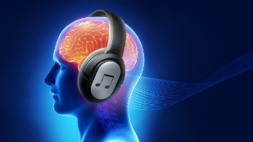

PSYCHOLOGY AND EMOTIONS IN ADVERTISING
Music in advertising
The aim is to encourage attention, create pleasant atmosphere, create image of brand (L. Armstrong – „What a wonderful world“).
The most important is music style and movement.
EMOTION | SCALE | MELODY | PACE
In dignity, ceremonially | dur | rising | slowly
Sadly, seriously | moll | xxx | slowly
Happily, clearly | dur | xxx | quickly
Boisterously, excitedly | xxx | decreasing | quickly
… | … | .. | …
Source: Vysekalová, Psychologie reklamy, 2002.

Slide 27

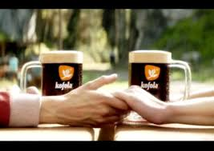

PSYCHOLOGY AND EMOTIONS IN ADVERTISING
Warmth in advertising
The aim is to evoke pleasant and positive emotions – love, friendship, comfort, safety, …
This emotion is especially typical of women and empathic people.
Promoting of services.

Slide 28

PSYCHOLOGY AND EMOTIONS IN ADVERTISING
Measurement of emotions in advertising
Physiological measurements - the body's reaction to emotion:
Skin conductance measurement
Measurement of heart rate turbulence
Measuring of the facial muscles activity
Self-report measurements – verbal, visual and measurement of the force moment.
Verbal – questionnaire survey after seeing the ad, Likert scale and semantic differential.
Visual – respondent selects from photographs of faces expressing different emotions that correspond to his or her feelings after seeing the ad.
Measurement of the force moment – respondent moves from left to right with a special pen during watching the advertising, and it shows his or her immediate emotions (from the highest to the lowest emotions).

Slide 29
PSYCHOLOGY AND EMOTIONS IN ADVERTISING
Measurement of emotions in advertising
Symbolic measurement of emotions:
Zaltman´s technique about symbol reminder - respondents are asked to express their thoughts and feelings about advertising by using the pictures. Then depth interview takes place, where spontaneous and conscious thoughts regarding advertising are identified. The method is very beneficial, but time consuming.
Method of archetypes selection – respondent selects from photographs of classic archetypal patterns such as a hero, lazy bones etc. according to the perception of the presented product - brand.

Slide 30
PSYCHOLOGY AND EMOTIONS IN ADVERTISING
Measurement of emotions in advertising - facial coding
The concept of facial coding is that we reveal our emotions by our facial expressions. Particularly in some social settings, we may seek to conceal these, but the underlying emotion we experience still registers on our face, even as a brief micro-expression.
A good review of the first emotional reactions to the commercials. Man responds to the stimulus immediately. The change in the face is natural and unconscious.
The condition is that the respondent agrees with the webcam use, either at home, in CAWI data collection or in some research place.
The testing process: turn on the camera, recording the basic features of the face, facial reaction measurements, quantitative processing and analysis, display of emotional reactions to the spot.

Slide 31
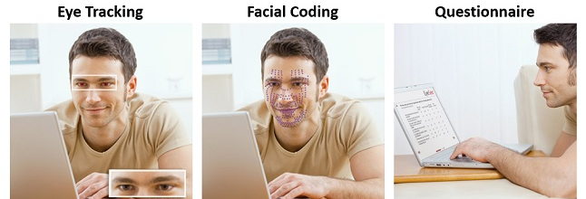
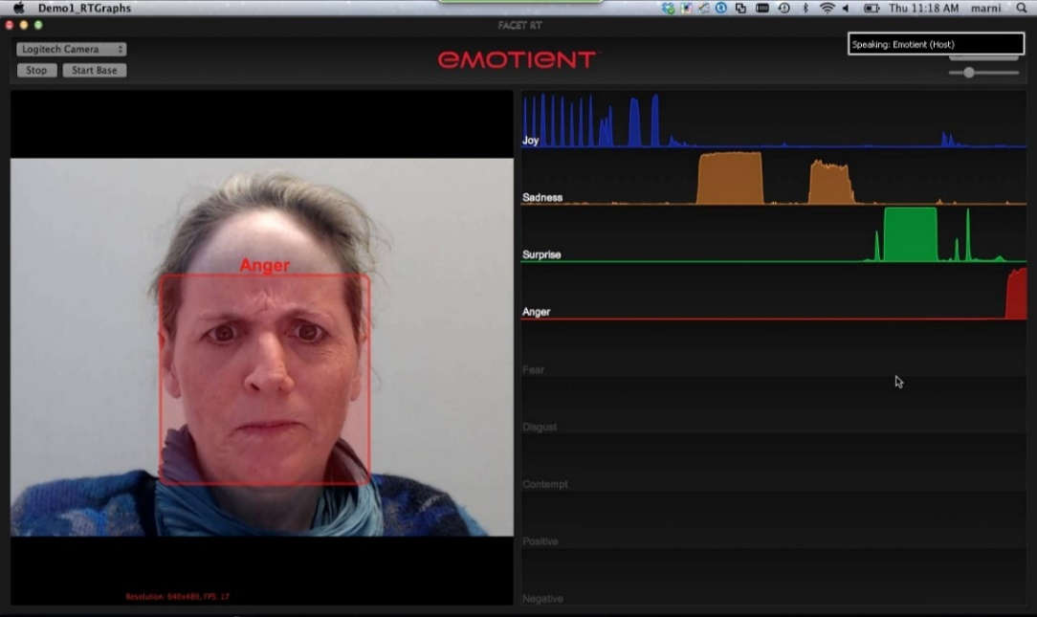
PSYCHOLOGY AND EMOTIONS IN ADVERTISING
Measurement of emotions in advertising - facial coding
DASHBOARD

Slide 32
PSYCHOLOGY AND EMOTIONS IN ADVERTISING
5. NEUROMARKETING
It is invested over $ 400 million to marketing communication annually, but efficiency declines (Morin, 2011).
60-year-old man has watched an average of 2 million ads during his or her life, which one of them does he remember them?
Traditional market research is based on the willingness and ability of respondents to describe their emotions, decision-making process ...
Conventional methods of testing and evaluation of advertising effectiveness essentially collapses.
Neuromarketing enables the acquisition of undistorted data about consumer behaviour, promotion ...

Slide 33
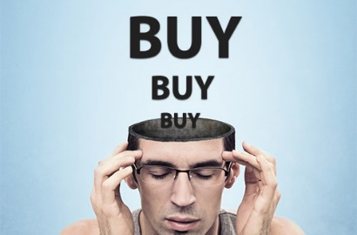
PSYCHOLOGY AND EMOTIONS IN ADVERTISING
NEUROMARKETING
Neuromarketing is a new field of marketing that studies consumers' sensorimotor, cognitive, and affective response to marketing stimuli. Researchers use technologies such as function a magnetic resonance imaging (fMRI) to measure changes in activity in parts of the brain, electroencephalography (EEG) to measure activity in specific regional spectra of the brain response, and/or sensors to measure changes in one's physiological state (heart rate, respiratory rate, galvanic skin response) to learn why consumers make the decisions they do, and what part of the brain is telling them to do it.
This knowledge will help marketers create products and services designed more effectively and marketing campaigns focused more on the brain's response.

Slide 34
PSYCHOLOGY AND EMOTIONS IN ADVERTISING
NEUROMARKETING
Neuromarketing aims to better understand the impact of marketing stimuli, by observing and interpreting human emotions.
The rationale behind neuromarketing is that human decision making is not so much a conscious process and the idea of the “homo economicus”, basis for the majority of economic models around, is out dated. Instead, there is more and more prove that the willingness to buy products and services is an emotional process where the brain uses a lot of short cuts to accelerate the decision making process.
Neuromarketing studies which emotions are relevant in human decision making and uses this knowledge to make marketing more effective. The knowledge is applied in product design, enhancing promotions and advertising, pricing, store design and the improving the consumer experience in a whole.

Slide 35
PSYCHOLOGY AND EMOTIONS IN ADVERTISING
NEUROMARKETING
The vast majority of companies under the umbrella of neuromarketing are active in the market research domain. These companies are experts in evaluating commercials, ads, new products, or even measure audience responses to media like broadcasting or movies.
How a product looks, feels and functions is affecting the consumer experience in a whole. Applying neuromarketing principles and neuromarketing testing can provide insights on the emotional effects of design choices.
Marketers know for a very long time, that price is an important variable in the success of product and service. Knowledge on how price information is perceived and processed is the added value of neuromarketing in this part of the marketing process.
If every in-store decision was taken rationally, your weekly groceries would take up to eight hours. The success of retailers depends on how consumers experience their stores and services, how easy they can navigate and how products, price and promotions are presented (and perceived). Shopper marketing can be enriched by real time measurements of participants’ emotions in a lab or in-store situation. Retailers can also apply the scientific principles of neuromarketing in their retail environments.
Neuromarketing applied to advertising uses neuromarketing principles to develop ads and campaigns. While advertising is mainly a creative process, neuromarketing can add value by a better understanding the effects of ads on human beings. Neuromarketing is well developed in ad-testing on effectiveness. Predicting how well it is related to likability and sales.

Slide 36
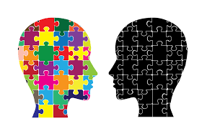
PSYCHOLOGY AND EMOTIONS IN ADVERTISING
NEUROMARKETING – practical examples
Microsoft
It monitors brain activity while the software is used by selected users.
The aim is to improve services and programs.
Candy M & M's
The product has 1/20 of a second to attract people.
Candy began to be produced also in blue colour.
Increase of sales.

Slide 37
PSYCHOLOGY AND EMOTIONS IN ADVERTISING
THANKS FOR YOUR ATTENTION.

