Slide 1

Strategic Analysis
External Analysis
Ing. Šárka Zapletalová, Ph.D.
Department of Business Economics and Management
STRATEGIC MANAGEMENT

Slide 2

Introduction
Before an organization can begin strategy formulation, it must scan the external environment to identify possible opportunities and threats and its internal environment for strengths and weaknesses.
Environmental scanning is the monitoring, evaluation, and dissemination of information from the external and internal environments to key people within the corporation.
A corporation uses this tool to avoid strategic surprise and to ensure its long-term health.
Research has found a positive relationship between environmental scanning and profits.

Slide 3
Strategic Management in Organization
Strategic management is implemented at the top management level, has a significantly complex scope covering all the activities of the company and is the basis for all corporate plans and projects. Strategic management is implemented through the creation and implementation of individual strategies.
Tactical management has the task of determining and managing the procedures and means leading to the most effective implementation of the enterprise's strategy. Tactical management takes place at the middle management level, where strategic objectives and means are specified, and includes a narrower range of activities. Planning is an essential part of tactical management and results in a business plan.
Operational management represents the last, lowest link in the hierarchy of corporate management. It is very specific and detailed management over short time horizons, in quarters, months, decades, days and hours. The instruments are operational in-house plans and in-house management tools.

Slide 4
Strategic Management
To be successful in the long-run, companies must not only be able to execute current activities to satisfy an existing market, but they must also adapt those activities to satisfy new and changing markets.
Strategic management is a set of managerial decisions and actions that determines the longrun performance of a corporation. It includes environmental scanning (both external and internal), strategy formulation (strategic or long-range planning), strategy implementation, and evaluation and control.
The study of strategic management, therefore, emphasizes the monitoring and evaluating of external opportunities and threats in light of a corporation’s strengths and weaknesses.
Strategic management is a broader term that includes not only the stages already identified but also the earlier steps of determining the mission and objectives of an organization within the context of its external environment.

Slide 5
Strategic Management Concept
Strategic management is a set of activities aimed at shaping the long-term objectives of the company.
Strategic management is an integral part of the overall management of an enterprise.
The objective of strategic management is to gain competitive advantage.
It indicates the direction of the development of the enterprise and defines the main strategic directions of the enterprise.
It enables the company to orient itself in the competitive environment.
Strategic management has basic characteristics: long term, high risk, dynamic and creative approach
The implementers of strategic management are the managers (top management or CEO) who
  decide on the necessary activities of the enterprise;
  create the conditions for the smooth running of these activities.

Slide 6
Strategic Management and Strategic Decision-Making
Strategic decision-making is the process of finding such options in the future that will ensure the success of the company on the market, strengthen its competitiveness, and ensure its suitable position among producers.
Decision-making is a typical managerial activity, which represents a dynamic conscious process of choosing one of the possible alternatives that, in the opinion of the decision-maker, allows the effective achievement of the goal.
The decision-making process is always influenced by the personality of the decision maker, his personal characteristics, interests, knowledge and the influence of external conditions, especially time.
The decision-making process always results in a decision that is the product of the individual's thought process or the recommendations of his/her colleagues and advisors.

Slide 7
Deciding between Strategic and Operational Decision-Making
Basic characteristics of strategic decision-making
Long-term, future-oriented, high degree of risk and uncertainty, organization-wide, prioritizing, flexible, creative, relates the organization to the environment, always learning something new
Basic characteristics of operational decision-making
Reactive, isolated, short-term, cautious, non-prioritizing, inflexible, predictable, satisfaction with the status quo

Slide 8
Process of Strategic Decision-Making
Precise formulation of the problem to be solved.
Determine the time appropriate for a decision (immediately, later, leave without a decision and await developments).
Gather all the necessary and available information and verify its veracity and telling power.
Examine the possible options and consider selecting one option from the given set.
Select the optimal option in the opinion of the decision maker.
Implement the chosen decision.
Verify the correctness of the decision based on the results of its implementation.

Slide 9
Characteristics of Strategic Decision-Making
It is primarily the activity of the top management or owners of the business.
It primarily takes into account the influences of the external environment in the form of opportunities and threats.
It is oriented towards the more distant future, so that impacts are not immediately apparent.
It has an impact on the organisational set-up of the enterprise.
It influences the long-term perspective and existence of the enterprise.
The results of decision-making are original.
It affects much greater values than operational management.

Slide 10
Nature of Strategic Decision-Making
The unique nature of the decisions, which are often irreversible given the high costs, when they are proven to be ineffective once implemented.
Strategic decision-making must take into account both economic efficiency and potential social impacts, so that it is necessary to ensure that we move towards the creation of effective socio-economic systems within the company.
Given the multi-criteria nature of strategic problems, it is necessary to address the conflict of criteria and to seek an appropriate compromise even when activities are contradictory and have different weights of importance.
Respect for the existence of non-quantifiable factors that can be described and ranked according to intensity but cannot be expressed in terms of value.
Imperfect information in solving strategic problems is a concomitant phenomenon of the strategic decision-making process, and therefore some risk of success or failure must be taken into account.
Lack of information and longer time horizons for meeting objectives mean that strategic decisions often take on the character of open systems and must be addressed as such.
The role of the human actor in decision-making is irreplaceable, as he brings his individual characteristics, subjective criteria, motivation, his own opinions and personal characteristics to the decision-making process.

Slide 11
Strategic Mindset (Thinking)
Strategic thinking represents a complex of cognitive and purposeful thinking activities of the top management of the company, aimed at achieving the set strategic goals of the company.
Proper and well-implemented strategic thinking is one of the basic prerequisites for successful strategic management, which aims to create an optimal corporate strategy. It is therefore essentially a way of thinking that corresponds to the nature and specific features of strategic processes.
Strategic thinking is characterised, on the one hand, by an intense analytical effort to make the best use of all available true information, which gives us a picture of both the enabling and constraining factors. At the same time, however, it is necessary to think prospectively and look at the enterprise and business activities on the basis of the foreseeable future.

Slide 12
Principles of Strategic Mindset (Thinking)
The principles of strategic thinking represent a set of characteristic principles of strategic thinking that cannot be understood in isolation, as only their application as a whole brings the expected results.
The principle of thinking in variations,
the principle of permanence of the strategic process,
the principle of interdisciplinary thinking
the principle of creative thinking,
the principle of synthesis of intuitive and exact thinking,
the principle of thinking in time,
the principle of applying feedback thinking,
the principle of risk awareness,
the principle of concentration,
the principle of ethics.

Slide 13
Stakeholders (Interest Groups) in Strategic Management
The process of strategic management involves different people or groups of people who have different stakes and interests in the nature of the strategy developed, we speak of so-called interest groups.
The term interest group refers to anyone (natural or legal persons) whose activities can affect the enterprise or who is affected by the enterprise's activities.
The relative strength of interest groups in an enterprise is determined by a number of factors, including control over information or resources, irreplaceability in the corporate organism, functional position in the enterprise and the ability to exploit it, and control over contingencies (ability to cope with unexpected problems).
In every enterprise, there are other interest groups outside the strategy maker, but their totality may not be complete and it is useful for each enterprise to broaden or narrow it.
Interest groups: top management of the company, middle management, outsourced, business owners, employees, unions, creditors, customers, suppliers, competitors, local community, the general public, state (government)

Slide 14
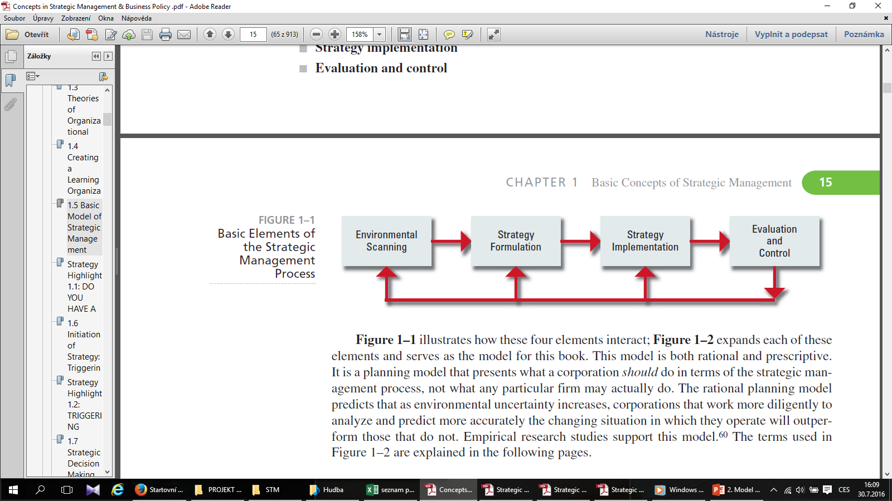
Strategic Management Process
Strategic management consists of four basic elements:
Environmental scanning (Strategic analysis)
Strategy formulation
Strategy implementation
Evaluation and control
SOURCE: T. L. Wheelen, “Strategic Management Model,” adapted from “Concepts of Management,” presented to Society for Advancement of Management (SAM)

Slide 15
Environmental Scanning (Strategic Analysis)
Environmental scanning involves monitoring, collecting, and evaluating information in order to understand the current trends in the natural, societal, and task environments.
The information is then used to forecast whether these trends will continue or whether others will take their place.
  How will developments in the natural environment affect the world?
  What kind of developments can we expect in the societal environment to affect our industry?
  What will an industry look like in 10 to 20 years?
  Who will be the key competitors?
  Who is likely to fall by the wayside?

Slide 16
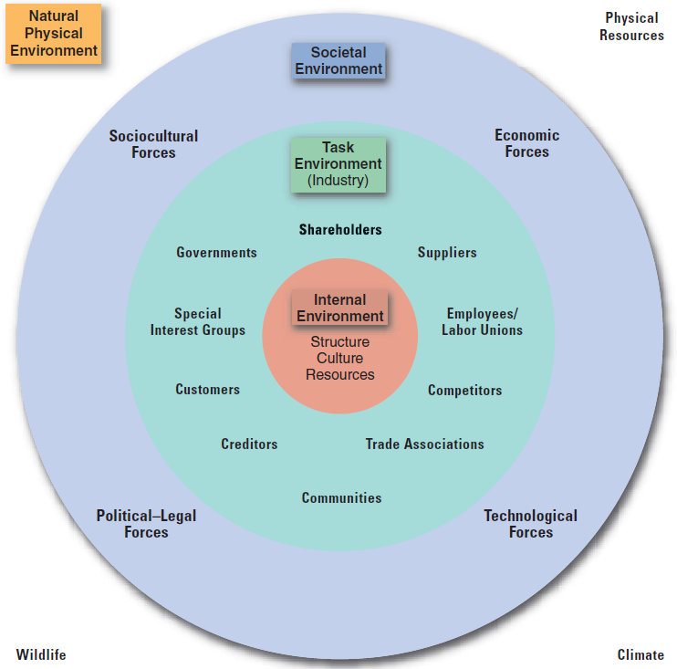
Environmental Scanning
Company´s environment – general forces and trends within the natural or societal environments or specific factors that affect company.

Slide 17
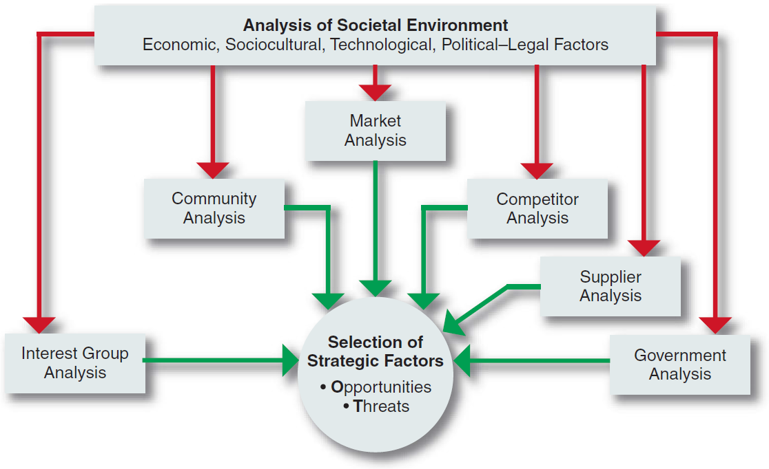
Environmental Scanning
Environmental scanning is the monitoring, evaluating, and disseminating of information from the external and internal environments to key people within the corporation.
A corporation’s scanning of the environment includes analyses of all the relevant elements in the task environment.

Slide 18
Essence of Strategic Analysis
Strategic analysis is the identification and evaluation of all relevant factors that can be expected to influence or may influence the strategy and strategic objectives of the company.
Strategic analysis is a systematic, regular, thorough, critical and impartial examination and assessment of the internal situation of the enterprise (internal analysis) and the external environment (external analysis).
The analysis is carried out at specific time intervals and examines past, present and future developments.
The analysis assesses the overall situation of the enterprise, determines its place in the environment and defines the development of its future activities.
It is the first step in the strategic planning process.

Slide 19
Structure of Strategic Analysis
Analysis of the external environment – provides information on the nature of the external environment and its possible effects on the company in order to identify possible opportunities and threats
  Remote environment analysis - macro environment
  Analysis of the near environment - market, industry
Internal environment analysis – provides information on the internal environment and internal resources of the enterprise, resulting in the identification of the strengths (strengths) and weaknesses (weaknesses) of the enterprise
Synthesis – confronts the strengths/weaknesses of the enterprise with opportunities and threats from the environment in order to determine adequate strategic direction.

Slide 20
External Environment
The external business environment is the external environment of the enterprise that influences and affects the enterprise.
The external business environment can be divided into two levels, namely the more distant and the more proximate environment (the environment). The more distant environment is usually referred to as the macroenvironment and the more proximate environment as the market environment (market and industry).
Analysis of the external environment is a continuous process of obtaining information about events (changes) taking place outside the organization to identify and interpret potential trends in the external environment.
External environment analysis works with the following information sources:
  Secondary sources about the macro environment and submarkets, studies, research, statistical files, journal articles, secondary information related to the target market;
  Primary information obtained through research, information from the company's information system, etc.

Slide 21
External Environment: Macroenvironment
Macroenvironment consists of large-scale fundamental forces that shape opportunities and pose threats to the organization. These forces are largely uncontrollable but must be monitored for purposes of both short- and long-term planning.
Macroenvironment concerns events and systems that operate on a large scale and form a backdrop to day-to-day business decisions. The macro environment also contains issues and events which are beyond the capacity of individual organizations to influence or control.
The macro environment is affecting all organizations in the economy/industry and over which no individual organization has much (if any) influence or control.
The business entity alone cannot influence the macro environment and its parts.
The enterprise only reflects the factors from the macro environment, can use them and possibly counteract the negative factors.
The macro-environment is created by the social and historical development of a particular society in a particular location, which is why it is also referred to as the 'contextual level'. Which means that the enterprise operates and exists in a certain wider context, a broader context.
The macro-environment is not created by the state or the government.

Slide 22
Elements (Variables) of Macroenvironment
The demographic environment is made up of the people who live in a particular territory.
The economic environment focuses mainly on the disposable purchasing power of the population, on prices, savings, debt and the availability of money (credit).
The political environment and its influence is based on political decisions or political events in the country.
The legislative environment creates the legislative framework for the activities of business entities through legal norms regulating business practices, rights and obligations in the implementation of these activities.
The social environment shapes the basic beliefs, values and norms of the people living in it.
The cultural environment is determined by culture, which is generally understood as a complex of values, customs, traditions, behaviours and other factors adopted and shared by persons of a particular group, society.
The technological environment follows the development and use of new technologies in the activities of the enterprise.
The natural environment focuses on the current state and deterioration of the environment, the depletion of natural resources and the increasing cost of energy.

Slide 23
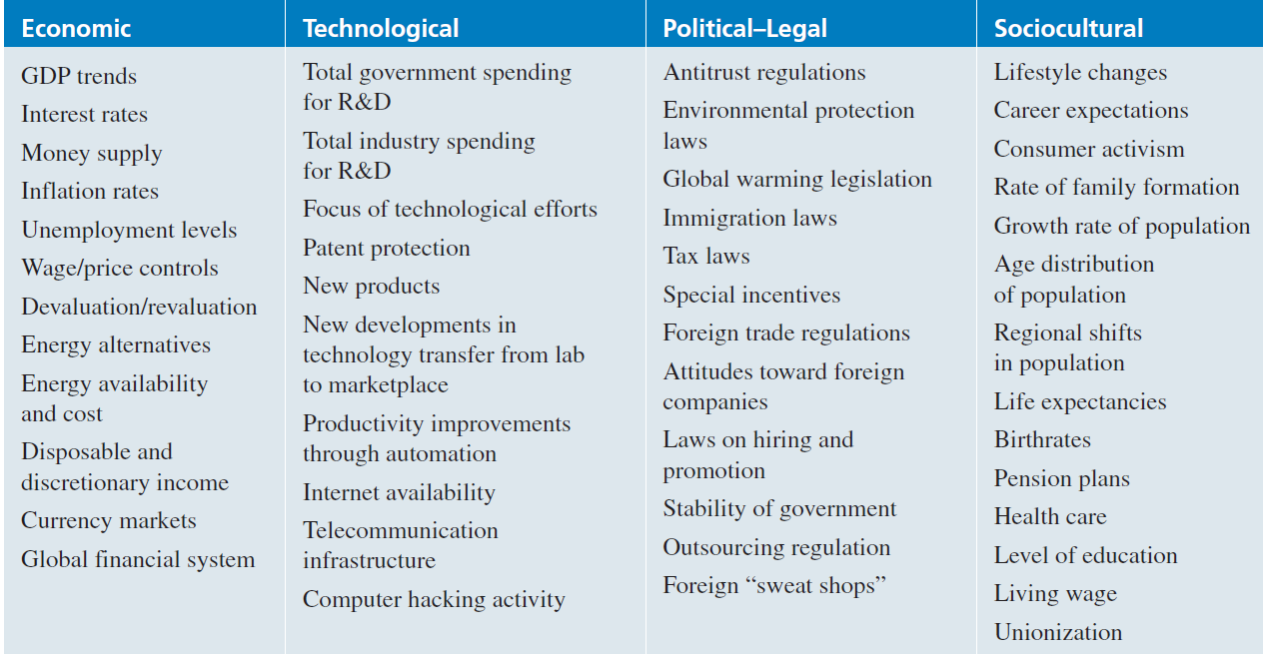
External Environmental Variables: Macroenvironment
Some important variables in the environment

Slide 24
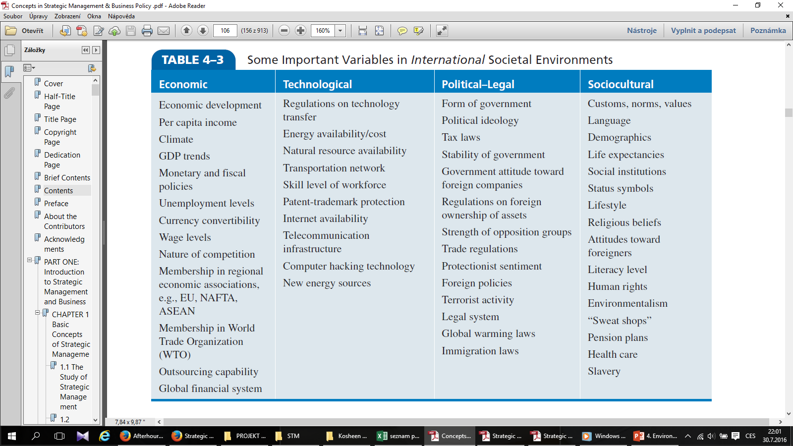
External Environmental Variables: Macroenvironment
Some important variables in the international environment

Slide 25
Methods of Macroenvironmental Analysis
The main sources of data for the analysis of the macro-environment are secondary sources: various statistics, analyses, studies, research, articles in professional journals, etc.
PEST, PESTLE, STEP, STEEPLED, STEER
Extrapolation of trends (forecasting) - a forecasting method determining the probable course of a certain phenomenon from its previous development.
Expert methods - QUEST method (Quick Environmental Scanning Technique), Delphi method, Brainstorming - the use of experts for activities requiring special knowledge and expert assessment of the problem and its future development.
Scenarios method
Statistical analysis methods (time series analysis, regression and correlation analysis)
Methods of demographic statistics
Political science and macroeconomic theory
Causal analysis methods

Slide 26
PEST Analysis
PEST analysis is a modern method of analysing the macroenvironment.
Its aim is to find and analyse those components of the environment that are of importance to the company and may represent an opportunity or a threat to it. The analysis also tracks the evolution of critical factors over time.
PEST analysis focuses on the environment in which the enterprise actually operates.
PEST analysis looks at the macro environment of the firm in terms of four basic groups of factors: political and legislative P, economic E, social and demographic S, technical and technological T.
This original form of the method has been modified and extended over time to include additional elements. So today we encounter the following forms: PESTLE analysis (added legislative and environmental environment), SLEPT analysis, STEEP analysis, STEER analysis, STEEPLED analysis.
The common purpose of all these analyses is to identify specific threats and opportunities, which helps the company to focus on key aspects of the macro environment and to evaluate these comprehensively.

Slide 27
LONGPEST Analysis
LONGPEST analysis, which is another modification of PEST analysis, takes into account local LO, national N and global G level political-legislative, economic, socio-demographic and technical-technological factors.
The result is a strategic profile of the neighbourhood. The procedure includes the following steps:
Creating a list of factors to be analyzed.
Rating the importance of the factors using a Likert scale.
Evaluation of the factors that have the greatest impact on the company (impact on profitability, liquidity, growth) and the company's options for responding to these factors.

Slide 28
Forecasting (Prognosing)
Forecasting is a professional assessment of future developments, whereby possible future processes and phenomena are determined on the basis of the examination of past and existing processes and phenomena, while the characteristic feature of these processes and phenomena is their uncertainty, virtually uncertainty.
Forecasting results in a forecast.
A forecast is a qualified and reasoned statement relating to an unknown future event, the content of which is a probabilistic statement about the future with a relatively high degree of confidence.
Forecast relies on scientific knowledge and specific methods.
Forecast is systematically derived, reliably evaluable and occurs under certain conditions and at certain times.

Slide 29
Forecasting Methods
Forecasting methods are sets of theoretical and practical rules taken from different disciplines that lead to the construction of a forecast with a certain predictive power.
Quantitative methods - are based on the assumption that future developments are a predictable and direct continuation (extrapolation) of existing trends. In this case, statistical analysis of past data at different points in time is applied.
  Statistical methods (Trend and time series extrapolation method, regression and correlation analysis method, Box-Jenkins based methods, classification and regression trees, cluster analysis methods, spectral time series analysis methods, factor analysis methods, adaptive methods)
  Operational research methods (Mathematical programming methods, simulation methods and games, decision theory methods, modified network graphs)
  Methods of model experiments (Growth models, structuring models, global models)
Qualitative methods - use the human factor, are based on the variation, ambiguity and probabilistic nature of the development of future events. Sometimes also called subjective or reflective.
  Heuristic methods - Delphi method, Brainstorming method, Brainwriting method, Panel method, Personal evaluation, Market research, Future scenarios
According to the degree of subjectivity - Subjective methods, Objective methods, Systematic methods
Further breakdown of methods - Exploratory (survey) method, Normative method (goal-directed), Integral forecasting method

Slide 30
Brainstorming
Free team discussion to get new creative ideas and thoughts to improve or find the right solution in a short time.
Logical thinking is replaced by intuitive
When solving a fuzzy problem, a framed area
Participants - experts in the field 50%, experts in related fields 30%, people with no connection to the field 20%
Rules - no criticism, unleash imagination, mutual inspiration, as many as possible, equality of participants
Brainstorming process:
  The leader will repeat the basic rules of brainstorming.
  Introducing the participants to the problem to be discussed and solved
  Warm-up - to relax the participants and get them in the mood for creative thinking
  Discussion of the topic itself
  Processing and evaluation of the topics

Slide 31
DELPHI Method
The purpose is to obtain predictive information or opinions from a selected group of experts relating to the identification or prediction of future events, development issues or trends
Forms: Conventional Delphi, Argument Delphi, Policy Delphi
Basic principles: anonymity, interaction, controlled feedback, statistical evaluation of responses
Essence:
  Sending a thoughtfully chosen series of questions (formalized questionnaire)
  Independent experts
  Repeated mailings - convergence of views
  Consensus is only reached over the correct solution
  Replaces direct discussion or seminar

Slide 32
Method of Scenarios
Used when there are non-continuous changes in the company's environment.
A scenario is a picture arranged from all achievable and relevant forecasts and information. an indicative, context-dependent description of a possible future situation that leads from the initial (current) state through the logical connections of a chain of events to a predicted end state
The aim of scenarios is to identify the critical points of development at which major decisions need to be made.
The basic groups of scenarios are:
Scenarios of possible events
Simulation scenarios
Environmental scenarios
Environmental process scenarios

Slide 33
Applicability of Forecasting Methods
Groundbreaking technical and technological inventions
Basic research directions and application research directions
Product parameters, functional characteristics of technologies and equipment
Development tendencies and trends
Societal implications of possible trends and technical developments
Alternative solutions to societal objectives
Alternative solutions and anticipation of objectives at lower levels of the organisation
Anticipation of market behaviour, price movements, demand

Slide 34
External Environment: Task (Market) Environment
The term market or industry, or the mesoenvironment, is used rather than the term proximate business environment. Some authors include this environment in the microenvironment, i.e. the internal environment of the firm.
A fundamental characteristic of this business environment is that enterprises can influence the actors and forces of this business environment. This influence is targeted and deliberate.
The market environment can be referred to as the transactional level, because it is in this environment that transactions related to the implementation of business activities take place.
Market environment actors include groups of people or organisations directly related to a particular business entity. Market environment actors include: customers, competitors, distribution links, the public, external influencers.
Market environment analysis focuses on assessing the basic parameters of the market and the situation in a particular industry. Therefore, market environment analysis can be divided into industry analysis and market analysis.

Slide 35
Industry
An industry is a group of firms that produces a similar product or service, such as soft drinks or financial services. An examination of the important stakeholder groups, such as suppliers and customers, in a particular corporation’s task environment is a part of industry analysis.
Dozens of industry classifications exist, and these are typically grouped into larger categories known as sectors.
Organizations operating in the same industry can also be compared to each other to evaluate the relative attractiveness of a organization within that industry.
Industries or economic activities are compulsorily classified in the European Union according to the NACE-CZ classification, which is derived from the ISIC (International Classification of All Economic Activities) used by the United Nations.

Slide 36
Industry
Typology of industries
Industries according to dependence on the economic cycle:
  Cyclical industry;
  Anti-cyclical industry;
  Neutral industry.
Industries according to the intensity of production factors:
  Labor intensive;
  Capitally intensive;
  Investment intensive.
Industries according to the number of available competitive advantages:
  Volumetric;
  At an impasse;
  Fragmented;
  Specialized.

Slide 37
Industry
Dozens of industry classifications exist, and these are typically grouped into larger categories known as sectors. A sector is a group of closely related industries.
Economic sectors:
  Primary sector – agriculture, mining and other natural resource industries;
  Secondary sector – covering manufacturing, engineering and construction;
  Tertiary sector – service industries;
  Quarternary sector – intellectual activities involving education and research;
  Quinary sector – high level decision makers in government and industry.

Slide 38
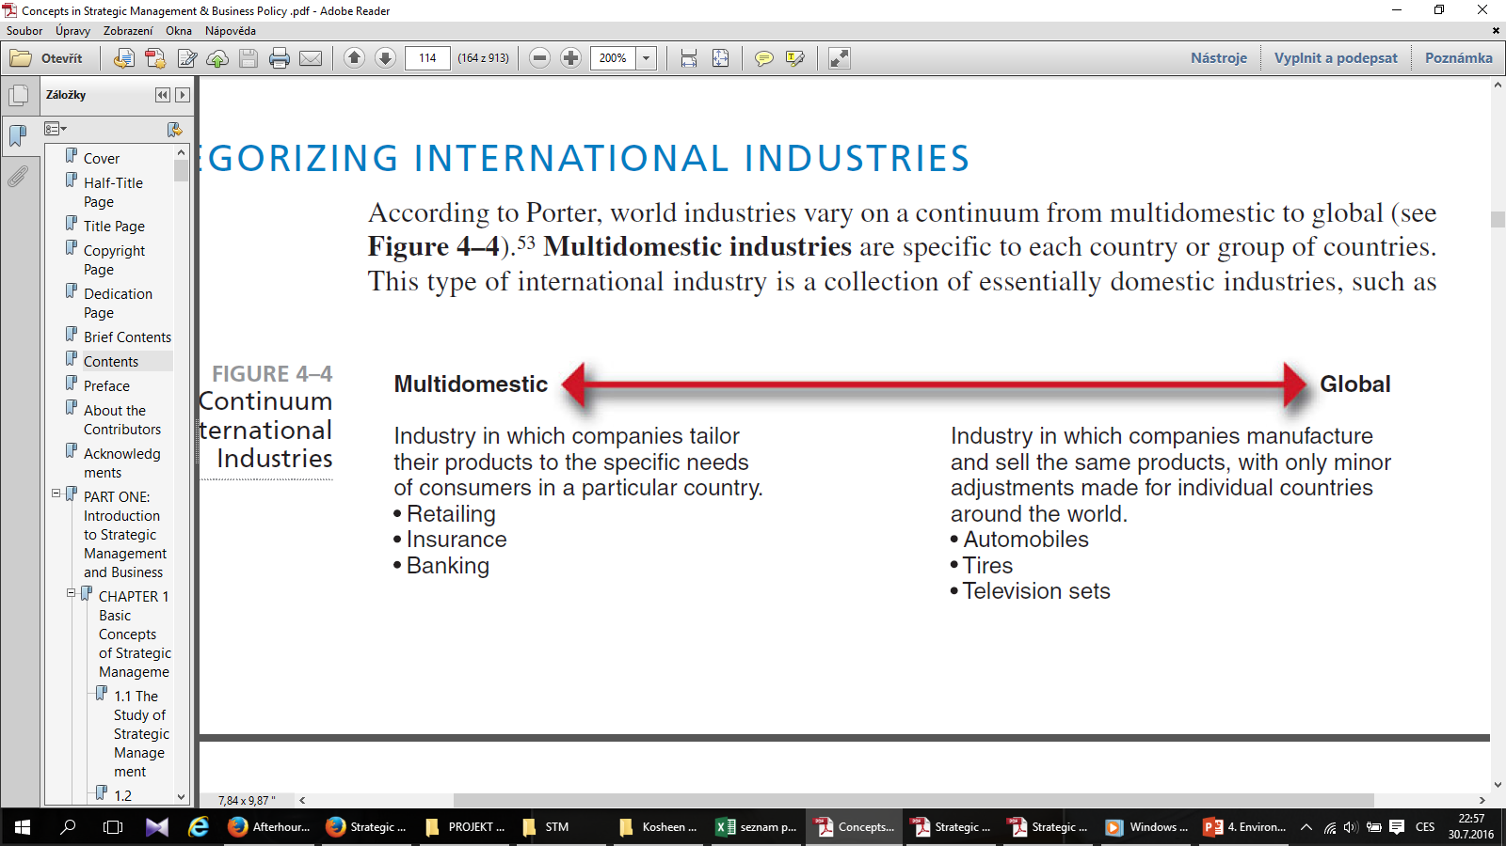
International Industries
According to Porter, world industries vary on a continuum from multidomestic to global.

Slide 39
International Industries
Multidomestic industries are specific to each country or group of countries. This type of international industry is a collection of essentially domestic industries, such as retailing and insurance.
  The activities in a subsidiary of a multinational corporation (MNC) in this type of industry are essentially independent of the activities of the MNC’s subsidiaries in other countries.
  Within each country, it has a manufacturing facility to produce goods for sale within that country.
  The MNC is thus able to tailor its products or services to the very specific needs of consumers in a particular country or group of countries having similar societal environments.

Slide 40
International Industries
Global industries, in contrast, operate worldwide, with MNCs making only small adjustments for country-specific circumstances.
In a global industry an MNC’s activities in one country are significantly affected by its activities in other countries.
MNCs in global industries produce products or services in various locations throughout the world and sell them, making only minor adjustments for specific country requirements.
  Examples of global industries are commercial aircraft, television sets, semiconductors, copiers, automobiles, watches, and tires.

Slide 41
International Industries
The factors that tend to determine whether an industry will be primarily multidomestic or primarily global are:
  Pressure for coordination within the MNCs operating in that industry.
  Pressure for local responsiveness on the part of individual country markets.
Between these two extremes lie a number of industries with varying characteristics of both multidomestic and global industries. These are regional industries, in which MNCs primarily coordinate their activities within regions, such as the Americas or Asia.

Slide 42
Methods of Industry Analysis
The object of the sector analysis is the business entities in a particular sector. The purpose of the sector analysis is to describe the structure of the sector, identify the main drivers of the sector, assess the attractiveness of the sector and the level of the sector.
The information sources for the market environment analysis are mainly secondary information related to the target market, primary information obtained through research, information from the company's information system.
The sectoral structure follows the basic characteristics of a particular industry :
  the number and size of enterprises in the sector;
  types of products and services in the sector;
  the strength of individual enterprises in the sector;
  the extent of market barriers in the sector.
The analysis of sectoral drivers is intended to identify the forces in the sector that are determinant for a firm in a particular sector. The process of analysing sectoral drivers involves the following steps :
  Defining the relevant industry;
  identification of key players, forces in each group according to Porter's competitive analysis;
  determining the strength of each force and the sources of its strength;
  assessing the overall structure of the industry.

Slide 43
Methods of Industry Analysis
Porter's five competitive forces analysis evaluates the competitive forces in a given industry that affect the long-term profit attractiveness of a particular industry. The competitive forces evaluated include (Porter, 1994):
  Existing competitors - their ability to influence the price and quantity offered of a given product/service.
  Potential competitors - their ability to enter the market and influence the price and quantity offered of a given product/service.
  Suppliers - their ability to influence the price and quantity offered of the input required.
  Buyers - their ability to influence the price and quantity demanded of the product/service.
  Substitutes - the price and quantity offered of products/services capable of substituting, at least in part, the product/service in question.
In the context of significant changes in the business environment, there are some modifications to this traditional model of competitive forces. For example, a sixth force is added, namely complementary products

Slide 44
Methods of Industry Analysis
The attractiveness of an industry is a multi-criteria evaluation of the industry based on selected factors and their weighted assessment. According to Váchal and Váchalová (2001), there are 15 factors and they are rated on a scale of 1 to 10. Different authors include different elements in the factors assessing industry attractiveness.
Porter's attractiveness factors - profits in excess of entry costs, opportunity for growth, barriers to entry into the industry, investment costs necessary to engage in the new business, additional investment to overcome other barriers to entry, expected costs due to retaliation by industry members against entry, expected cash flows associated with being in the industry, opportunity for the new business to establish a defensible position in the industry over the long term, etc.
Michael E. Porter's method, known as the Porter Diamond, is used to assess the level and maturity of an industry. The Porter diamond identifies four basic groups of factors:
  Conditions of Production Factors (Conditions Factor);
  Demand-side conditions (demand conditions);
  Related and supporting industries (related and supporting industries);
  Corporate strategy, structure and rivalry in the industry.

Slide 45
Market
Market consists of individuals and organizations which are interested and willing to buy a particular product to obtain benefits that will satisfy a specific need or want and who have the resources to engage in such a transaction.
In the market we can to find these market subjects: buyers, organizational buyers, competition, publics
Market is usually measured by dollar (euro) sales and/or unit sales for a defined product-market and specified time period. For measurement of market we can use these three measures:
  Market potential is an estimate of the maximum possible sales of a product, a group of products or a service for an entire industry during a specified time period.
  Market size (market capacity) is total sales of product, a group of product or a service of the defined industry during a specified time period.
  Market share is defined as the sales of product, a group of product or a service of the particular company in the defined industry during a specified time period.

Slide 46
Market
Market segments are distinct groups of customers within a market that can be differentiated from each other on the basis of their distinct attributes and specific demands.
Each segment contains people who are relatively homogenous in their needs, wants and the product benefits they seek. Also, each segment seeks a different set of benefits from the same product category.
The aim of segmentation is to identify groups within a heterogeneous market who share distinctive needs, preferences and behaviors.

Slide 47
Methods of Market Analysis
The market analysis focuses on the specification and description of customers and customer groups.
The market analysis is used to identify the customers that are under consideration for a particular market offer.
The information sources for the market environment analysis are mainly secondary information related to the target market, primary information obtained through research, information from the company's information system.
Market research is the specification, collection, analysis and interpretation of information used as a basis for managerial decision making.
Market research is a part of the enterprise information system, which consists of: internal information system, external intelligence system, research system, decision support system.
The market research process is a sequence of steps leading from the preparation of research towards the actual implementation of research. Although each research and its process is characterised by specific features and differences, it can be divided into three basic phases:
  Preparatory phase - setting the research objective, specification of the research problem, designing the research plan;
  Implementation phase - collection of information, data analysis, transformation of data structure into information;
  Presentation phase - written and oral presentation of research results.

Slide 48
Methods of Market Analysis
Strategy maps are created by examining the differences of companies in a given sector.
They are particularly meaningful in those sectors where there are several groups of competitors with different characteristics and a significant market position.
These groups of firms are then plotted on a two-variable map according to selected characteristics. This creates strategic areas, spaces, strategic groups of competitors in the overall market. The size of each circle indicates the share of the strategic group in the total market.
Strategic maps are an important, useful and simple tool for industry analysis. They allow a better understanding of the nature of sectoral competition and to make changes in the sector or strategic group of customers.

Slide 49
Methods of Market Analysis
The analysis of globalisation trends mainly looks at:
Costs (technology development and deployment costs, transport and resources),
customers (their requirements and the possibility of applying uniform forms of marketing),
national specificities (business support and state protection, application of technical standards, institutional norms, customs barriers)
competition (manifestations of global competition in its 'super' and 'hyper' forms).
This method is often referred to as the '4C' method, as it is made up of the words
  CUSTOMER,
  COUNTRY (national specifics),
  COMPETITION
  COST.
The result of this analysis should be a proposal of the country where the company will locate its plant, how many markets the company will offer its products, etc.

Slide 50
Methods of Market Analysis
Strategic gap analysis – in the course of using the strategy, it can be noted that there is a drop-off or, on the contrary, a fall-off in the performance of the set tasks, which creates a certain gap between the plan and the reality. These possible changes are caused by both internal and external conditions that need to be remedied as a matter of urgency.
The causes of deviations from the plan in a negative direction are often due to the following phenomena:
  Unexpected developments in the company's environment.
  The increasing influence of competitors and their unexpected activities.
  Changes in customer segment values.
  Inappropriate employee selection and management.
  The demands of an influential interest group.
  Incorrectly developed corporate activity plan.
  Inappropriate implementation of sub-strategic measures.

