Slide 1
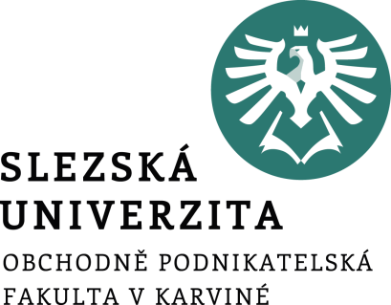

2. Part I-Tourist attractions in the Czech Republic -7 regions
.
The Tourist Attractions in the Czech Republic and in the World
Ing. Patrik Kajzar, Ph.D.

Slide 2
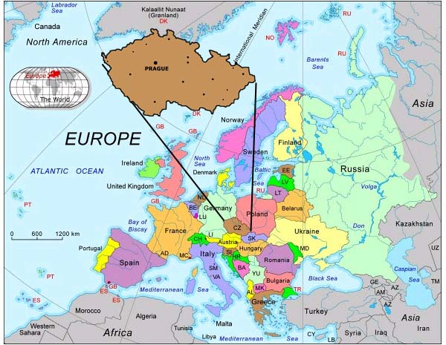
Europe and Czech Republic
Fig. 1: EUROPEAN MAP
The Vatican is Europe's smallest country
Europe's highest point is Mt. Elbrus in Russia
Europe's lowest point is the Caspian Sea bordering Russia
(If European Russian is excluded, the highest and lowest stats shown below apply to continental western Europe)
Europe's highest point is Mt. Blanc in France and Italy
Source: https://www.mzv.cz/london/en/about_the_czech_republic/basic_information_on_the_czech_republic/index.html

Slide 3
Czech Republic
The Czech Republic (Czechia) is a landlocked country in Central Europe. It borders on Germany in the west, Austria in the south, Slovakia in the east and Poland in the north.
Its capital and largest city, with 1.3 million inhabitants, is Prague.
The territory of the Czech Republic consists of three historical lands: Bohemia, Moravia and Czech Silesia.
The Czech Republic, with a total area of approximately 79,000 km2, is divided into 14 territorial administration units, called regions.
These regions are: Prague, South Bohemia, South Moravia, Karlovy Vary, Hradec Králové, Liberec, Moravia-Silesia, Olomouc, Pardubice, Plzeň, Central Bohemia, Ustí nad Labem, Zlín and Vysočina.

Slide 4
Geography of the Czech Republic
National parks: Krkonoše, Šumava, Podyjí, Bohemian Switzerland
Lakes: Black (Šumava), Čertovo (Plzeň), Laka (Šumava), Plešné (Šumava)
Ponds: Rožmberk (Třeboň, the largest pond of the world), Svět (Třeboň), Bezdrev (České Budějovice,)
Valleys, lowlands, high grounds (the Bohemian-Moravian Highland) and mountain ranges
the Šumava mountains (primeval forest Boubín)
The Giant Mountains (Krkonoše) are the highest mountains in Czech Republic, with the highest peak Snezka, which is 1602 m high.
the Lužické mountains , the Jizerské mountains, Beskydy, Jeseniky.
The longest river: the Vltava
The Elbe - major Central European river
the Odra, the Morava

Slide 5
The main tourist attractions in Prague
Prague, Czech Praha, city, capital of the Czech Republic.
Lying at the heart of Europe, it is one of the continent’s finest cities and the major Czech economic and cultural centre. The city has a rich architectural heritage that reflects both the uncertain currents of history in Bohemia and an urban life extending back more than 1,000 years.
The Capital city of the Czech Republic is Prague. There are a lot of historical buildings. For example:
The Czech Museum of Music is located in the former Baroque church of St. Mary Magdalene, built in the 17th Century.
Charles Bridge (Karlův most) is a 14th century stone bridge linking the two sides of Prague. This magnificent structure, one of the city's finest attractions, is the main pedestrian route connecting the Old Town with the Lesser Town / Prague Castle.
Dancing House (Tančící dům) is set in a fine location by the Vltava River in Prague. Its design is unique, and especially striking in the city centre because it is a modern building surrounded by historic architecture.

Slide 6
The main tourist attractions in Prague
The Estates Theatre in Prague opened in 1783. It is Prague's oldest theatre and finest neo-classical building. Indeed, it is one of the most beautiful historical theatres in the whole of Europe.
Golden Lane (Zlatá ulička) is an ancient street within the Prague Castle complex. Golden Lane dates from the 15th Century and has a beautiful, olden world quaintness about it. It comprises 11 historic houses, inside which period scenes have been created to show the life of the artisans who once worked, ate, drank and slept in them.
The Klementinum founded in 1232, the Klementinum in Prague is the largest and most historic complex of buildings in the Old Town. It covers an area of over two hectares close to the Vltava River, near Charles Bridge. The Klementinum (Clementinum) has undergone a rich architectural evolution. Since the Middle Ages many of Europe's great astronomers, scientists, philosophers and musicians have studied and worked here, influencing the development of its wonderful array of buildings.

Slide 7
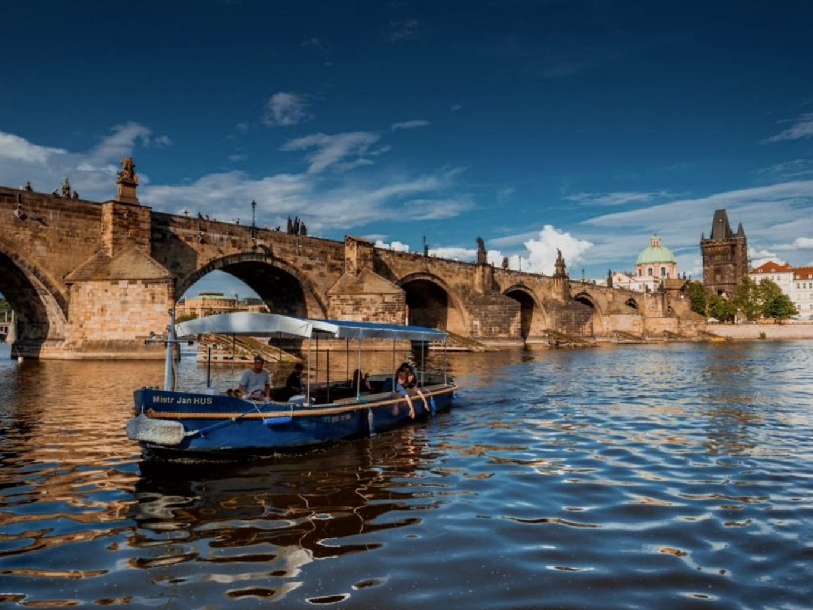
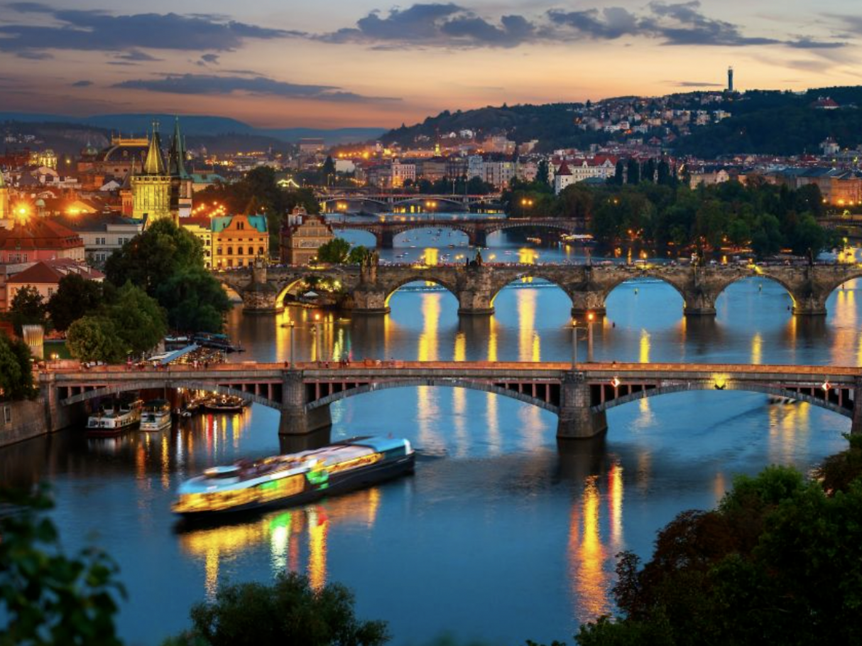
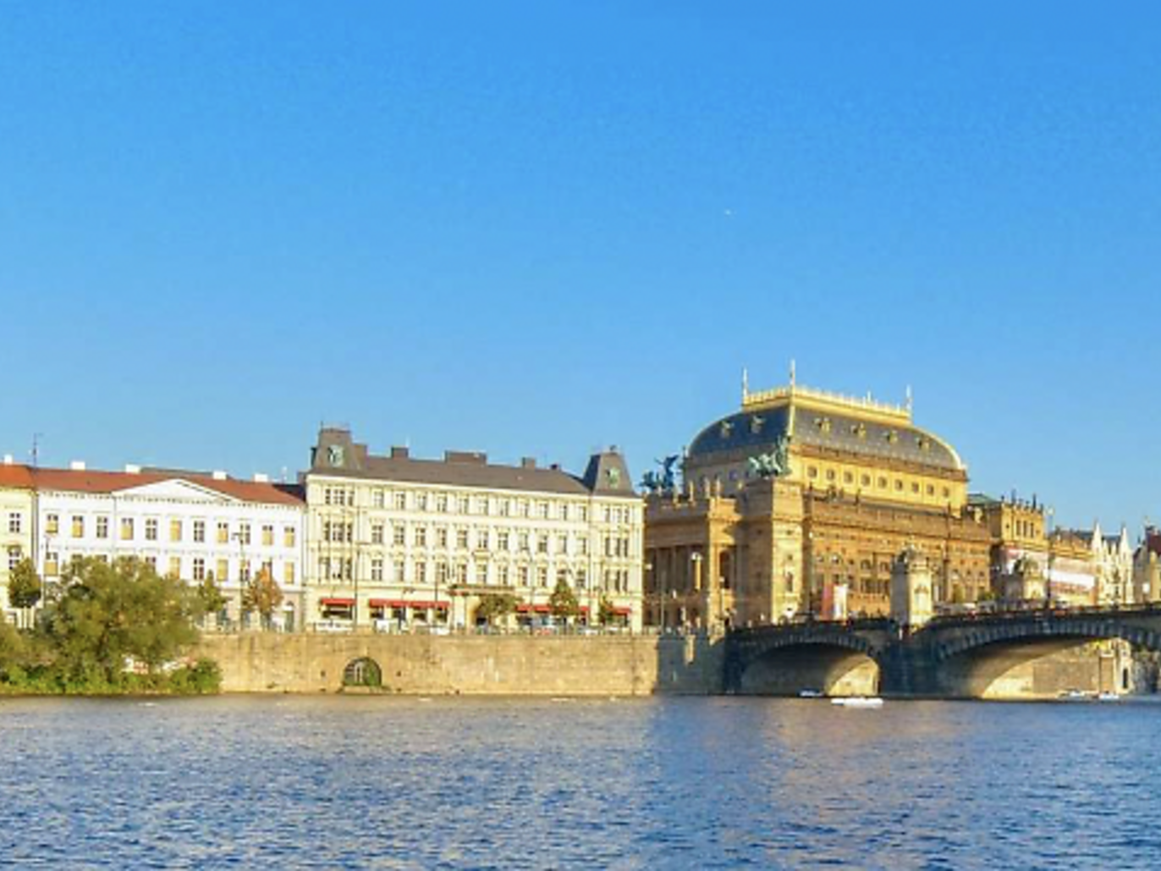
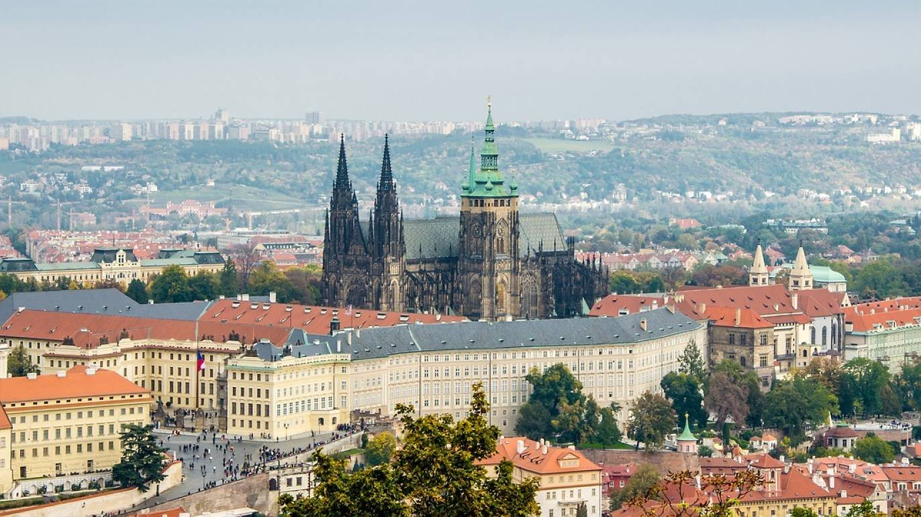
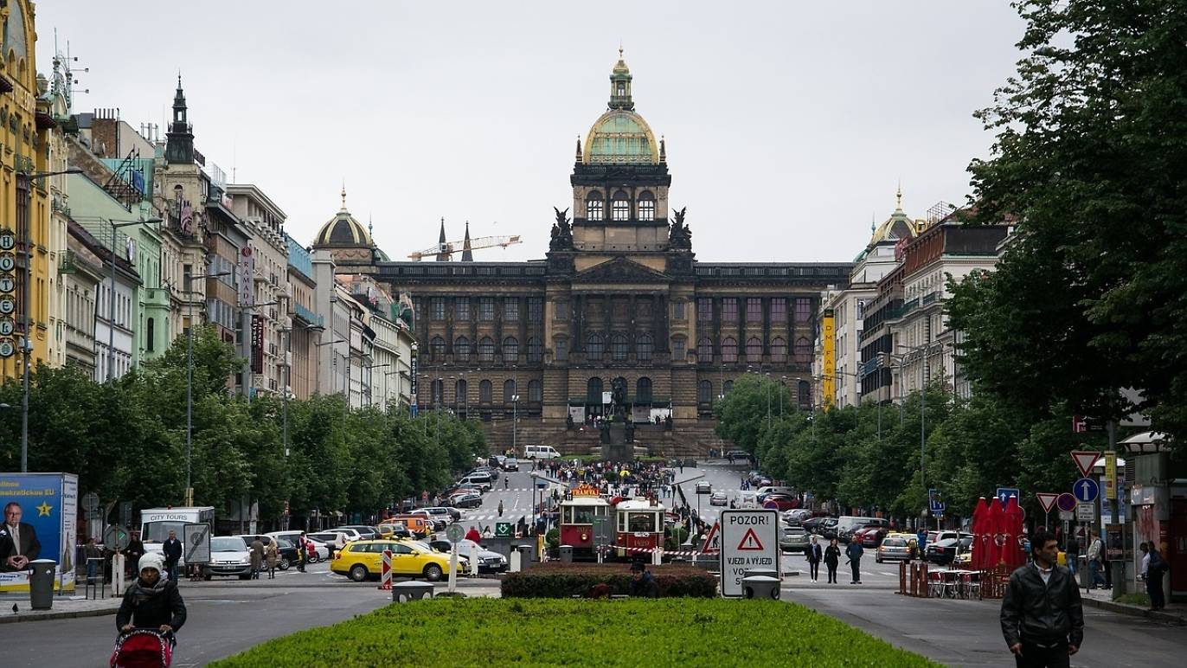
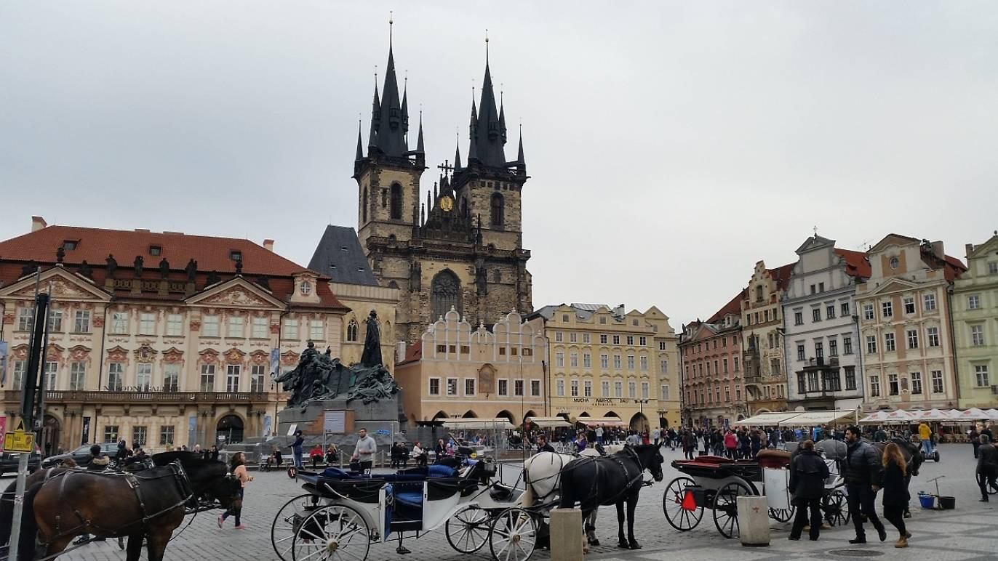
Selected attractions in Prague
Charles Bridge
Vltava river
National Theatre
Prague Castle
Wenceslas Square
Old Town Square

Slide 8
The main tourist attractions in South Bohemia
South Bohemia is A landscape of forests and fishponds with beautiful countryside, fairytale chateaux and rural farms.
The region borders (from the west clockwise) the regions Plzeň, Central Bohemia, Vysocina and South Moravia. To the south it borders Austria and Germany. Until 30 May 2001, the region was named as Budějovický kraj or Českobudějovický kraj, after its capital, České Budějovice.
The Trebon Region (Třeboňsko) is famous for its unique network of fishponds and canals. Most of the 460 fishponds in the area were built in the 16th century. With its milieu of ancient waterworks, the soulful calls of water birds, the healing peat bogs, peaceful pine forests and traditional village architecture, the Trebon Region is among the foremost jewels of South Bohemia.

Slide 9
The main tourist attractions in South Bohemia
Český Krumlov In the southernmost part of the Czech Republic there is a region which is an ideal place to experience some highly interesting adventures.
Its centre is the town of Český Krumlov which, although not large in size, is all the more attractive due to its bewitching atmosphere that harks back to ancient times. Thanks to its unique medieval buildings it has been rightly protected by UNESCO since 1992.
The village Holašovice was first mentioned in the mid-13th century during the period of the colonising movements in the South Bohemian border region. Holašovice is an exceptionally well-preserved example of a traditional Central European village. A number of high-quality village buildings from the 18th and 19th centuries in a style known as „South Bohemian Folk Baroque“ have been preserved on a ground plan that dates from the middle ages and in 1998 the almost entirely preserved medieval system of houses and grain stores was inscribed in the UNESCO World Cultural Heritage List.

Slide 10
The main tourist attractions in South Moravia
South Moravia offers not only great wine, but also natural wonders and many cultural monuments.
South Moravia is the warmest and most fertile region in the Czech Republic and you can also find the oldest traces of settlement in the Czech territory there.
It is a place worth visiting both for those who love nature and those who are interested in cultural monuments.
South Moravia prides itself on numerous cultural, historic, religious, and natural jewels, some of which are listed as UNESCO heritage sites.
Admirers of historic and Jewish monuments, as well as modern architecture will be satisfied. Among the most significant monuments are Villa Tugendhat, the functionalist jewel in Brno, and the Lednice-Valtice Area, a unique “man-designed landscape” with the Lednice and Valtice Chateaux as the biggest landmarks.

Slide 11
The main tourist attractions in South Moravia
History enthusiasts can visit the Špilberk Castle in Brno, the Slavkov (Austerlitz) Chateau and adjoining Napoleonic battlefield, or the fairytale Gothic-Renaissance Pernštejn Castle.
The region may also pride itself on its unique beauties of nature. The Moravian Karst protected area with fascinating dripstone formations will amaze all its visitors.
The Bílé Karpaty (White Carpathians) and Pálava UNESCO biosphere reserves, and the Podyjí (Thaya River area) National Park along the Austrian border offer numerous experiences to lovers of unspoiled nature.

Slide 12
The main tourist attractions in Karlovy Vary
The Karlovy Vary Region or Carlsbad Region (Czech: Karlovarský kraj) is an administrative unit (Czech: kraj) of the Czech Republic, located in the westernmost part of its historical region of Bohemia. It is named after its capital Karlovy Vary.
The region is well known for its spas and is responsible over half of the county's spa industry.
Twelve spas can be found in the city of Karlovy Vary alone. Other famous spa towns in the region include The Spa towns of Jáchymov, Františkovy Lázně, Mariánské Lázně, Lázně Kynžvart. The spas are visited not only by Czechs but by people from the rest of Europe, Russia, Israel and North America as well.
Karlovy Vary spa wafers, a food item from the region, was awarded protected designation of origin (PDO) status by the European Commission in 2011.
The water from the region is used in locally produced beverages including Mattoni from Karlovy Vary and Aquila from the village of Kyselka.

Slide 13
The main tourist attractions in Karlovy Vary
The Orthodox Church of St. Peter and Paul - Built in 1898, the lovely Orthodox Church of St. Peter and Paul is well worth a visit. Despite being in an area of Karlovy Vary known for its beautiful Art Nouveau villas, this splendid old church manages to stand out thanks to its tall golden domes and rich blue roof. Based on the design of a Byzantine church in Moscow and built with funds provided by wealthy Russians visiting the spas, the church's interior - laid out in the shape of a Greek cross - is as attractive as its façade and includes such notable features as a relief of Czar Peter the Great, numerous murals, and a large wooden wall of icons and paintings.
A good place to learn more about the history of the town and the region is the Karlovy Vary Museum. Highlights of the museum's permanent collection include an in-depth look at the region's rise as an important spa town, as well as the waters themselves and their many therapeutic uses and qualities, including their mineral compositions. The facility also houses an important library with many books related not just to balneology (the study of spa waters), but also to the history of art, along with lectures and educational workshops.

Slide 14
The main tourist attractions in Hradec Králové
The Region of Hradec Králové is situated in northeastern Bohemia and covers the territory of the following five districts: Hradec Králové, Jičín, Náchod, Rychnov nad Kněžnou and Trutnov.
In the north it borders with the Liberec Region, to the west with the Central Bohemia region and to the south with the Pardubice Region. The part of its northern and eastern border is as well the state frontier with the Polish republic.
The Hradec Králové Region boasts plenty of natural attractions, such as the Krkonoše National Park with the highest mountain in the Czech Republic, Sněžka and the fascinating sandstone rock towns.
There are also a large number of chateaus, castles and other cultural, architectural and historical monuments. These attractions, combined with ideal conditions for hiking, biking, water sports or skiing, attract many visitors of all ages year round not only from the Czech Republic but also from abroad.

Slide 15
The main tourist attractions in Hradec Králové
Visitors to this area can admire a number of tourist attractions and enjoy various interesting activities.
Whether you choose to visit the open-air textbook of architecture - Hradec Králové, romantic chateaux, an interesting open-air museum, mechanical nativity scene, War Museum or Baroque Chapel, in all of these places there is plenty to see.
Cathedral of the Holy Ghost - The cathedral was founded probably by Queen Elizabeth Rejčka in 1308. It is a brick building with two towers in a Gothic style. Throughout its history, burned down several times and was always rennovated. At the end of the 19th century there were a pseudo-gothic reconstruction. There are located busts of queens Elizabeth Richeza and Elizabeth of Pomerania in the royal hall.
Hradec Králové - synagogue - The building was designed in the Moorish style Václav Weinzettel and was built as a replacement for the synagogue, which was built in the yard of a rabbinic house in Rokytanská Street. The building houses a large prayer hall, apartment for the rabbi, shamash, caretaker and a meeting room with an archive

Slide 16
The main tourist attractions in Liberec
Liberec region is located in the northernmost part of its historical region of Bohemia. It is named after its capital Liberec.
The region shares international borders with Germany and Poland. Domestically the region borders the Ústí nad Labem Region to the west, the Central Bohemian Region to the south and the Hradec Králové Region to the east.
The region's landscape includes the Jizera Mountains, part of the Krkonoše Mountains and part of the Lusatian Mountains.
The Liberec Region is home to 11 national cultural monuments including Bezděz Castle, the Ještěd Tower which transmits television signals as well as being a hotel.
Lake Mácha near the town of Doksy is an important regional centre for leisure, attracting around 30,000 visitors annually.

Slide 17
The main tourist attractions in the Moravian – Silesian region
The region is located in the north-eastern part of its historical region of Moravia and in most of the Czech part of the historical region of Silesia.
The region borders the Olomouc Region to the west and the Zlín Region to the south.
It also borders two other countries – Poland (Opole and Silesian Voivodeships) to the north and Slovakia (Žilina Region) to the east.
In the west lie the Hrubý Jeseník mountains, with the highest mountain of the region (and all Moravia), Praděd, rising 1,491 metres (4,892 ft).
The mountains are heavily forested, with many spectacular places and famous spas such as Karlova Studánka and Jeseník and are therefore very popular with tourists. There are also several ski resorts, including Červenohorské Sedlo and Ovčárna, with long-lasting snow cover. The Hrubý Jeseník mountains slowly merge into the rolling hills of the Nízký Jeseníks and Oderské Vrchy, rising to 800 m at Slunečná and 680 m at Fidlův Kopec respectively.

Slide 18
The main tourist attractions in the Moravian – Silesian region
To the east, the landscape gradually descends into the Moravian Gate (Moravská brána) valley with the Bečva and Odra rivers.
The former flows to the south-west, the latter to the north-east, where the terrain spreads into the flat Ostrava and Opava basins (Ostravská a Opavská pánev), where most of the population lives. The region's heavy industry, which has been in decline for the last decade, is located there too, benefiting from huge deposits of hard coal. The confluence of the rivers Odra and Olše is the lowest point of the region, at 195 m.
To the south-east, towards the Slovakian border, the landscape sharply rises into the Moravian-Silesian Beskids (Czech: Moravskoskoslezské Beskydy) (often referred to just as Beskydy), with its highest mountain Lysá Hora at 1,323 m (4,341 ft), which is the place with the highest annual rainfall in the Czech Republic.
There are three large Landscape Protected Areas (Chráněné krajinné oblasti, CHKO) and a number of smaller nature reserves in the region. The countryside is mostly man-made, but there are five Natural Parks (Přírodní parky) with preserved natural scenery.

Slide 19
The main tourist attractions in the Moravian – Silesian region
The CHKO Jeseníky (with an area of 745 km2 or 288 sq mi) lies in the mountain range of the same name in the north east of the region.
The CHKO Poodří (81.5 km2 or 31.5 sq mi) lies in the Moravian Gate, in close proximity to the region's capital Ostrava, on the banks of the meandering Odra.
The CHKO Beskydy (1,160 km2 or 450 sq mi) is the largest Czech CHKO. It lies in the south-east of the region, along the Slovakian boundary. In the north, the mountains rise steeply from the Ostrava basin, to the south their elevation and severity decreases.
There are three towns with protected historical centers. Příbor, the birthplace of Sigmund Freud, was an important center of education for northern Moravia from the 17th century to the first half of the 20th.
Nový Jičín, founded under the castle of Starý Jičín, has a well-preserved central square dating back to the 14th century, with the Žerotínský château nearby.
Štramberk is a unique small town nestled in a valley between lime hills, with many timber houses and the Trúba Spire rising on a hill above the town.
others.

Slide 20
The main tourist attractions in the Moravian – Silesian region
There are many castles and châteaus in the region; the most famous being Hradec nad Moravicí, Raduň, Kravaře and Fulnek. Hukvaldy, in a village of the same name under the Moravian-Silesian Beskids, is one the region's many castle ruins, known for a musical festival dedicated to the composer Leoš Janáček, who was born there. Another well-known castle ruin is Sovinec under the Hrubý Jeseníks.
Due to the importance of industry in the region, there are many museums displaying products of local technical development: The Automobile Museum in Kopřivnice exhibiting the history of the Tatra cars, the Train Carriage Museum in Studénka, the Mining Museum and the former Michal Mine (Důl Michal) in Ostrava, and many others.
Silesian Ostrava Castle is located in Ostrava - The castle was built by a Těšín prince from the Piastovec family as a borderland fortress against the Czech state in the second half of the 13th century. It was converted during the Renaissance and the entrance gate with a tower dating back to the 16th century has been preserved until this very day.

Slide 21
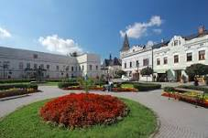
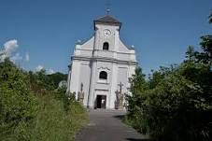
The main tourist attractions in the Moravian – Silesian region
The castle of Fryštát has two sightseeing tours with the castle interiors, and are also acompanied by a contemporary costumes of the guides. The third tours will lead you to the exhibitions of the Czech National Gallery and you can see Czech art of the 19th century here.
The leaning Church of St Peter of Alcantara – the “Czech Pisa” - The ground where this church stands has sunk by 37 metres in just a few decades due to the collapse of mine tunnels under the site. Now the church is leaning 6.8 degrees to the south – but it is still standing, and it has become a unique and renowned tourist attraction.
Castel Frystat
The Leaning Church of St. Peter of Alcantara

Slide 22
The main tourist attractions in the Moravian – Silesian region
Darkov Spa
is a leading spa and rehabilitation resort in the Czech Republic and one of the oldest iodine spas in Europe. Our Spa is worldwide known for the iodine-bromine brine. Our resort is specialised in the treatment of locomotive, nervous and circulatory system, skin and gynaecological diseases.
Provided care with more than 150 years of tradition is based on the natural wealth of iodine-bromine water with high content of iodine, the professional staff and the latest medical technology, including robotic devices.
Golf resort Lipiny,
in Karviná Lipiny in the industrial landscape, between the two active shafts was created new golf course. Golf Resort Lipina is a 18 holes golf course that will satisfy professional players and also beginners

Slide 23
Thank you for your attention

