Slide 1
E-business
E-business system - III
Petr Suchánek
E-business

Slide 2
Outline of the lecture
ERP in e-business

Slide 3
ERP
An ERP (Enterprise Resource Planning) system includes core software components, often called modules, that focus on essential business areas, such as:*
finance and accounting;
human resources;
production management;
materials management;
customer relationship management (CRM);
supply chain management.
Organizations choose which core modules to use based on which are most important to their particular business.*
*https://searcherp.techtarget.com/definition/ERP-enterprise-resource-planning

Slide 4
ERP
ERP systems rely on a centralized relational database, which collects business information and stores them in tables.*
Having the data stored centrally allows end users, such as from finance, sales and other departments, to quickly access the desired information for analysis.*
Instead of employees in different departments managing their own spreadsheets and reports, ERP systems allow for reporting to be generated from a single, centralized system.*
Information updated in one ERP module, such as CRM, HR and finance, is sent to a central, shared database.*
The appropriate information in the central database is then shared with the other modules.*
*https://searcherp.techtarget.com/definition/ERP-enterprise-resource-planning

Slide 5
ERP architecture
ERP applications are most commonly deployed in a distributed and often widely dispersed manner.*
While the servers may be centralized, the clients are usually spread to multiple locations throughout the enterprise.*
Database component
the central repository for all of the data that is transferred to and from the clients;
Clients
here raw data gets inputted, requests for information are submitted, and the data satisfying these requests is presented;
Application component
acts as the intermediary between the client and the database.
*http://www.erppandit.com/erp-architecture.html

Slide 6
ERP - benefits
ERP offers a plethora of benefits, most of which come from information sharing and standardization.*
Because ERP components can share data more easily than disparate systems, they can make cross-departmental business processes easier to manage on a daily basis.*
They can also enable better insights from data, especially with the newer technologies that many ERP systems are including, such as powerful analytics, machine learning and industrial IoT capabilities.*
*https://searcherp.techtarget.com/definition/ERP-enterprise-resource-planning

Slide 7
ERP - benefits
In addition, ERP software:*
boosts efficiencies by automating data collection;
enables business growth by managing increasingly complex business processes;
helps lower risk by enabling better compliance;
fosters collaboration using data sharing and integrated information;
provides better business intelligence and customer service capabilities; and
improves supply chain management.
*https://searcherp.techtarget.com/definition/ERP-enterprise-resource-planning

Slide 8
ERP – components – Human resource
ERP HR module streamlines the management of human resources and human capitals.*
HR modules routinely maintain a complete employee database including:*
contact information;
salary details;
attendance;
performance evaluation;
promotion of all employees.
Advanced HR module is integrated with knowledge management systems to optimally utilize the expertise of all employees.*
*https://www.erp-information.com/erp-hr-module.html

Slide 9
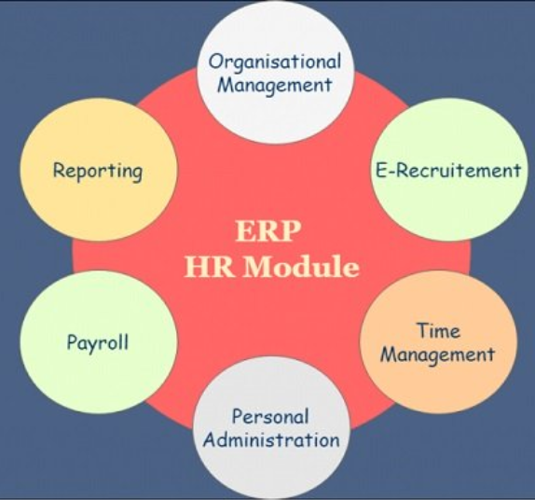
ERP – components – Human resource
Submodules of ERP HR module:*
Organizational Management;
E-Recruitment;
Time Management;
Personal Administration;
Payroll;
Reporting.
*https://www.erp-information.com/erp-hr-module.html

Slide 10
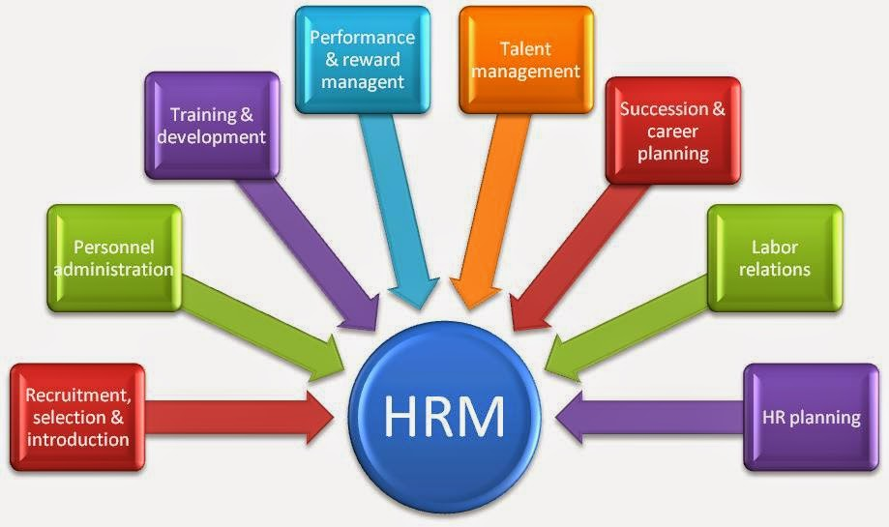
ERP – components – Human resource
*https://solutiondots.com/blog/top-12-erp-human-resource-management-software-2016/

Slide 11
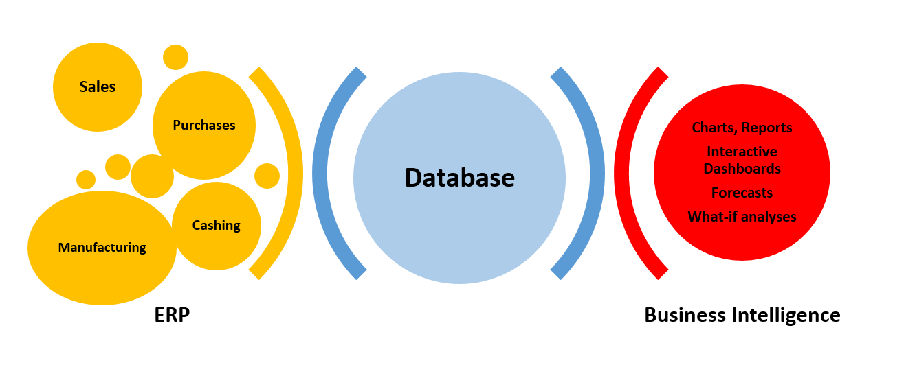
ERP – components – Business Intelligence
The BI component of ERP collects data and performs analysis that can provide actionable insights about business processes.*
The best BI ERP components deliver insights in reports.
A good reporting feature is very important in BI and enables you to make sense of the data being analyzed.*
Some reports come in the form of numbers and tables.*
*https://selecthub.com/enterprise-resource-planning/6-main-erp-components/
**https://www.seniorerp.ro/en/a-business-intelligence-solution-helps-you-discover-the-added-value-of-an-erp/

Slide 12
ERP – components – supply chain management
Effective demand forecasting and lean inventory*
An ERP solution in SCM improves the accuracy of demand forecasting and ensures that the cost of inventory is minimized in case of large-batch production process.
A lean inventory is essential to address just-in-time production method to reduce the cost of production and keep supply chain flexible.
Reduce production bottlenecks*
ERP for supply chain significantly reduces the bottlenecks between internal processes and external suppliers.
Modern solution helps in handling proper procurement and supply of the goods, services and other resources that are needed across the supply chain.
*https://www.deskera.com/erp-for-supply-chain-management/

Slide 13
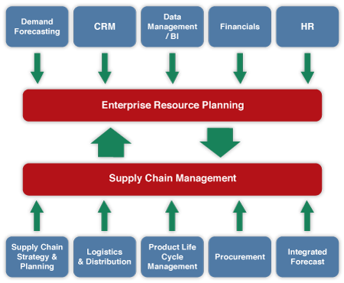
ERP – components – supply chain management
Transparency through the business
The consolidated view of the supply chain enables the business executive make more informed and balanced decisions with ERP for supply chain.
*https://www.deskera.com/erp-for-supply-chain-management/
**http://cmuscm.blogspot.com/2014/02/implementing-erp-for-supply-chain.html

Slide 14
ERP – components – inventory management system
A component of supply chain management, inventory management supervises the flow of goods from manufacturers to warehouses and from these facilities to point of sale.*
A key function of inventory management is to keep a detailed record of each new or returned product as it enters or leaves a warehouse or point of sale.*
ERP inventory management, short for enterprise resource planning inventory management, refers to an integrated approach to business planning and operations.**
With an ERP inventory management system, businesses can manage all their finances, logistics, operations, and inventory in one place.**
*https://www.tradegecko.com/inventory-management/what-is-erp-inventory-management
**https://searcherp.techtarget.com/definition/inventory-management

Slide 15
ERP – components – inventory management system
Typical features of an ERP inventory management system
Stock tracking and management;
Sales and purchase order management;
Multi-channel order fulfillment;
Warehouse management and stock transfers;
B2B eCommerce functionality;
Payment gateway functionality;
Integrations with eCommerce, accounting, shipping and other operational tools;
Intelligence reports and analytics.
* https://www.tradegecko.com/inventory-management/what-is-erp-inventory-management

Slide 16
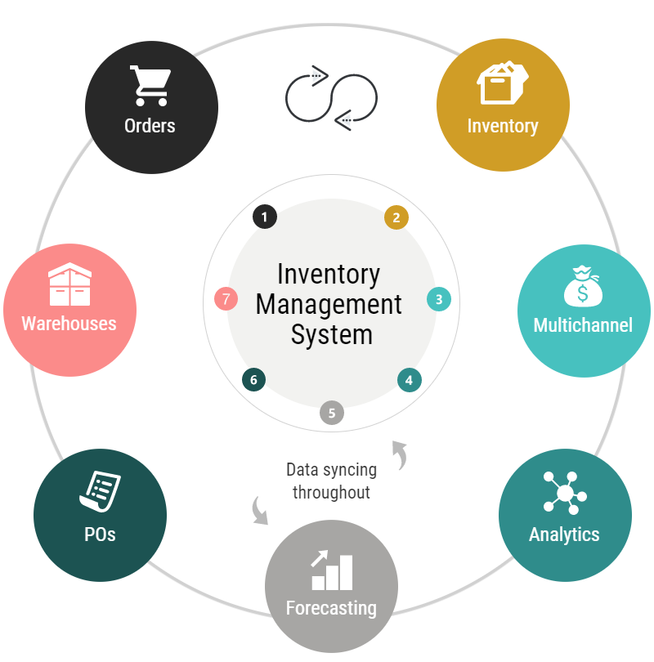
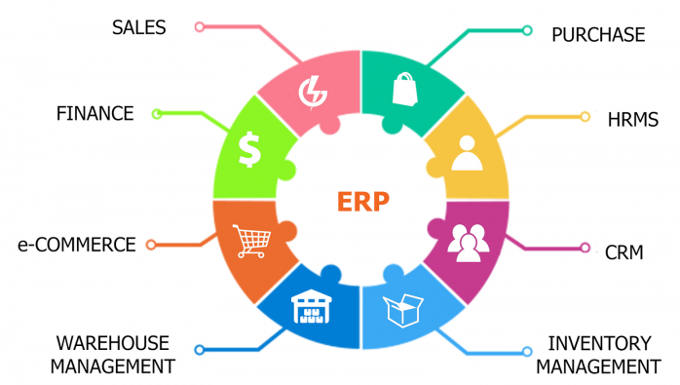
ERP – components – inventory management system
* https://www.shopify.com/enterprise/ecommerce-logistics-at-scale
** https://elogic.co/blog/how-to-implement-a-magento-erp-solution-for-ecommerce-without-spending-too-much-money-based-on-a-case-study/

Slide 17
ERP in e-business and e-commerce
https://hackernoon.com/top-10-erp-and-e-commerce-integration-providers-in-2019-69bacf1bb7d2
https://www.managementstudyguide.com/erp-and-ecommerce.htm
https://www.aphixsoftware.com/blog/ecommerce-erp-integration.html
https://blog.saleslayer.com/7-tips-ecommerce-erp-integration
https://www.erpsoftwareblog.com/2017/08/4-reasons-e-commerce-erp-made/
https://www.dckap.com/blog/ecommerce-erp-integration-a-quick-guide/

Slide 18
The end
Thank you for your attention!
Any questions?

