Slide 1
Management information systems
Enterprise application integration
Information system security
Petr Suchánek
Management information systems
DAMIA

Slide 2
Outline of the lecture
Enterprise application integration
Information systems security

Slide 3
Enterprise application integration (EAI)
An organization may use various information systems:*
Supply Chain Management: For managing suppliers, inventory and shipping, etc.
Human Resource Management: Ffor managing personnel, training and recruiting talents;
Employee Health Care: For managing medical records and insurance details of employees;
Customer Relationship Management: For managing current and potential customers;
Business Intelligence Applications: For finding the patterns from existing data from business operations.
* https://www.tutorialspoint.com/management_information_system/mis_tutorial.pdf

Slide 4
Enterprise application integration (EAI)
Integration - definition*
Integration is the act of bringing together smaller components into a single system that functions as one. In an IT context, integration refers to the end result of a process that aims to stitch together different, often disparate, subsystems so that the data contained in each becomes part of a larger, more comprehensive system that, ideally, quickly and easily shares data when needed. This often requires that companies build a customized architecture or structure of applications to combine new or existing hardware, software and other communications.*
*http://searchcrm.techtarget.com/definition/integration

Slide 5
Enterprise application integration (EAI)
All these systems work as individual islands of automation. Most often these systems are standalone and do not communicate with each other due to incompatibility issues such as:*
Operating systems they are residing on;
Database system used in the system;
Legacy systems not supported anymore.
EAI is an integration framework, a middleware, made of a collection of technologies and services that allows smooth integration of all such systems and applications throughout the enterprise and enables data sharing and more automation of business processes.*
* https://www.tutorialspoint.com/management_information_system/mis_tutorial.pdf

Slide 6
Enterprise application integration (EAI)
Characteristics of EAI*
EAI is defined as "the unrestricted sharing of data and business processes among any connected applications and data sources in the enterprise."
EAI, when used effectively allows integration without any major changes to current infrastructure.
Extends middleware capabilities to cope with application integration.
Uses application logic layers of different middleware systems as building blocks.
Keeps track of information related to the operations of the enterprise e.g. Inventory, sales ledger and execute the core processes that create and manipulate this information.
* https://www.tutorialspoint.com/management_information_system/mis_tutorial.pdf

Slide 7
Enterprise application integration (EAI)
Need for enterprice integration*
Unrestricted sharing of data and business processes across an organization.
Linkage between customers, suppliers and regulators.
The linking of data, business processes and applications to automate business processes.
Ensure consistent qualities of service (security, reliability etc.).
Reduce the on-going cost of maintenance and reduce the cost of rolling out new systems.
* https://www.tutorialspoint.com/management_information_system/mis_tutorial.pdf

Slide 8
Enterprise application integration (EAI)
Challenges of EAI*
Hub and spoke architecture concentrates all of the processing into a single server/cluster.
Often became hard to maintain and evolve efficiently.
Hard to extend to integrate 3rd parties on other technology platforms.
The canonical data model introduces an intermediary step.
Added complexity and additional processing effort.
EAI products typified.
Heavy customization required to implement the solution.
Lock-In: Often built using proprietary technology and required specialist skills.
Lack of flexibility: Hard to extend or to integrate with other EAI products!
Requires organization to be EAI ready.
* https://www.tutorialspoint.com/management_information_system/mis_tutorial.pdf

Slide 9
Enterprise application integration (EAI)
Types of EAI*
Data Level - Process, techniques and technology of moving data between data stores.
Application Interface Level - Leveraging of interfaces exposed by custom or packaged applications.
Method Level - Sharing of the business logic.
User Interface Level - Packaging applications by using their user interface as a common point of integration.
* https://www.tutorialspoint.com/management_information_system/mis_tutorial.pdf

Slide 10
Enterprise application integration (EAI)
Types of EAI*
Data integration:
If we want the above two integrations to succeed, we must also integrate the data involved. Its location must be identified, recorded, and a metadata model must be bulit (a master guide for various data stores). Now, data can be shared or distributed across database systems, providing it is in a standard format such as COM+/DCOM, CORBA, EDI, JavaRMI, and XML.**
Application integration:
Here, the goal is to “bring data or a function from one application together with that of another application that together provide near real-time integration.” This can include, business-to-business integration, customer relationship management (CRM) systems which can be integrated with a company's backend applications, web integration, and building web sites that interact with multiple business systems.**
*http://www0.cs.ucl.ac.uk/staff/ucacwxe/lectures/3C05-02-03/aswe21-essay.pdf
**EAI.ITtoolbox.com

Slide 11
Enterprise application integration (EAI)
Types of EAI*
Business Process Integration (BPI):
It is fundamentally important for a corporation to specify the processes involved in the exchange of enterprise information. “This allows organizations to streamline operations, reduce costs and improve responsiveness to customer demands.** ”This can include process management, process modelling, and workflow. Here, we involve the combination of tasks, procedures, organizations, required input and output information, and tools needed for each step in a business process.**
Platform Integration:
Finally, the separate needs of the heterogeneous network must be integrated. Platform Integration deals with the processes and tools that are required to allow these systems to communicate, both optimally and securely, so data can be passed through different applications without difficulty. For example, finding how an Apple can pass data to a wireless palmtop is part of the entire corporate system integration.**
*http://www0.cs.ucl.ac.uk/staff/ucacwxe/lectures/3C05-02-03/aswe21-essay.pdf
**Andre Yee, "Demystifying Business Process Integration." EaiQ

Slide 12
Enterprise application integration (EAI)
Intercommunication between enterprise applications (EA), such as customer relations management (CRM), supply chain management (SCM) and business intelligence is not automated. Thus, EAs do not share common data or business rules. EAI links EA applications to simplify and automate business processes without applying excessive application or data structure changes.*
However, EAI is challenged by different operating systems, database architectures and/or computer languages, as well as other situations where legacy systems are no longer supported by the original manufacturers.*
* https://www.techopedia.com/definition/1506/enterprise-application-integration-eai

Slide 13
Enterprise application integration (EAI)
EAI meets these challenges by fulfilling three purposes, as follows:*
Data Integration: Ensures consistent information across different systems.
Vendor Independence: Business policies or rules regarding specific business applications do not have to be re-implemented when replaced with different brand applications.
Common Facade: Users are not required to learn new or different applications because a consistent software application access interface is provided.
* https://www.techopedia.com/definition/1506/enterprise-application-integration-eai

Slide 14
Enterprise application integration (EAI)
Benefits of EAI*
Information Sharing
EAI enables the flow of information between separate software programs within a company, as well as from outside the company’s own computer systems. EAI can consolidate data collection efforts, eliminating the redundancies of having each application collect and store data for its own purposes. Integration also creates a single point of access to data for the people who need it. That means employees spend less time searching for information – and the data they get is often more complete and up to date. EAI also enables more effective collaboration between individual people and departments.
Process Automation
EAI can streamline processes that include data or activity from multiple software applications. For example, data from a CRM can be integrated with an e-mail marketing platform to deliver targeted messages to customers based on their prior behavior or demographics. That effort could then be coupled with an analytics package to measure the success of the email campaign. And all that data can be integrated with an ERP system to help the company invest resources where they’re most effective.
*https://www.singlemindconsulting.com/2013/01/25/top-4-enterprise-application-integration-benefits/

Slide 15
Enterprise application integration (EAI)
Benefits of EAI*
Reduced IT Complexity
Most enterprise-level companies find it difficult to use new technology effectively. The learning curve is often steep, and a new application may not work well with the systems already in place. Enterprise application integration overcomes these roadblocks to smooth business process by combining the information and functionality of several applications into a single, easy-to-use interface.
Increased Agility
One of the highest business benefits of enterprise application integration is that it allows organizations to recognize and respond to opportunities more quickly. EAI can help companies address shifts in the market, reputation management issues, supply chain disruptions and more – all from a single interface.
*https://www.singlemindconsulting.com/2013/01/25/top-4-enterprise-application-integration-benefits/

Slide 16
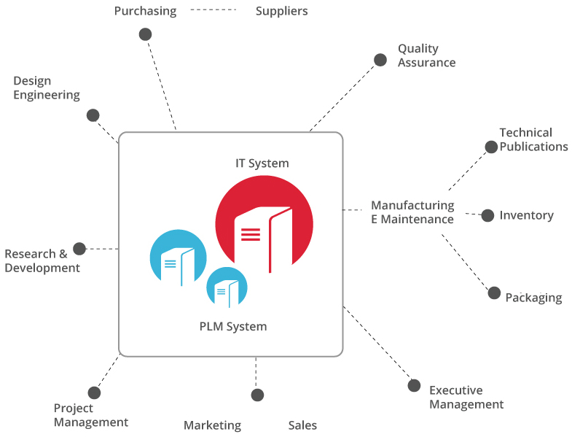
Enterprise application integration (EAI)
*http://www.sconce.com/what-we-do/plm-services/enterprise-application-integration/

Slide 17
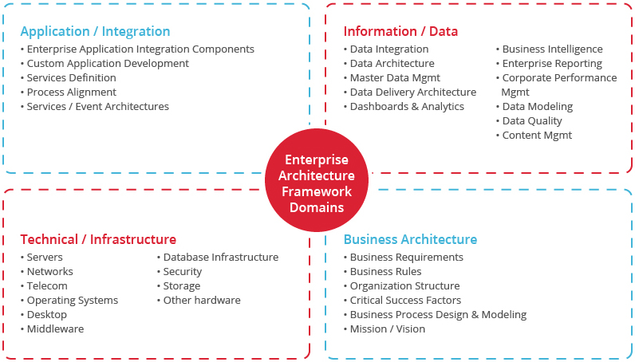
Enterprise application integration (EAI)
*http://www.sconce.com/what-we-do/plm-services/enterprise-application-integration/

Slide 18
Security of informaton systems
There are two major aspects of information system security:*
Security of the information technology used - securing the system from malicious cyber-attacks that tend to break into the system and to access critical private information or gain control of the internal systems.
Security of data - ensuring the integrity of data when critical issues arise such as natural disasters, computer/server malfunction, physical theft etc. Generally an off-site backup of data is kept for such problems.
* https://www.tutorialspoint.com/management_information_system/mis_tutorial.pdf

Slide 19
Informaton systems security
Guaranteeing effective information security has the following key aspects:*
Preventing the unauthorized individuals or systems from accessing the information.
Maintaining and assuring the accuracy and consistency of data over its entire life-cycle.
Ensuring that the computing systems, the security controls used to protect it and the communication channels used to access it, functioning correctly all the time, thus making information available in all situations.
Ensuring that the data, transactions, communications or documents are genuine.
Ensuring the integrity of a transaction by validating that both parties involved are genuine, by incorporating authentication features such as "digital signatures".
Ensuring that once a transaction takes place, none of the parties can deny it, either having received a transaction, or having sent a transaction. This is called 'non-repudiation'.
Safeguarding data and communications stored and shared in network systems.
* https://www.tutorialspoint.com/management_information_system/mis_tutorial.pdf

Slide 20
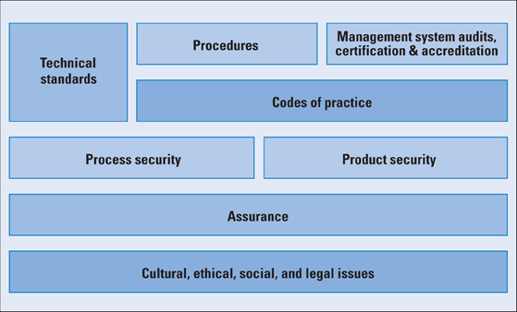
Informaton systems security
Information Security Management Elements*
*https://www.cisco.com/c/en/us/about/press/internet-protocol-journal/back-issues/table-contents-38/104-standards.html

Slide 21
Informaton systems security
ISO 17799 Areas and Objectives*
Security Policy
Provide management direction and support for information security in accordance with business requirements and relevant laws and regulations.
Organization of Information Security
Manage information security within the organization. Maintain the security of the organization's information and information processing facilities that are accessed, processed, communicated to, or managed by external parties.
Asset Management
Achieve and maintain appropriate protection of organizational assets. Ensure that information receives an appropriate level of protection.
*https://www.cisco.com/c/en/us/about/press/internet-protocol-journal/back-issues/table-contents-38/104-standards.html

Slide 22
Informaton systems security
ISO 17799 Areas and Objectives*
Human Resources Security
Ensure that employees, contractors, and third-party users:
understand their responsibilities and are suitable for the roles they are considered for;
are aware of information security threats and concerns;
exit an organization or change employment in an orderly manner.
Physical and Environmental Security
Prevent unauthorized physical access, damage, and interference to the organizations premises and information. Prevent loss, damage, theft, or compromise of assets and interruption to the organization's activities.
Communications and Operations Management
Develop controls for operational procedures, third-party service delivery management, system planning, malware protection, backup, network security management, media handling, information exchange, e-commerce services, and monitoring.
*https://www.cisco.com/c/en/us/about/press/internet-protocol-journal/back-issues/table-contents-38/104-standards.html

Slide 23
Informaton systems security
ISO 17799 Areas and Objectives*
Access Control
Develop controls for business requirements for user access, user responsibilities, network access control, OS access control, application access control, and information access control.
Information Systems Acquisition, Development, and Maintenance
Develop controls for correct processing in applications, cryptographic functions, system file security, support process security, and vulnerability management.
Information Security Incident Management
Ensure information security events and weaknesses associated with information systems are communicated in a manner that allows timely corrective action to be taken. Ensure a consistent and effective approach is applied to the management of information security incidents.
*https://www.cisco.com/c/en/us/about/press/internet-protocol-journal/back-issues/table-contents-38/104-standards.html

Slide 24
Informaton systems security
ISO 17799 Areas and Objectives*
Business Continuity Management
Counteract interruptions to business activities to protect critical business processes from the effects of major failures of information systems or disasters and to ensure their timely resumption.
Compliance
Avoid breaches of any law, statutory, regulatory, or contractual obligations, and of any security requirements. Ensure compliance of systems with organizational security policies and standards. Maximize the effectiveness of and minimize interference to and from the information systems audit process.
*https://www.cisco.com/c/en/us/about/press/internet-protocol-journal/back-issues/table-contents-38/104-standards.html

Slide 25
Compulsory and recommended references
LAUDON, K.C. and J.P LAUDON, 2015. Management Information Systems: Managing the Digital Firm (14th Edition). New York: Pearson Publishing. ISBN 978-0133898163.
https://www.techopedia.com/definition/1506/enterprise-application-integration-eai
http://www.informationbuilders.com/eai-enterprise-application-integration
http://study.com/directory/category/Computer_Sciences/Information_Technology_Management/Information_Systems_Security.html
https://ce.uci.edu/areas/it/systems_security/

