Slide 1
Management information systems
ERP an CRM & MIS
Petr Suchánek
Management information systems
DAMIA

Slide 2
Outline of the lecture
Enterprise resource planning (ERP)
Customer relationship management (CRM)

Slide 3
ERP and CRM & MIS
Enterprise resource planning (ERP)
Enterprise resource planning (ERP) is a process by which a company (often a manufacturer) manages and integrates the important parts of its business. An ERP management information system integrates areas such as planning, purchasing, inventory, sales, marketing, finance and human resources.*
ERP is most frequently used in the context of software. As the methodology has become more popular, large software applications have been developed to help companies implement ERP.*
ERP is an integrated, real-time, cross-functional enterprise application, an enterprise-wide transaction framework that supports all the internal business processes of a company.**
It supports all core business processes such as sales order processing, inventory management and control, production and distribution planning, and finance.**
*http://www.investopedia.com/terms/e/erp.asp
**https://www.tutorialspoint.com/management_information_system/mis_tutorial.pdf

Slide 4
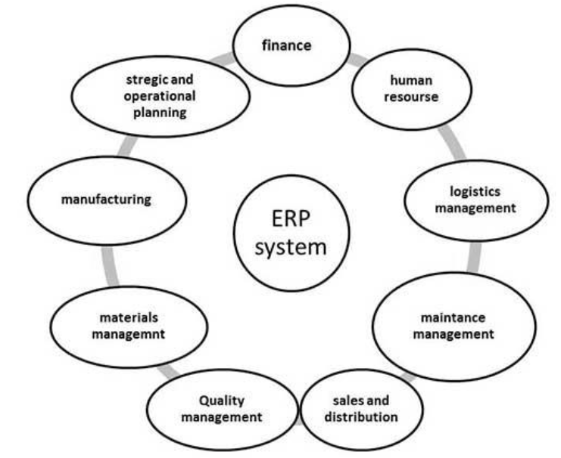
ERP and CRM & MIS
Enterprise resource planning (ERP)
*http://www.investopedia.com/terms/e/erp.asp
**https://www.tutorialspoint.com/management_information_system/mis_tutorial.pdf

Slide 5
ERP and CRM & MIS
Enterprise resource planning (ERP)
ERP is very helpful in the following areas:*
Business integration and automated data update;
Linkage between all core business processes and easy flow of integration;
Flexibility in business operations and more agility to the company;
Better analysis and planning capabilities;
Critical decision-making;
Competitive advantage;
Use of latest technologies.
*https://www.tutorialspoint.com/management_information_system/mis_tutorial.pdf

Slide 6
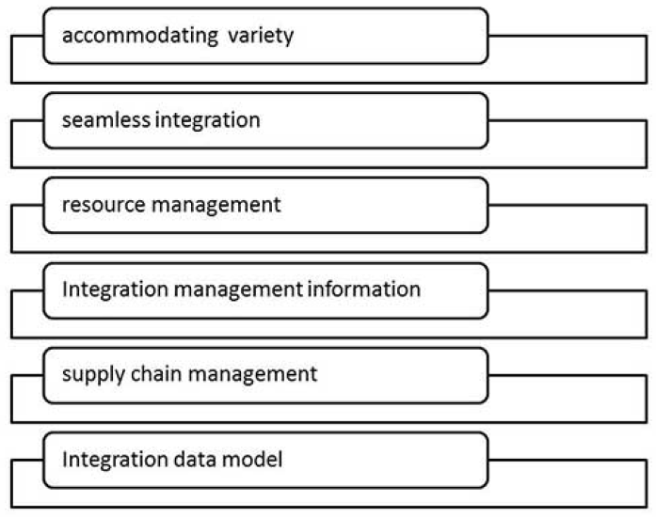
ERP and CRM & MIS
Enterprise resource planning (ERP)
Features of ERP*
*https://www.tutorialspoint.com/management_information_system/mis_tutorial.pdf

Slide 7
ERP and CRM & MIS
Enterprise resource planning (ERP)
Scope of ERP:*
Finance - Financial accounting, Managerial accounting, treasury management, asset management, budget control, costing, and enterprise control.
Logistics - Production planning, material management, plant maintenance, project management, events management, etc.
Human resource - Personnel management, training and development, etc.
Supply Chain - Inventory control, purchase and order control, supplier scheduling, planning, etc.
Work flow - Integrate the entire organization with the flexible assignment of tasks and responsibility to locations, position, jobs, etc.
*https://www.tutorialspoint.com/management_information_system/mis_tutorial.pdf

Slide 8
ERP and CRM & MIS
Enterprise resource planning (ERP)
Advantages of ERP:*
Reduction of lead time;
Reduction of cycle time;
Better customer satisfaction;
Increased flexibility, quality, and efficiency;
Improved information accuracy and decision making capability;
Onetime shipment;
Improved resource utilization;
Improve supplier performance;
Reduced quality costs;
Quick decision-making;
Forecasting and optimization;
Better transparency.
*https://www.tutorialspoint.com/management_information_system/mis_tutorial.pdf

Slide 9
ERP and CRM & MIS
Enterprise resource planning (ERP)
Disadvantages of ERP:*
Expense and time in implementation;
Difficulty in integration with other system;
Risk of implementation failure;
Difficulty in implementation change;
Risk in using one vendor.
*https://www.tutorialspoint.com/management_information_system/mis_tutorial.pdf

Slide 10
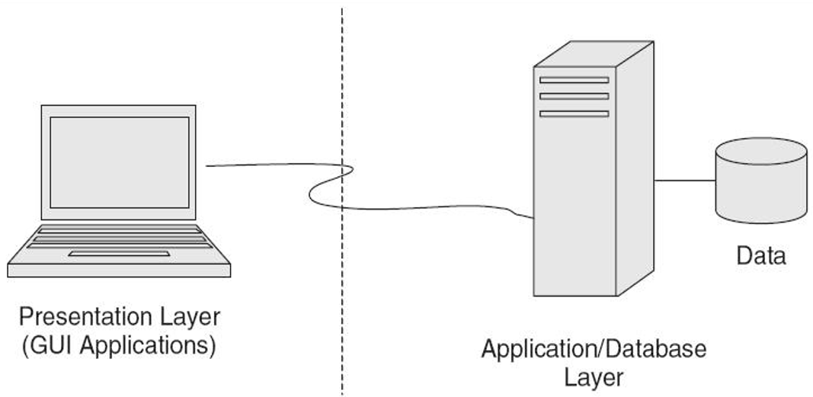
ERP and CRM & MIS
Enterprise resource planning (ERP)
Architecture Categories*
Two-tiers architecture;
Three-tiers architecture;
Service oriented architecture.
Two-tiers architecture
The server handles both application and database duties.
*faculty.ksu.edu.sa/ziani/ziani/IS450/ERP_Chapter_5.ppt

Slide 11
ERP and CRM & MIS
Enterprise resource planning (ERP)
Two-tiers architecture benefits*
Easy-to-use and access to information and services;
Low cost in terms of infrastructure requirements;
High performance with a limited number of workstations.
Two-tiers architecture drawbacks*
Inflexible in terms of adding more clients and software;
Requires expensive middleware for integration;
Changes or modifications in database affect applications;
Limited flexibility in moving program functionality from one server to another.
*faculty.ksu.edu.sa/ziani/ziani/IS450/ERP_Chapter_5.ppt

Slide 12
ERP and CRM & MIS
Enterprise resource planning (ERP)
Three-tiers architecture*
Data Tier (Data Management);
Business Tier (Business logic of functional modules);
Presentation Tier (End-User Interface—GUI).
*faculty.ksu.edu.sa/ziani/ziani/IS450/ERP_Chapter_5.ppt

Slide 13
ERP and CRM & MIS
Enterprise resource planning (ERP)
Three-tiers architecture benefits*
End-users have access to ERP applications over the Web.
Easily integrate ERP applications with existing systems.
Server-centric - No complex, expensive client software installation.
Client-centric - Architecture has better response time because user requests are mostly processed on the client’s computer.
Web-based architectures also allow better system-to-system integration.
Three-tiers architecture drawbacks*
Client-centric architectures lack security.
*faculty.ksu.edu.sa/ziani/ziani/IS450/ERP_Chapter_5.ppt

Slide 14
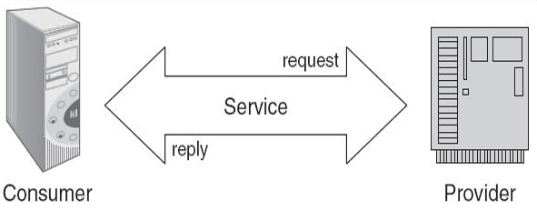
ERP and CRM & MIS
Enterprise resource planning (ERP)
Service oriented architecture (SOA)*
Also known as object-oriented architectures for Web platforms;
Breaks the business tier into smaller, distinct units of services, collectively supporting an ERP functional module;
Allows message interaction between any service consumer and service provider;
A consumer from a device using any operating system in any language can use this service.
*faculty.ksu.edu.sa/ziani/ziani/IS450/ERP_Chapter_5.ppt

Slide 15
ERP and CRM & MIS
Enterprise resource planning (ERP)
Benefits of SOA*
Enhances reliability of the architecture;
Reduces hardware acquisition costs;
Leverages existing development skills;
Accelerates movement to standards-based server and application consolidation;
Provides a data bridge between incompatible technologies.
*faculty.ksu.edu.sa/ziani/ziani/IS450/ERP_Chapter_5.ppt

Slide 16
ERP and CRM & MIS
Customer relationship management (CRM)
CRM is an enterprise application module that manages a company's interactions with current and future customers by organizing and coordinating, sales and marketing, and providing better customer services along with technical support.*
Customer relationship management (CRM) is a term that refers to practices, strategies and technologies that companies use to manage and analyze customer interactions and data throughout the customer lifecycle, with the goal of improving business relationships with customers, assisting in customer retention and driving sales growth. CRM systems are designed to compile information on customers across different channels -- or points of contact between the customer and the company -- which could include the company's website, telephone, live chat, direct mail, marketing materials and social media. CRM systems can also give customer-facing staff detailed information on customers' personal information, purchase history, buying preferences and concerns.**
*https://www.tutorialspoint.com/management_information_system/mis_tutorial.pdf
**http://searchcrm.techtarget.com/definition/CRM

Slide 17
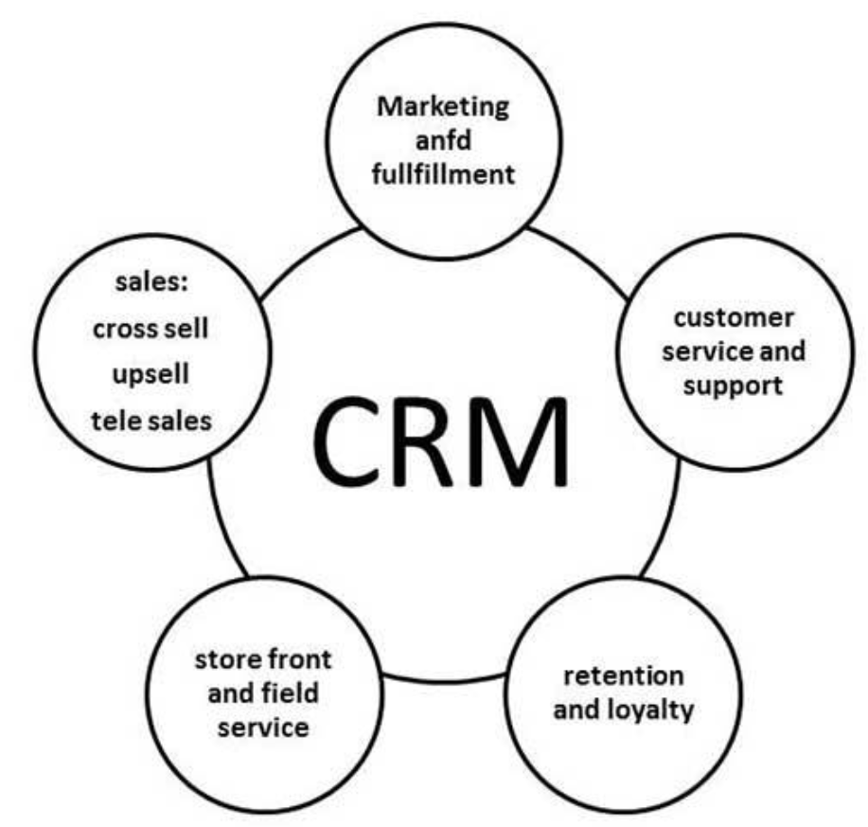
ERP and CRM & MIS
Customer relationship management (CRM)
*https://www.tutorialspoint.com/management_information_system/mis_tutorial.pdf

Slide 18
ERP and CRM & MIS
Customer relationship management (CRM)
Advantages of CRM*
Provides better customer service and increases customer revenues;
Discovers new customers;
Cross-sells and up-sells products more effectively;
Helps sales staff to close deals faster;
Makes call centers more efficient;
Simplifies marketing and sales processes.
Disadvantages of CRM
Sometimes record loss is a major problem;
Overhead costs;
Giving training to employees is an issue in small organizations.
*https://www.tutorialspoint.com/management_information_system/mis_tutorial.pdf

Slide 19
ERP and CRM & MIS
Customer relationship management (CRM)
CRM system architecture can be broken down into 3 broad categories:*
Collaborative
Operational
Analytical
Collaborative CRM
All communications between a business and its customers are recorded, organised and processed in the collaborative section of the software. This means communication by telephone, in person, and by email.
Customer relationships can be nurtured using data already provided by them which demonstrates their shopping patterns and behaviours, likes and dislikes, the times they are most likely to buy, and how much they spend on average.
Businesses use this information to provide enhanced customer service, cross-sell products based on previous buying history, and offer targeted deals to segments of their customer base. Customers can be segmented by various criteria including geographical location, age, gender, and profession, and can be targeted via personalised emails or newsletters offering discounts and deals.
*http://crmsystems.expertmarket.co.uk/crm-system-architecture

Slide 20
ERP and CRM & MIS
Customer relationship management (CRM)
Operational CRM*
This category within a CRM system deals with the automation of business processes including customer service, data on competitors, industry trends, customer account information and management.
Data is collected and stored within the database, ready for use in day-to-day operations such as management of customer accounts, in addition to overall strategic planning. Detailed information about special customer needs, destined for the sales force, is also stored here. Use of this type of data further enables a business to personalise its approach to customers.
*http://crmsystems.expertmarket.co.uk/crm-system-architecture

Slide 21
ERP and CRM & MIS
Customer relationship management (CRM)
Analytical CRM*
Analytical CRM might result in cross-selling certain items to particular customers based on their previous buying habits, or imparting information relevant only to certain segments of a customer base.
This part of the CRM architecture is also invaluable for identifying changes in the industry as a whole, so that businesses remain agile and respond quickly to changing market demands. Data can be analysed in a number of ways, and graphs, reports and diagrams produced to better illustrate the results.
This is the basic architecture of a customer relationship management system, but the rise of social media and mobile working has brought other, more defined systems to the market. Popular ‘add-ons’ to the basic structure of a CRM solution might include cloud based systems that are accessible from any device.
The key word in CRM is integration – integration of data so that it can be put to use in a way that benefits not only the business, but also customers, suppliers and the workforce. Using mobile technology and social media was the obvious next step in this process, and targets a whole new potential customer base.
*http://crmsystems.expertmarket.co.uk/crm-system-architecture

Slide 22
ERP and CRM & MIS
Customer relationship management (CRM)
CRM can be broken down into a number of different components which many software vendors have developed packages for. For the most part, there are three areas which are core to successful customer relationship management:*
Customer Service
Sales Force Automation
Campaign Management
Customer service*
The customer service function in your company represents the front office functions that interact with your customers. These are the business processes that allow your company to sell products and services to your customers, communicate with your customers with regards marketing and dealing with the after sales service requirements of your customers. Each interaction with the customer is recorded and stored within the CRM software where it can be retrieved by other employees if needed.
*http://www.itinfo.am/eng/customer-relationship-management/

Slide 23
ERP and CRM & MIS
Customer relationship management (CRM)
Sales Force Automation*
Your company’s sales department is constantly looking for sales opportunities with existing and new customers. The sales force automation functionality of CRM software allows the sales teams to record each contact with customers, the details of the contact and if follow up is required. This can provide a sales force with greater efficiencies as there is little chance for duplication of effort. The ability for employees outside of the sales team to have access to this data ensures that they have the most recent contact information with customers. This is important when customers contact employees outside of the sales team so that customers are given the best level of customer service.
Campaign Management*
The sales team approach prospective customers in the hope of winning new business. The approach taken by the sales team is often focused in a campaign, where a group of specific customers are targeted based on a set of criteria. These customers will receive targeted marketing materials and often special pricing or terms are offered as an inducement. CRM software is used to record the campaign details, customer responses and analysis performed as part of the campaign.
*http://www.itinfo.am/eng/customer-relationship-management/

Slide 24
ERP and CRM & MIS
Customer relationship management (CRM)
Below are listed the following building blocks for successful CRM projects:*
Vision
The board must take leadership in creating a CRM vision for the enterprise. The CRM vision should be used as the guide to the creation of a CRM strategy.
Strategy
The CRM strategy is all about how to build and develop a valuable asset: the customer base. It must set objectives and metrics for attaining that goal. It directs the objectives of other operational strategies and the CRM implementation strategy.
Customer experience
The customer experience must be designed in line with the CRM vision and must be constantly refined, based on actively sought customer feedback.
Organizational collaboration
Changes to organizational structures, processes, metrics, incentives, skills, and even the enterprise culture must be made to deliver the required external customer experience. Ongoing change management will be key.
*http://www.itinfo.am/eng/customer-relationship-management/

Slide 25
ERP and CRM & MIS
Customer relationship management (CRM)*
Process
Successful customer process reengineering should create processes that not only meet customers' expectations and support the customer value proposal, but also provide competitive differentiation and contribute to a designed customer experience.
Information
Successful CRM demands the creation of a customer-information blood supply that flows around the organization, as well as tight integration between operational and analytical systems.
Technology
CRM technologies form a fundamental part of any enterprise's application portfolio and architecture. CRM application needs should be considered as the provision of integrated functionality that supports seamless customer-centric processes across all areas of the enterprise and its partners.
Metrics
Enterprises must set measurable CRM objectives and monitor all levels of CRM indicators to turn customers into assets. Without performance management ,a CRM implementation will fail.
*http://www.itinfo.am/eng/customer-relationship-management/

Slide 26
ERP and CRM & MIS
Customer relationship management (CRM)
The keys to successful CRM implantation are the followings:*
Develop your customer-focused strategy first before considering what kind of technology you need.
Break your CRM project down into manageable pieces by setting up pilot programs and short-term milestones. Start with a pilot project that incorporates all the necessary departments but is small enough and flexible enough to allow tinkering along the way.
Make sure your CRM plans include a scalable architecture framework. Think carefully about what is best for your enterprise: a solution that ties together “best of breed” software from several vendors via Web Services or an integrated package of software from one vendor.
Don't underestimate how much data you might collect (there will be LOTS) and make sure that if you need to expand systems you'll be able to.
Be thoughtful about what data is collected and stored. The impulse will be to grab and then store EVERY piece of data you can, but there is often no reason to store data. Storing useless data wastes time and money.
*http://www.itinfo.am/eng/customer-relationship-management/

Slide 27
ERP and CRM & MIS
Customer relationship management (CRM)
Several CRM software packages exist that can help companies in deploying CRM activities. Besides choosing one of these packages, companies can also choose to design and build their own solutions. In order to implement CRM in an effective way, one needs to consider the following factors:*
Create a customer-based culture in the organization.
Adopt customer-based managers to assess satisfaction.
Develop an end-to-end process to serve customers.
Recommend questions to be asked to help a customer solve a problem.
Track all aspects of selling to customers, as well as prospects.
Furthermore, CRM solutions are more effective once they are being implemented in other information systems used by the company. Examples are Transaction Processing System (TPS) to process data real-time, which can then be sent to the sales and finance departments in order to recalculate inventory and financial position quick and accurately. Once this information is transferred back to the CRM software and services it could prevent customers from placing an order in the belief that an item is in stock while it is not.
*http://www.itinfo.am/eng/customer-relationship-management/

Slide 28
ERP and CRM & MIS
E-Customer relationship management (e-CRM)
Electronic customer relationship management (E-CRM) is the application of Internet-based technologies such as emails, websites, chat rooms, forums and other channels to achieve CRM objectives. It is a well-structured and coordinated process of CRM that automates the processes in marketing, sales and customer service.*
An effective E-CRM increases the efficiency of the processes as well as improves the interactions with customers and enables businesses to customize products and services that meet the customers’ individual needs.*
*https://www.techopedia.com/definition/30914/electronic-customer-relationship-management-e-crm

Slide 29
ERP and CRM & MIS
Difference between CRM and e-CRM*
Customer contacts
CRM – Contact with customer made through the retail store, phone, and fax.
eCRM – All of the traditional methods are used in addition to Internet, email, wireless, and PDA technologies.
System interface
CRM – Implements the use of ERPsystems, emphasis is on the back-end.
eCRM – Geared more toward front end, which interacts with the back-end through use of ERP systems, data warehouses, and data marts.
System overhead (client computers)
CRM – The client must download various applications to view the web-enabled applications. They would have to be rewritten for different platform.
eCRM – Does not have these requirements because the client uses the browser.
*https://www.linkedin.com/pulse/differences-between-crm-e-crm-kassem-hashem

Slide 30
ERP and CRM & MIS
Difference between CRM and e-CRM*
Customization and personalization of information
CRM – Views differ based on the audience, and personalized views are not available. Individual personalization requires program changes.
eCRM – Personalized individual views based on purchase history and preferences. Individual has ability to customize view.
System focus
CRM – System (created for internal use) designed based on job function and products. Web applications designed for a single department or business unit.
eCRM – System (created for external use) designed based on customer needs. Web application designed for enterprise-wide use.
System maintenance and modification
CRM – More time involved in implementation and maintenance is more expensive because the system exists at different locations and on various servers.
eCRM – Reduction in time and cost. Implementation and maintenance can take place at one location and on one server.
*https://www.linkedin.com/pulse/differences-between-crm-e-crm-kassem-hashem

Slide 31
ERP and CRM & MIS
Difference between CRM and e-CRM*
In defining the scope of eCRM, three different levels can be distinguished:
Foundational services
This includes the minimum necessary services such as web site effectiveness and responsiveness as well as order fulfillment.
Customer-centered services
These services include order tracking, product configuration and customization as well as security/trust.
Value-added services
These are extra services such as online auctions and online training and education.
*http://www.itinfo.am/eng/customer-relationship-management/

Slide 32
ERP and CRM & MIS
Difference between CRM and e-CRM*
Self-services are becoming increasingly important in CRM activities. The rise of the Internet and eCRM has boosted the options for self-service activities. A critical success factor is the integration of such activities into traditional channels. CRM activities are mainly of two different types:
Reactive service is where the customer has a problem and contacts the company.
Proactive service is where the manager has decided not to wait for the customer to contact the firm, but to be aggressive and contact the customer himself in order to establish a dialogue and solve problems.
*http://www.itinfo.am/eng/customer-relationship-management/

Slide 33
Compulsory and recommended references
LAUDON, K.C. and J.P LAUDON, 2015. Management Information Systems: Managing the Digital Firm (14th Edition). New York: Pearson Publishing. ISBN 978-0133898163.
http://www.differencebetween.com/difference-between-erp-and-vs-mis/
http://www.netsuite.com/portal/resource/articles/erp/what-is-erp.shtml
http://searcherp.techtarget.com/definition/ERP-enterprise-resource-planning
https://www.slideshare.net/anniyappa/crm-with-mis
https://www.quora.com/How-are-CRM-customer-relationship-management-and-MIS-management-in-information-systems-related-to-each-other
http://www.gartner.com/it-glossary/e-crm-electronic-customer-relationship-management
http://www.businessmanagementideas.com/crm/e-crm/e-crm-meaning-evolution-and-benefits/3688

