Slide 1
Management information systems
MIS development
Petr Suchánek
Management information systems
DAMIA

Slide 2
Outline of the lecture
System development life cycle
MIS development process

Slide 3
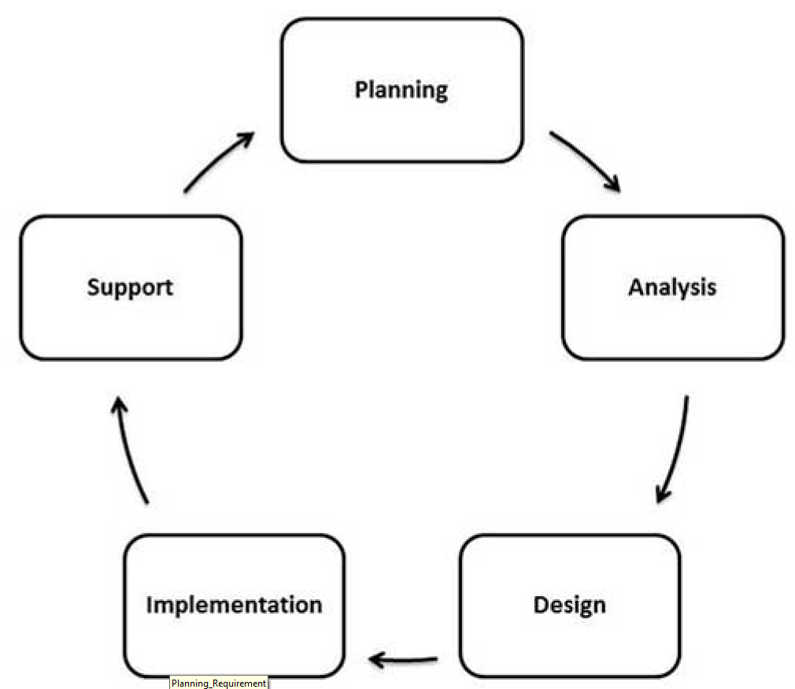
System development life cycle
Like any other product development, system development requires careful analysis and design before implementation. System development generally has the following phases:*
*https://www.tutorialspoint.com/management_information_system/mis_tutorial.pdf

Slide 4
System development life cycle*
Analysis Planning and Requirement
The project planning part involves the following steps:
Reviewing various project requests;
Prioritizing the project requests;
Allocating the resources;
Identifying the project development team.
*https://www.tutorialspoint.com/management_information_system/mis_tutorial.pdf

Slide 5
System development life cycle*
The techniques used in information system planning are:
Critical Success Factor
Business System Planning
End/Mean Analysis
The requirement analysis part involves understanding the goals, processes, and the constraints of the system for which the information system is being designed.
*https://www.tutorialspoint.com/management_information_system/mis_tutorial.pdf

Slide 6
System development life cycle*
It is basically an iterative process involving systematic investigation of the processes and requirements. The analyst creates a blueprint of the entire system in minute details, using various diagramming techniques like:
Data flow diagrams
Context diagrams
Requirement analysis has the following sub-processes:
Conducting preliminary investigation
Performing detailed analysis activities
Studying current system
Determining user requirements
Recommending a solution
*https://www.tutorialspoint.com/management_information_system/mis_tutorial.pdf

Slide 7
System development life cycle*
Defining requirements
The requirement analysis stage generally completes by creation of a 'Feasibility Report'. This report contains:
A preamble
A goal statement
A brief description of the present system
Proposed alternatives in details
The feasibility report and the proposed alternatives help in preparing the costs and benefits study.
Based on the costs and benefits, and considering all problems that may be encountered due to human, organizational or technological bottlenecks, the best alternative is chosen by the end-users of the system.
*https://www.tutorialspoint.com/management_information_system/mis_tutorial.pdf

Slide 8
System development life cycle*
Designing System
System design specifies how the system will accomplish this objective. System design consists of both logical design and physical design activity, which produces 'system specification' satisfying system requirements developed in the system analysis stage.
In this stage, the following documents are prepared:
Detailed specification
Hardware/software plan
*https://www.tutorialspoint.com/management_information_system/mis_tutorial.pdf

Slide 9
System development life cycle*
Building or developing the system
The most creative and challenging phase of the system life cycle is system design, which refers to the technical specifications that will be applied in implementing the candidate system. It also includes the construction of programmers and program testing.
It has the following stages:
Acquiring hardware and software, if necessary;
Database design;
Developing system processes;
Coding and testing each module.
*https://www.tutorialspoint.com/management_information_system/mis_tutorial.pdf

Slide 10
System development life cycle*
Building or developing the system
The final report prior to implementation phase includes procedural flowcharts, record layout, report layout and plan for implementing the candidate system. Information on personnel, money, hardware, facility and their estimated cost must also be available. At this point projected cost must be close to actual cost of implementation.
*https://www.tutorialspoint.com/management_information_system/mis_tutorial.pdf

Slide 11
System development life cycle*
Testing the system
System testing requires a test plan that consists of several key activities and steps for programs, strings, system, and user acceptance testing. The system performance criteria deals with turnaround time, backup, file protection and the human factors.
Testing process focuses on both:
The internal logic of the system/software, ensuring that all statements have been tested;
The external functions, by conducting tests to find errors and ensuring that the defined input will actually produce the required results.
*https://www.tutorialspoint.com/management_information_system/mis_tutorial.pdf

Slide 12
System development life cycle*
Testing the system
In some cases, a 'parallel run' of the new system is performed, where both the current and the proposed system are run in parallel for a specified time period and the current system is used to validate the proposed system.
*https://www.tutorialspoint.com/management_information_system/mis_tutorial.pdf

Slide 13
System development life cycle*
Deployment of the system
At this stage, system is put into production to be used by the end users. Sometime, we put system into a Beta stage where users’ feedback is received and based on the feedback, the system is corrected or improved before a final release or official release of the system.
System Evaluation and Maintenance
Maintenance is necessary to eliminate the errors in the working system during its working life and to tune the system to any variation in its working environment. Often small system deficiencies are found, as system is brought into operation and changes are made to remove them. System planner must always plan for resources availability to carry on these maintenance functions.
*https://www.tutorialspoint.com/management_information_system/mis_tutorial.pdf

Slide 14
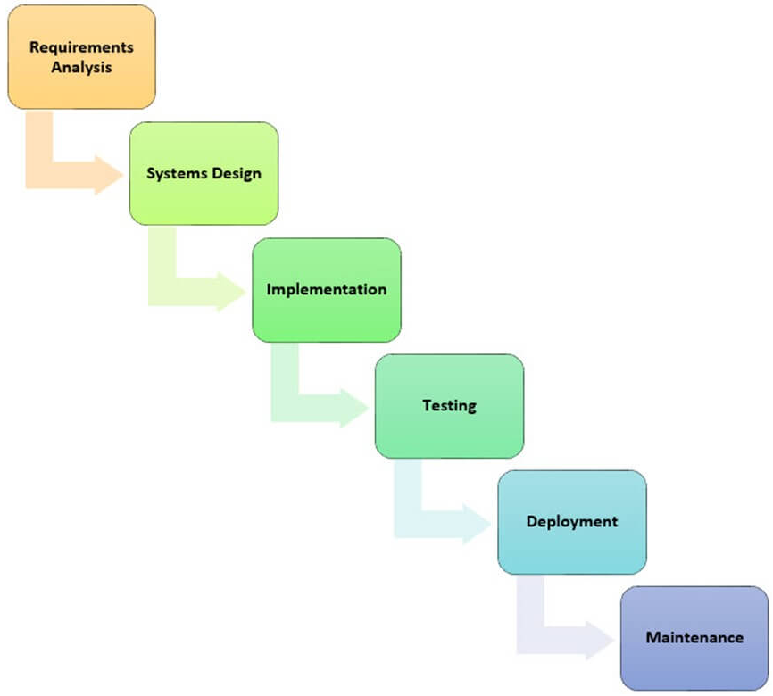
System development life cycle
Watterfall model
The waterfall model uses a sequential design model. The next stage starts only after the completion of the previous stage. The first stage is usually drawn on the top and the subsequent stages below and to the left bottom. This forms a waterfall like structure, and it's where the name came from.*
*https://www.guru99.com/mis-development-process.html

Slide 15
System development life cycle*
Watterfall model
The main objective of the waterfall model is
Planning;
Time scheduling;
Budgeting and;
Implementing an entire system at once.
The waterfall model is ideal when the user requirements are clearly understood and are not expected to change radically during the development of the information system. The waterfall model is ideal in situations where a project has a fixed-scope, fixed time frame, and fixed price.
The biggest challenge of the waterfall model is adoption to change. It is not easy to incorporate new user requirements.
*https://www.guru99.com/mis-development-process.html

Slide 16
System development life cycle*
Agile development
Agile development is an alternative methodology to traditional project management which promotes adaptive planning, evolutionary development, early delivery, continuous improvement, and encourages rapid and flexible response to change.
A sprint in agile terms is a well-defined task to be accomplished within a given time. Sprint goals and durations are set by the customers and development team. All stakeholders must meet in person to get the feedback on the sprint before they can move on to the next sprint if any.
*https://www.guru99.com/mis-development-process.html

Slide 17
System development life cycle*
Agile development
Agile methodologies usually follow the agile manifesto. The agile manifesto is based on the following twelve (12) principles
Customer satisfaction through early and continues delivery of software.
Welcoming changes in requirements any time of the project.
Frequent releases of working software usually on a weekly basis.
Collaboration between business people and developers when working on a project.
Projects built around motivated and trusted individuals.
Efficient and effective Face-to-face meetings.
Progress is measured based on working software.
Sustainable development, sponsors, users, and developers should be able to maintain a constant pace indefinitely.
Continuous attention to technical excellence and good design enhances agility.
Simplicity.
Self-organizing teams.
At regular intervals, the team reflects on how to become more effective, then tunes and adjusts its behavior accordingly.
*https://www.guru99.com/mis-development-process.html

Slide 18
System development life cycle*
Agile development
*https://www.guru99.com/mis-development-process.html

Slide 19
System development life cycle*
Prototyping
A prototype is a semi-functional simulation model of the actual system to be developed. Prototyping development methodologies make use of prototypes. Prototypes allow both developers and users to get feedback early.
Prototyping makes it easy for users to specify their requirements and developers understanding the requirements of the users because of the prototypes. A prototyping methodology stands with identifying the basics system requirements especially the input and output from the system. These requirements are then used to create a simulation model that users can interact with and provide feedback. The user feedback is used to enhance the prototype and make other important decisions such as project costing and feasible time schedules.
*https://www.guru99.com/mis-development-process.html

Slide 20
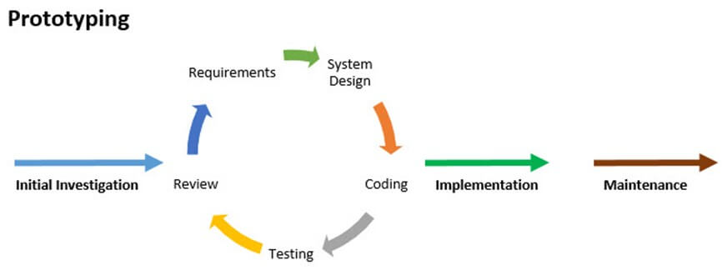
System development life cycle*
*https://www.guru99.com/mis-development-process.html

Slide 21
MIS development process*
Deployment of the system
In MIS, the information is recognized as a major resource like capital and time. If this resource has to be managed well, it calls upon the management to plan for it and control it, so that the information becomes a vital resource for the system.
The management information system needs good planning.
This system should deal with the management information not with data processing alone.
It should provide support for the management planning, decision-making and action.
It should provide support to the changing needs of business management.
*https://www.tutorialspoint.com/management_information_system/mis_tutorial.pdf

Slide 22
MIS development process*
Major challenges in MIS implementation are:
Quantity, content and context of information - how much information and exactly what should it describe.
Nature of analysis and presentation - comprehensibility of information.
Availability of information - frequency, contemporariness, on-demand or routine, periodic or occasional, one-time info or repetitive in nature and so on
Accuracy of information.
Reliability of information.
Security and Authentication of the system.
*https://www.tutorialspoint.com/management_information_system/mis_tutorial.pdf

Slide 23
MIS development process*
Planning for MIS
MIS design and development process has to address the following issues successfully:
There should be effective communication between the developers and users of the system.
There should be synchronization in understanding of management, processes and IT among the users as well as the developers.
Understanding of the information needs of managers from different functional areas and combining these needs into a single integrated system.
Creating a unified MIS covering the entire organization will lead to a more economical, faster and more integrated system, however it will increase in design complexity manifold.
*https://www.tutorialspoint.com/management_information_system/mis_tutorial.pdf

Slide 24
MIS development process*
Planning for MIS
MIS design and development process has to address the following issues successfully:
The MIS has to be interacting with the complex environment comprising all other sub-systems in the overall information system of the organization. So, it is extremely necessary to understand and define the requirements of MIS in the context of the organization.
It should keep pace with changes in environment, changing demands of the customers and growing competition.
It should utilize fast developing in IT capabilities in the best possible ways.
Cost and time of installing such advanced IT-based systems is high, so there should not be a need for frequent and major modifications.
It should take care of not only the users i.e., the managers but also other stakeholders like employees, customers and suppliers.
*https://www.tutorialspoint.com/management_information_system/mis_tutorial.pdf

Slide 25
MIS development process*
Once the organizational planning stage is over, the designer of the system should take the following strategic decisions for the achievement of MIS goals and objectives:
Development Strategy: Example - an online, real-time batch.
System Development Strategy: Designer selects an approach to system development like operational verses functional, accounting verses analysis.
Resources for the Development: Designer has to select resources. Resources can be in-house verses external, customized or use of package.
Manpower Composition: The staffs should have analysts, and programmers.
*https://www.tutorialspoint.com/management_information_system/mis_tutorial.pdf

Slide 26
MIS development process*
Information system planning essentially involves:
Identification of the stage of information system in the organization.
Identification of the application of organizational IS.
Evolution of each of this application based on the established evolution criteria.
Establishing a priority ranking for these applications.
Determining the optimum architecture of IS for serving the top priority applications.
*https://www.tutorialspoint.com/management_information_system/mis_tutorial.pdf

Slide 27
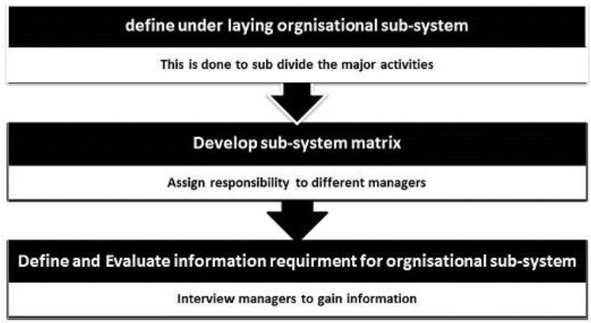
MIS development process*
Information system requirements
The following diagram illustrates a brief sketch of the process of information requirement analysis:
*https://www.tutorialspoint.com/management_information_system/mis_tutorial.pdf

Slide 28
MIS development process*
The following three methodologies can be adopted to determine the requirements in developing a management information system for any organization:
Business Systems Planning (BSP) - this methodology is developed by IBM.
It identifies the IS priorities of the organization and focuses on the way data is maintained in the system.
It uses data architecture supporting multiple applications.
It defines data classes using different matrices to establish relationships among the organization, its processes and data requirements.
*https://www.tutorialspoint.com/management_information_system/mis_tutorial.pdf

Slide 29
MIS development process*
Critical Success Factor (CSF) - this methodology is developed by John Rockart of MIT.
It identifies the key business goals and strategies of each manager as well as that of the business.
Next, it looks for the critical success factors underlying these goals.
Measure of CSF effectiveness becomes an input for defining the information system requirements.
End/Means (E/M) analysis - this methodology is developed by Wetherbe and Davis at the University of Minnesota.
It determines the effectiveness criteria for outputs and efficiency criteria for the processes generating the outputs.
At first it identifies the outputs or services provided by the business processes.
Then it describes the factors that make these outputs effective for the user.
Finally it selects the information needed to evaluate the effectiveness of outputs.
*https://www.tutorialspoint.com/management_information_system/mis_tutorial.pdf

Slide 30
MIS development process*
Information system analysis and design
System analysis and design follows the typical System/Software Design Life Cycle (SDLC) as discussed in the previous chapter. It generally passes through the following phases:
Problem Definition;
Feasibility Study;
Systems Analysis;
System Design;
Detailed System Design;
Implementation;
Maintenance.
*https://www.tutorialspoint.com/management_information_system/mis_tutorial.pdf

Slide 31
MIS development process*
Information system analysis and design
In the analysis phase, the following techniques are commonly used:
Data flow diagrams (DFD);
Logic Modeling;
Data Modeling;
Rapid Application Development (RAD);
Object Oriented Analysis (OOA).
*https://www.tutorialspoint.com/management_information_system/mis_tutorial.pdf

Slide 32
MIS development process*
Technology for Information system
The technology requirement for an information system can be categorized as:
Devices
Data center systems - It is the environment that provides processing, storage, networking, management and the distribution of data within an enterprise.
Enterprise software - These are software system like ERP, SCM, Human Resource Management, etc. that fulfill the needs and objectives of the organizations.
IT services - It refers to the implementation and management of quality IT services by IT service providers through people, process and information technology. It often includes various process improvement frameworks and methodologies like six sigma, TQM, and so on.
Telecom services
*https://www.tutorialspoint.com/management_information_system/mis_tutorial.pdf

Slide 33
MIS development process*
System test planning and Execution
The system should be fully tested for errors before being fully operational.
The test plan should include for each test:
purpose;
definition;
test inputs;
detailed specification of test procedure;
details of expected outputs.
Each sub-system and all their components should be tested using various test procedures and data to ensure that each component is working as it is intended.
The testing must include the users of the system to identify errors as well as get the feedback.
*https://www.tutorialspoint.com/management_information_system/mis_tutorial.pdf

Slide 34
MIS development process*
System operation
Before the system is in operation, the following issues should be taken care of:
Data security, backup and recovery;
Systems control;
Testing of the system to ensure that it works bug-free in all expected business situations;
The hardware and software used should be able to deliver the expected processing;
The system capacity and expected response time should be maintained;
The system should be well documented including:
A user guide for inexperienced users,
A user reference or operations manual for advanced users,
A system reference manual describing system structures and architecture.
*https://www.tutorialspoint.com/management_information_system/mis_tutorial.pdf

Slide 35
MIS development process*
Factore for success and failure
MIS development projects are high-risk, high-return projects. Following could be stated as critical factors for success and failure in MIS development:
It should cater to a specific, well-perceived business.
The top management should be completely convinced, able and willing to such a system. Ideally there should be a patron or a sponsor for the system in the top management.
All users including managers and other employees should be made an integral part of the development, implementation, and use of the system.
There should be an operational prototype of the system released as soon as possible, to create interest among the users.
There should be good support staff with necessary technical, business, and interpersonal skills.
*https://www.tutorialspoint.com/management_information_system/mis_tutorial.pdf

Slide 36
MIS development process*
Factore for success and failure
MIS development projects are high-risk, high-return projects. Following could be stated as critical factors for success and failure in MIS development:
The system should be simple, easy to understand without adding much complexity. It is a best practice, not to add up an entity unless there is both a use and user for it.
It should be easy to use and navigate with high response time.
The implementation process should follow a definite goal and time.
All the users including the top management should be given proper training, so that they have a good knowledge of the content and function of the system, and can use it fully for various managerial activities such as reporting, budgeting, controlling, planning, monitoring, etc.
It must produce useful outputs to be used by all managers.
The system should be well integrated into the management processes of planning, decision-making, and monitoring.
*https://www.tutorialspoint.com/management_information_system/mis_tutorial.pdf

Slide 37
Compulsory and recommended references
LAUDON, K.C. and J.P LAUDON, 2015. Management Information Systems: Managing the Digital Firm (14th Edition). New York: Pearson Publishing. ISBN 978-0133898163.
https://www.slideshare.net/georgepdr/system-development-life-cycle-implementation-of-mis
http://www.yourarticlelibrary.com/management/mis-management/top-11-stages-in-system-development-life-cycle-mis/70394/
http://ecomputernotes.com/mis/system-development-approaches/systemsdevelopmentlifecycle
https://www.slideshare.net/hirenselani5/development-process-of-mis-18708463
https://gtumis.files.wordpress.com/2014/04/chapter-9.pdf
https://www.guru99.com/mis-development-process.html

