Slide 1
Management information systems
MIS selected software
Petr Suchánek
Management information systems
Subject code

Slide 2
Outline of the lecture
MIS selected software

Slide 3
MIS selected software
Dynamics NAV
Microsoft Dynamics NAV is a versatile and robust Enterprise Resource Planning (ERP) software platform which provides the tools for employees to be more effective in their various defined roles across your entire company.*
All key functions in your business are covered by the functionality of Dynamics NAV including:
Financial Management;
Manufacturing;
Supply Chain Management;
Reporting and Business Intelligence;
Sales and Marketing;
Human Resource Management;
Project Management;
Service Management.
*http://www.dynamics-consultants.co.uk/solutions/dynamics-nav/what-is-microsoft-dynamics-nav

Slide 4
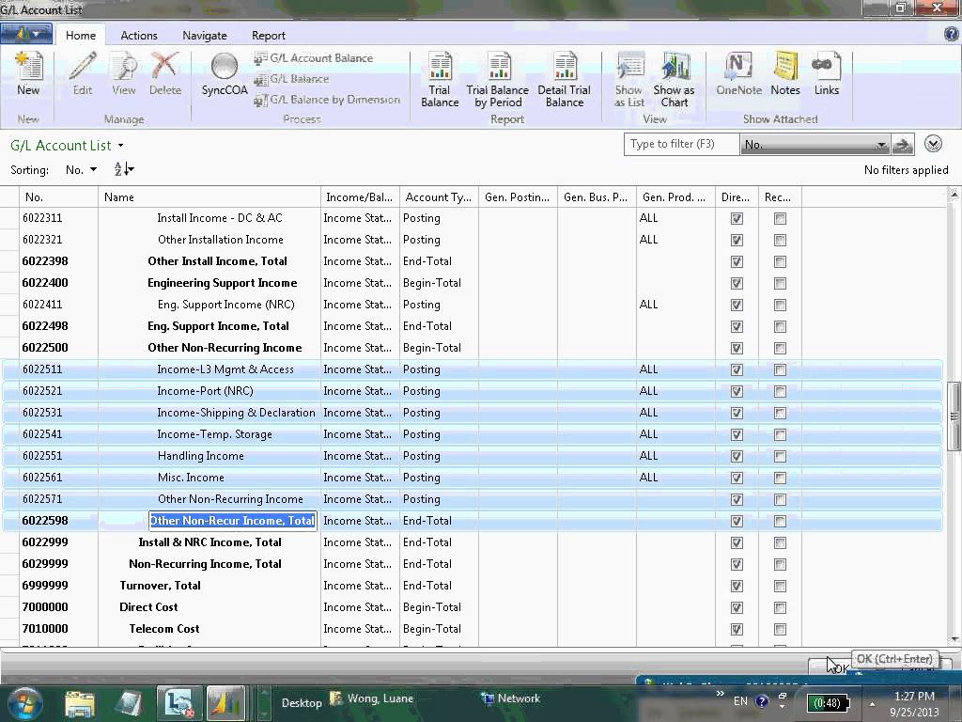
MIS selected software
Dynamics NAV – Financial management
*https://www.quantiq.com/microsoft-dynamics-nav/

Slide 5
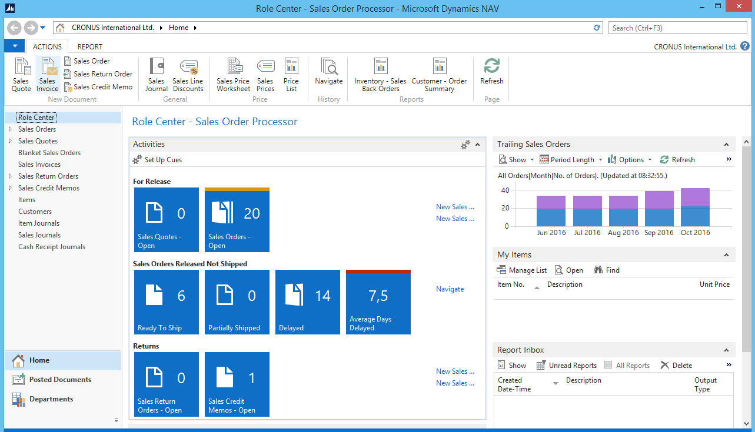
MIS selected software
Dynamics NAV – Supply chain management
*https://www.quantiq.com/microsoft-dynamics-nav/

Slide 6
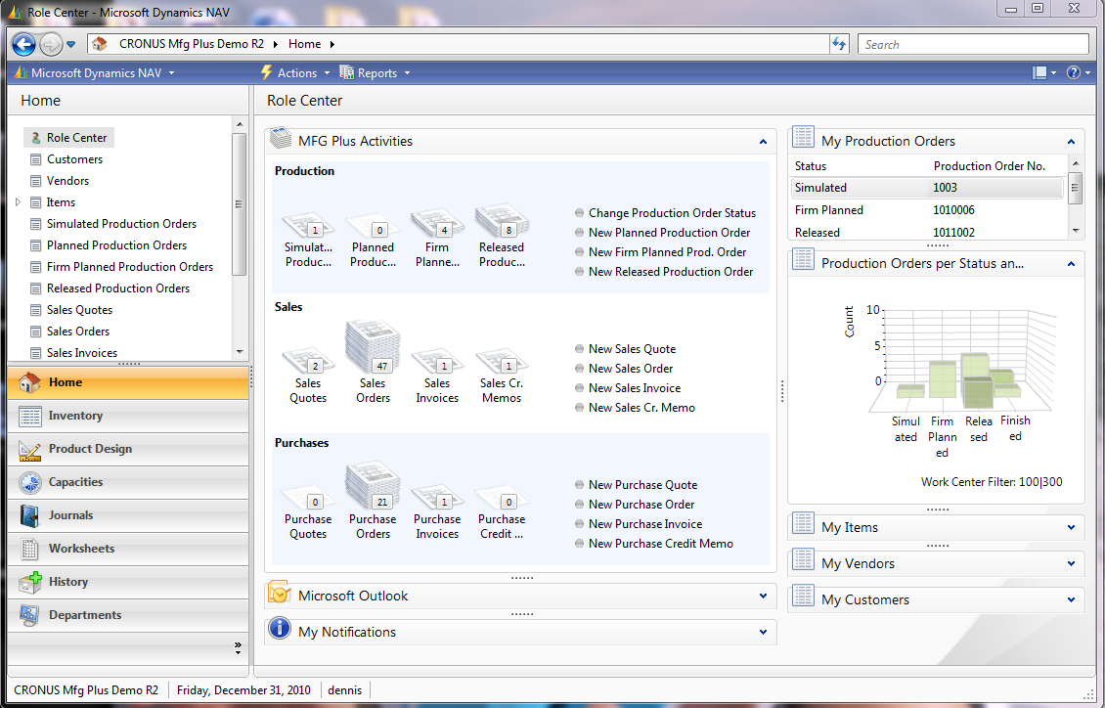
MIS selected software
Dynamics NAV – Manufacturing management
*https://www.quantiq.com/microsoft-dynamics-nav/

Slide 7
MIS selected software
Dynamics NAV
https://www.microsoft.com/en-us/dynamics365/nav-overview
http://www.dynamics-consultants.co.uk/solutions/dynamics-nav/what-is-microsoft-dynamics-nav
http://www.icepts.com/microsoft-dynamics-nav-financial-management/
https://www.perfion.com/features/product-data-in-microsoft-dynamics-nav-with-pim/
https://mbs.microsoft.com/customersource/northamerica/NAV/support/support-lifecycle/lifecycle
http://www.icepts.com/microsoft-dynamics-nav-project-and-jobs-management/

Slide 8
MIS selected software
SAP R/3
Functional modules in SAP
Finanacial Modules
Financial Accounting (FI);
Controlling (CO);
Investment Management (IM);
Treasury (TR);
Enterprise Control (EC).
Logistics Modules
Material management (MM);
Sales & distribution (SD);
Production;
Planning & Control (PP);
Product Data Management (PDM);
Quality Management (QM);
Plant maintenance (PM);
Service management(SM);
Project systems (PS).
*http://sapoverview.blogspot.cz/2012/10/sap-modules-overview.html

Slide 9
MIS selected software
SAP R/3
Functional modules in SAP
Human resource management Module
Personnel Management;
Organizational Management;
Payroll Accounting;
Time Management;
Personnel Development;
Training & Event Management.
Cross Application Module
Workflow (WF);
SAP Office.
*http://sapoverview.blogspot.cz/2012/10/sap-modules-overview.html

Slide 10
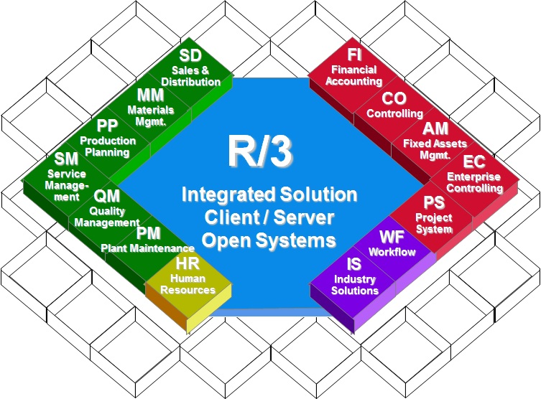
MIS selected software
SAP R/3
*http://www.beginners-sap.com/what-does-4-in-abap-4-stand-for/

Slide 11
MIS selected software
NetSuite
NetSuite software is an online service that enables companies to manage all key business processes in a single system. There is no hardware to procure, no large, up-front license fee, no maintenance fees associated with hardware or software and no complex set-ups.*
NetSuite is used to manage inventory, for enterprise resource planning (ERP), to keep track of financials, to host eCommerce stores, and to maintain customer relationship management (CRM) systems. It is a flexible platform that can be applied to a wide variety of business applications.*
*http://www.exploreconsulting.com/what-is-netsuite/

Slide 12
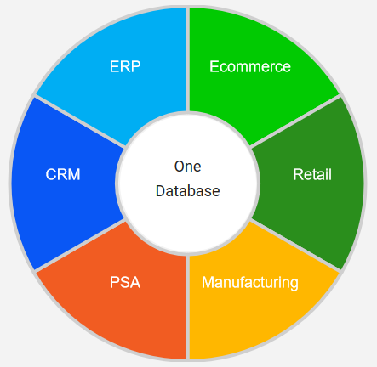
MIS selected software
NetSuite modules
*http://www.exploreconsulting.com/what-is-netsuite/

Slide 13
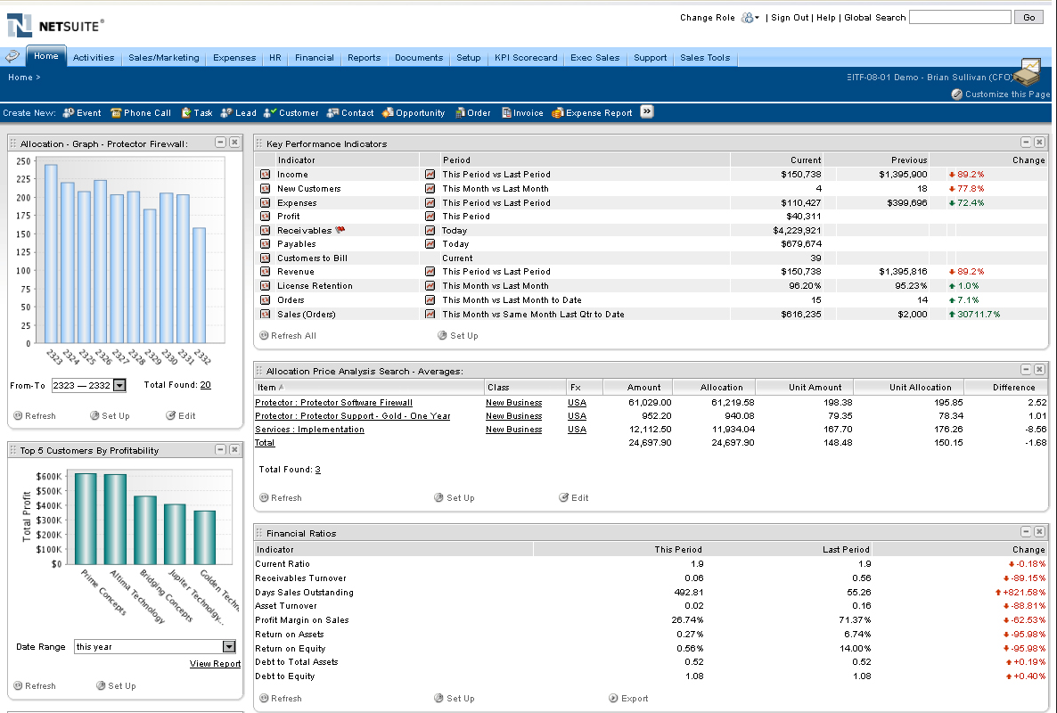
MIS selected software
NetSuite modules
*https://www.getapp.com/operations-management-software/a/netsuite-financials-software/

Slide 14
MIS selected software
E2 Shop System
E2 by Shoptech Corporation brings all business operations into a single simple solution, from estimating to scheduling, purchasing, shipping and even customer management and accounting, with its easy-to-use solution. Designed specifically for job shops, contract and a variety of make-to-order manufacturers, Shoptech's comprehensive ERP helps job shops run more smoothly, while increasing both productivity and profits.*
*http://www.softwareadvice.com/manufacturing/e2-shop-system-profile/

Slide 15
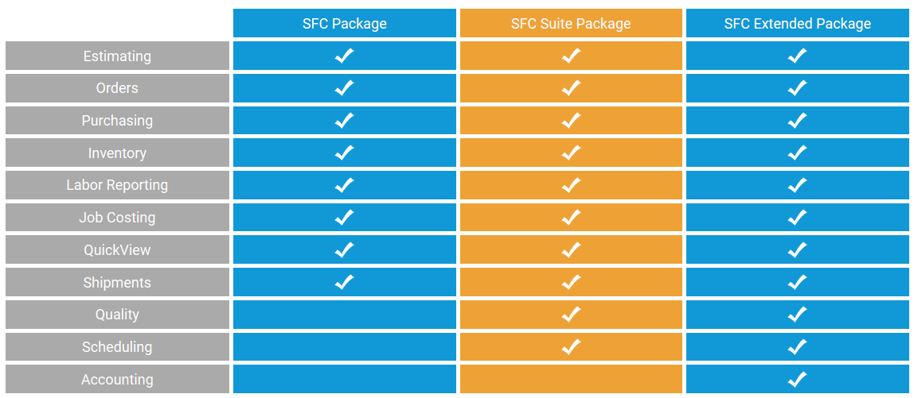
MIS selected software
E2 Shop System - modules
*http://www.shoptech.com/products/e2-shop-system/

Slide 16
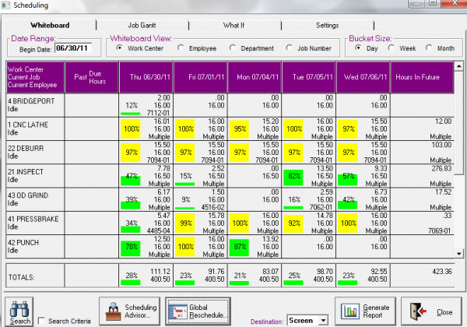
MIS selected software
E2 Shop System
*http://www.shoptech.com/products/e2-shop-system/

Slide 17
MIS selected software
WorkWise ERP
Engineering
SOLIDWORKS CAD integration;
product configurator
BOM and routings.
Planning
Advanced forecasting;
CRP;
MRP;
MPS.
Materials
inventory;
MCM;
mobile data collection;
purchasing;
shipping integration.
Production
shop floor control;
visual scheduling;
production dispatch;
lean/Kanban;
quality.
*http://www.softwareadvice.com/manufacturing/e2-shop-system-profile/

Slide 18
MIS selected software
WorkWise ERP
Marketing, Sales & Customer Service
CRM;
quoting & estimating;
order management;
commerce gateway;
EDI;
RMA.
Documents
Paperless routing & archiving;
Labels.
Finance
job cost;
standard cost;
AR/AP;
Payroll;
HR;
credit card gateway;
cash management.
Analytics
business metrics mobile app;
event manager;
mobile alerts;
data journaling.
*http://www.softwareadvice.com/manufacturing/e2-shop-system-profile/

Slide 19
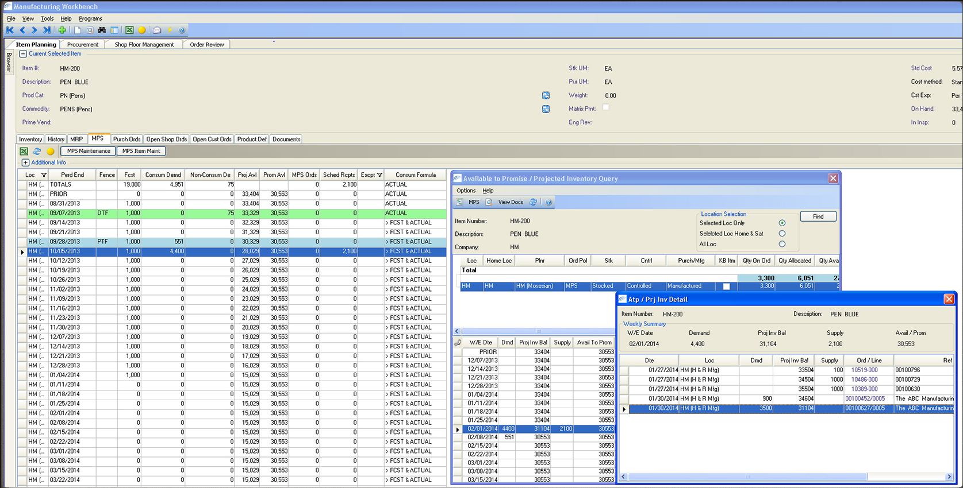
MIS selected software
WorkWise ERP
*http://www.softwareadvice.com/manufacturing/e2-shop-system-profile/

Slide 20
MIS selected software
ePROMIS Software
ePROMIS’s business solutions encompass the entire spectrum of enterprise functionalities, including:
finance;
inventory management;
distribution;
supply chain;
analytics;
human resources
customer relations;
planning.
Service offerings are also customized for a wide range of market verticals including Construction, Contracting, Oil & Gas, Trading, Supply Chain, Automobile, Transportation, Logistics, Healthcare, Retail and more.
*http://www.softwareadvice.com/erp/epromis-profile/

Slide 21
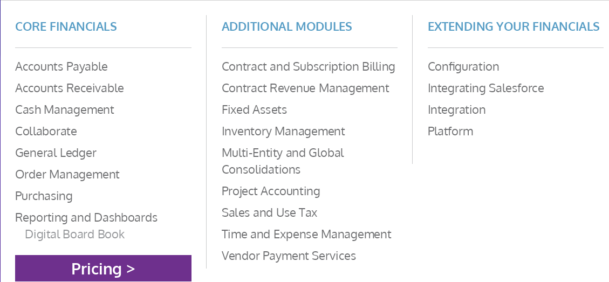
MIS selected software
Intacct
*https://us.intacct.com/

Slide 22
MIS selected software
EAMbrace Asset Management
Key features
Audit Trail
Document Management
Vendor Management
Barcode Scanning
Multi-Currency
Tax Management
Lease Management
Reporting
Asset Lifecycle Management
Disposal Management
Depreciation Calculation
Fixed Asset Register
Asset Management
Budgeting
Inventory Management
Fixed assets
Compliance Management
Billing & Invoicing
Barcoding / RFID
Lease Information
Asset Budgeting
Depreciation Management
Asset Breakup
Multi shift depreciation
Full-Fledged Security Module
*https://www.softwaresuggest.com/eambrace

Slide 23
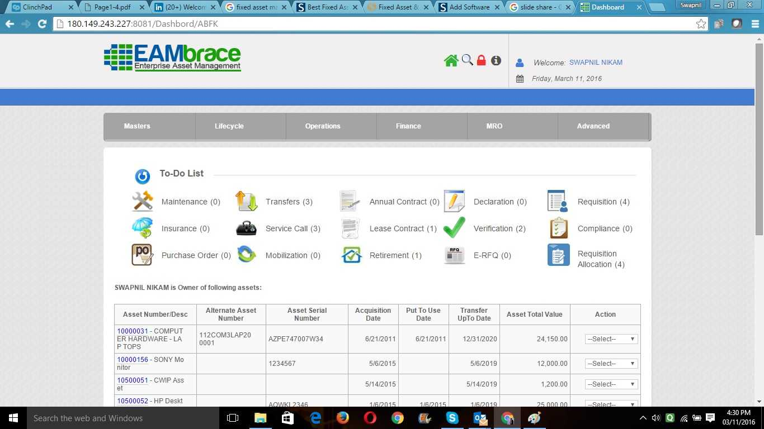
MIS selected software
EAMbrace Asset Management
*https://www.softwaresuggest.com/eambrace

Slide 24
MIS selected software
Cerebrate Integrated Business Intelligence
CIBI is a powerful Business Intelligence tool that is built around open source technologies, bundled together with innovation from Cerebrate, using modern web frameworks. CIBI’s main focus is to empower the users with intuitive, easy to use, self-service BI.*
It packs a lot of punch in terms of advanced statistical functions, in-memory capabilities, innovative visualizations and productivity boosters such as chart annotations with alerting triggers, one-click download options and advanced filtering.*
*https://www.softwaresuggest.com/cibi

Slide 25
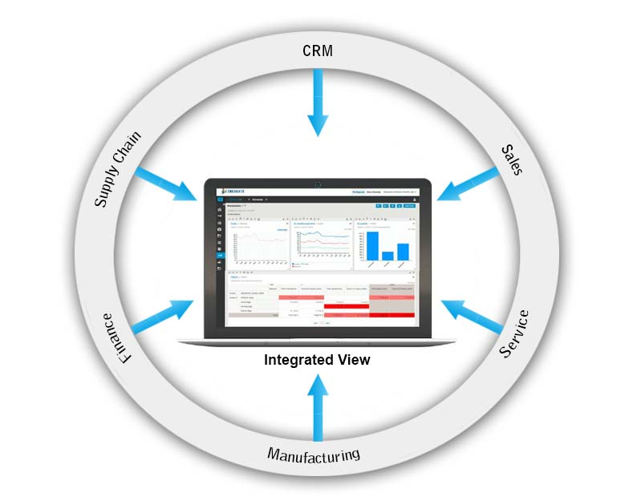
MIS selected software
Cerebrate Integrated Business Intelligence
*http://cerebrateinc.com/

Slide 26
MIS selected software
Introduction of ten key principles to ensure that information management activities are effective and successful:
recognise (and manage) complexity;
focus on adoption;
deliver tangible & visible benefits;
prioritise according to business needs;
take a journey of a thousand steps;
provide strong leadership;
mitigate risks;
communicate extensively;
aim to deliver a seamless user experience;
choose the first project very carefully.
*http://www.steptwo.com.au/papers/kmc_effectiveim/

Slide 27
MIS selected software
Principles for Selecting Software Packages
When you buy packaged software you join its network.
Take a long-term perspective: Look ahead but reason back.
When choosing packaged software, there is safety in numbers.
Focus on compatibility and beware of false gold.
Choose a software package with accessible knowledge.
Choose packaged software with the right type of standardization.
All journeys start with a first step.
*https://cacm.acm.org/magazines/2010/8/96615-seven-principles-for-selecting-software-packages/fulltext

Slide 28
Compulsory and recommended references
LAUDON, K.C. and J.P LAUDON, 2015. Management Information Systems: Managing the Digital Firm (14th Edition). New York: Pearson Publishing. ISBN 978-0133898163.

