Slide 1


Název prezentace
Název projektu | Rozvoj vzdělávání na Slezské univerzitě v Opavě
Registrační číslo projektu | CZ.02.2.69/0.0./0.0/16_015/0002400
Prezentace předmětu:
INFORMATION MANAGEMENT
Vyučující:
Ing. Radim Dolák, Ph.D.

Slide 2

INFORMATION MANAGEMENT
9. INFORMATION STRATEGIES OF THE ORGANIZATION, MODELS OF ICT MANAGEMENT
Ing. Radim Dolák, Ph.D.

Slide 3
Introduction
ICT management is a key factor in an organization's information strategy, which is one of the organization's partial strategies. Business management from an ICT point of view generally takes place at three basic levels - strategic, tactical and operational. In practice, two basic IT control models, ITIL and COBIT, are the most used.
Every business or organization should have a good insight into its information management processes to make it more efficient to use the information.
For this purpose, a company's information audit is normally performed. The most well-known system quality management tools include ISO 9000 standards, which can also be used to find the current universal definition of quality.
Notes:
csvukrs

Slide 4
Goals of the chapter
Define the concept of information strategy and learn about the principles of ICT management
Introduce the basic computer science management scheme
Define and describe the content of the ITIL and COBIT methodologies
Notes:
csvukrs

Slide 5
Definition of the concept of Information Strategy
ICT governance is a key factor in an organization's information strategy, which is one of the organization's partial strategies.
The information strategy builds on and elaborates on the corporate strategy. The aim is primarily to support business goals with an appropriate information system and to effectively work with information in general.
The information strategy also defines the overall concept of the enterprise information system development for two to three years. (Czech Society for System Integration, 2011)
Notes:
csvukrs

Slide 6
Definition of the concept of Information Strategy
In terms of the hierarchy between business strategies, it has a special position among functional strategies in the sense that it must support both superseded business strategy and other functional strategies, and should be interlinked to maximize IS / IT to support the achievement of strategic goals functional strategies. (Keřkovský, 2003)
For example, according to Richta (2005), it is necessary to create an enterprise's information strategy in connection with the business development plan. Strategic planning of information systems in isolation from a strategic business plan is the root of later problems. An isolated creation of an information strategy plan is likely to lead to costly systems that will not be able to fully serve the needs of the business.
Notes:
csvukrs

Slide 7
Definition of the concept of Information Strategy
According to Maryška (2008), the information strategy ensures, above all, the mutual synchronization and interconnection of planned and solved projects and exploited applications.
If an organization does not have an information strategy, usually investment in IT is not linked to corporate goals and thus does not provide enough return on IS / ICT investment.
Notes:
csvukrs

Slide 8
ICT management in the enterprise
Business management from an ICT perspective usually takes place at three basic levels: strategic, tactical and operational. It is also the case in computer science.
Each of these levels is further subdivided into areas, respectively. domains, control, and these then contain individual processes and control functions. This concept is documented in the following illustration.
Notes:
csvukrs

Slide 9
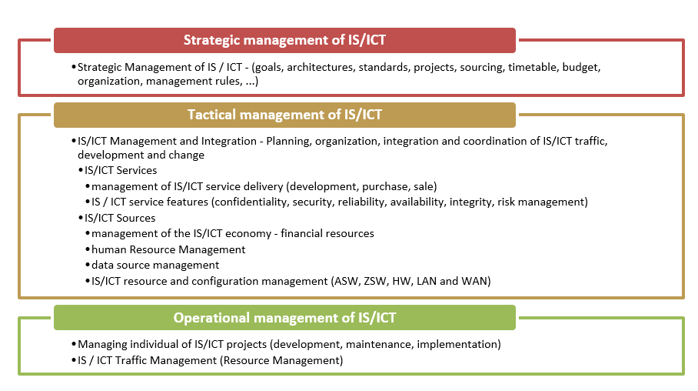
ICT management in the enterprise
Figure 1: Basic schema of business informatics management
Source: Custom processing by Gala, Pour and Toman (2005)
Notes:
csvukrs

Slide 10
Methods and Models of ICT management
Gala (2005) has published that the importance of information technology for the performance and success of the company has put pressure on the rationalization of its management and the related development of various methodologies and models. In practice, two basic IT control models, ITIL and COBIT, are the most used.
ITIL - Presents a set of business informatics management practices through services provided by the Central Government and Telecommunications Agency (CCTA).
COBIT (Control Objectives for Information and Related Technology) is a basic methodology of ISACA (Information Systems Audit and Control Association).
Notes:
csvukrs

Slide 11
Methods and Models of ICT management - ITIL
ITIL stands for "Information Technology Infrastructure Library", which means "Information Technology Infrastructure Book". A number of companies and governmental organizations have worked together to create a set of Best Practices in the area of process management of IT support services. Currently, ITIL is in version 3 (consisting of 5 books).
According to Basl (2008), ITIL contains one of the most comprehensive reference models for enterprise information management. Although not as structured as CMMI or COBIT, it is written in a very readable language.
Notes:
csvukrs

Slide 12
Methods and Models of ICT management - ITIL
The basic concept is the service that is the most important term ITIL and we understand it as an "IT" service because it is provided by an IT department or an IT company. This is the technical or organizational capacity IT provides to its users.
It can take a variety of forms from e-mail, traffic and network management, such as backing up data. It is important to realize that each service has its own life cycle, which represents the "life" of service from its origin to operation and extinction.
Notes:
csvukrs

Slide 13
Methods and Models of ICT management - ITIL
ITIL version 3 is possible to devided into the following five phases:
Service Strategy - In the first phase of the life cycle, a selection of services will be provided by the organization. It is chosen such a service that will bring profit and pay to operate it,
Service Design - here is suggested how the selected service will look and from which technologies it will be composed,
Service Transition - At this stage, the proposed service is physically created, which means, for example, that it is programmed and that hardware is purchased. It will also take place here,
Service Operation - within which the service is operated and subject to routine IT support,
Continuous Service Improvement - the service is continuously monitored and improved.
Notes:
csvukrs

Slide 14
Methods and Models of ICT management - ITIL
It is advisable to proceed according to the following scenario when companyi s implementing individual ITIL processes (Sveřepa, 2008):
get a general idea of ITIL processes and their interrelationships,
identify the IT process whose implementation by ITIL will bring the greatest benefit (or solve the most pressing problems),
explore in detail its links to other processes and determine their multiplicity (eg one problem may relate to several incidents),
if this is not the first implemented process, it is necessary to consider the impacts of the selected process on already deployed processes,
consider the implications for other IT processes that we will implement in the future.
Notes:
csvukrs

Slide 15
Methods and Models of ICT management - ITIL
The most important benefits of ITIL implementation are as follows (Implementation of ITIL, 2011):
cost savings for running IT services,
better quality and reliability of IT services (more satisfied customers),
better use of expensive ICT resources and fewer outages of ICT systems,
a higher level of communication between ICT segment staff and customers/ users.
Notes:
csvukrs

Slide 16
Methods and Models of ICT management - COBIT
The COBIT methodology covers IS/ICT management issues in a wider context and thus including aspects of corporate governance, which is the infrastructure. (Řepa, 2006)
According to Doucek, the following list of information criteria is available:
efficiency,
efficiency,
confidentiality,
integrity,
availability,
the match,
authenticity.
Notes:
csvukrs

Slide 17
Methods and Models of ICT management - COBIT
According to Doucek, the following is a list of IT resources
applications,
information,
infrastructure,
people.
According to Doucek, the following is a list of domains for IT processes
planning and organization,
acquisition and implementation,
delivery and support,
monitoring and evaluation.
Notes:
csvukrs

Slide 18
Methods and Models of ICT management - COBIT
As part of the continuity management of IT activities, the COBIT methodology is important:
protect,
reveal,
respond,
restore,
operate,
return.
Notes:
csvukrs

Slide 19
THANK YOU FOR YOUR ATTENTION

