Slide 1
Statistical Data Processing
Time series analysis

Slide 2
Time series
Decomposition of the time series into
the trend, seasonal, cyclic, and random component
The trend component
The seasonal component
Autocorrelation of the random component: Durbin-Watson test
Moving average: simple, centred, and weighted moving average

Slide 3
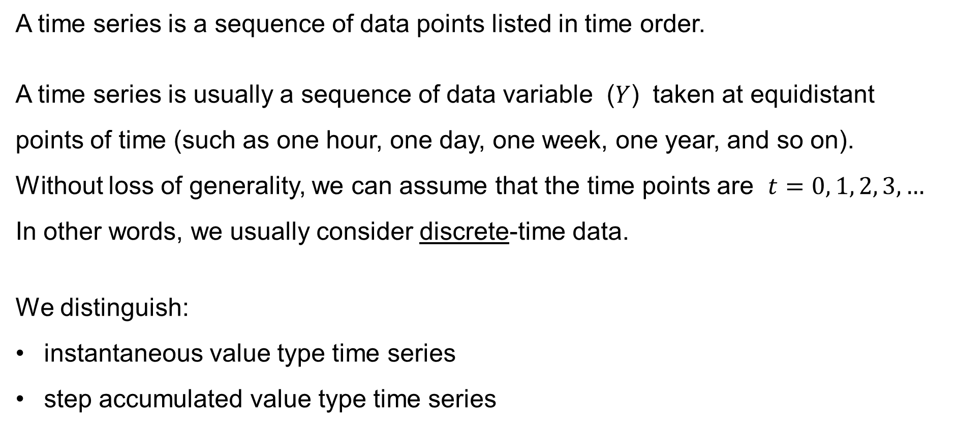
Time series
A time series is a sequence of data points listed in time order.
A time series is usually a sequence of data variable ($Y$) taken at equidistant
points of time (such as one hour, one day, one week, one year, and so on).
Without loss of generality, we can assume that the time points are $t=0, 1, 2, 3,…$
In other words, we usually consider discrete-time data.
We distinguish:
instantaneous value type time series
step accumulated value type time series

Slide 4
Time series
Instantaneous value type time series
— the measured value is taken at a particular time.
Examples: the air temperature, the wind speed
Step accumulated value type time series
— the measured value is take over an entire interval of time
Example: the rainfalls during the past hour

Slide 5
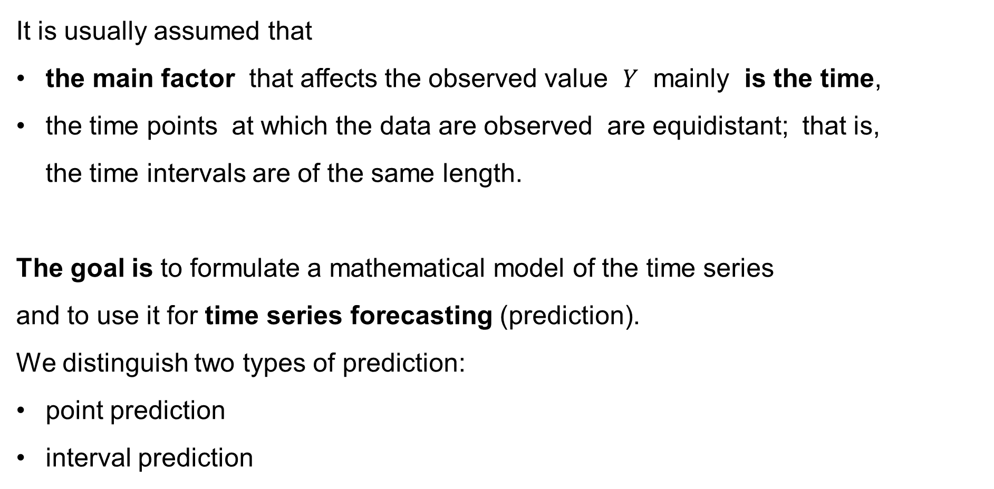
Time series
It is usually assumed that
the main factor that affects the observed value $Y$ mainly is the time,
the time points at which the data are observed are equidistant; that is,
the time intervals are of the same length.
The goal is to formulate a mathematical model of the time series
and to use it for time series forecasting (prediction).
We distinguish two types of prediction:
point prediction
interval prediction

Slide 6
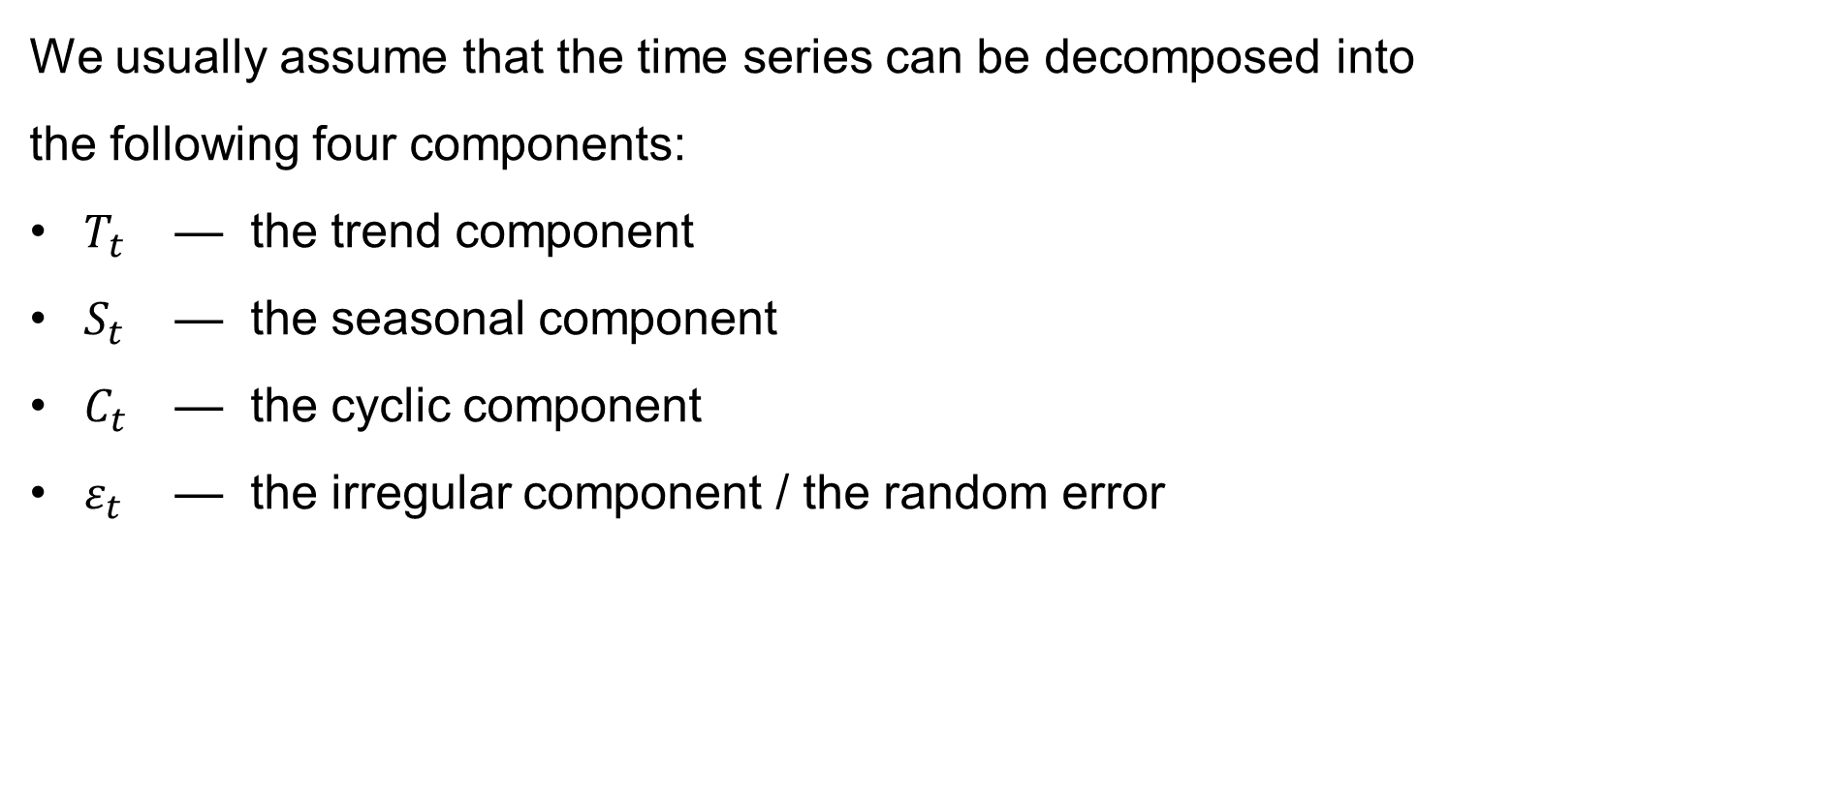
Time series
We usually assume that the time series can be decomposed into
the following four components:
$T_{t}$ — the trend component
$S_{t}$ — the seasonal component
$C_{t}$ — the cyclic component
$ε_{t}$ — the irregular component / the random error

Slide 7
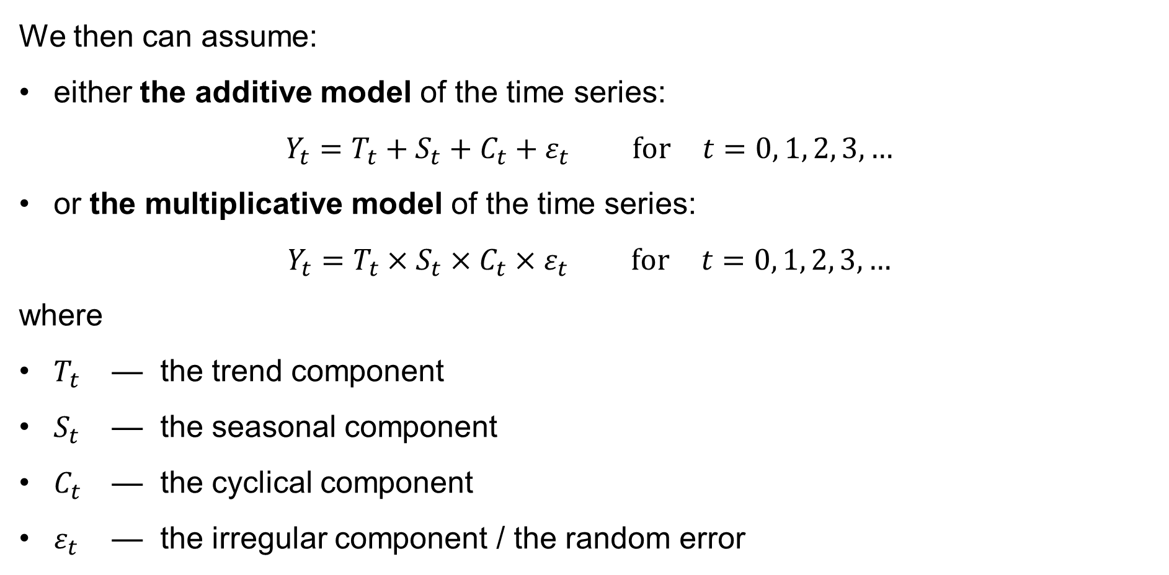
Time series
We then can assume:
either the additive model of the time series:
$Y_{t}=T_{t}+S_{t}+C_{t}+ε_{t} \text{for} t=0, 1, 2, 3,…$
or the multiplicative model of the time series:
$Y_{t}=T_{t}×S_{t}×C_{t}×ε_{t} \text{for} t=0, 1, 2, 3,…$
where
$T_{t}$ — the trend component
$S_{t}$ — the seasonal component
$C_{t}$ — the cyclical component
$ε_{t}$ — the irregular component / the random error

Slide 8
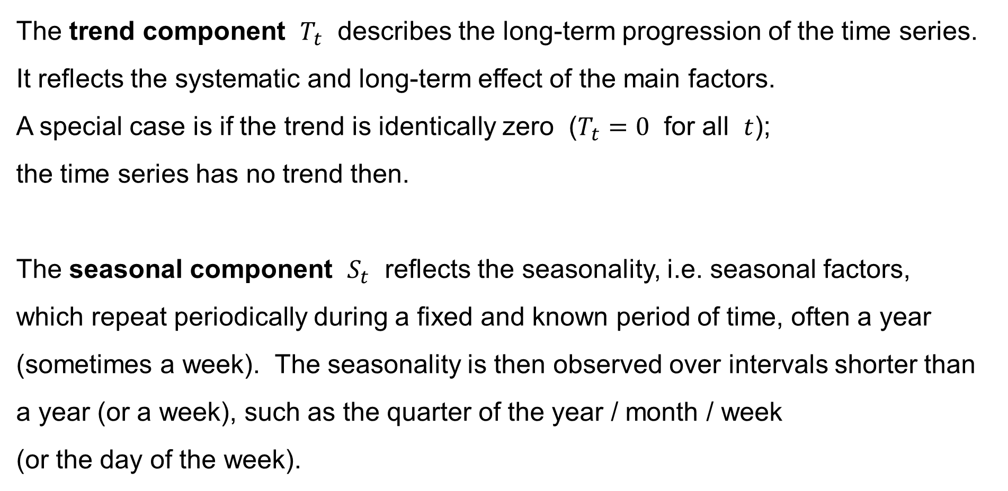
Time series
The trend component $T_{t}$ describes the long-term progression of the time series.
It reflects the systematic and long-term effect of the main factors.
A special case is if the trend is identically zero ($T_{t}=0$ for all $t$);
the time series has no trend then.
The seasonal component $S_{t}$ reflects the seasonality, i.e. seasonal factors,
which repeat periodically during a fixed and known period of time, often a year (sometimes a week). The seasonality is then observed over intervals shorter than a year (or a week), such as the quarter of the year / month / week
(or the day of the week).

Slide 9
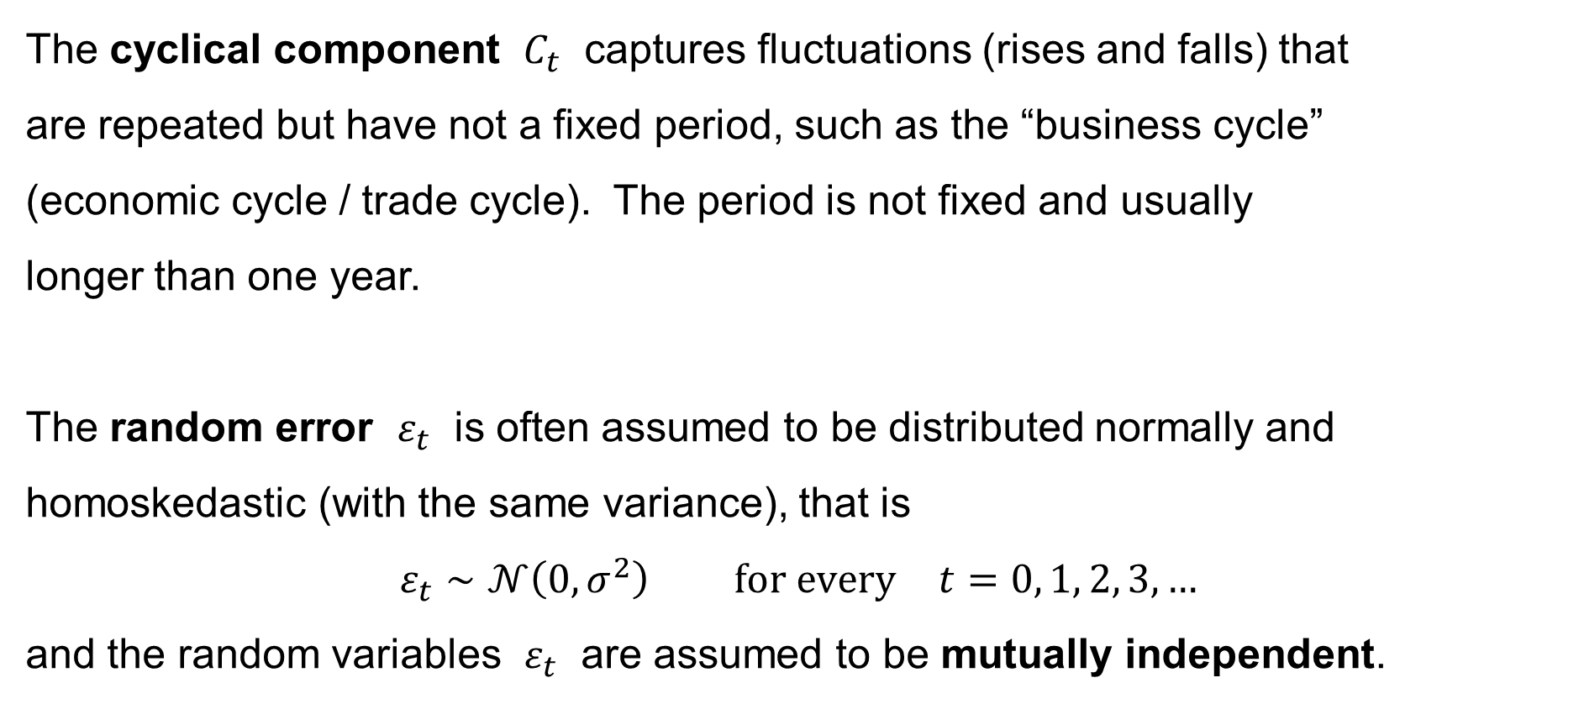
Time series
The cyclical component $C_{t}$ captures fluctuations (rises and falls) that
are repeated but have not a fixed period, such as the “business cycle”
(economic cycle / trade cycle). The period is not fixed and usually
longer than one year.
The random error $ε_{t}$ is often assumed to be distributed normally and homoskedastic (with the same variance), that is
$$ε_{t}∼𝒩\left(0,σ^{2}\right) \text{for} \text{every} t=0, 1, 2, 3,…$$
and the random variables $ε_{t}$ are assumed to be mutually independent.

Slide 10
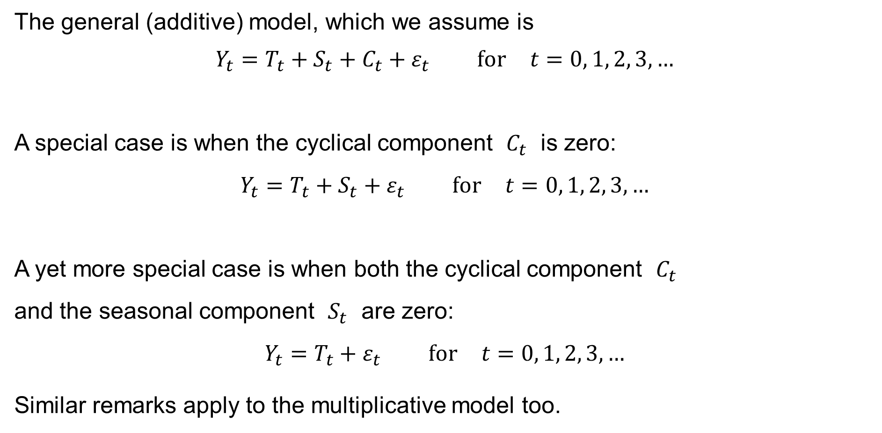
Time series: Special cases
The general (additive) model, which we assume is
$$Y_{t}=T_{t}+S_{t}+C_{t}+ε_{t} \text{for} t=0, 1, 2, 3,…$$
A special case is when the cyclical component $C_{t}$ is zero:
$$Y_{t}=T_{t}+S_{t}+ε_{t} \text{for} t=0, 1, 2, 3,…$$
A yet more special case is when both the cyclical component $C_{t}$
and the seasonal component $S_{t}$ are zero:
$$Y_{t}=T_{t}+ε_{t} \text{for} t=0, 1, 2, 3,…$$
Similar remarks apply to the multiplicative model too.

Slide 11
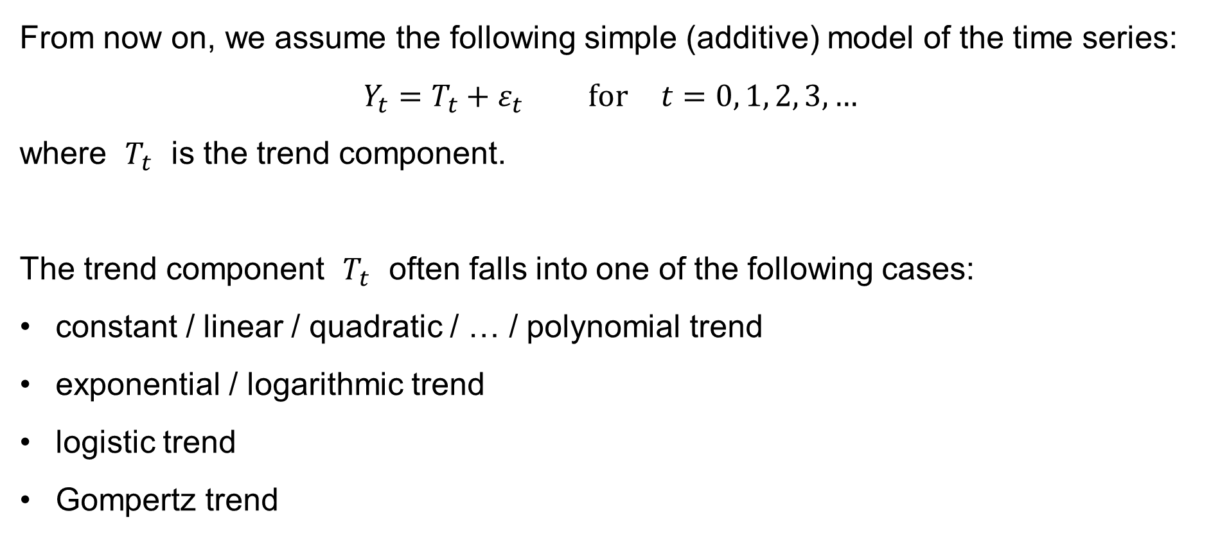
Time series: Trend component
From now on, we assume the following simple (additive) model of the time series:
$$Y_{t}=T_{t}+ε_{t} \text{for} t=0, 1, 2, 3,…$$
where $T_{t}$ is the trend component.
The trend component $T_{t}$ often falls into one of the following cases:
constant / linear / quadratic / … / polynomial trend
exponential / logarithmic trend
logistic trend
Gompertz trend

Slide 12
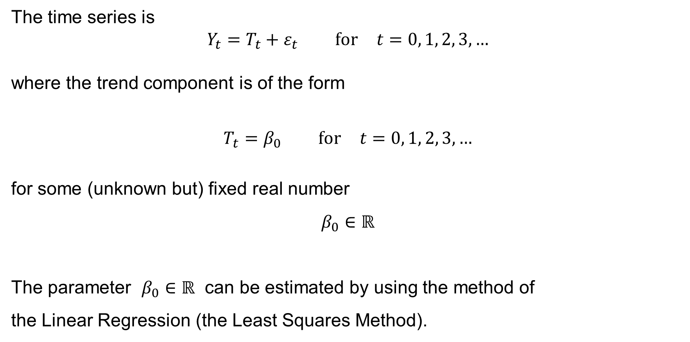
Time series: Constant trend
The time series is
$$Y_{t}=T_{t}+ε_{t} \text{for} t=0, 1, 2, 3,…$$
where the trend component is of the form
$$T_{t}=β_{0} \text{for} t=0, 1, 2, 3,…$$
for some (unknown but) fixed real number
$$β_{0}∈ℝ$$
The parameter $β_{0}∈ℝ$ can be estimated by using the method of
the Linear Regression (the Least Squares Method).

Slide 13
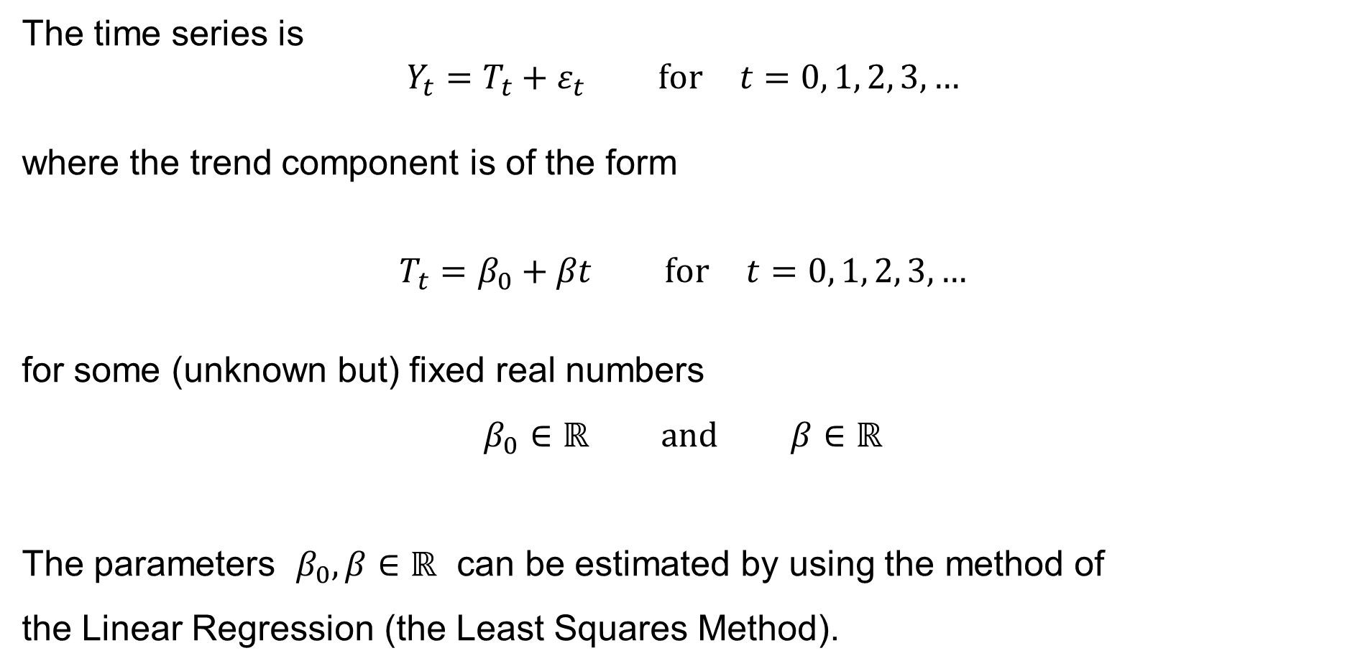
Time series: Linear trend
The time series is
$$Y_{t}=T_{t}+ε_{t} \text{for} t=0, 1, 2, 3,…$$
where the trend component is of the form
$$T_{t}=β_{0}+βt \text{for} t=0, 1, 2, 3,…$$
for some (unknown but) fixed real numbers
$$β_{0}∈ℝ \text{and} β∈ℝ$$
The parameters $β_{0},β∈ℝ$ can be estimated by using the method of
the Linear Regression (the Least Squares Method).

Slide 14
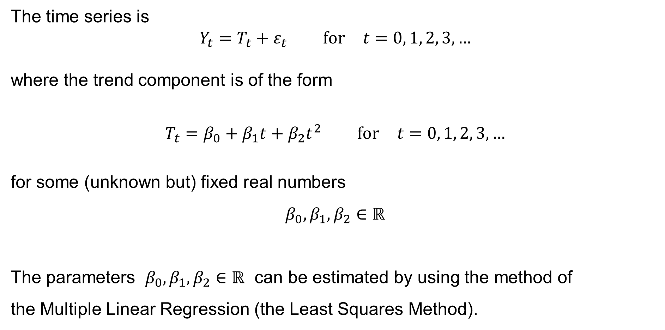
Time series: Quadratic trend
The time series is
$$Y_{t}=T_{t}+ε_{t} \text{for} t=0, 1, 2, 3,…$$
where the trend component is of the form
$$T_{t}=β_{0}+β_{1}t+β_{2}t^{2} \text{for} t=0, 1, 2, 3,…$$
for some (unknown but) fixed real numbers
$$β_{0},β_{1},β_{2}∈ℝ$$
The parameters $β_{0},β_{1},β_{2}∈ℝ$ can be estimated by using the method of
the Multiple Linear Regression (the Least Squares Method).

Slide 15
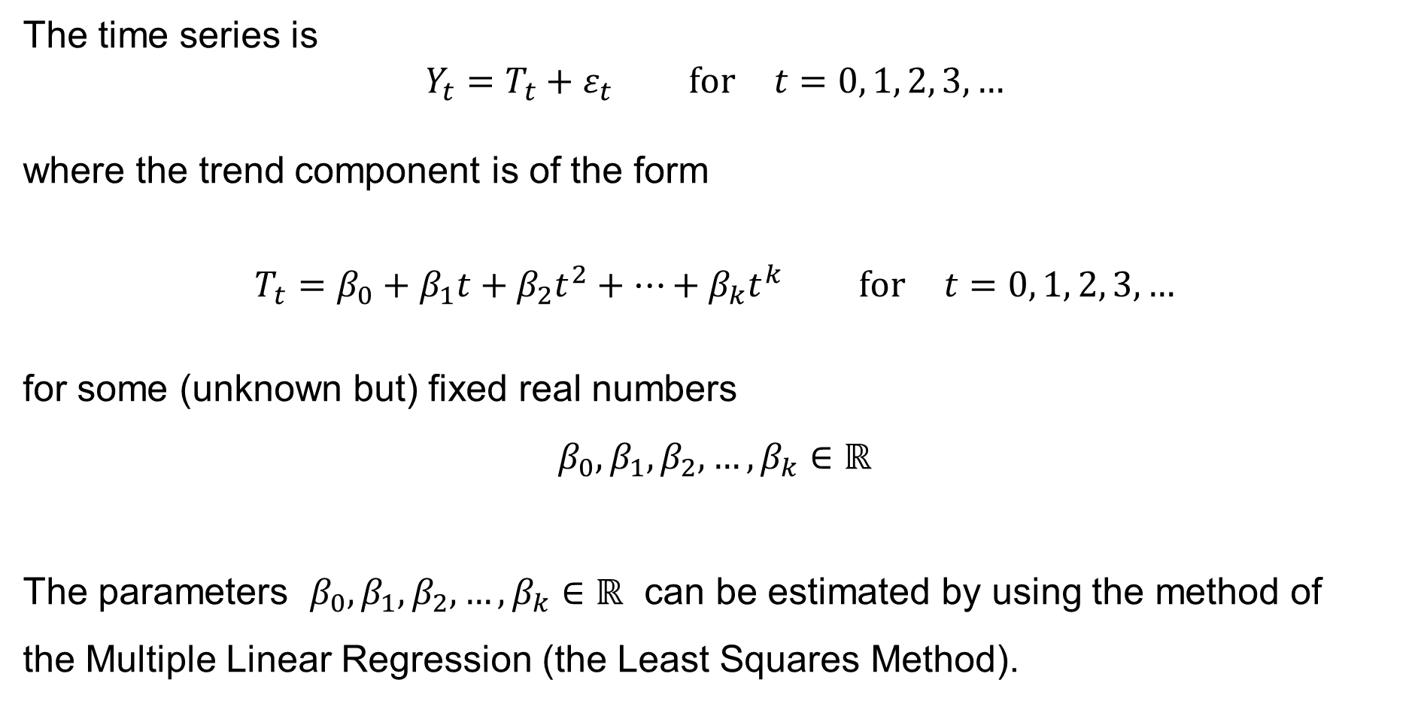
Time series: Polynomial trend
The time series is
$$Y_{t}=T_{t}+ε_{t} \text{for} t=0, 1, 2, 3,…$$
where the trend component is of the form
$$T_{t}=β_{0}+β_{1}t+β_{2}t^{2}+⋯+β_{k}t^{k} \text{for} t=0, 1, 2, 3,…$$
for some (unknown but) fixed real numbers
$$β_{0},β_{1},β_{2},…,β_{k}∈ℝ$$
The parameters $β_{0},β_{1},β_{2},…,β_{k}∈ℝ$ can be estimated by using the method of
the Multiple Linear Regression (the Least Squares Method).

Slide 16
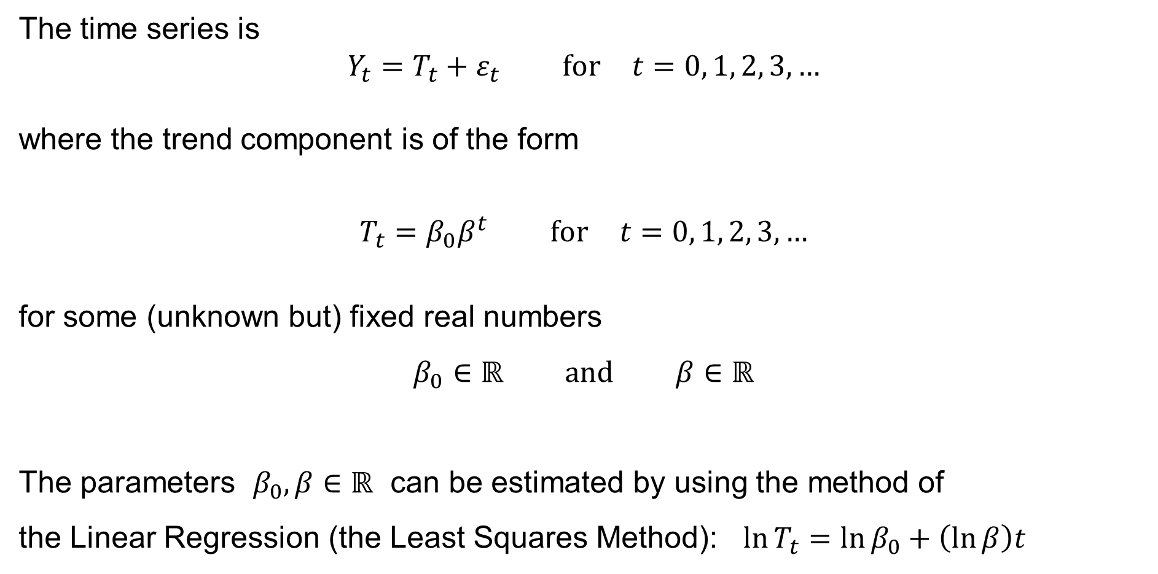
Time series: Exponential trend
The time series is
$$Y_{t}=T_{t}+ε_{t} \text{for} t=0, 1, 2, 3,…$$
where the trend component is of the form
$$T_{t}=β_{0}β^{t} \text{for} t=0, 1, 2, 3,…$$
for some (unknown but) fixed real numbers
$$β_{0}∈ℝ \text{and} β∈ℝ$$
The parameters $β_{0},β∈ℝ$ can be estimated by using the method of
the Linear Regression (the Least Squares Method): $\ln{T_{t}}=\ln{β_{0}}+\left(\ln{β}\right)t$

Slide 17
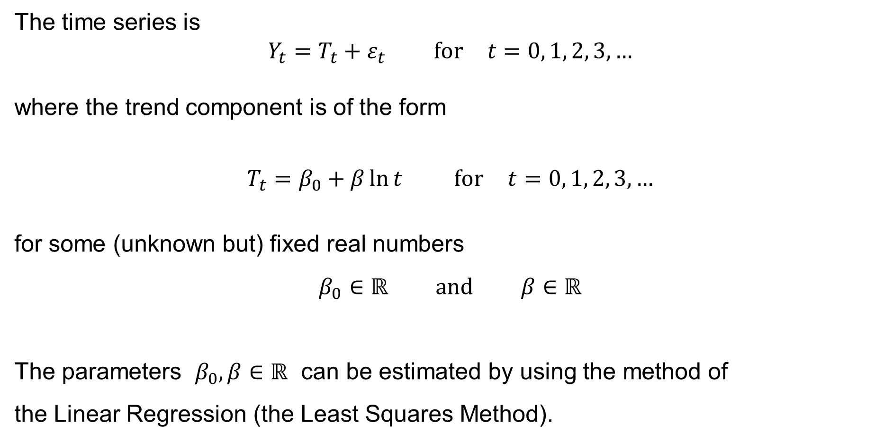
Time series: Logarithmic trend
The time series is
$$Y_{t}=T_{t}+ε_{t} \text{for} t=0, 1, 2, 3,…$$
where the trend component is of the form
$$T_{t}=β_{0}+β\ln{t} \text{for} t=0, 1, 2, 3,…$$
for some (unknown but) fixed real numbers
$$β_{0}∈ℝ \text{and} β∈ℝ$$
The parameters $β_{0},β∈ℝ$ can be estimated by using the method of
the Linear Regression (the Least Squares Method).

Slide 18
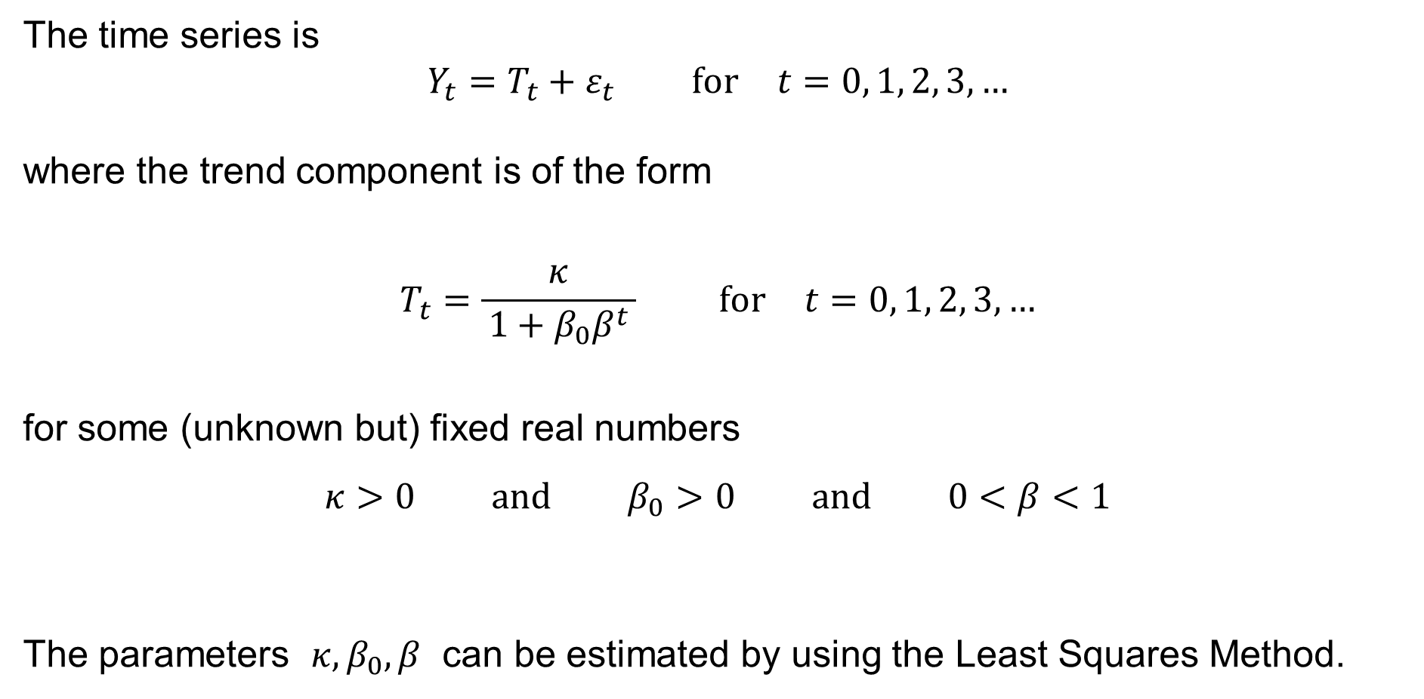
Time series: Logistic trend
The time series is
$$Y_{t}=T_{t}+ε_{t} \text{for} t=0, 1, 2, 3,…$$
where the trend component is of the form
$$T_{t}=\frac{κ}{ 1+β_{0}β^{t} } \text{for} t=0, 1, 2, 3,…$$
for some (unknown but) fixed real numbers
$$κ>0 \text{and} β_{0}>0 \text{and} 0<β<1$$
The parameters $κ,β_{0},β$ can be estimated by using the Least Squares Method.

Slide 19
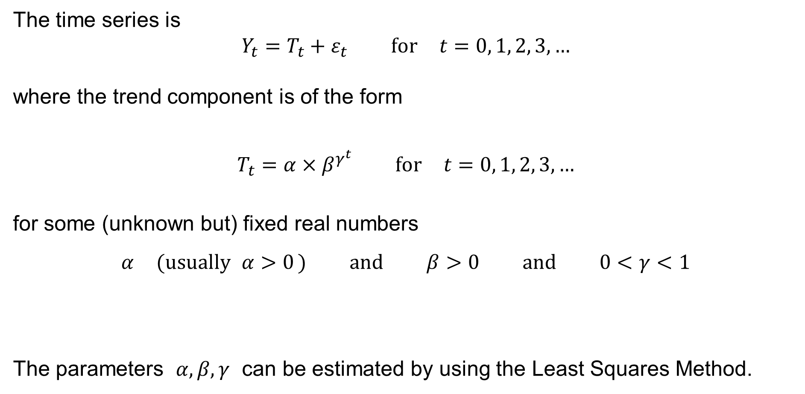
Time series: Gompertz trend
The time series is
$$Y_{t}=T_{t}+ε_{t} \text{for} t=0, 1, 2, 3,…$$
where the trend component is of the form
$$T_{t}=α×β^{γ^{t}} \text{for} t=0, 1, 2, 3,…$$
for some (unknown but) fixed real numbers
$$α \text{(}\text{usually} α>0\text{ )} \text{and} β>0 \text{and} 0<γ<1$$
The parameters $α,β,γ$ can be estimated by using the Least Squares Method.

Slide 20
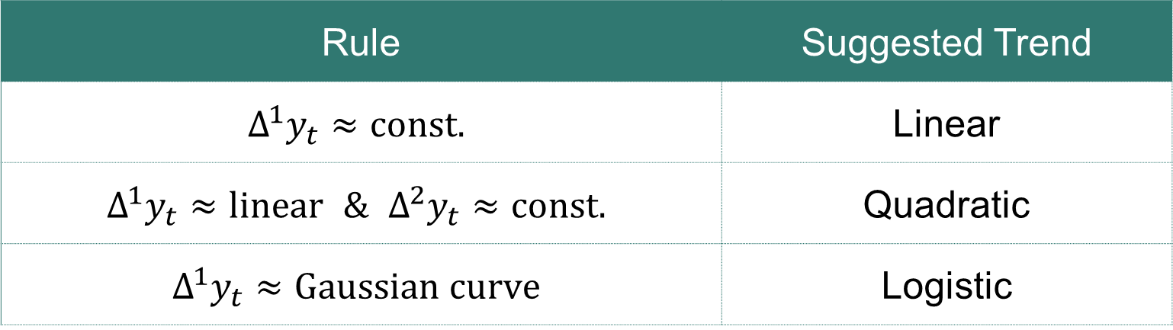

Time series: Which trend to choose?
where
$$Δ^{1}y_{t}=y_{t}−y_{t−1} \\ Δ^{2}y_{t}=Δ^{1}y_{t}−Δ^{1}y_{t−1}$$
Rule | Suggested Trend
$$Δ^{1}y_{t}≈const.$$ | Linear
$$Δ^{1}y_{t}≈linear \& Δ^{2}y_{t}≈const.$$ | Quadratic
$$Δ^{1}y_{t}≈Gaussian curve$$ | Logistic

Slide 21
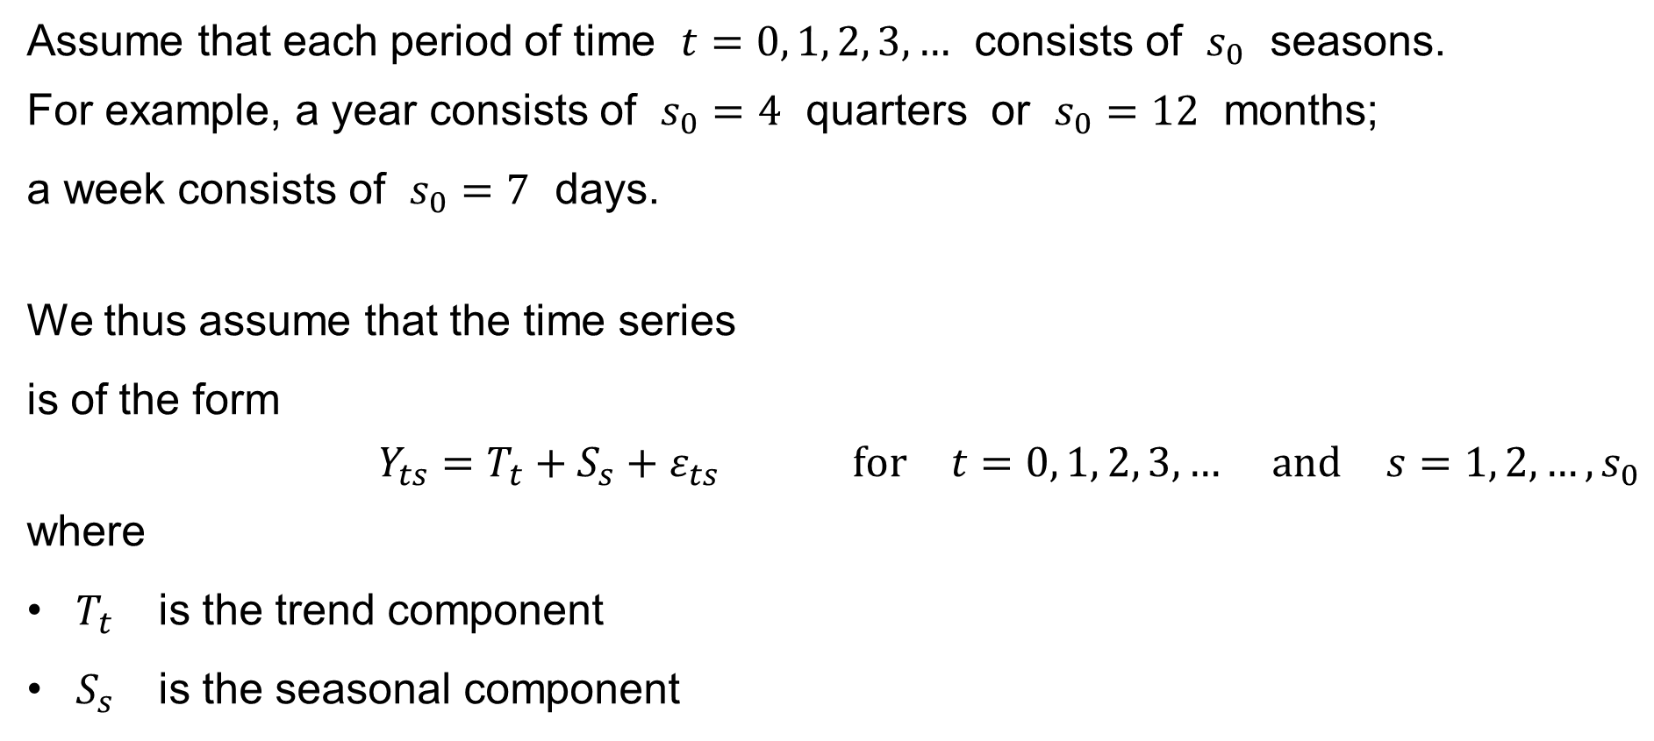
Time series: Seasonal component
Assume that each period of time $t=0, 1, 2, 3,…$ consists of $s_{0}$ seasons.
For example, a year consists of $s_{0}=4$ quarters or $s_{0}=12$ months;
a week consists of $s_{0}=7$ days.
We thus assume that the time series
is of the form
$$Y_{ts}=T_{t}+S_{s}+ε_{ts} \text{for} t=0, 1, 2, 3,… \text{and} s=1, 2,…,s_{0}$$
where
$T_{t}$ is the trend component
$S_{s}$ is the seasonal component

Slide 22
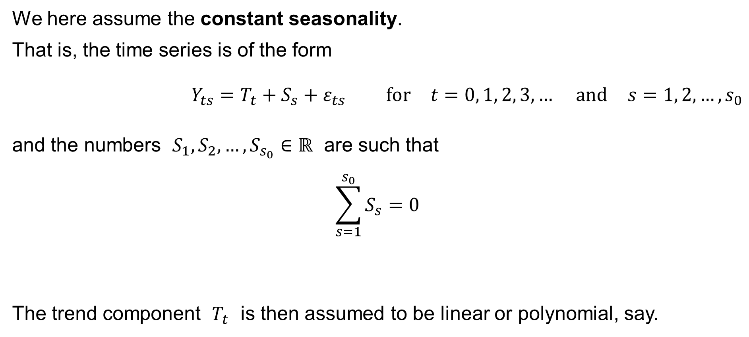
Time series: Seasonal component
We here assume the constant seasonality.
That is, the time series is of the form
$$Y_{ts}=T_{t}+S_{s}+ε_{ts} \text{for} t=0, 1, 2, 3,… \text{and} s=1, 2,…,s_{0}$$
and the numbers $S_{1},S_{2},…,S_{s_{0}}∈ℝ$ are such that
$$\sum_{s=1}^{s_{0}}{S_{s}}=0$$
The trend component $T_{t}$ is then assumed to be linear or polynomial, say.

Slide 23
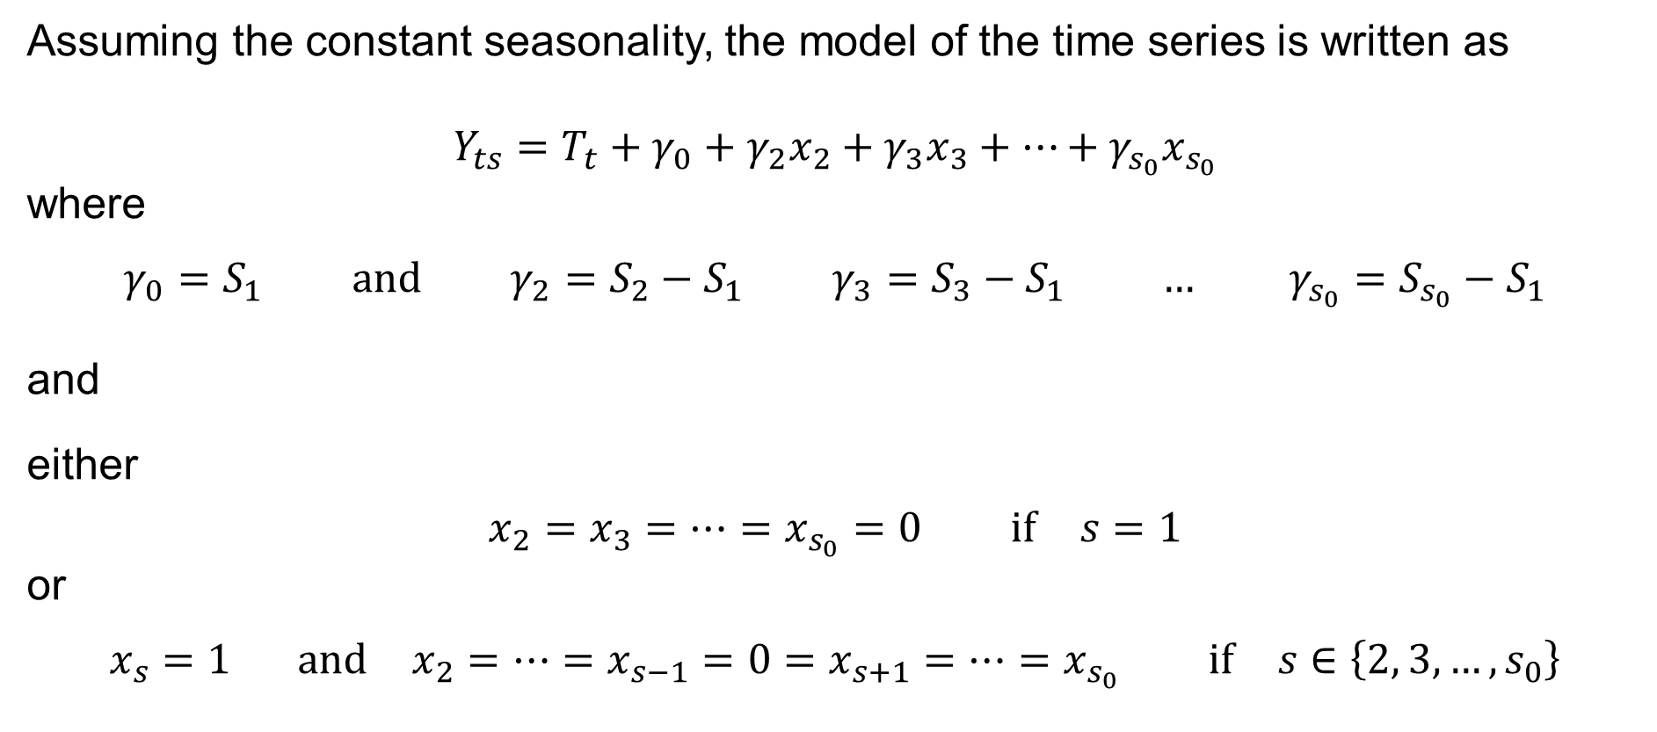
Time series: Seasonal component
Assuming the constant seasonality, the model of the time series is written as
$$Y_{ts}=T_{t}+γ_{0}+γ_{2}x_{2}+γ_{3}x_{3}+⋯+γ_{s_{0}}x_{s_{0}}$$
where
$$γ_{0}=S_{1} \text{and} γ_{2}=S_{2}−S_{1} γ_{3}=S_{3}−S_{1} … γ_{s_{0}}=S_{s_{0}}−S_{1}$$
and
either
$$x_{2}=x_{3}=⋯=x_{s_{0}}=0 \text{if} s=1$$
or
$$x_{s}=1 \text{and} x_{2}=⋯=x_{s−1}=0=x_{s+1}=⋯=x_{s_{0}} \text{if} s∈\left\{2, 3,…,s_{0}\right\}$$

Slide 24
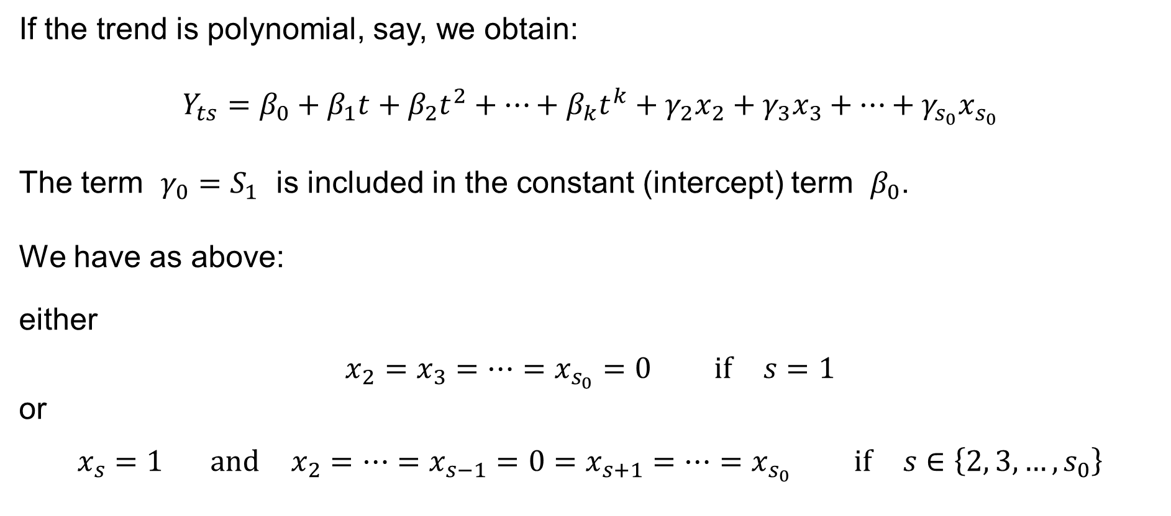
Time series: Seasonal component
If the trend is polynomial, say, we obtain:
$$Y_{ts}=β_{0}+β_{1}t+β_{2}t^{2}+⋯+β_{k}t^{k}+γ_{2}x_{2}+γ_{3}x_{3}+⋯+γ_{s_{0}}x_{s_{0}}$$
The term $γ_{0}=S_{1}$ is included in the constant (intercept) term $β_{0}$.
We have as above:
either
$$x_{2}=x_{3}=⋯=x_{s_{0}}=0 \text{if} s=1$$
or
$$x_{s}=1 \text{and} x_{2}=⋯=x_{s−1}=0=x_{s+1}=⋯=x_{s_{0}} \text{if} s∈\left\{2, 3,…,s_{0}\right\}$$

Slide 25
Autocorrelation of the random component
Durbin-Watson test

Slide 26
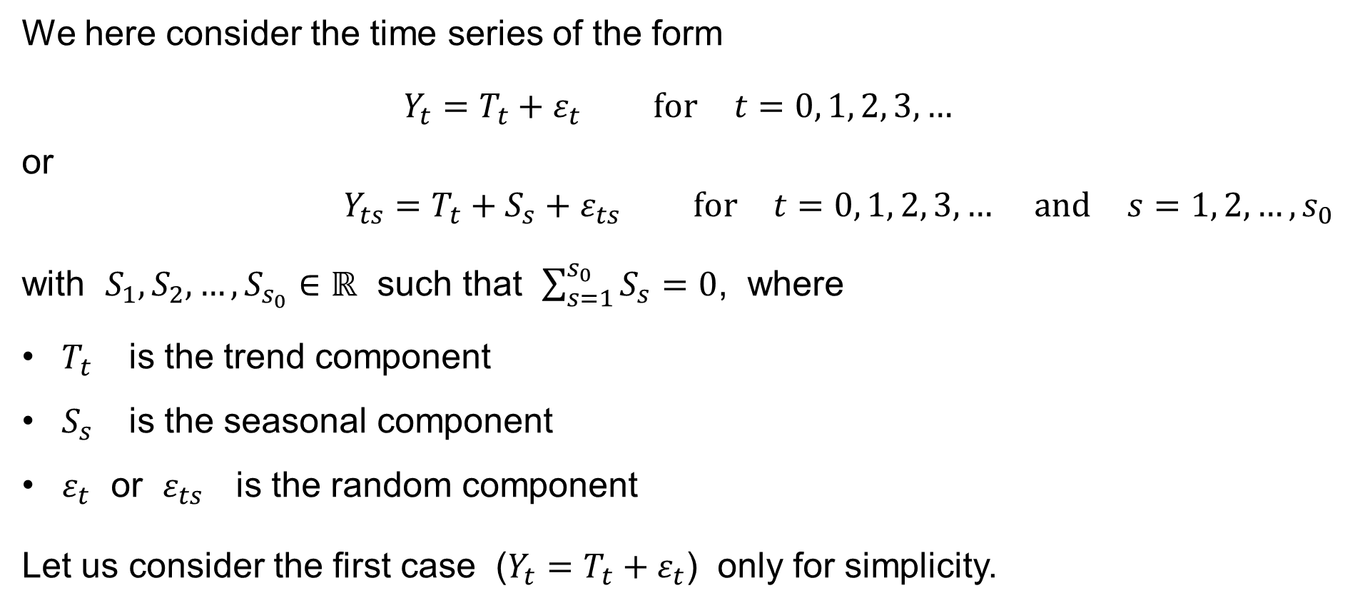
Time series: The Classical Assumption
We here consider the time series of the form
$$Y_{t}=T_{t}+ε_{t} \text{for} t=0, 1, 2, 3,…$$
or
$$Y_{ts}=T_{t}+S_{s}+ε_{ts} \text{for} t=0, 1, 2, 3,… \text{and} s=1, 2,…,s_{0}$$
with $S_{1},S_{2},…,S_{s_{0}}∈ℝ$ such that $\sum_{s=1}^{s_{0}}{S_{s}}=0$, where
$T_{t}$ is the trend component
$S_{s}$ is the seasonal component
$ε_{t}$ or $ε_{ts}$ is the random component
Let us consider the first case ($Y_{t}=T_{t}+ε_{t}$) only for simplicity.

Slide 27
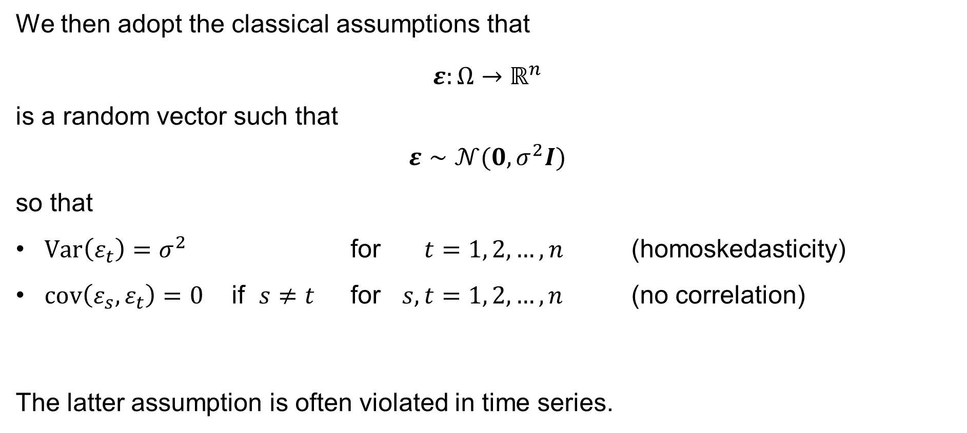
Time series: The Classical Assumption
We then adopt the classical assumptions that
$$ε:Ω→ℝ^{n}$$
is a random vector such that
$$ε∼𝒩(0,σ^{2}I)$$
so that
$Var\left(ε_{t}\right)=σ^{2}$ for $t=1, 2,…,n$ (homoskedasticity)
$cov\left(ε_{s},ε_{t}\right)=0$ if $s≠t$ for $s,t=1, 2,…,n$ (no correlation)
The latter assumption is often violated in time series.

Slide 28
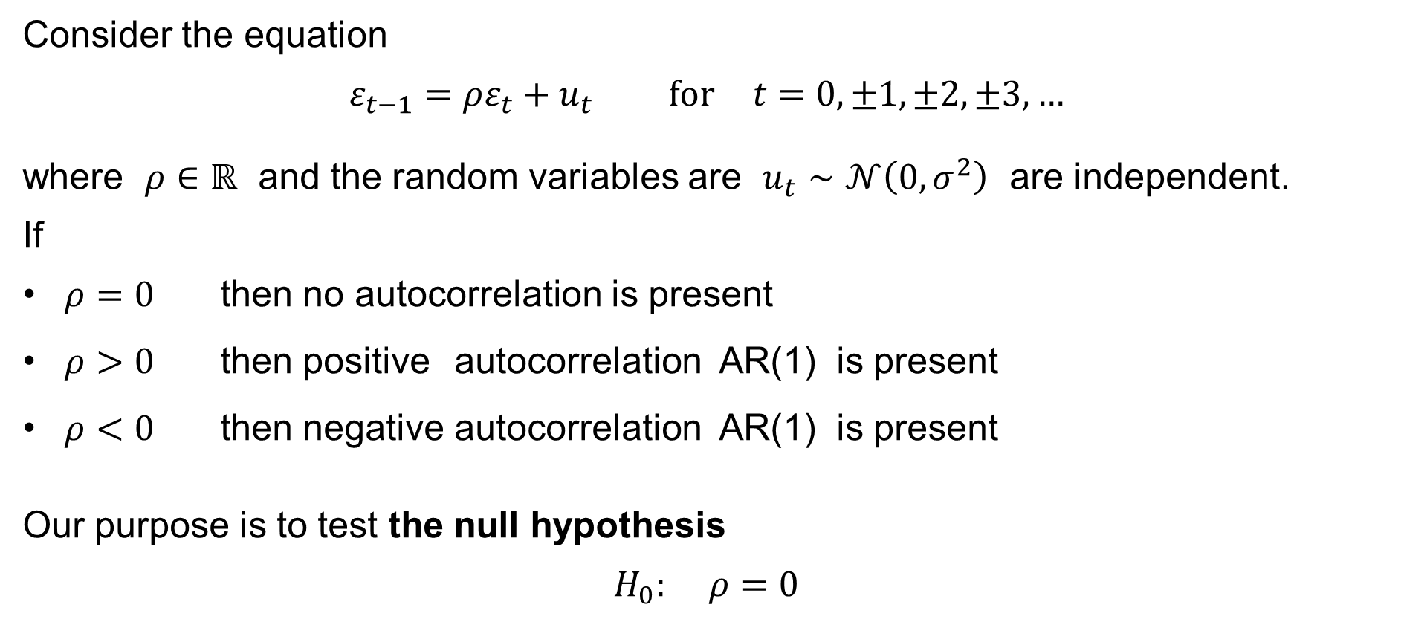
Time series: Autocorrelation
Consider the equation
$$ε_{t−1}=ρε_{t}+u_{t} \text{for} t=0,±1,±2,±3,…$$
where $ρ∈ℝ$ and the random variables are $u_{t}∼𝒩\left(0,σ^{2}\right)$ are independent.
If
$ρ=0$ then no autocorrelation is present
$ρ>0$ then positive autocorrelation AR(1) is present
$ρ<0$ then negative autocorrelation AR(1) is present
Our purpose is to test the null hypothesis
$$H_{0}: ρ=0$$

Slide 29
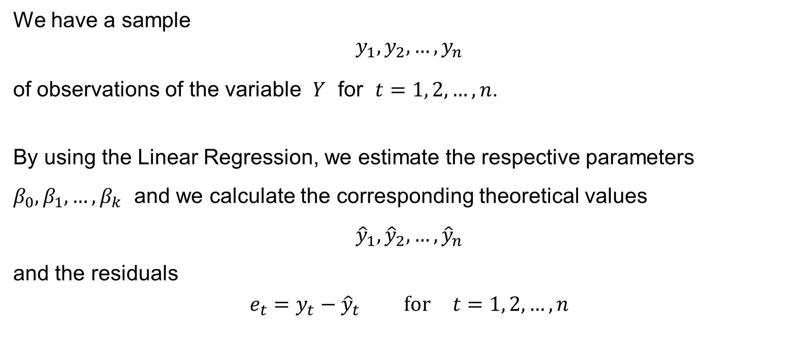
Time series: Durbin-Watson test
We have a sample
$$y_{1},y_{2},…,y_{n}$$
of observations of the variable $Y$ for $t=1, 2,…,n$.
By using the Linear Regression, we estimate the respective parameters $β_{0},β_{1},…,β_{k}$ and we calculate the corresponding theoretical values
$${\hat{y}}_{1},{\hat{y}}_{2},…,{\hat{y}}_{n}$$
and the residuals
$$e_{t}=y_{t}−{\hat{y}}_{t} \text{for} t=1, 2,…,n$$

Slide 30

Time series: Durbin-Watson test
We calculate the statistic
$$d=\frac{\sum_{t=2}^{n}{{\left(e_{t}−e_{t−1}\right)}^{2}}}{RSS}=\frac{\sum_{t=2}^{n}{{\left(e_{t}−e_{t−1}\right)}^{2}}}{\sum_{t=1}^{n}{e_{t}^{2}}}$$
and formulate the null hypothesis
$$H_{0}: ρ=0$$
The alternative hypothesis is
— either
$$H_{1}: ρ>0$$
— or
$$H_{1}: ρ<0$$

Slide 31
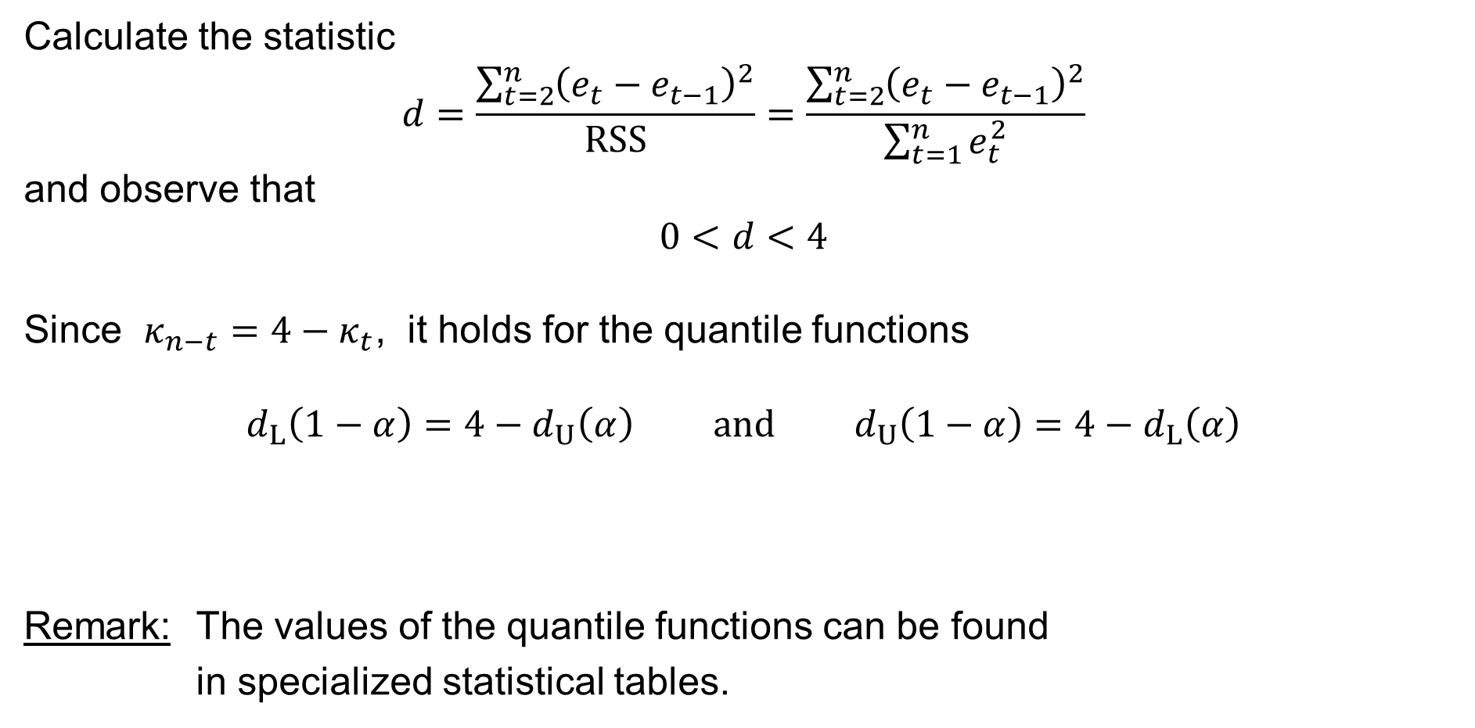
Time series: Durbin-Watson test
Calculate the statistic
$$d=\frac{\sum_{t=2}^{n}{{\left(e_{t}−e_{t−1}\right)}^{2}}}{RSS}=\frac{\sum_{t=2}^{n}{{\left(e_{t}−e_{t−1}\right)}^{2}}}{\sum_{t=1}^{n}{e_{t}^{2}}}$$
and observe that
$$0<d<4$$
Since $κ_{n−t}=4−κ_{t}$, it holds for the quantile functions
$$d_{L}\left(1−α\right)=4−d_{U}\left(α\right) \text{and} d_{U}\left(1−α\right)=4−d_{L}\left(α\right)$$
Remark: The values of the quantile functions can be found
in specialized statistical tables.

Slide 32
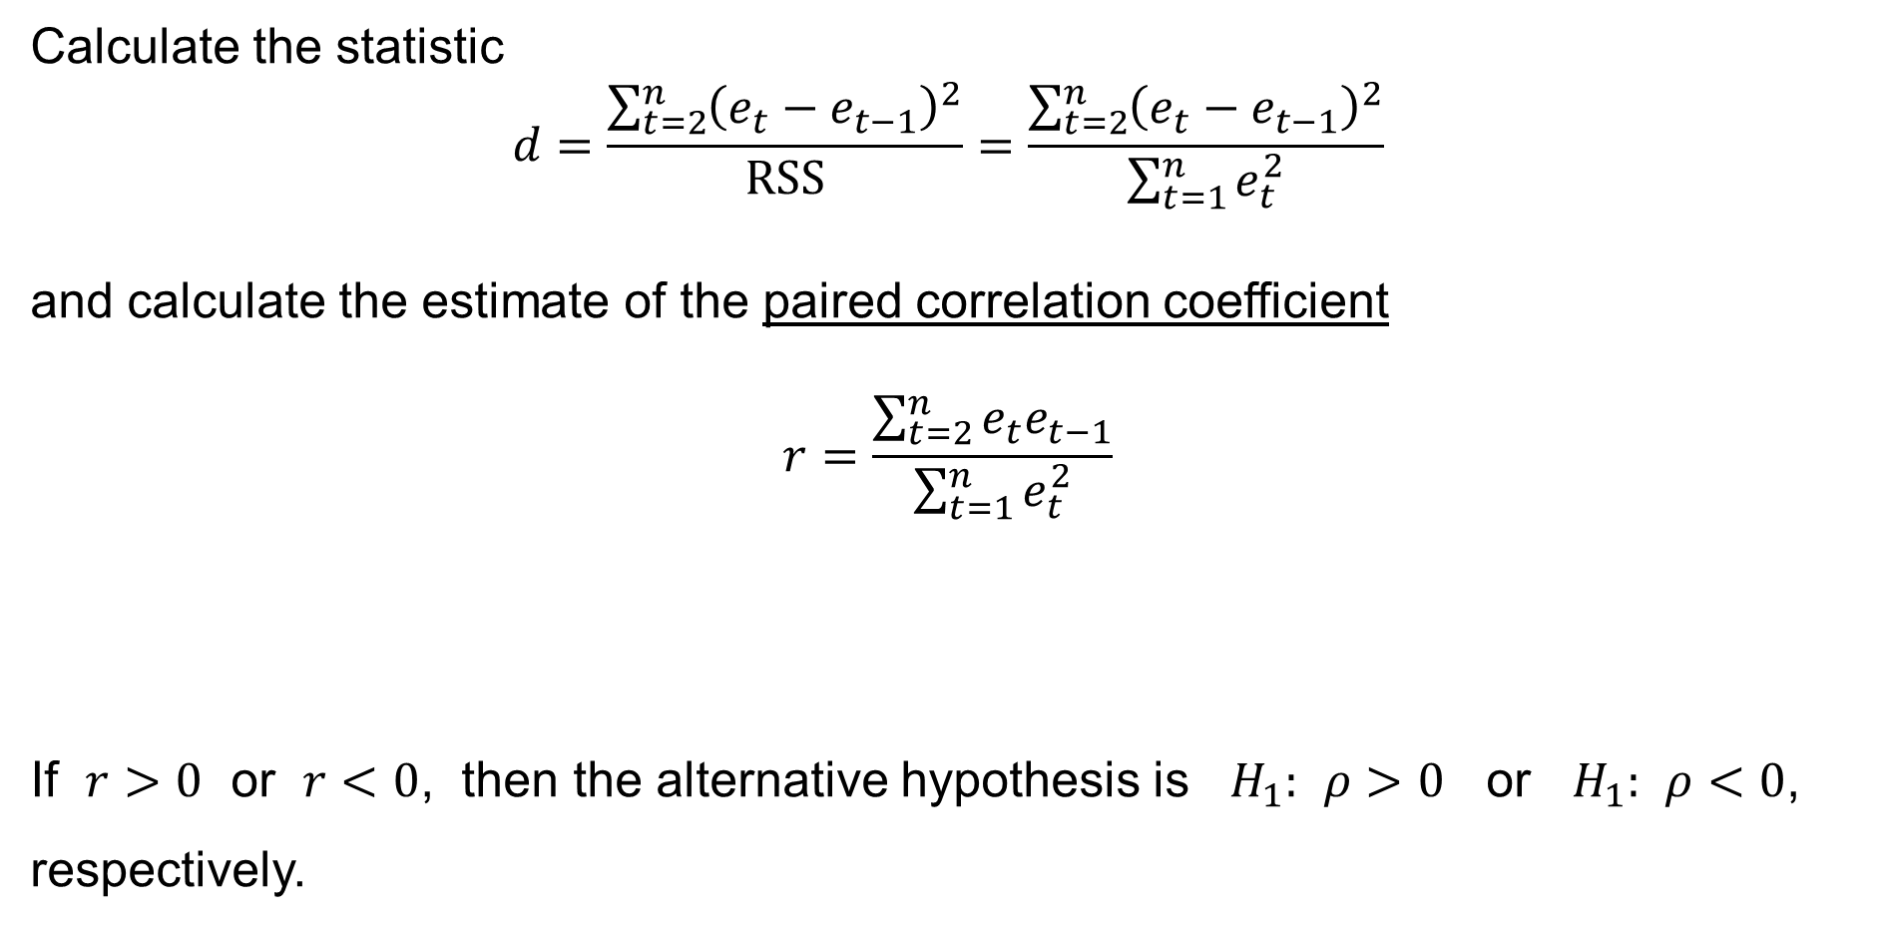
Time series: Durbin-Watson test
Calculate the statistic
$$d=\frac{\sum_{t=2}^{n}{{\left(e_{t}−e_{t−1}\right)}^{2}}}{RSS}=\frac{\sum_{t=2}^{n}{{\left(e_{t}−e_{t−1}\right)}^{2}}}{\sum_{t=1}^{n}{e_{t}^{2}}}$$
and calculate the estimate of the paired correlation coefficient
$$r=\frac{\sum_{t=2}^{n}{e_{t}e_{t−1}}}{\sum_{t=1}^{n}{e_{t}^{2}}}$$
If $r>0$ or $r<0$, then the alternative hypothesis is $H_{1}: ρ>0$ or $H_{1}: ρ<0$, respectively.

Slide 33
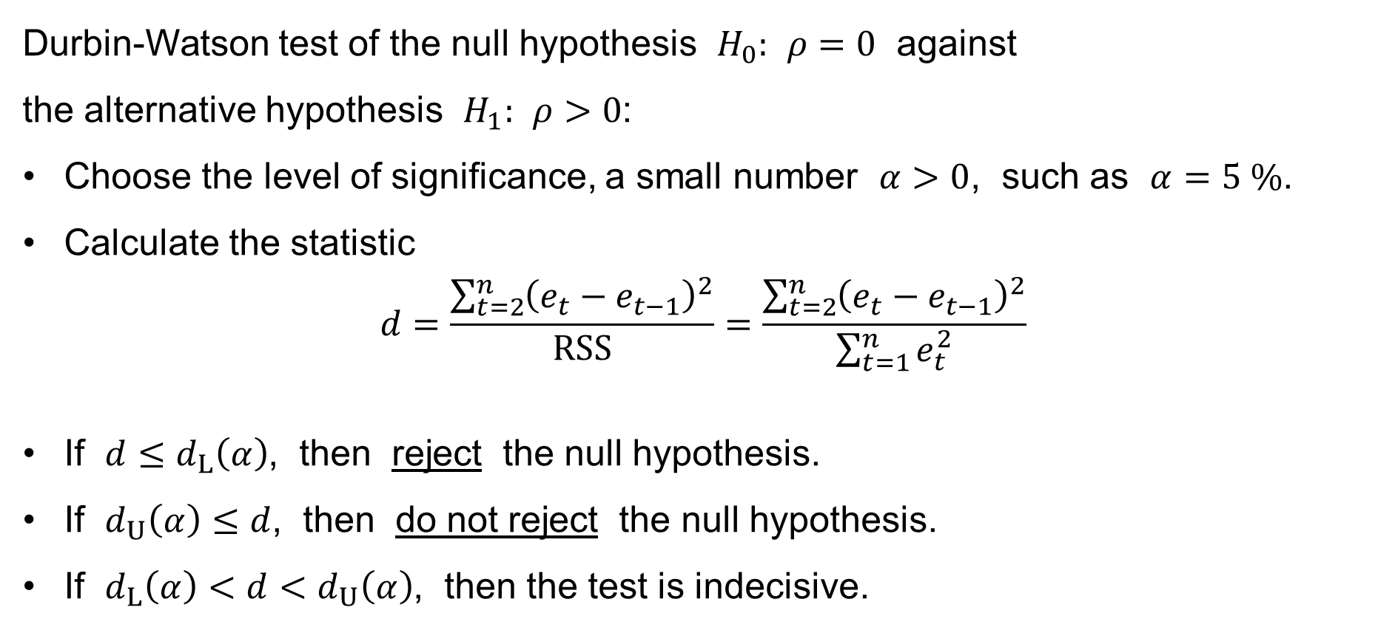
Time series: Durbin-Watson test
Durbin-Watson test of the null hypothesis $H_{0}: ρ=0$ against
the alternative hypothesis $H_{1}: ρ>0$:
Choose the level of significance, a small number $α>0$, such as $α=5 \%$.
Calculate the statistic
$$d=\frac{\sum_{t=2}^{n}{{\left(e_{t}−e_{t−1}\right)}^{2}}}{RSS}=\frac{\sum_{t=2}^{n}{{\left(e_{t}−e_{t−1}\right)}^{2}}}{\sum_{t=1}^{n}{e_{t}^{2}}}$$
If $d≤d_{L}\left(α\right)$, then reject the null hypothesis.
If $d_{U}\left(α\right)≤d$, then do not reject the null hypothesis.
If $d_{L}\left(α\right)<d<d_{U}\left(α\right)$, then the test is indecisive.

Slide 34
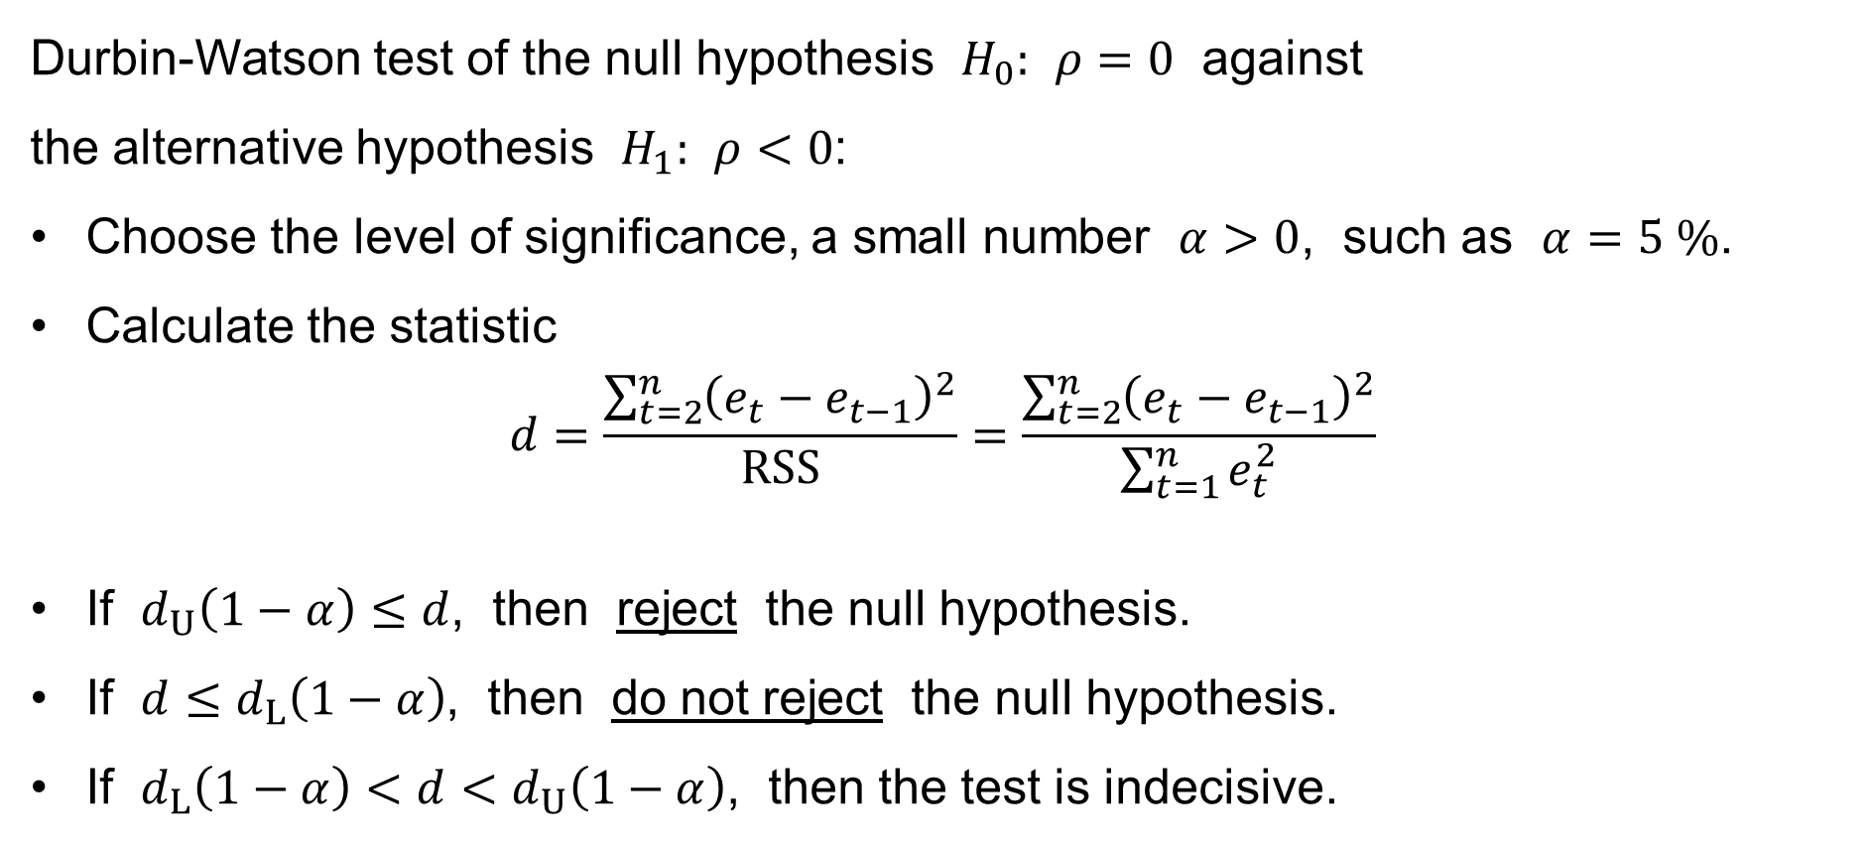
Time series: Durbin-Watson test
Durbin-Watson test of the null hypothesis $H_{0}: ρ=0$ against
the alternative hypothesis $H_{1}: ρ<0$:
Choose the level of significance, a small number $α>0$, such as $α=5 \%$.
Calculate the statistic
$$d=\frac{\sum_{t=2}^{n}{{\left(e_{t}−e_{t−1}\right)}^{2}}}{RSS}=\frac{\sum_{t=2}^{n}{{\left(e_{t}−e_{t−1}\right)}^{2}}}{\sum_{t=1}^{n}{e_{t}^{2}}}$$
If $d_{U}\left(1−α\right)≤d$, then reject the null hypothesis.
If $d≤d_{L}\left(1−α\right)$, then do not reject the null hypothesis.
If $d_{L}\left(1−α\right)<d<d_{U}\left(1−α\right)$, then the test is indecisive.

Slide 35
Moving average
Simple moving average
Weighted moving average

Slide 36
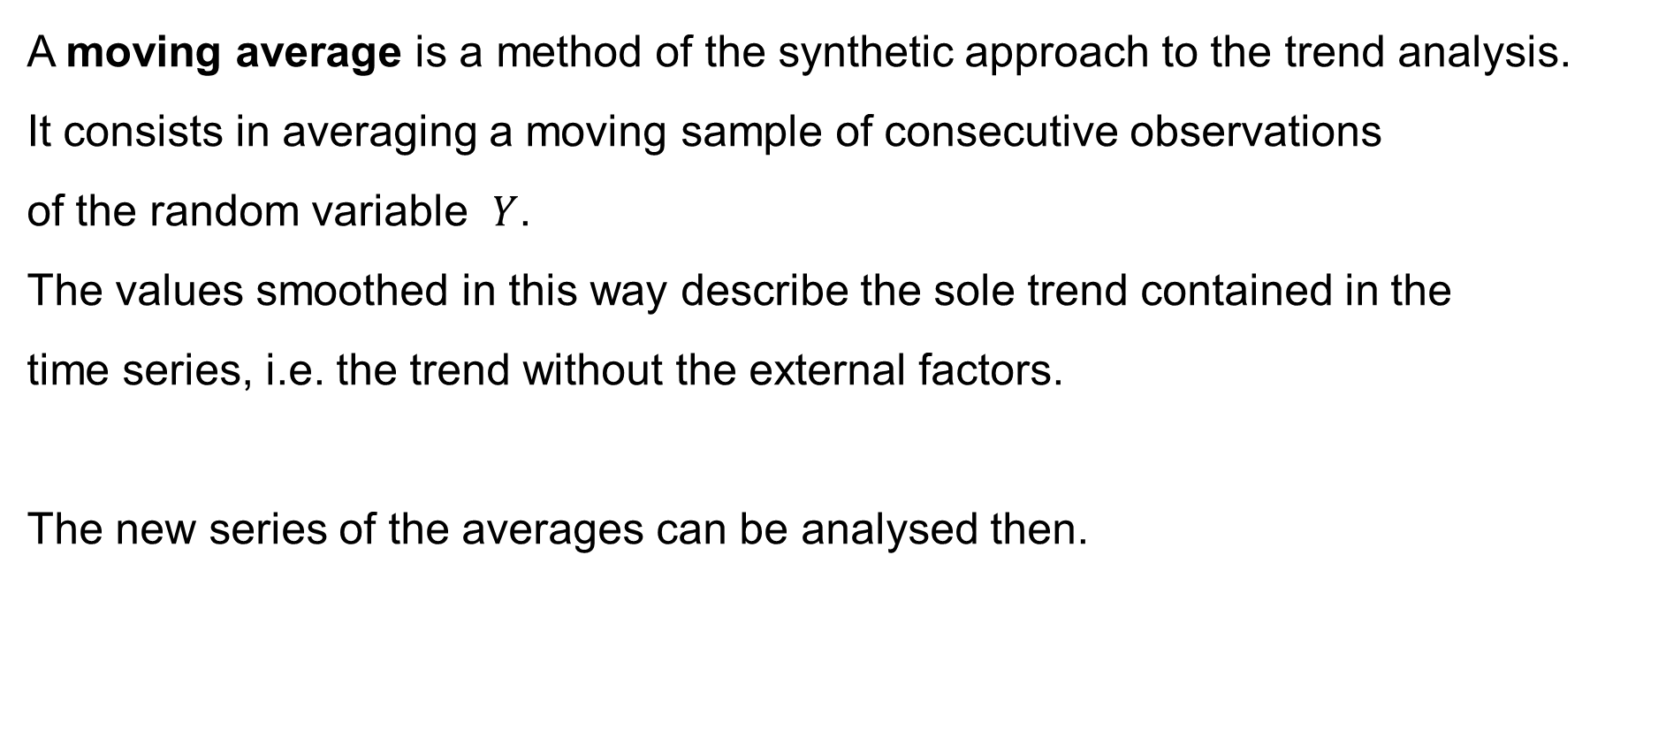
Moving average
A moving average is a method of the synthetic approach to the trend analysis.
It consists in averaging a moving sample of consecutive observations
of the random variable $Y$.
The values smoothed in this way describe the sole trend contained in the
time series, i.e. the trend without the external factors.
The new series of the averages can be analysed then.

Slide 37
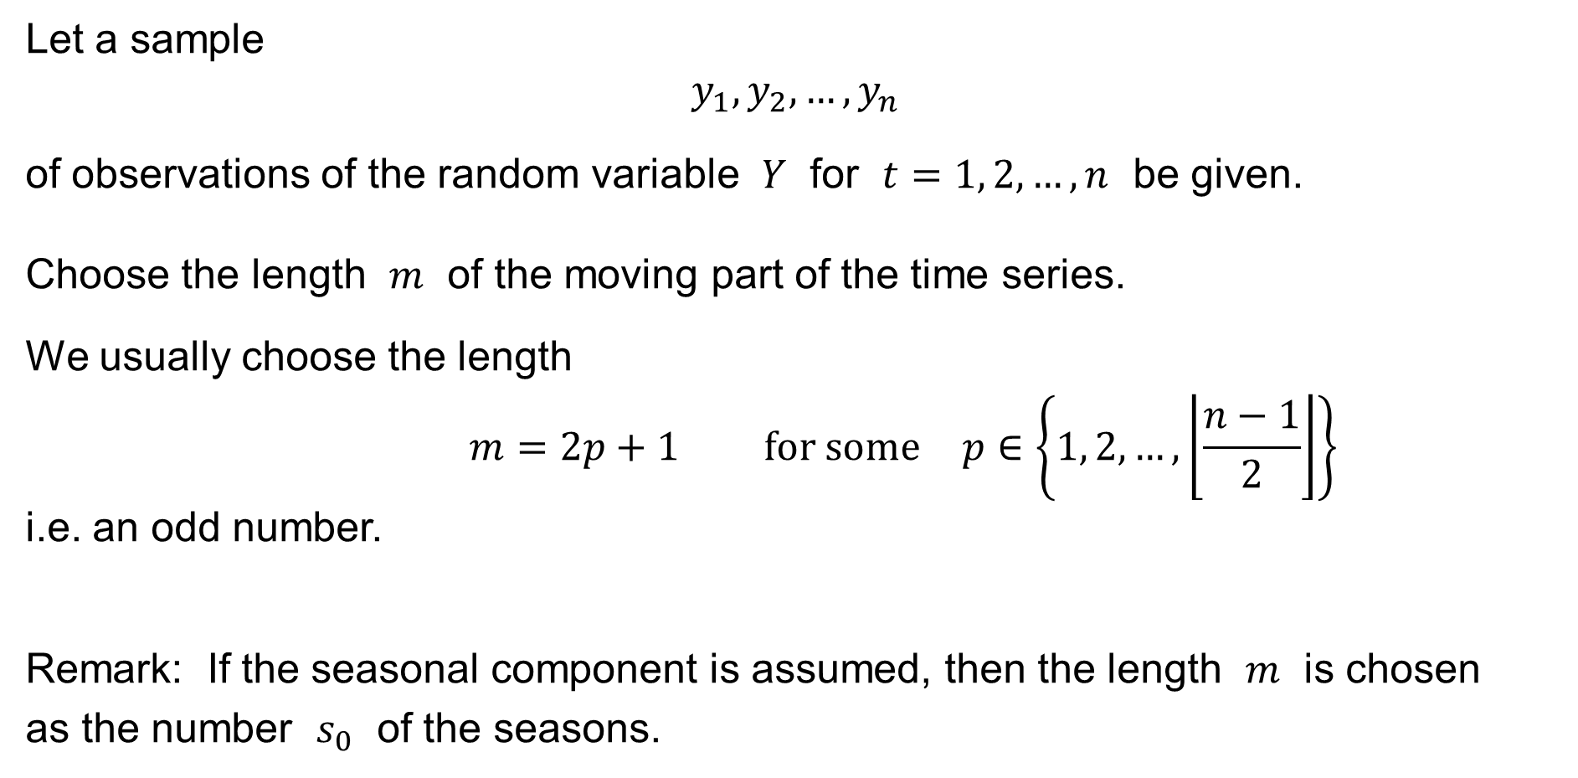
Simple moving average
Let a sample
$$y_{1},y_{2},…,y_{n}$$
of observations of the random variable $Y$ for $t=1, 2,…,n$ be given.
Choose the length $m$ of the moving part of the time series.
We usually choose the length
$$m=2p+1 \text{for} \text{some} p∈\left\{1, 2,…,\left\lfloor \frac{n−1}{2}\right\rfloor \right\}$$
i.e. an odd number.
Remark: If the seasonal component is assumed, then the length $m$ is chosen
as the number $s_{0}$ of the seasons.

Slide 38

Simple moving average
Having chosen the length
$$m=2p+1$$
and having the sample
$$y_{1},y_{2},…,y_{n}$$
we consider the new time series
$${\overline{y}}_{p+1},{\overline{y}}_{p+2},…,{\overline{y}}_{n−p}$$
of the moving averages
$${\overline{y}}_{τ}=\frac{1}{2p+1}\sum_{t=τ−p}^{τ+p}{y_{t}} \text{for} τ=p+1, p+2,…, n−p$$

Slide 39
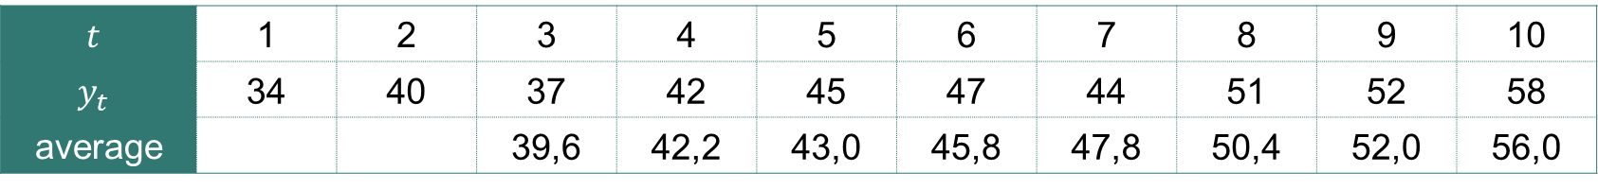

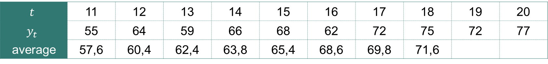
Simple moving average: Example
A time series and its moving averages of length $m=5$:
$$t$$ | 1 | 2 | 3 | 4 | 5 | 6 | 7 | 8 | 9 | 10
$$y_{t}$$ | 34 | 40 | 37 | 42 | 45 | 47 | 44 | 51 | 52 | 58
average |  |  | 39,6 | 42,2 | 43,0 | 45,8 | 47,8 | 50,4 | 52,0 | 56,0
$$t$$ | 11 | 12 | 13 | 14 | 15 | 16 | 17 | 18 | 19 | 20
$$y_{t}$$ | 55 | 64 | 59 | 66 | 68 | 62 | 72 | 75 | 72 | 77
average | 57,6 | 60,4 | 62,4 | 63,8 | 65,4 | 68,6 | 69,8 | 71,6

Slide 40
Simple moving average: Example

Slide 41
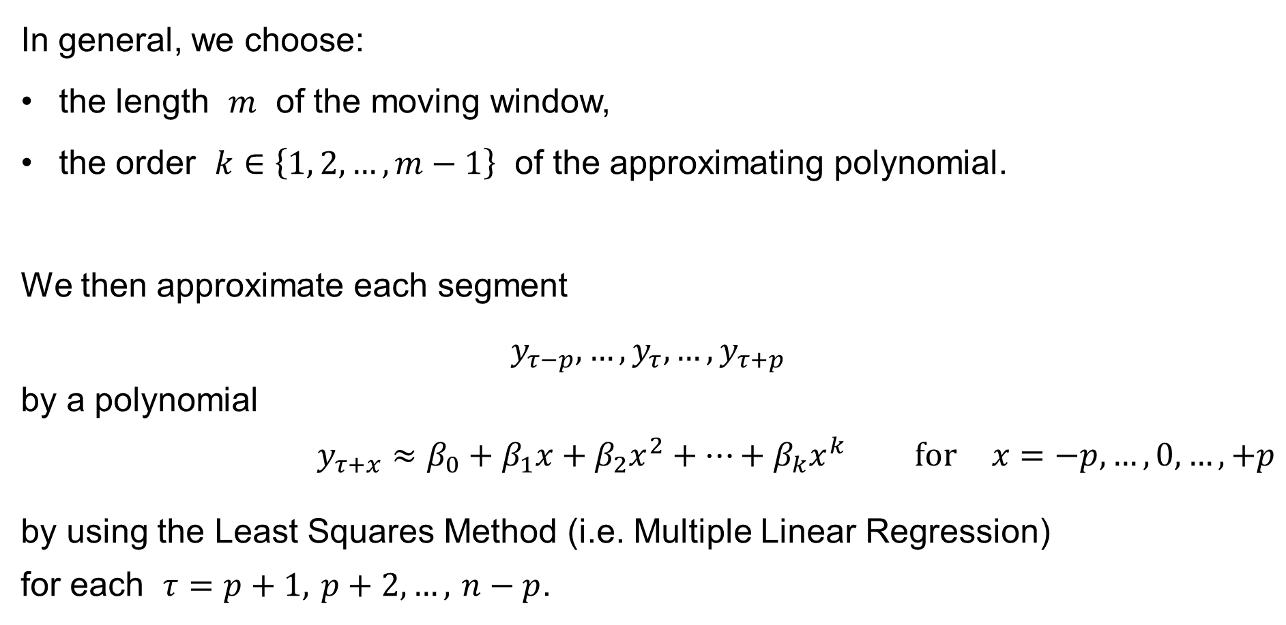
Moving average
In general, we choose:
the length $m$ of the moving window,
the order $k∈\left\{1, 2,…,m−1\right\}$ of the approximating polynomial.
We then approximate each segment
$$y_{τ−p},…,y_{τ},…,y_{τ+p}$$
by a polynomial
$$y_{τ+x}≈β_{0}+β_{1}x+β_{2}x^{2}+⋯+β_{k}x^{k} \text{for} x=−p,…,0,…,+p$$
by using the Least Squares Method (i.e. Multiple Linear Regression)
for each $τ=p+1, p+2,…, n−p$.

Slide 42
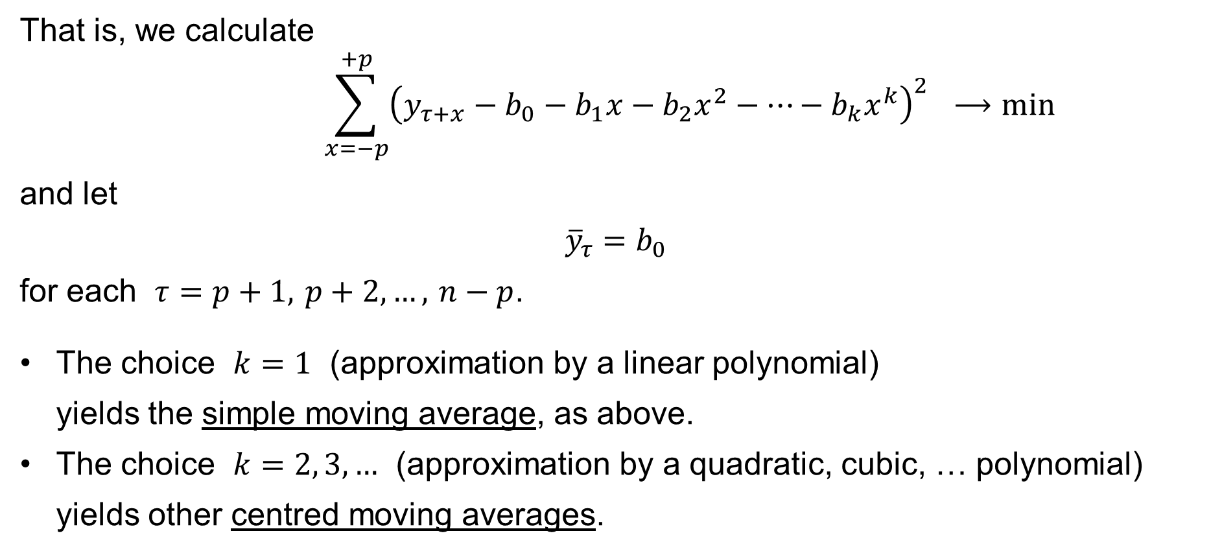
Moving average
That is, we calculate
$$\sum_{x=−p}^{+p}{{\left(y_{τ+x}−b_{0}−b_{1}x−b_{2}x^{2}−⋯−b_{k}x^{k}\right)}^{2}} ⟶min$$
and let
$${\overline{y}}_{τ}=b_{0}$$
for each $τ=p+1, p+2,…, n−p$.
The choice $k=1$ (approximation by a linear polynomial)
yields the simple moving average, as above.
The choice $k=2, 3,…$ (approximation by a quadratic, cubic, … polynomial) yields other centred moving averages.

Slide 43
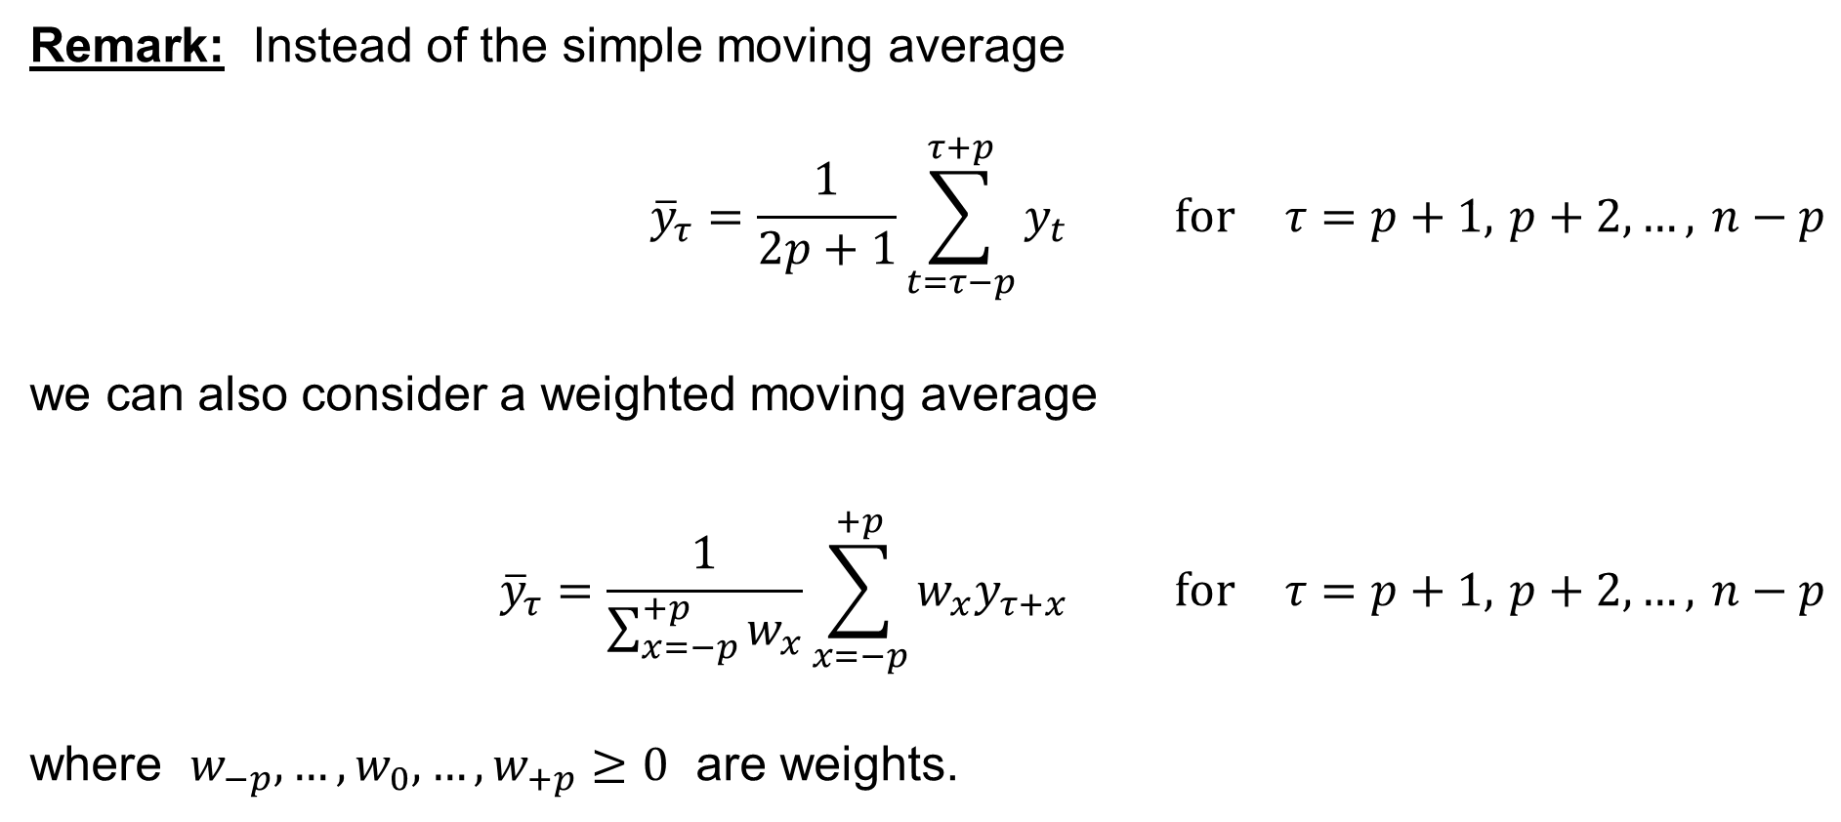
Moving average: Weighted moving average
Remark: Instead of the simple moving average
$${\overline{y}}_{τ}=\frac{1}{2p+1}\sum_{t=τ−p}^{τ+p}{y_{t}} \text{for} τ=p+1, p+2,…, n−p$$
we can also consider a weighted moving average
$${\overline{y}}_{τ}=\frac{1}{\sum_{x=−p}^{+p}{w_{x}}}\sum_{x=−p}^{+p}{w_{x}y_{τ+x}} \text{for} τ=p+1, p+2,…, n−p$$
where $w_{−p},…,w_{0},…,w_{+p}≥0$ are weights.

