Slide 1

Master thesis seminar (2)
FT purpose, methodology, thesis topic, citations
Ing. Michal Stoklasa, PhD
Business economics and managemen

Slide 2

Seminar agenda
1 Final thesis purpose and structure
2 Methodology – goals, methods
3 Sources and citations

Slide 3
1 Final thesis purpose
It is a scientific thesis - its elaboration is guided by a certain logic, it is necessary to work with literature, to cite it appropriately, plan, conduct and evaluate research, draw conclusions and make recommendations.
Throughout this thesis, the author shows that they are able to identify an area suitable for research, are able to set a goal, study theoretical information, understand the current situation, plan and conduct own research, evaluate everything and make recommendations for solving the problem. Hence the structure, see further.
Can ChatGPT write your thesis? NO! But it can help a lot!

Slide 4
Scientific approach
Problem – a company has a problem, you want to solve it – thats why you write your thesis. At first you have a vague understanding of the area, but you can formulate thesis name, goal and annotation.
Analysis – you can start your literature review and analysis of current situation. Based on this understanding of how it should work and how it is you can design your own research – create methodology.
Research – you choose best research method(s) to acquire relevant data.
Results and recommendations how to solve the problem – conduct the research, interprete data, present results, draw conclusions, formulate recommendations – how the company should solve the problem.

Slide 5
General thesis information
There is a Dean‘s Decree No. 8/2023 (and 1/2024 and 10/2023) for writing the final thesis, for editing, publishing and storing thesis, and your supervisor for consultation.
Learn to work with time - write on time, consult on time, your supervisor can have over 20 other students.
The thesis must be written in an impersonal style - it is a scientific work.

Slide 6
Thesis structure
Thesis structure depends on the topic, but in general, it could look like this:
  Introduction
  1 Theoretical basis (approx. 20 p.)
  2 Presentation of subjects (municipality, country, company) (approx. 5 p.)
  3 Practical part (approx. 20 p.)
  4 Suggestions and recommendations (approx. 10 p.)
  Conclusion
Numbers of pages are approximates, it will always depend on the specific topic and if you managed to fulfil the goal of the chapter (e.g. did I present enough data in the practical part to solve the problem?)

Slide 7
Find your own way
Thesis is intimidating – over 60 pages of scientific text!
But it can be a lot of fun to write!
Find an area, that is close to your heart (hobby, passion, sport) and bend your topic to this area.
Examples:
  Marketing Strategy – of a cricket team I like to watch every evening.
  Communication Strategy – of a company I love on social media.
  Business Plan – of a business I would love to start after graduation.

Slide 8
AI tools
If you were able to write the whole thesis through AI – what would be your contribution = value? Why would you receive the degree and not the AI?
AI tools can greatly help! But you are the arbiters of the information – you need to decide that it is correct and you want to use it in your thesis.
AI can help you discover the topic. Find subtopics. Correct your texts. Help with methodology. Analyse the data. Etc. But do not trust it 100 %! You have to always check if it is correct. It can not work well with your specific context (yet).
Set-up an agent for style corrections.
Explore your topic, ask questions, follow the science – so you are best prepared for your supervisor. But do not 100 % rely on the generated knowledge as it does not have to be true or usable in a thesis. Always listen to your supervisor!
Our faculty has official Statement on the use of artificial intelligence (AI).
Useful tools: ChatGPT/Gemini/Claude, SciSpace.

Slide 9
Abstract
The abstract should describe the whole thesis in 15 lines (half of a page).
It should therefore include thesis goal, its structure and chapters description, characteristics of the research carried out, main findings, main conclusions and recommendations.

Slide 10
Introduction
The introduction is structured - general introduction to the problem, thesis goal (exact wording as in the thesis topic submited to the IS!), methods and procedures for achieving the goal, description of chapters.
Common mistakes - you do not write impersonally, missing any introduction to the issue, the wording of the goal is completely different than in the thesis topic, there is no text explaining how you aim to achieve your thesis goal.

Slide 11
1st chapter – theoretical basis
The purpose of this chapter is to create a theoretical basis for your further efforts in this area. So you want to work with valuable resources (books by reputable authors), not just articles on the Internet.
The content of the first chapter must correspond to the issue in the third chapter.
The chapter must have a logical sequence - it must be clear why the author proceeds in a certain way and where they are heading - a frequent mistake is the text acting as copied disparate parts, where it is not clear why they are listed and where the text will lead.
Citations:
  We use the Harvard system - see. methodological instruction!
  We use direct quotations more sparingly than paraphrases, but both require reference.
  Most of the text of the first chapter is taken over from other sources, so each paragraph will have a reference.
  However, do not forget to work with the theory - to introduce different approaches of several authors and to define them (own view, which will be used in the work) - polemics.

Slide 12
2nd chapter – company characteristics
It contains the characteristics of the company (country, industry etc.) - characteristics (short history), organizational structure, subject of business, subjects, characteristics of competition or market (if specific), etc.
For this chapter, you cannot just copy information from the company website!
The second chapter must also have links to resources (web, company internal materials, etc.).

Slide 13
3rd chapter – own research (analysis)
The purpose of this chapter is to first characterize the current state of the researched issue, then plan your own research, conduct it, evaluate it and interprete it.
We follow the basic research logic - starting with secondary data, after we exhaust it, we plan to obtain primary data.
It is advisable to follow marketing research plan – e.g. Saunders, Kumar etc.
You will write the most important part of your thesis, your own suggestions and recommendations, based on the secondary and primary data, so it is advisable to pay close attention to the design of your research. After creating the research design, try to pilot it - does it substantialy help to achieve the thesis goal, can you make valuable suggestions and recommendations?

Slide 14
4th chapter – suggestions and recommendations
Outline of suggestions and recommendations, the implementation of which in practice would help solve the problem identified in the thesis.
Proposals and recommendations must be formulated based on the results of the third chapter - the actual contribution of the thesis. (because XY % of respondents answered the question Z in this way, it is recommended that the company implements this …; the data shows this, it is recommended …)
Justify the proposals and recommendations adequately, explain their benefits and costs (financial, human, time etc.). It is advisable to create a calculation for proposals directly, if not, we proceed at least in general. Everybody is able to create recommendations, you have to prove that yours are both appropriate and realistic.

Slide 15
Conclusion
In the conclusion, the main findings should be sufficiently justified, it is an overall evaluation of the thesis.
Conclusion therefore summarizes the main results of the work; moreover, the author should take into account that in the introduction they set the goal of their diploma thesis and all their efforts should be directed towards this goal.
If there are hypotheses set in the thesis, it is necessary to point out how they were accepted / rejected.
An important part of the conclusion is to define the contribution of the thesis or outline recommendations and proposals, the implementation of which would help solve the problem identified in the thesis.

Slide 16
2 Methodology
„Methodology is the systematic, theoretical analysis of the methods applied to a field of study.“ (Berg, 2009)
Simply – HOW we do our research (understand, plan, carry out, analyse, interprete, present).
Different fields of study use different methods! We are in Social sciences, we use methodology best suited to our needs.
General methods of social research – deduction and induction, analysis and synthesis, abstraction and generalization, analogy and modelling, etc.
Marketing research – qualitative and quantitative, secondary and primary data, research process and methods.
Notes:
Source: Berg, Bruce L., 2009, Qualitative Research Methods for the Social Sciences. Seventh Edition. Boston MA: Pearson Education Inc.

Slide 17
Marketing research
Qualitative marketing research - generally used for exploratory purposes - small number of respondents - not generalizable to the whole population - statistical significance and confidence not calculated - examples include focus groups and projective techniques.
Quantitative marketing research - generally used to draw conclusions - tests a specific hypothesis - uses random sampling techniques so as to infer from the sample to the population - involves a large number of respondents - examples include surveys and questionnaires.
Secondary marketing research is conducted on data published previously and usually by someone else. Secondary data may be internal to the firm, such as sales invoices and warranty cards, or may be external to the firm such as published data or commercially available data.
A company conducts primary marketing research by gathering original data.

Slide 18
Marketing research methods
Survey – based on the statements of recipients through communication, question-form (written – mail, e-mail, website, face-to-face, telephone).
Observation (hidden x noticeable) is focusing primarily on human behavior in the process of receiving marketing inputs and subsequent behavior.
Experiment (often called Test Marketing) actively manipulates examined factors, it influences the situation and explores the reactions of people in natural or laboratory situation.

Slide 19
Marketing research process (Kozel, 2011, p. 73)
PREPARATORY STAGE
  Phase 1 - problem definition, objectives and research hypotheses.
  Phase 2 - orientation analysis.
  Phase 3 - marketing research plan - the type of data, methods and techniques for their collection, sample, time schedule, control.
  Phase 4 - pilot study.
IMPLEMENTATION STAGE
  Phase 5 - data collection.
  Phase 6 - data processing.
  Phase 7 - analysis of collected data - processing using MS Excel and SPSS.
  Phase 8 - the interpretation of the information obtained.
  Phase 9 - presentation of results.

Slide 20
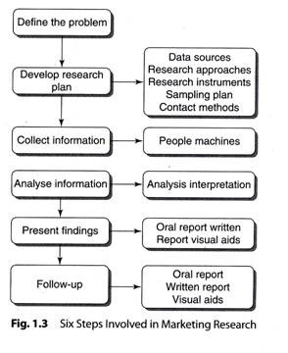
Research proces by Kotler

Slide 21
Methodology in Thesis
I recommend to have a chapter "3.1 Thesis Methodology" where you describe the whole process of creating your thesis.
On the basis of secondary research - critical analysis of available literary sources (literature, articles, research, etc.) and the current state of the issue, primary research was planned - describe the method, technique, sample, etc. (where, who, with whom, why, how).
At the state exams you present your thesis in 8 minutes with a 10 minutes discussion. You need to explain how you wrote your thesis and why. So you started with a secondary research of theoretical resources to have an overview of the subject matter… description of what and how… then you needed to find out the current state of the subject in practice, again secondary data… description of what and how… and only after you have exhausted all available secondary data and there was still an information gap, you planned your primary research in a certain way because …, which aims to find out this and that. You want to explain the reasons and continuity of the thesis. All this leads to enough data, information and knowledge to create suggestions and recommendations.

Slide 22
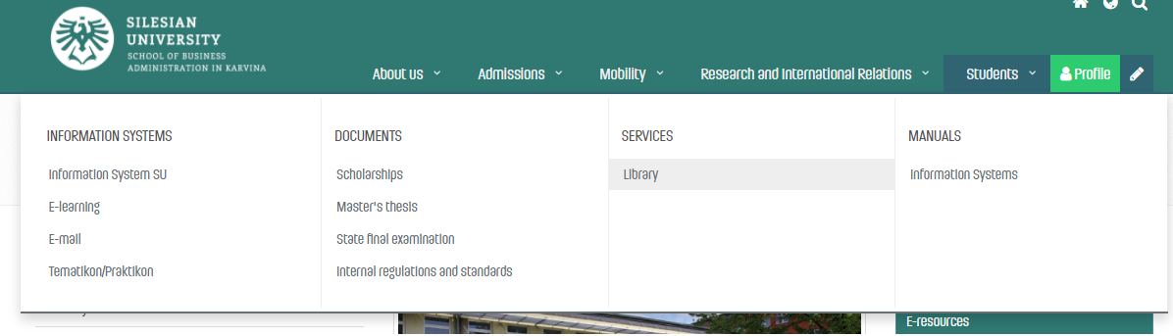
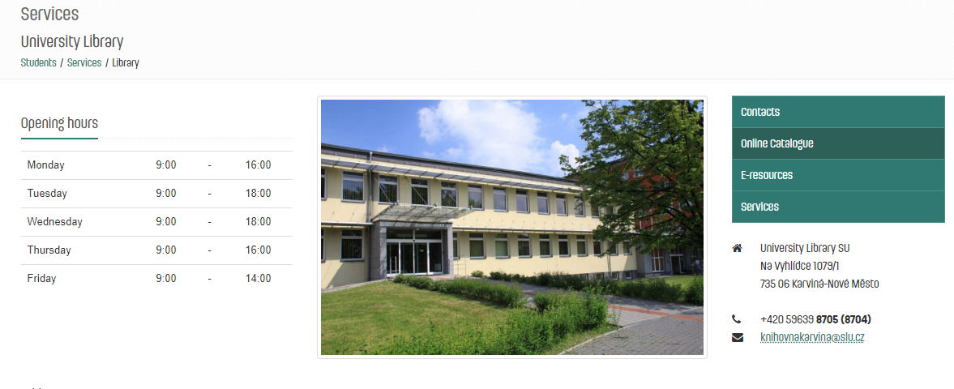
3 Sources and citations
Our library is full of sources.

Slide 23
Citations
DI 8/2023 states that „all that is stated in the References in the wording of full bibliographic citations, must be continuously cited in the text, and the student uses the abbreviated citation method (the Harvard citation system), i.e. the surname of the author or authors (year of publication, in the case of direct or indirect citations the page or the range of pages, is stated)“.
The taken text can be cited in the following forms (DI 8/2023):
  a) Direct citation - the text is taken literally from the original work and is in quotation marks.
  b) Indirect citation (paraphrase) - the text is interpreted from the original work in own words, without changing the meaning of the text.

Slide 24
Examples
DI 8/2023 states that „all that is stated in the References in the wording of full bibliographic citations, must be continuously cited in the text, and the student uses the abbreviated citation method (the Harvard citation system), i.e. the surname of the author or authors (year of publication, in the case of direct or indirect citations the page or the range of pages, is stated)“.
I need a long text. Long text is what I need. I need a long text. Long text is what I need. I need a long text. Long text is what I need. I need a long text. Long text is what I need. I need a long text. Long text is what I need. I need a long text. Long text is what I need. I need a long text. Long text is what I need. I need a long text. Long text is what I need. (Stoklasa, 2024, 23-34)

