Slide 1

Research methods II
Master thesis seminar
19.11.2024

Slide 2
Content
Analysing qualitative data
Statistical analysis of quantitative data
Writing convincing conclusions
Presentation skills

Slide 3
1
Analysing qualitative data

Slide 4
Short recap
Qantitative data | Qualitative data
Based on meanings derived from numbers | Based on meanings expressed through words (spoken and textual) and images
Collection results in numerical and standardised data | Collection results in non-standardised data requiring classification into categories
Analysis conducted through the use of diagrams and statistics | Analysis conducted through the use of conceptualisation
When using both quant and qual, we call the approach mixed method research design.

Slide 5
Analysing qualitative data
Qualitative data are likely to be characterised by their richness and fullness, based on your opportunity to explore a subject in as real a manner as is possible.
In qualitative research, meanings are principally derived from words and images, not numbers.
Since words and images may have multiple meanings as well as unclear meanings, it is necessary to explore and clarify these with great care.

Slide 6
Collecting qualitative data
Qualitative data can be generated in many forms:
  Archival and documentary research (secondary data)
  Observations, surveys and interviews (primary data)
Primary qualitative data are recorded and have to be transcripted later on.
  As an interviewer, you would be interested not only in what participants said, but in the way they said it as well.
    Tone of a voice
    Facial expression
    Body language

Slide 7
Transcribing qualitative data - checklist
Have you thought about how you intend to analyse your data and made sure that your transcription will facilitate this?
Have you chosen clear interviewer and respondent identifiers and used them consistently?
Have you included the interview questions in full in your transcription?
Have you saved your transcribed data using a separate file for each interview?
Does your filename maintain confidentiality and preserve anonymity while still allowing you to recognise important information easily?
Have you checked your transcript for accuracy and, where necessary, ‘cleaned up’ the data?
Have you stored a separate backup or security copy of each data file on your USB mass storage device or cloud?

Slide 8
Analysing qualitative data
There are some tools which can help you when analysing qualitative data:
  interim or progress summaries;
  transcript summaries;
  document summaries;
  self-memos;
  research notebook;
  reflective diary or journal.

Slide 9
Qualitative data analysis: Example
Research question: What is the approach to inventory management in the large XY company.
3 structured interviews with managers.
Thematic analysis on qualitative data.

Slide 10
Qualitative data analysis: Example
Familiarization with Data:
  Read through all the data thoroughly to become familiar with the content.
Generating Initial Codes:
  Systematically code the data, identifying features of the data that are interesting and relevant to the research question.
Searching for Themes:
  Collate codes into potential themes, gathering all data relevant to each potential theme.
Conclusion:
  Relate the analysis back to the research question and literature, providing a narrative that tells a story about the data.

Slide 11
Qualitative data analysis: Interviews
Manager A: "In our department, we've adopted a Just-in-Time (JIT) inventory system. Our focus is on efficiency and reducing waste. We coordinate closely with our suppliers to ensure that inventory is delivered exactly when needed. This approach minimizes storage costs and keeps our inventory levels low. We do face challenges in ensuring timely delivery and managing the risks associated with supply chain disruptions. However, we've found that with careful planning and strong relationships with suppliers, JIT is extremely effective for us."

Slide 12
Qualitative data analysis: Interviews
Manager B: "My team uses an ABC analysis approach for inventory management. We categorize inventory into three groups: A, B, and C, based on their importance and value. 'A' items are high-value with low frequency of use, 'B' items are moderate in value and use, and 'C' items are low-value but high frequency. This method helps us optimize our inventory by focusing more resources on the most valuable items. We invest in advanced tracking and analytics to monitor these categories and adjust our strategy accordingly. This method has significantly improved our inventory turnover and reduced carrying costs."

Slide 13
Qualitative data analysis: Interviews
Manager C: "Our approach is centered around detailed demand forecasting and maintaining safety stock. We use historical sales data, market trends, and predictive analytics to forecast future demand accurately. Based on these forecasts, we maintain a certain level of safety stock to cushion against unexpected demand spikes or supply issues. This approach requires a delicate balance – too much safety stock increases holding costs, while too little risks stockouts. We're continuously refining our forecasting models to improve accuracy. This strategy has been effective in ensuring product availability and customer satisfaction."

Slide 14
Qualitative data analysis: Interviews
Manager A: "In our department, we've adopted a Just-in-Time (JIT) inventory system. Our focus is on efficiency and reducing waste. We coordinate closely with our suppliers to ensure that inventory is delivered exactly when needed. This approach minimizes storage costs and keeps our inventory levels low. We do face challenges in ensuring timely delivery and managing the risks associated with supply chain disruptions. However, we've found that with careful planning and strong relationships with suppliers, JIT is extremely effective for us.”
Themes: Efficiency Optimization, Risk Management, Data-Driven Decision Making, Cost-Benefit Balance

Slide 15
Qualitative data analysis: Interviews
Manager B: "My team uses an ABC analysis approach for inventory management. We categorize inventory into three groups: A, B, and C, based on their importance and value. 'A' items are high-value with low frequency of use, 'B' items are moderate in value and use, and 'C' items are low-value but high frequency. This method helps us optimize our inventory by focusing more resources on the most valuable items. We invest in advanced tracking and analytics to monitor these categories and adjust our strategy accordingly. This method has significantly improved our inventory turnover and reduced carrying costs.”
Themes: Efficiency Optimization, Risk Management, Data-Driven Decision Making, Cost-Benefit Balance

Slide 16
Qualitative data analysis: Interviews
Manager C: "Our approach is centered around detailed demand forecasting and maintaining safety stock. We use historical sales data, market trends, and predictive analytics to forecast future demand accurately. Based on these forecasts, we maintain a certain level of safety stock to cushion against unexpected demand spikes or supply issues. This approach requires a delicate balance – too much safety stock increases holding costs, while too little risks stockouts. We're continuously refining our forecasting models to improve accuracy. This strategy has been effective in ensuring product availability and customer satisfaction.”
Themes: Efficiency Optimization, Risk Management, Data-Driven Decision Making, Cost-Benefit Balance

Slide 17
Qualitative data analysis: Interviews
Conclusion:
The thematic analysis reveals that inventory management in a large company involves a multifaceted approach. Managers prioritize efficiency, but also recognize the importance of risk management, especially in systems like JIT. The use of data-driven strategies, such as ABC analysis and demand forecasting, highlights the shift towards analytics in inventory management. Balancing cost and benefits is a recurring theme, as managers aim to optimize inventory levels while ensuring customer satisfaction and minimizing costs.

Slide 18
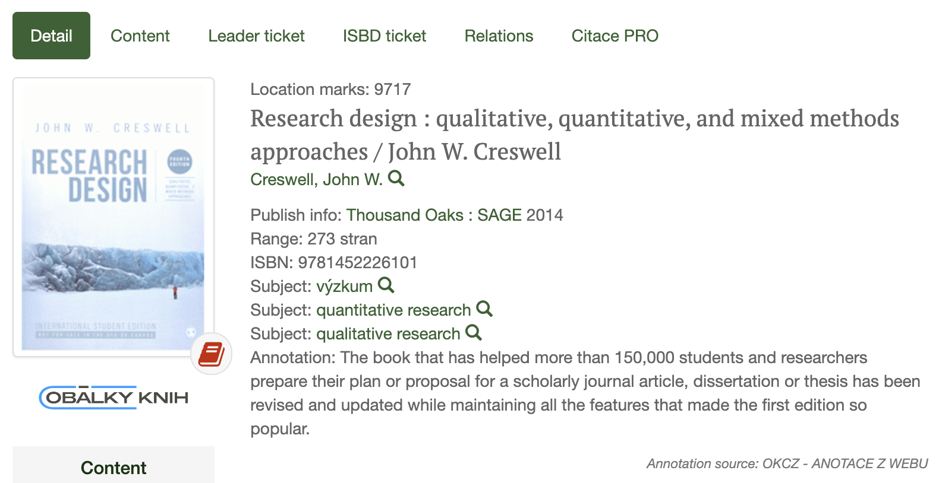
Books on qualitative methods in library

Slide 19
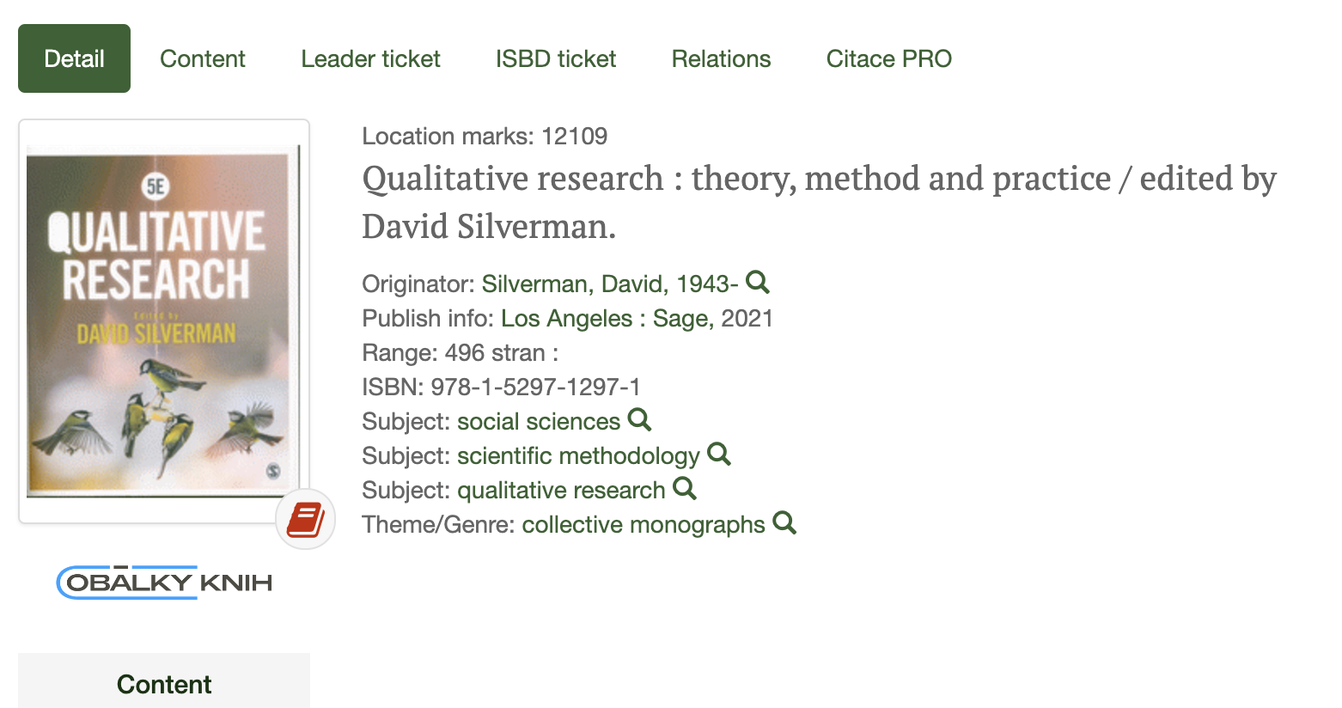
Books on qualitative methods in library

Slide 20

Books on qualitative methods in library

Slide 21

Trusted Youtube Channel
https://www.youtube.com/@GradCoach

Slide 22
2
Statistical analysis of quantitative data

Slide 23
Statistical analysis of quantitative data
Quantitative data in a raw form, that is, before these data have been processed and analysed, convey very little meaning to most people.
These data, therefore, need to be processed to make them useful, that is, to turn them into information.
Quantitative analysis techniques such as tables, graphs and statistics allow us to do this, helping us to explore, present, describe and examine relationships and trends within our data.

Slide 24
Types of data
Categorical
  Categorical data refer to data whose values cannot be measured numerically but can be either classified into sets (categories) according to the characteristics that identify or describe the variable or placed in rank order.
Numerical
  Numerical data are those whose values are measured or counted numerically as quantities.

Slide 25
Types of data
Categorical
  Nominal (descriptive) data
  Ordinal (ranked) data
Numerical
  Interval data
  Ratio data

Slide 26
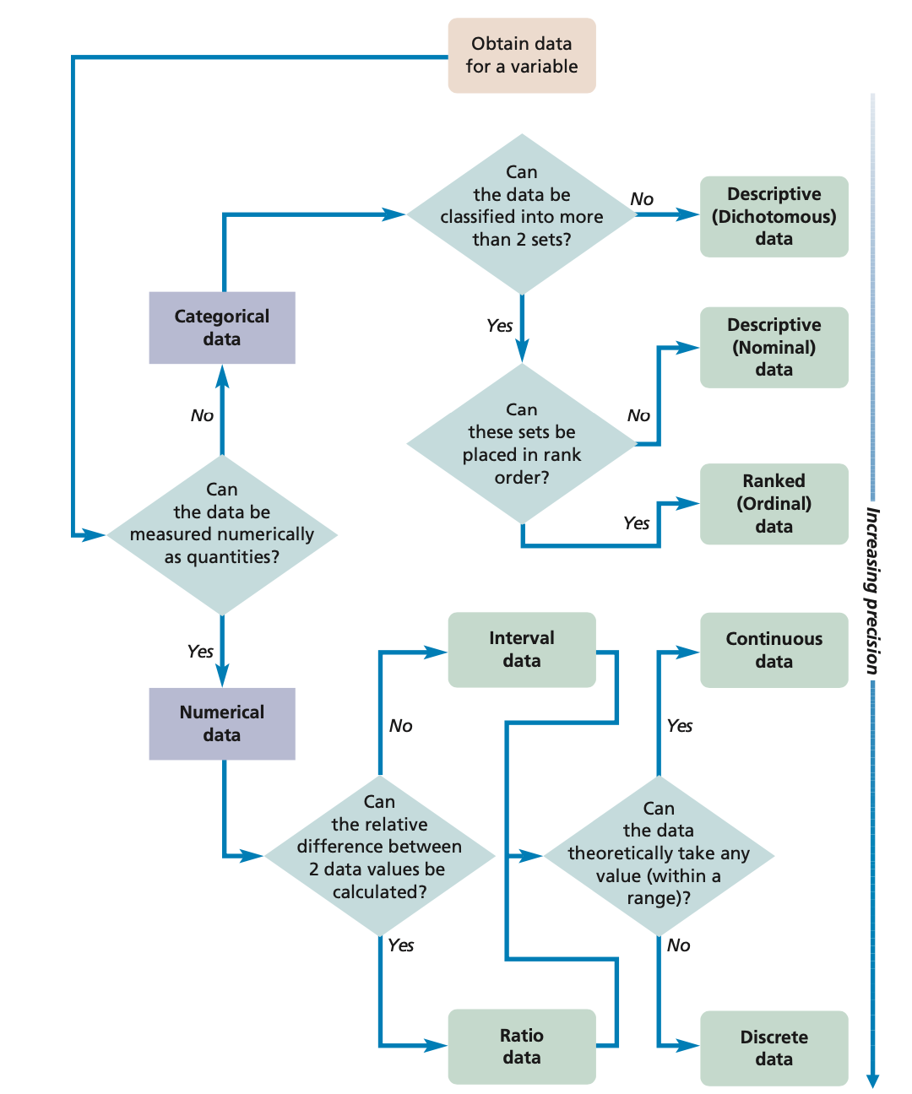

Slide 27
 | Description:what is it? | Order: What is more and what is less | Distance: How much bigger is one than the other | Relative difference: What is a ratio between two values | Examples
Nominal | ✓ | ✗ | ✗ | ✗ | Gender
Ordinal | ✓ | ✓ | ✗ | ✗ | Education
Interval | ✓ | ✓ | ✓ | ✗ | Temperature
Ratio | ✓ | ✓ | ✓ | ✓ | Profit

Slide 28
Descriptive statistics
It is essentially a description of the quantitative data collected.
We describe the individual variables, yet separately from the other variables.
The variable is, for example, customer satisfaction
The categories of values are variations of the scores on the scale (for example: very satisfied, satisfied, dissatisfied, very dissatisfied)

Slide 29
Descriptive statistics
Modus - the value of the response with the highest frequency
Median - the middle value in an ascending order of values
Mean - the arithmetic mean is also used only for numeric variables - interval or ratio and is influenced with outliers compared to the median.
Quantiles - divide an ordered set into n parts in ascending order of values. Quartiles are most commonly used, dividing the set into 4 parts. We know 25% quartiles (lower or first) and then 75% (upper or also third).

Slide 30
Types of variables
There are two basic types of dependent variables:
  The first is the dependent variable, which, as the name implies, is influenced by another variable. Thus, we expect changes due to a change in the independent variable.
  The second is an independent variable that influences another variable.
Independent
Dependent

Slide 31
Statistical methods
Knowing types of data and variables one can select a statistical test to be used.
What type of data is dependent variable?
What type of data is independent variable?

Slide 32
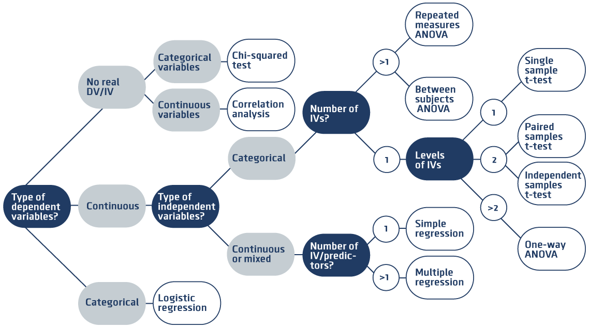
https://tales.nmc.unibas.ch/de/conducting-psychological-research-6/statistics-and-analyses-22/which-test-for-which-hypothesis-71

Slide 33
Chi-Square
It is based on the logic of a contingency table that compares two variables against each other.
The variables are ideally nominal or ordinal.
The underlying version of the statistical method is based on a 2x2 matrix, where each variable takes two values.
Beyond simple contingency, chi-square allows comparison of expected frequency and observed frequency. This essentially reveals the relationships that are present in the data.
Both contingency tables and chi-squares can be processed in Excel and other statistical programs such as SPSS.

Slide 34
Correlation analysis
Expresses the degree of association between two variables in the data matrix. These variables should ideally be at least cardinal.
Correlation measures the closeness of the relationship, i.e. the interrelation of the variables, not causality. Correlation cannot reveal causality, that is, the causal relationship between two variables.
The result of correlation analysis is in the form of a correlation coefficient, which takes values from -1 to 1 describing the strength of the association.
It is widely used on its own, but it is also the basis for more advanced analyses such as factor analysis, etc.

Slide 35
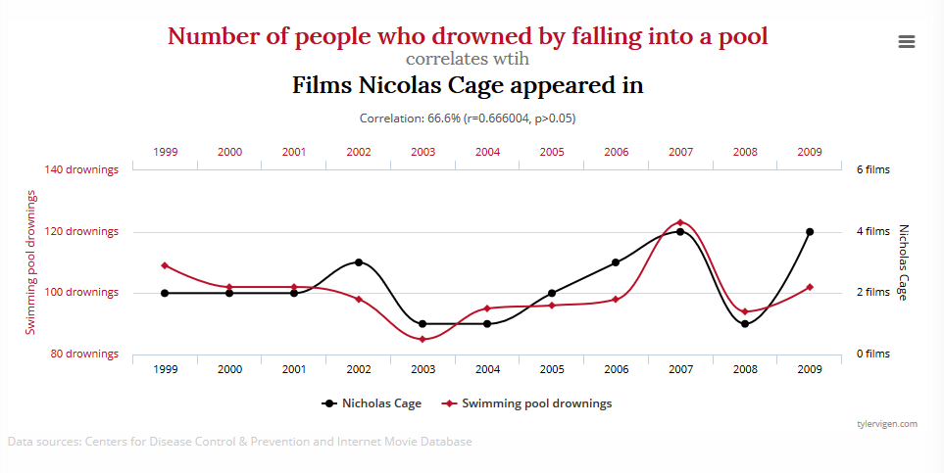
Correlation analysis

Slide 36
Anova
Abbreviation for the English term ANalysis Of Variance.
Analysis of Variance - is nothing more than comparing the differences in variances of different variants.
The nominal trait is the independent variable.
The cardinal trait is the dependent variable.
By comparing variances within groups, we determine whether the nominal variable has an effect on the cardinal variable.

Slide 37
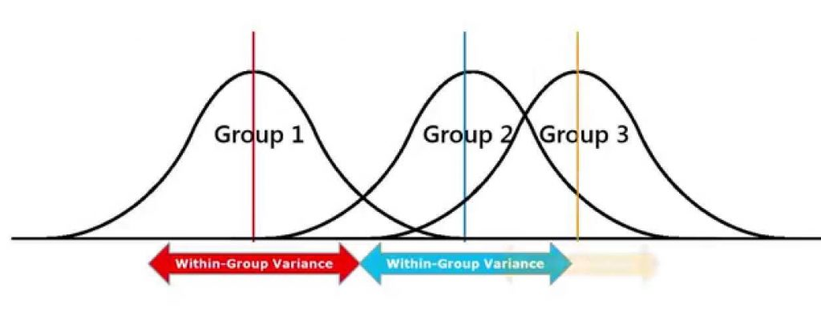
Anova

Slide 38
Regression
Measuring the relationship between the dependent and independent variables
A more accurate description of the relationship between variables
The aim is to construct a regression function
Multiple variables can be used
Possibility to predict the evolution
Interleave the data with a regression curve

Slide 39
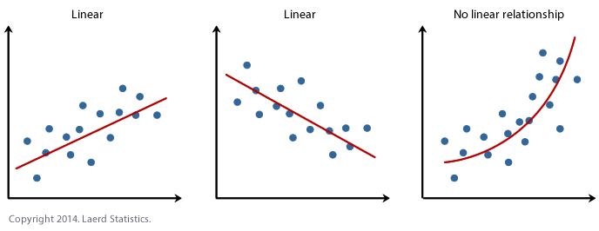
Regression

Slide 40
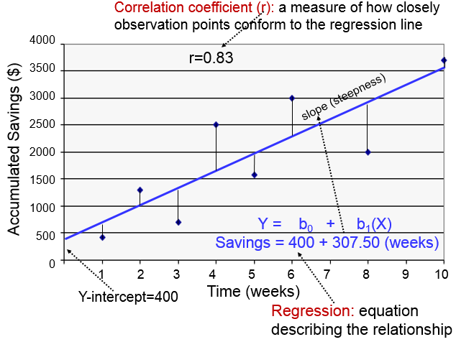
Regression and correlation

Slide 41
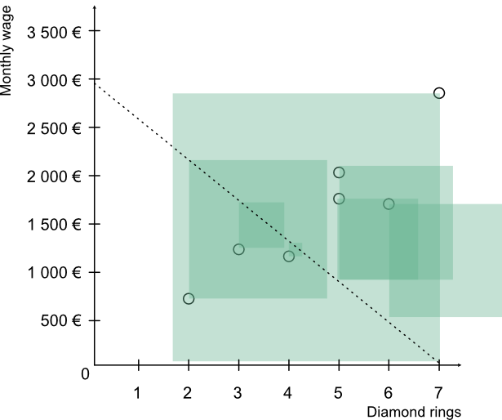
Linear regression and least square method
The least squares method is a mathematical approach used to find the best-fitting line or curve to a set of observed data points by minimizing the sum of the squares of the differences (residuals) between the observed values and the values predicted by the model.
From each datapoing we run vertical line until it touch the regression line then we form a square (thus Least Square method)

Slide 42
Linear regression and least square method
From the picture it is clear there is better regression line to be fitted to data.
The current line says more money less diamonds but the datapoints show different story.
Thus by naked eye this is not the right regression line to describe relationship between variables.

Slide 43
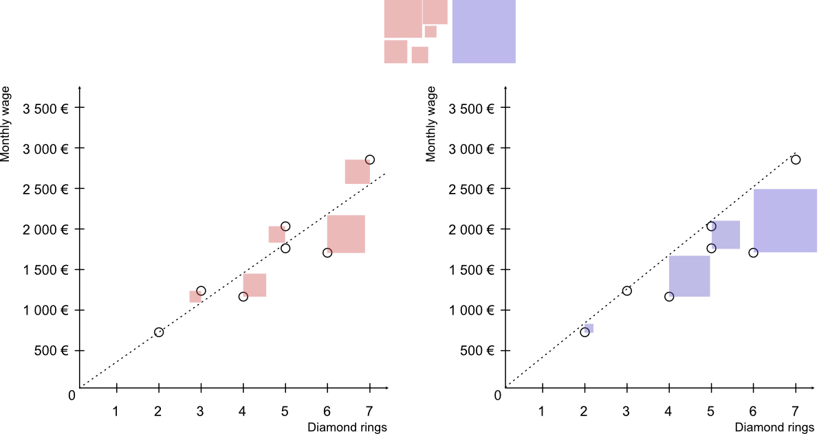
Linear regression and least square method
This is a much better regression line.
Look at the size of the squares. They are smaller then in the previous example.
Now we can say the data are fitted properly and the relationship is as follows:
  Larger the monthly wate higher amount of diamond rings customer posses.

Slide 44
Linear regression and least square method

Slide 45
Linear regression and least square method
We can fitt the data even better just look at the size of squares in red and blue example.
Red squares are smaller (all of them fit in one big blue square – see the comparison on top) thus the last example provide best descrioption of the data and the relationship of variables.

Slide 46
Logistic regression
Logistic regression is an extension of simple linear regression.
Where the dependent variable is dichotomous or binary in nature, we cannot use simple linear regression.
Logistic regression is the statistical technique used to predict the relationship between predictors and a predicted variable where the dependent variable is binary (e.g., sex, response , score, etc…)
There must be two or more independent variables, or predictors, for a logistic regression, which can be continuous (interval/ratio) or categorical (ordinal/nominal).

Slide 47
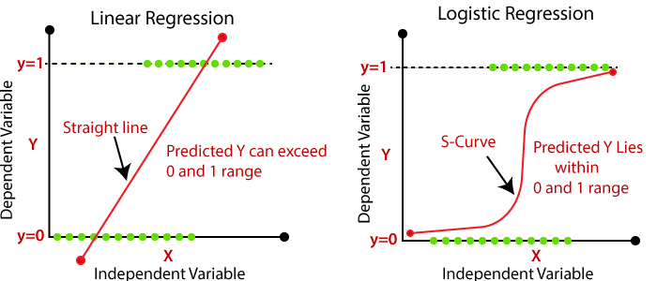
Logistic regression

Slide 48
More statistical methods
T-test
Cluster analysis
Factor analysis
MANOVA
etc…

Slide 49
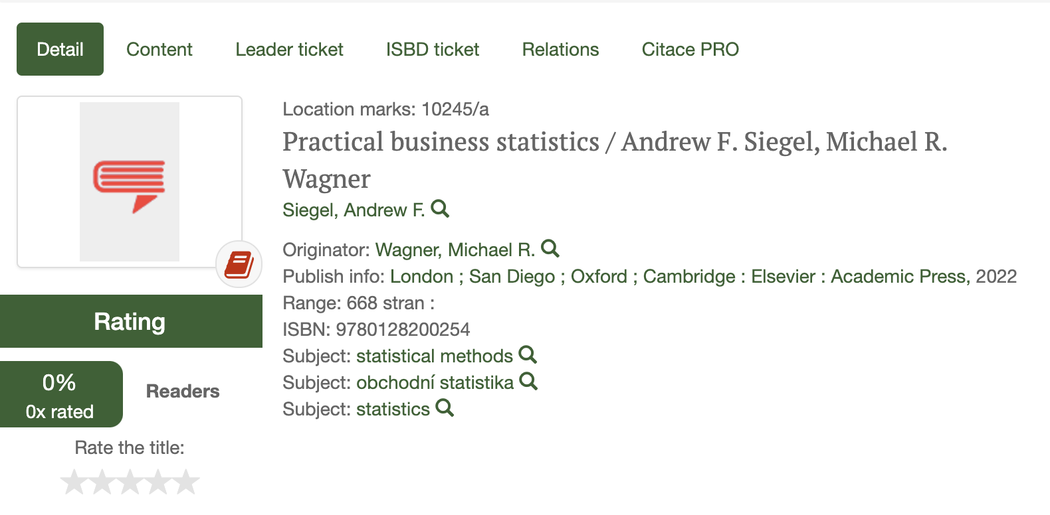
Books on statistical methods in library

Slide 50
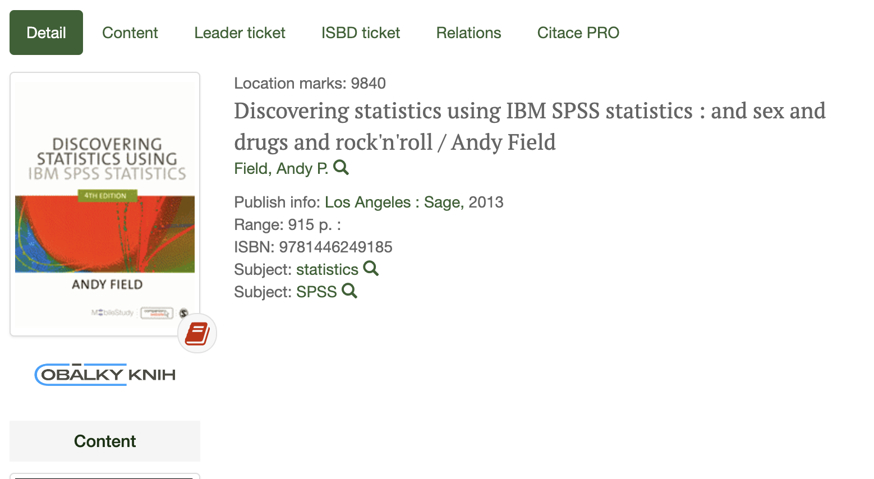
Books on statistical methods in library

Slide 51





Trusted Youtube Channels
https://www.youtube.com/@statquest
https://www.youtube.com/@rossavilla8664
https://www.youtube.com/@statisticsfun
https://www.youtube.com/@how2stats
https://www.youtube.com/@BrandonFoltz

Slide 52
3
Writing convincing conclusions

Slide 53
Convincing conclusions
Synthesize, Don’t Summarize:
  Instead of simply summarizing the chapters, synthesize the key findings or arguments to show how they come together to support your thesis.
Reflect on the Significance:
  Clearly articulate the significance of your research, emphasizing its contribution to the field or company.

Slide 54
Convincing conclusions
Address Limitations and Future Work:
  Acknowledge any limitations of your study and suggest potential areas for future research, demonstrating your critical thinking and understanding of the subject.
End with a Strong Final Thought:
  Conclude with a memorable final thought or statement that leaves a lasting impression and underscores the importance of your research.

Slide 55
4
Presentation skills

Slide 56
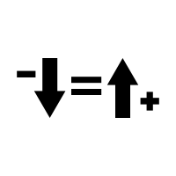
Less is more
Resist the temptation to cram too much information, text, or complex graphics onto your slides.
Overloaded slides can overwhelm your audience, making it hard for them to follow your main points.
Stick to key points and use visuals effectively to complement your speech, not replace it.
7x7 rule.

Slide 57

Practice makes perfect
Avoid going into your presentation without sufficient practice.
Familiarity with your material and the flow of your presentation is crucial.
Practice helps in managing time effectively, smoothing transitions between topics, and refining your speaking pace and tone.
Use your colleague students to be the judge in your practice sessions.

Slide 58

Focus on audience
Don't just focus on your slides or script; engage with your audience.
Avoiding eye contact, not acknowledging the presence of your audience, or failing to gauge their reactions can make your presentation less effective.
Interaction, even in subtle ways, helps in keeping the audience engaged.

Slide 59

Time is money
Be mindful of the time allocated for your presentation.
Running significantly over time can be as problematic as a presentation that is too brief.
It shows a lack of preparation and respect for the audience's time.
Ensure your presentation covers all key points within the allotted time.
Practice with stopwatch

Slide 60
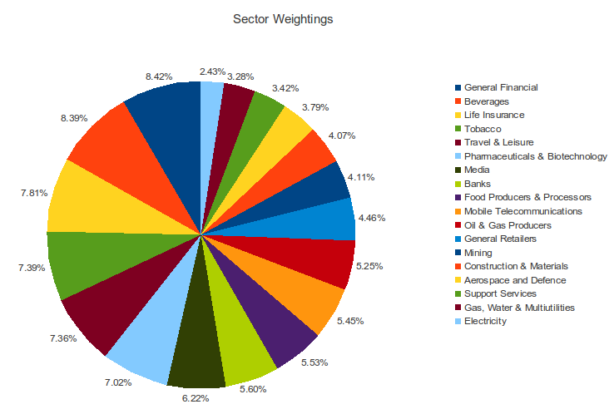
Visual communication

Slide 61
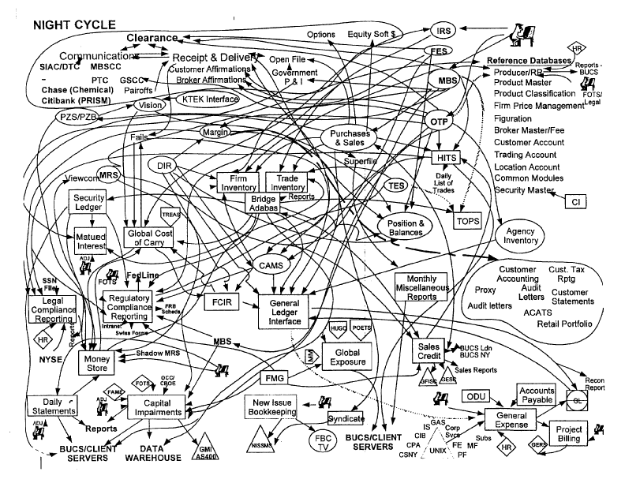
Visual communication

Slide 62
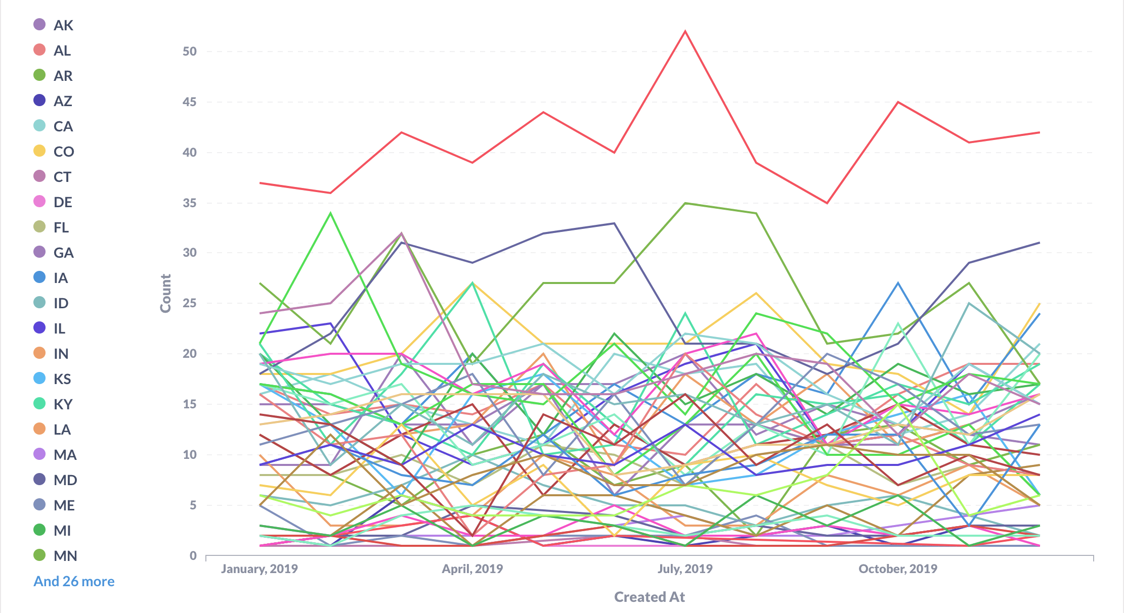
Visual communication

Slide 63



More references

Slide 64
Thank you

