Slide 1

Agile Project Management
What is agile project management
The differences between agile and waterfall PM
Agile PM frameworks
Project Management
Lucie Reczzkova
B304
Reczkova@opf.slu.cz
Office hours: Wednesday 10-11.30

Slide 2

Learning objectives
On the end of this lecture you should be able to understand and explain:
What is Agile project management
What is the difference between agile and traditional project management
What frameworks are used in agile project management

Slide 3
Key readings
You can find support in the following sources:
Layton, M. C. and Ostermiller, S. J. (2017) Agile Project Management For Dummies. 2nd edn. Hoboken: John Wiley & Sons, Ltd.

Slide 4
PART 1
What is agile project management?
Agile project management is an iterative approach to managing projects that focuses on continuous releases and then incorporating customer feedback with every iteration (smaller segments of the overall project).
Agile project management is popular in software development and in project where are unknown requirements.
Scrum is very well-known form of agile project management.

Slide 5

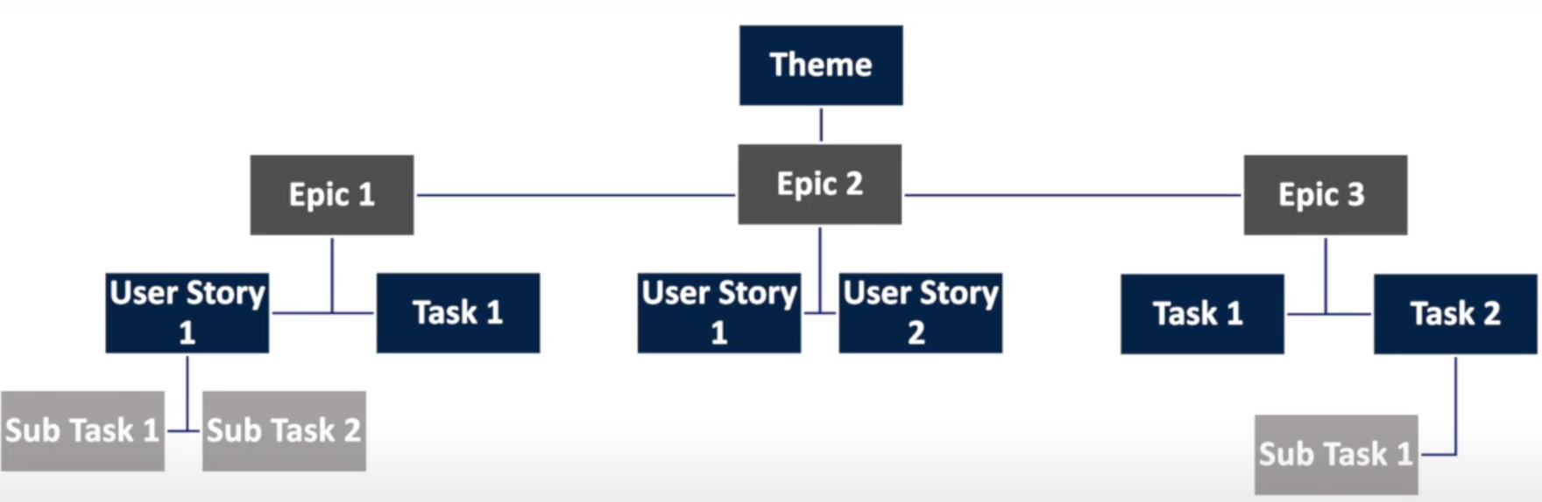
Example of agile project
Creating a grocery store app
In store shopping
Online ordering
Finding items quickly in the store
Order online in simple and effective way
Easy search function within an aisle number when using in store shopping app
Notes:
https://www.youtube.com/watch?v=2ltB6MK_pes

Slide 6
Scrum Terminology
Product Backlog – sets the priorities for the agile program
Wishlist of everything for a product including new features, changes to existing features, bug fixes, infrastructure changes or other activities that a team may deliver in order to achieve a specific outcome.
Single authoritative source for things that a team works on.
Sprint Backlog – is the work the team will complete within specific time
Sprints usually between 2-4 weeks
Items are selected from the Product Backlog to be worked in the sprint.

Slide 7
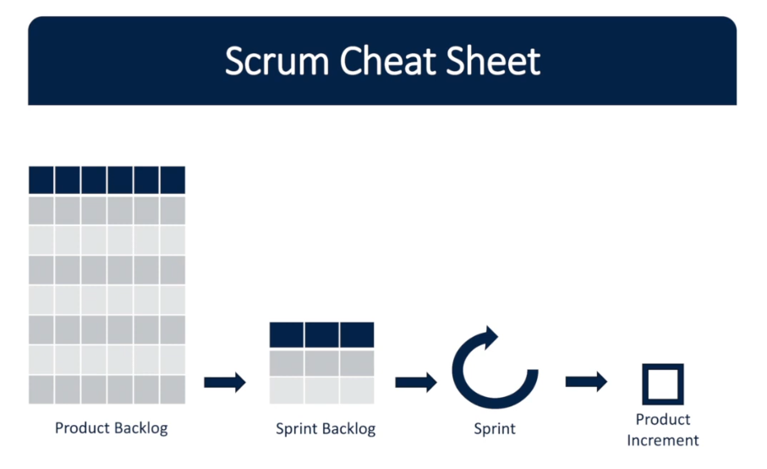
Scrum Terminology
User Story – Short, simple description of a feature the user or customer wants.
Ideally, a user story is small enough to fit within one project sprint.
For example, you were producing a book. If you could complete each chapter in a sprint, each chapter would become a user story.

Slide 8
How agile projects work
An agile project involves the same type of work as in a traditional waterfall project:
You Create requirements and designs, develop the product, document it, and if necessary, integrate the product with other products.
You test the product, fix any problems, and deploy it for use. However, instead of completing these steps for all product features at once, as in a waterfall project, you break the project into iterations, also called sprints.

Slide 9
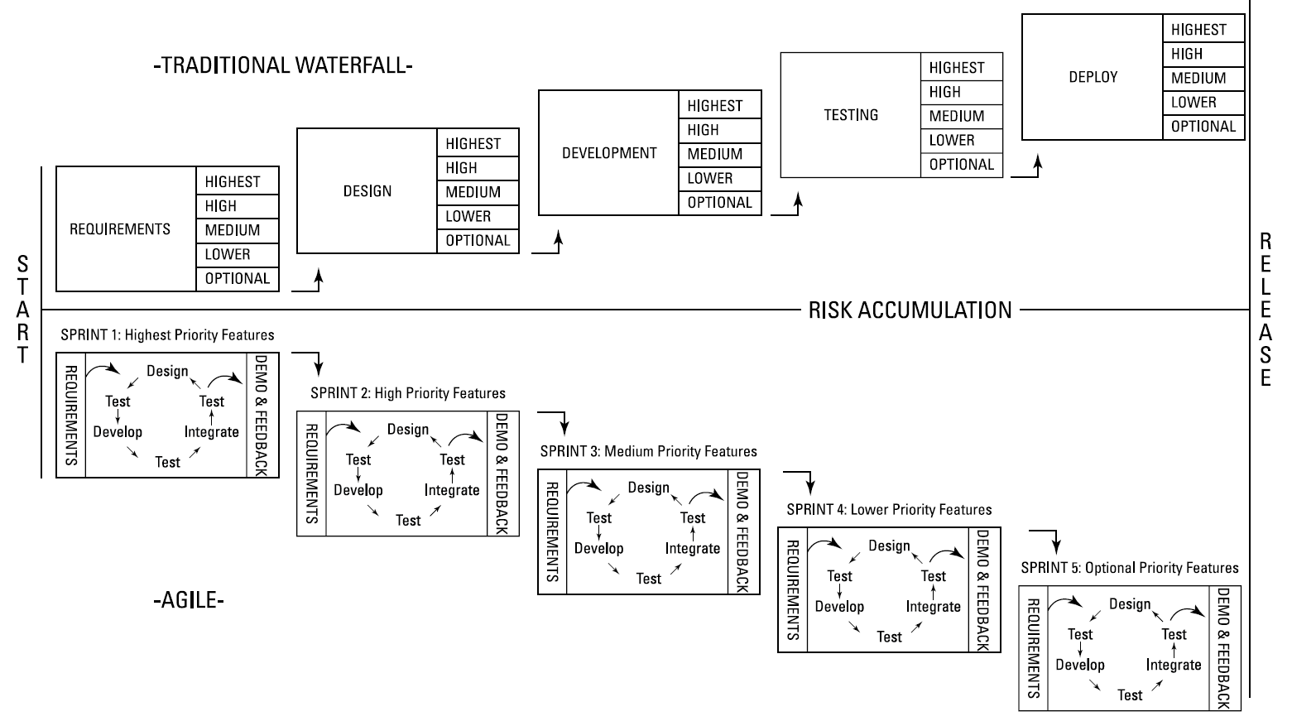
How agile projects work
Source: Layton, M. C., Ostermiller S. J. 2017. Agile Project Management, p. 15

Slide 10
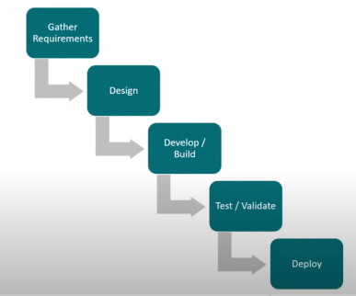
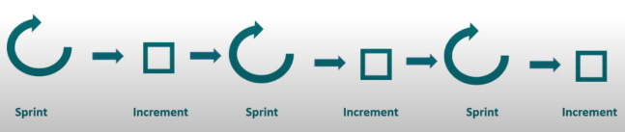
What is the difference between Waterfall and Agile project management?
Waterfall
Agile
The project needs, requirements, and constraints are well known
Plans are developed accordingly
Creating robust project
Plans drive the project forward
Example: building a bridge, building an airplane, home
Waterfall – you flow from one point to another
An approach where team works collaboratively with the customer to determine project needs.
Often used when requirements aren’t well known.
Coordination with the customer and team drives the project forward
Example: software development, innovative types of project.
Sprint – set amount of time to accomplish part of the work and deliver it incrementally.

Slide 11
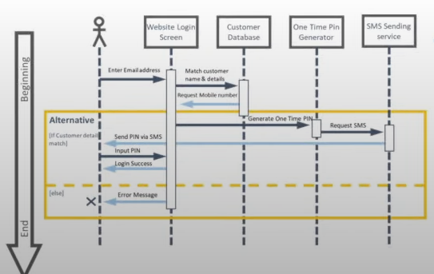
Start and manage the project
What is the difference between Waterfall and Agile project management?
Waterfall
Agile
We outline following upfront:
Business case – why we start the project
Project charter – resources and finding
Project management plan – planning upfront schedule, scope, costs and quality of our project
Triple constraints
Most of the documents used in waterfall replaced by:
Team charter - ways of team working agreed by team
High level model of system using any kind of diagram
Business model canvas or Lean canvas

Slide 12
Requirements
What is the difference between Waterfall and Agile project management?
Waterfall
Agile
Requirements documentation including acceptance criteria
Requirements from our stakeholders
More focus on people (our customer), real things, and testing
Business model canvas
High level model system
Acceptance criteria for test driven development

Slide 13
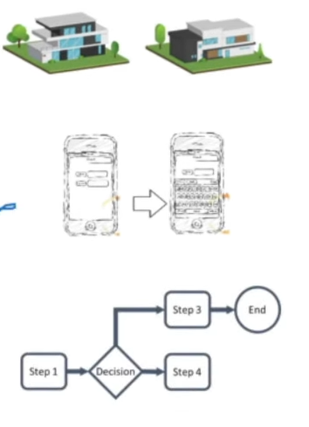
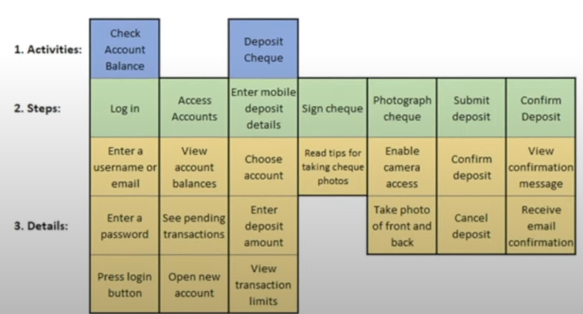
Create and manage scope
What is the difference between Waterfall and Agile project management?
Agile
Waterfall
Product Backlog – list of high level features or ideas that break down into User stories(10-50) that we complete during a spring
Story-board, Process map or Prototypes to show how our scope looks like
User Story mapping (features in order of customer use, broken down to User stories
Small increments (can be completed within a Sprint)
Sprint Review (for Story acceptance) – we show what we have created to our customer for review
Project scope statement
Project scope statement in details with high level of features
Prioritizing of scope
Work breakdown structure (WBS) we used in Project software
Work package – the most detailed WBS

Slide 14
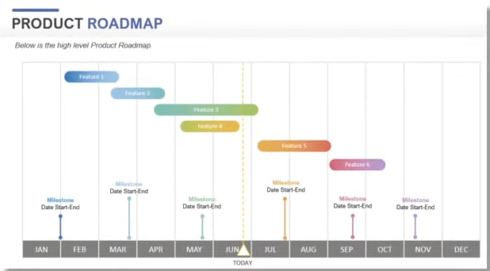
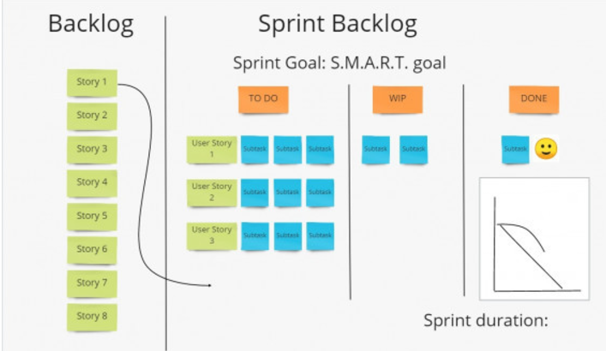
Create and manage the Schedule – to put scope in schedule
What is the difference between Waterfall and Agile project management?
Waterfall
Agile
Break our scope into activity list
Estimated activity duration
Sequence of activities
Create project schedule (Gantt chart)
Product Road Map
Sprint Planning – how many user story cards can we fit in one Sprint to have sustainable pace to match the Team velocity.

Slide 15
Manage Project Costs
What is the difference between Waterfall and Agile project management?
Waterfall
Agile
We estimate work and other resources costs for each task in our project (done in MS Project)
We estimate our reserve budgets
On the basis of these estimations we get Approved project budget
Fixed costs (stable, whole team of 5-9 people)
The team works for as long as the budget lasts
They deliver as many features as they can from the Product backlog
They start with delivering of the highest value items first

Slide 16
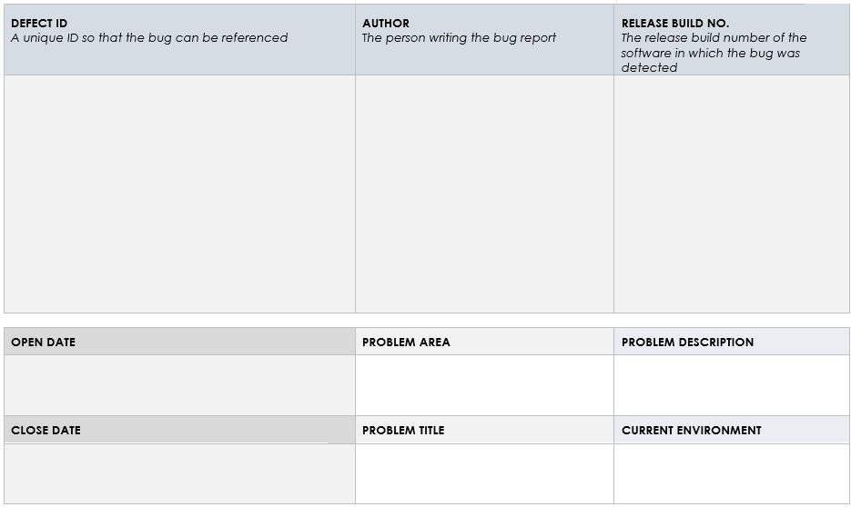
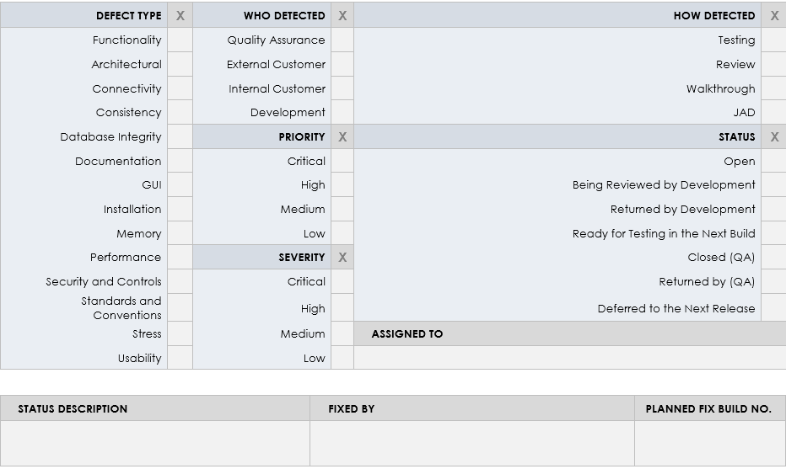
Managing the quality of the project
What is the difference between Waterfall and Agile project management?
Waterfall
Agile
Test and inspection plan
We are doing small increments, we deliver and test,
Testing while we are going
Code inspection for quality check
Unit testing – for each value on user card
Release planning – plan for our feature releases
The sprint review – at the end of the 2 weeks we will check the increments we want to deliver to our customer

Slide 17
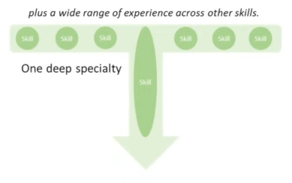
Plan and manage resources
What is the difference between Waterfall and Agile project management?
Waterfall
Agile
Estimated Resources required
Resource Breakdown structure (MS Project)
RACI matrix
Team calendar and team charter
We have done all these in MS Project
Team charter
The whole team approach – we bring all those who we need to complete the features
T-shaped team - wide range of experience across different other skills, but one deep specialty
Pair/side-by-side programming – working together

Slide 18
Project communication across the project
What is the difference between Waterfall and Agile project management?
Waterfall
Agile
Communication styles assessment – analyze and define how all information will be communicated throughout the project
Stakeholder Communication needs document
Open Visual Team area – on the walls
Daily stand-ups – 15 mins everyday catch up
Retrospective on the end of the sprint
Sprint planning – planning our sprint to not overload or underload our team
Sprint review – catching up as a team and demonstrating the real product to customer

Slide 19
Risk management
What is the difference between Waterfall and Agile project management?
Waterfall
Agile
Risk analysis
Risk definition and categories
Risk classification by likelihood and impact
RIPRAN method
Risk Adjusted Backlog
Brainstorming risks with our team and put them in the Backlog and then we prioritize them with our work and put these risks into sprints while sprint planning

Slide 20
Deployment
What is the difference between Waterfall and Agile project management?
Waterfall
Agile
Change management when we deliver our project product
Low or no documentation
Small features are released incrementally
Customer is part of the team and they pass information
Notes:
https://www.youtube.com/watch?v=3KgjfqiN2fE

Slide 21
Time for recap - let’s watch together
https://www.linkedin.com/learning/project-management-foundations-15528659/what-is-agile-project-management

Slide 22
PART 2
Agile project management frameworks
A project management framework is a collection of tools, tasks, and processes used to organize and execute a project from initiation to completion.
A framework outlines everything you need to plan, manage, and control your projects successfully.
Scrum – The entire scope of work is broken down into short development cycles – Sprints
The sprint’s duration is from 1 to 4 weeks usually 2 weeks
The team should strictly follow a work plan for each sprint
People involved in a project have predefined roles.
Kanban – Focuses on a visualized workflow with tasks broken into small pieces.
helps teams execute just-in-time (JIT) production by enabling everyone to see both the project’s progress and what’s coming up next.
uses a board to help view and keep track of progress, segmenting tasks into three primary columns: “To Do,” “Doing,” and “Done.” However, unlike Scrum, the Kanban board tracks all product work without separating it into sprints.
Notes:
A project management framework is a collection of tools, tasks, and processes used to organize and execute a project from initiation to completion. A framework outlines everything you need to plan, manage, and control your projects successfully.

Slide 23
Agile project management frameworks
Extreme programming (XP) – initially designed for Agile software development projects.
Like Scrum, this framework focuses on continuous development and customer delivery and uses intervals or sprints.
XP framework is centered on engineering principles
Feature-driven development (FDD) – aims to create software models every two weeks.
It also requires a separate development and design plan for every software model feature, making it more documentation-heavy than other Agile frameworks.
Due to its rigorous documentation requirements, FDD is better for teams with advanced design and planning abilities.
Crystal - is a family of Agile methodologies, including Crystal Clear, Crystal Yellow, Crystal Orange, Crystal Red, and more.
Each crystal methodology has a unique framework, and the one you choose depends on several project factors, such as your team size, project priorities, and project criticality.
Notes:
https://www.wrike.com/project-management-guide/project-management-frameworks/

Slide 24
References
Layton, M. C. and Ostermiller, S. J. (2017) Agile Project Management For Dummies. 2nd edn. Hoboken: John Wiley & Sons, Ltd.

