Slide 1
Defining Project
Project lifecycle and its types
Project organising and staffing
RACI matrix
Project Management
Lucie Reczzkova
B304
Reczkova@opf.slu.cz
Office hours: Wednesday 10-11.30

Slide 2
Contents
1. PART
Project lifecycle
2. PART
Outputs, results, and benefits of the project
Organizing and staffing the project
Working on your project part 1.6.1
3. PART
RACI matrix
Working on your project part 1.6.2

Slide 3
Learning objectives
On the end of this lecture you should be able to understand and explain:
What is project lifecycle and its phases.
The types of project lifecycles.
What is RACI matrix, why do we use it and how do we assemble it.
How is project organized and what staff do we need to do the project.

Slide 4
Key readings
You can find support in the following sources:
Chapter 2. Project Management Growth: Concepts and Definitions
Chapter 4. Organizing and Staffing the Project Office and Team
Kerzner, H. (2017). Project Management: A Systems Approach to Planning, Scheduling, and Controlling. Hoboken, New Jersey: John Wiley & Sons, Inc. ISBN 978-1-119-16535-4.
Chapter 5. Developing a mission, vision, goals, and objectives for the project
Haegney, J. (2016). Fundamentals of project management. AMACOM
Chapter 1, 2 & 6
Grit, R. (2021). Project management : A practical approach. Taylor & Francis Group.

Slide 5
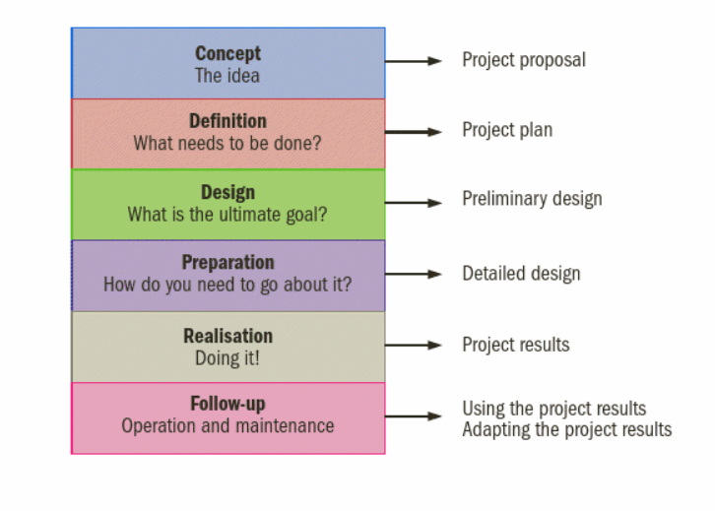
PART 1
What is project lifecycle
Every program, project, or product has certain phases of development known as life-cycle.
A clear understanding of these phases permits managers and executives to better control resources to achieve the specific objectives of the project.
However, the end result is often only temporary.
Example: The results of reorganising a car factory or manufacturing a new car model, will lose their value in the long term. After a number of years, the car factory will start up a new project in order to manufacture an even newer car model.
The entire process from start to finish of a project is called the ‘project lifecycle’.

Slide 6
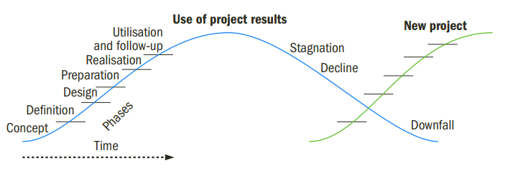
Project lifecycle phases

Slide 7
Project lifecycle phases
Phases at the start of the project - concept, definition, preliminary design, detailed design and production.
Utilisation phase - At the end of the production phase, the deliverable is accomplished and subsequently used.
During the utilisation phase, follow-up and maintenance are required to maintain the results and keep them up to date.
After some time, follow-up might be insufficient, and stagnation will occur.

Slide 8
Project lifecycle example
Example for car factory:
sales of the model start slowing down, or the factory becomes obsolete from a technical perspective.
A decline then follows, and the project output is no longer useful.
In the meantime, a new project might be started up to manufacture an even newer model or build a new factory, and the lifecycle of a new project begins.

Slide 9
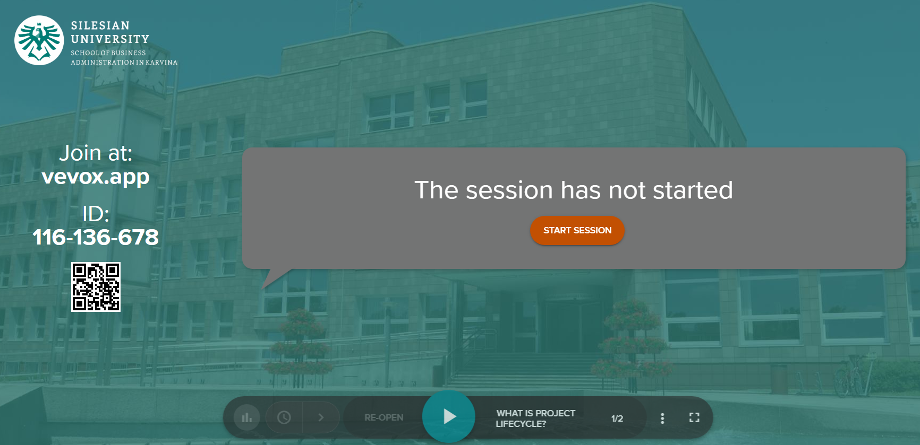
Vevox questions

Slide 10
PART 2
Types of Project Life Cycle
A project can have one of the following types of life cycles:
Predictive Life Cycle
Iterative Life Cycle
Incremental Life Cycle
Hybrid Life Cycle

Slide 11
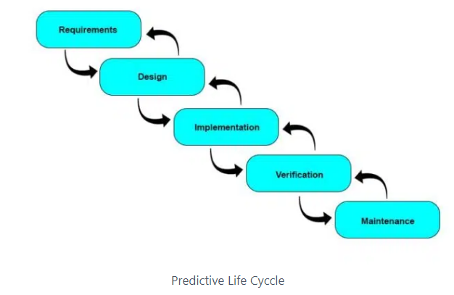
Predictive Life Cycle (PMBOK Guide 5)
Also known as the waterfall life cycle.
Traditional form of project management
Project manager develops the complete project management plan at the beginning and then follows it until the project completes.
You plan the work and then work the plan.
The scope of work is fixed.
The chances of changes are low.
Risks are rare, but costly.
Notes:
https://pmstudycircle.com/project-life-cycle/
https://www.simplilearn.com/project-management-life-cycles-evolution-article#:~:text=the%20Traditional%20approach.-,The%20Incremental%20Project%20Management%20Life%20Cycle,or%20deliverable%20is%20fully%20met.

Slide 12
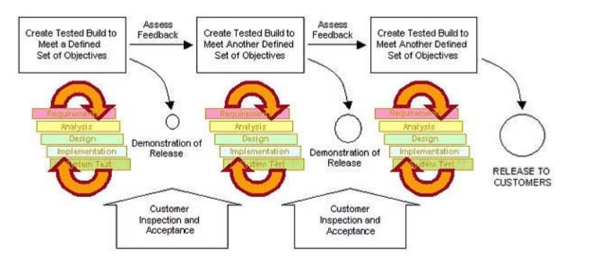
Iterative Life Cycle
The iterative and predictive life cycles are comparable.
The processes in each phase are iterated till the phase exit criteria are met.
It is series of mini-waterfalls.
For small or less complex projects.
Better insulation to changes than the traditional (predictive) approach.
Notes:
https://pmstudycircle.com/project-life-cycle/
https://www.simplilearn.com/project-management-life-cycles-evolution-article#:~:text=the%20Traditional%20approach.-,The%20Incremental%20Project%20Management%20Life%20Cycle,or%20deliverable%20is%20fully%20met.

Slide 13
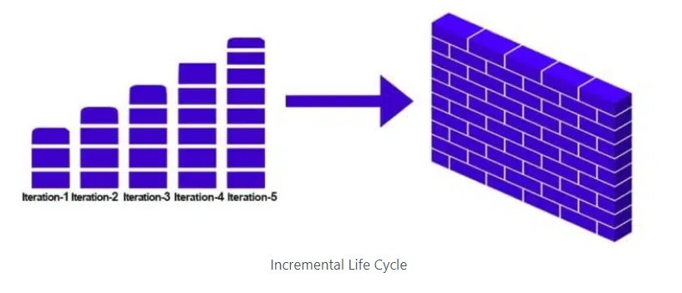
Incremental Life Cycle
The project manager delivers small, usable pieces of deliverables to the client, and based on the feedback the product is refined and developed.
The approach is cyclic in nature and each cycle delivers an added functionality.
The process is repeated till the exit criteria for deliverable is fully met.
For large and complex projects.
Better handles change.
Notes:
https://pmstudycircle.com/project-life-cycle/
https://www.simplilearn.com/project-management-life-cycles-evolution-article#:~:text=the%20Traditional%20approach.-,The%20Incremental%20Project%20Management%20Life%20Cycle,or%20deliverable%20is%20fully%20met.

Slide 14
Hybrid Life Cycle
The hybrid life cycle is a hybrid of all previously introduced life cycles.
It can be any combination of those life cycles.
A project manager is responsible for selecting the life cycle best suited for their project.
Notes:
https://pmstudycircle.com/project-life-cycle/

Slide 15
Significance of the Project Life Cycle
Offers a Framework to Execute Projects
Enhances Team Communication
Helps Measure Progress and Development
Allows Project’s Evolution
Helps Organize Reviews and Improve Governance
Notes:
https://pmstudycircle.com/project-life-cycle/

Slide 16
Vevox questions

Slide 17
PART 3
Project organising and staffing
In order to carry out a project, management must establish a separate project organisation.
This organisation is ‘outside’ of the normal line organisation and has its own, temporary project manager,
who acts as the temporary manager of the members of the project team.

Slide 18
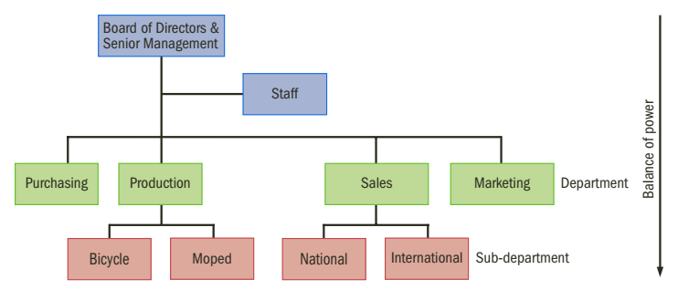
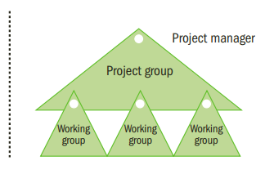
Organizing project

Slide 19
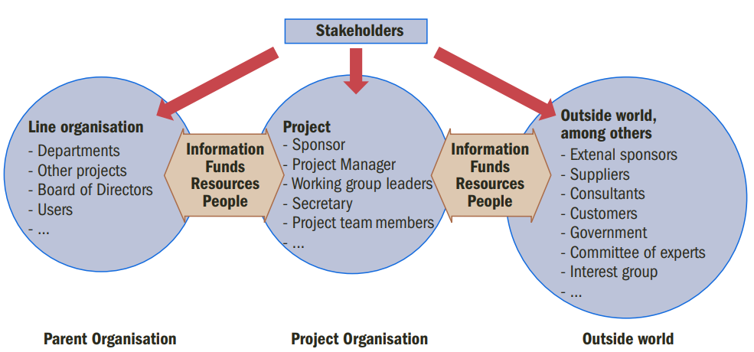
Project and its surroundings

Slide 20
Project and its surroundings – the stakeholders
Stakeholders must be identified and managed throughout the life of the project, because they have direct effect on the success or failure of our project.
How do we manage stakeholders? -> We ask following questions:
Who benefits from the project? -> Who benefits from the deliverables (output) of the project.
Who contributes to the project? The people or groups we rely on to get the project done (Project team members, project sponsor, outside experts etc.)
Who is impacted by the project? The project output (deliverable) can impact others who do not necessarily benefit from it (engineering supplying priority data for a new marketing campaign).

Slide 21
Project and its surroundings – the stakeholders
A signature means that the individual is committed to his contribution, agrees with the scope of work to be done, and accepts the specifications as valid.
A signature does not mean a guarantee of performance, it is only commitment that we will do our best to fulfil our obligations.

Slide 22
Organizing project – the project group
A project group is made up of people who have been brought together, because of their particular capacities, expertise and attitude.
To weld the group into a team, a good, positive atmosphere is essential: the members of the group may not even know each other.
As well as setting out the tasks of each individual in the team, the team has to make decisions relating to:
how its members should collaborate,
how and when meetings are planned, and
how decisions are reached.

Slide 23
Organizing project – the project group
A project group performs several functions:
Project management is the task of the project manager. A larger project may be divided up into various working groups with a working group manager in charge of each.
A project manager is sometimes supported by an assistant project manager.
Large projects in particular should have a project secretary assigned to them. With small projects, one of the members of the team could be appointed secretary.
The duties of the secretary consist of taking care of the correspondence, taking the minutes of meetings, noting how much time has gone into the tasks (time records) and managing the project’s files.
Project members are selected on the basis of their expertise and their capacity to execute the project. They may be recruited from within the organisation itself, but may also be brought in from outside.
Consultants. These are very often experts from the within organisation itself, but consultants from outside may also need to be hired.

Slide 24
Organizing project – working group
One or more working groups can be established within the project group.
The working group is responsible for carrying out a separate sub-task of the project.
The working group manager is in charge.
Example:
when building a new factory, for example, a working group can be put together to organise a festive opening, or,
when placing a new product on the market, a working group might be responsible for the advertising campaign.
A working group might even be put together to organise a training course after a totally new information system has been installed at a company.

Slide 25
Organizing project – project environment
The outside world
A project group does not do its work in isolation and has a certain relationship with the ‘outside world’, i.e. the project environment.
People from outside the organisation may include the following:
The project sponsor of the project group
A steering committee
A committee of experts. This is a group of people experienced in the activities that are required to execute the project. They are available to exchange experiences and act as a sounding board. Few projects have such a committee.
Departmental heads. These individuals provide project members from within the main organisation.
A representative advisory board (or other participation committee) that provides advice on the project or is required to give approval for the project.
The government, which provides subsidies and issues permits.
Interest groups which are inconvenienced by the project and the project result.

Slide 26
Who is the project sponsor?
The sponsor is the customer of the project group, who wants the project’s end product to be put at his disposal and who will pay for it.
The project sponsor is responsible for initiating the project and providing the funding.
He will support the project and communicate with the project manager on a regular basis.
There should be only one main sponsor for the project.
The result that the project delivers must meet at least to some extent the project’s objectives as established by the project sponsor.
The sponsor is sometimes termed the ‘owner of the project objectives’.
The project objectives must address the following question: why does the sponsor want this project to be implemented?

Slide 27
Who is the project sponsor?
The sponsor has the ultimate say in whether the project result is acceptable.
The decisions the sponsors make: whether to approve the project proposal, the project plan and the results that the team ultimately delivers.
The sponsor is also responsible for acquisition of a budget and for making sufficient staff and resources available to the project group.
The sponsor must be able to clarify any uncertainties the project group might have and help the group resolve any problems.
Along with the project manager, the sponsor is responsible for monitoring the time and money spent and the standard of research done.

Slide 28
Who are the future users of the project?
The project result (the end product) is eventually ‘put into use’ by (future) ‘users’.
Example:
a construction project yields a house in which the new occupants are considered the users of the project result.
Patients and nurses are the users of a new hospital wing following its construction, whereas the hospital director is the sponsor.
With a project that entails implementing a new computer program, the people who will be working with the new program are the users.
The users of a project with the goal of organising a major study trip are the students.
The sponsor pays for the project but the users must work with its results. It is therefore essential to involve the future users in the project from its onset and to keep them involved throughout the entire project.

Slide 29
Who is a project manager?
Project managers plan, monitor, and control the project
Project manager is the so-called owner of the project’s objectives, and
is the owner of the project’s results.
The project’s results must provide an answer to the following question: what product must this project group deliver?
If the project is carried out within a company, the project manager will usually be appointed by the board of directors.
occasionally a project group is allowed to choose a project manager from their midst.
If no one is available to take on the task of being the project manager, an experienced person could be engaged via a consulting agency.

Slide 30
The competencies of project manager?
In addition to general management skills, a project manager must be able to work
in a systematic and result-oriented fashion.
A project manager should at least possess the following abilities:
leadership
to negotiate
A result-oriented working style
to distinguish between main issues and minor issues
to estimate the risks that could threaten the project
to determine the limits of the project
to formulate a project plan
to determine the required competency levels of the project team members
to plan and think ahead
to monitor quality
to motivate and lead the members of the project team
to organise and delegate
to manage finances

Slide 31
Organizational structure types
Influence of Organizational Structures on projects
Each factor may carry a different level of importance in the final analysis.
The combination of the factor, its value, and relative importance provides the organization’s decision makers with the right information for inclusion in the analysis.
Source. PMBOK Guide

Slide 32
Group work – Organizational structure of the project Point 1.6.1 of the template
Do not forget to create an organigram - a diagram of your organizational structure of your project stakeholders.
Your project does not need necessarily all of the position listed in the template!
Choose only the relevant ones!

Slide 33
Vevox questions

Slide 34
Organizational structure of the project (diagram, RACI matrix)
RACI matrix - assigning of responsibilities of each individual or their jobs in a task (project, service or process) in the organization.
Responsible – who is responsible for performing the assigned task (implements, is responsible)
Accountable - who is responsible for the whole task, is responsible for what is done (manages, decides)
Consulted - who can provide advice or consultation for the task (consults, information is requested or waiting for a response to the activity) 2-way communication
Informed – who should be informed about the progress of the task or decisions in the task (1-way communication)

Slide 35
Organizational structure of the project (diagram, RACI matrix)

Slide 36
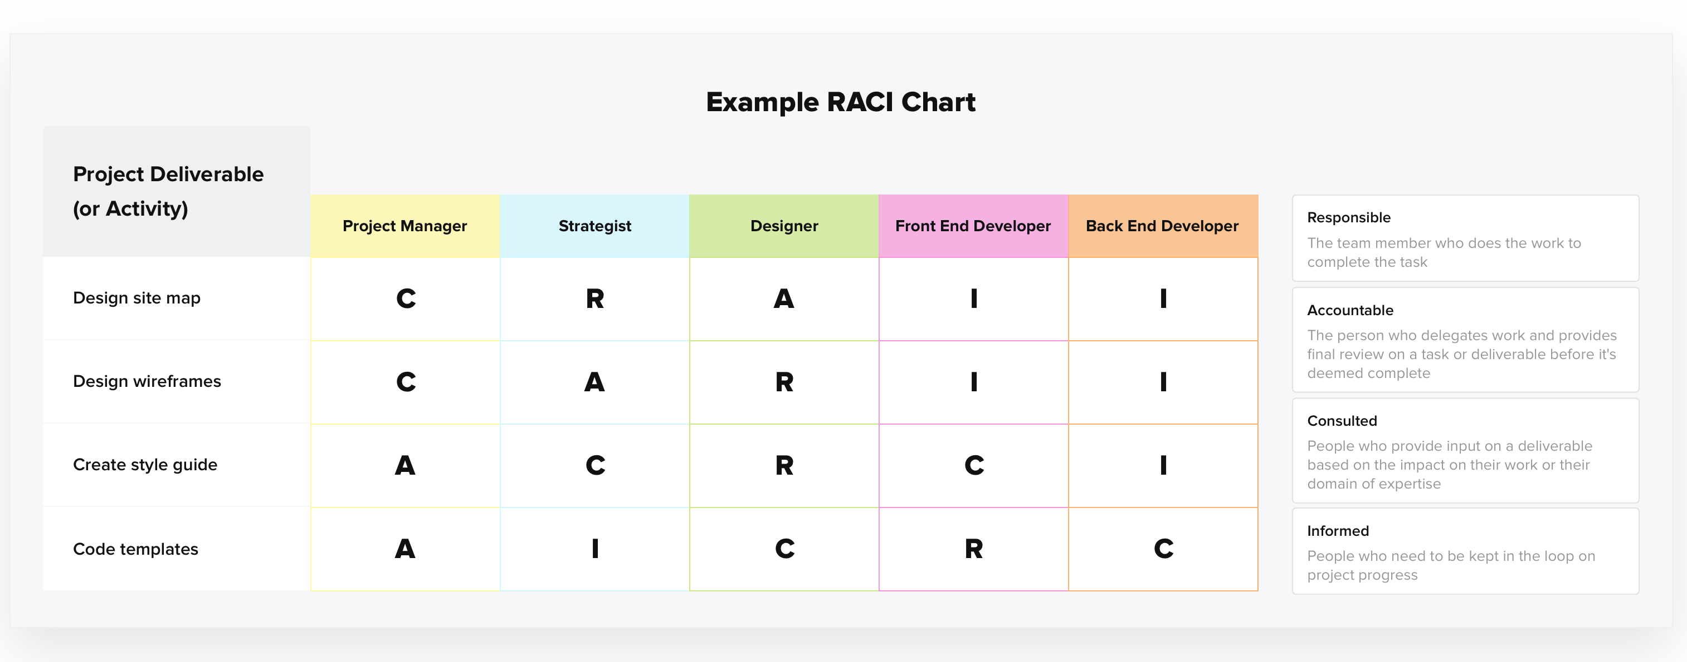
Organizational structure of the project (diagram, RACI matrix)

Slide 37
Organizational structure of the project (diagram, RACI matrix)

Slide 38
Time for recap – let’s watch together

Slide 39
Group work – RACI matrix Point 1.6.2 of the seminar work template
Create your own RACI matrix
First identify the main stakeholders and main activities of your project (look back in your Logical framework and the activities and tasks in your matrix, use them for your RACI matrix as well.

Slide 40
References
Grit, R. (2021). Project management : A practical approach. Taylor & Francis Group.
Haegney, J. (2016). Fundamentals of project management. AMACOM
Kerzner, H. (2017). Project Management: A Systems Approach to Planning, Scheduling, and Controlling. Hoboken, New Jersey: John Wiley & Sons, Inc. ISBN 978-1-119-16535-4.

