Slide 1
Extension of budgeting
What is project budgeting?
How to estimate the project budget?
Methods/Techniques for Capital Budgeting
Project Management
Lucie Reczzkova
B304
Reczkova@opf.slu.cz
Office hours: Wednesday 10-11.30

Slide 2
Contents
PART
Recap from the last lecture – Project costs and Project budget
2. PART
Techniques/Methods of Capital Budgeting, overview of selected methods, their explanation, examples of application
3. PART (20 min.)
Process of Capital Budgeting, objectives and factor affecting of Capital Budgeting

Slide 3
Learning objectives
After studying this topic, you should be able to:
Uderstand the meaning and methods of project evaluation.
Calculate and identify the advantages and disadvantages of techniques and methods used in capital budgeting.
Know the entire evaluation process and identify the time value of money and projected cash flows.
Identify the limitations and appropriateness of applying different techniques according to the effects of time, inflation, and discount rate.

Slide 4
Key readings
You can find support in the following sources:
Book – Kerzner, H. 2013. Project Management. Chapter 14, p. 511 (focused on parts 14.21-14.28)
Book – PMBOK Guide. 2017. Chapter 7 (p. 231 Project Cost Management)

Slide 5
Project budget - it’s the total amount of money you’ll need to finish the project that should be approved by all the stakeholders involved.
The project budget has a cost side and a revenue side;
it can be defined as the total amount of funds allocated to a project, usually divided into expenditure categories and phased over time.
For profitable projects - revenues exceed costs. Revenue > Costs
For non-profit projects - we should be able to cover our costs. Revenue = Costs
PART 1
Recap – Project budget, Estimating project budget,

Slide 6
Approaches to estimating a project budget
Bottom-up estimation
This process starts with zero total costs and adds the cost for each item in the hierarchical structure of work (WBS). The result is the sum of costs for the entire project.
Top-down estimation
It starts with the project budget total and involves breaking it down into smaller chunks.
Top-down estimation is typically used when you have a fixed project price with the budget set in stone.
Analogous estimation
This process is based on information about past activities, considers the actual costs of previous projects and applies them to the current project.
Expert estimates
This option is most often used in cases where it is too time consuming or expensive to determine prices from verifiable sources.

Slide 7
Approaches to estimating a project budget
Three-point estimation
a weighted average based on the best, worst, and most likely case budget scenarios and encourages you to think from multiple perspectives.
Parametric estimation
Parametric modelling uses a mathematical model based on known parameters, which may vary depending on the type of work performed. The parameter can be, for example, the cost per cubic meter, the cost per hour of work of the excavator, etc.

Slide 8
Approaches to estimating a project budget
Risk budget, tolerance budget, change budget
Tolerance budget is a range within which you can spend without having to report back to your sponsor or ask for more money. Tolerance budget is set at the beginning of your project but is particularly useful at the end of a project nearly the delivery date.
Change budget – changes in projects are very common during the whole project. How well you can adjust your budget to a scope change depends on how well you budgeted the project in the first place. This budget needs to be approved.
Risk budget - Creating a financial reserve to cover unexpected or higher costs. Risk costs are one of the most common project risks. It can arise from poor budget planning and inaccurate cost estimation.

Slide 9
Capital budgeting is a process that businesses use to evaluate potential major projects or investments. Building a new plant or taking a large stake in an outside venture are examples of initiatives that typically require capital budgeting before they are approved or rejected by management.
As part of capital budgeting, a company might assess a prospective project's lifetime cash inflows and outflows to determine whether the potential returns it generates meet a sufficient target benchmark.
The capital budgeting process is also known as investment appraisal.
PART 2
Capital budgeting
Techniques/Methods of Capital Budgeting

Slide 10
Capital budgeting
Features of Capital Budgeting
There is a long duration between the initial investments and the expected returns.
The organizations usually estimate large profits.
The process involves high risks.
It is a fixed investment over the long run.
All projects require significant amounts of funding.
The amount of investment made in the project determines the profitability of a company.

Slide 11
Capital budgeting
Understanding Capital Budgeting
While companies would like to take up all the projects that maximize the benefits of the shareholders, they also understand that there is a limitation on the money that they can employ for those projects.
Investment and financial commitments are part of capital budgeting. In taking on a project, the company involves itself in a financial commitment and does so on a long-term basis, which may affect future projects.
To measure the longer-term monetary and fiscal profit margins of any option contract, companies can use the capital-budgeting process. Capital budgeting projects are accepted or rejected according to different valuation methods. Under certain conditions, the internal rate of return (IRR) and payback period (PB) methods are sometimes used instead of net present value (NPV) which is the most preferred method. If all three approaches point in the same direction, managers can be most confident in their analysis.

Slide 12
Capital budgeting
Understanding Capital Budgeting
Investing in capital assets is determined by how they will affect cash flow in the future, which is what capital budgeting is supposed to do. The capital investment consumes less cash in the future while increasing the amount of cash that enters the business later is preferable.
Keeping track of the timing is equally important. It is always better to generate cash sooner than later if you consider the time value of money.
Other factors to consider include scale. To have a visible impact on a company's final performance, it may be necessary for a large company to focus its resources on assets that can generate large amounts of cash.

Slide 13
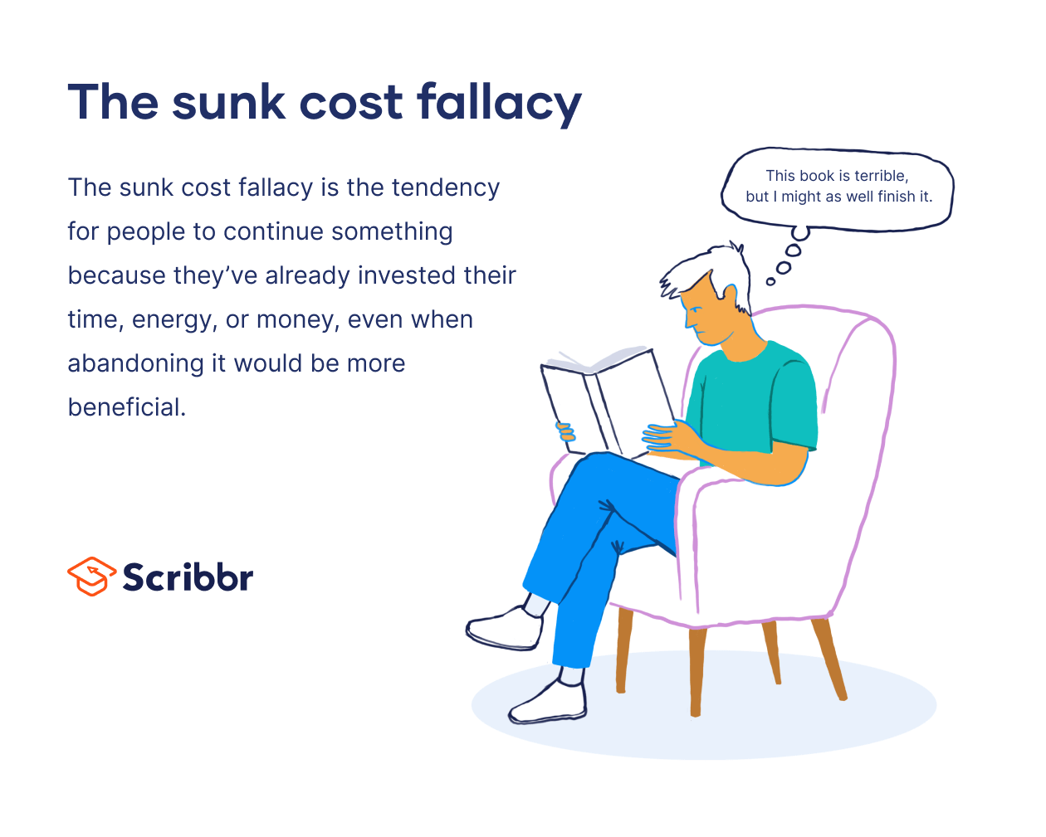
Capital budgeting
Understanding Capital Budgeting
In smaller businesses, a project that has the potential to deliver rapid and sizable cash flow may have to be rejected because the investment required would exceed the company's capabilities.
The amount of work and time invested in capital budgeting will vary based on the risk associated with a bad decision along with its potential benefits. Therefore, a modest investment could be a wiser option if the company fears the risk of bankruptcy in case the decisions go wrong.
Sunk costs are not considered in capital budgeting.

Slide 14
Capital budgeting
Limitations of Capital Budgeting
Although capital budgeting provides a lot of insight into the future prospects of a business, it cannot be termed a flawless method after all.
Cash Flows
Time Horizon
Time Value
Discount Rates

Slide 15
Capital budgeting – Key Takeaways
Capital Budgeting is defined as the process by which a business determines which fixed asset purchases are acceptable and which are not.
Capital budgeting leads to calculating the profitable capital expenditure.
Determining if replacing any existing fixed assets would yield greater returns is a part of capital budgeting
Selecting or denying a given project is based on its merits.
The process of capital budgeting requires calculating the number of capital expenditures.
An assessment of the different funding sources for capital expenditures is needed.
Payback Period, Net Present Value Method, Internal Rate of Return, and Profitability Index are the methods to carry out capital budgeting.
The process of capital budgeting involves the steps like Identifying the potential projects, evaluating them, selecting and implementing the projects, and finally reviewing the performance for future considerations.
Capital return, accounting methods, structures of capital, availability of funds, and working capital are some of the factors that affect the process of capital budgeting.

Slide 16
Techniques/Methods of Capital Budgeting
In addition to the many capital budgeting methods available, the following list outlines a few by which companies can decide which projects to explore:
Payback Period Method
Net Present Value Method (NPV)
Internal Rate of Return (IRR)
Profitability Index
Return on Investment (ROI)
Cost Benefit Analysis (CBA)

Slide 17
Techniques/Methods of Capital Budgeting
Payback Period Method
It refers to the time taken by a proposed project to generate enough income to cover the initial investment. The project with the quickest payback is chosen by the company.
Formula:
Despite being an easy and time-efficient method, the Payback Period cannot be called optimum as it does not consider the time value of money. The cash flows at the earlier stages are better than the ones coming in at later stages. The company may encounter two projections with the same payback period, where one depicts higher cash flows in the earlier stages/years. In such as case, the Payback Period may not be appropriate.
A similar consideration is that of a longer period, potentially bringing in greater cash flows during a payback period. In such a case, if the company selects the projects based solely on the payback period and without considering the cash flows, then this could prove detrimental for the financial prospects of the company.

Slide 18
Techniques/Methods of Capital Budgeting
Payback Period Method
Example of Payback Period Method:
An enterprise plans to invest $100,000 to enhance its manufacturing process. It has two mutually independent options in front: Product A and Product B. Product A brings a contribution of $25 and Product B of $15. The expansion plan is projected to increase the output by 500 units for Product A and 1,000 units for Product B.
Here, the incremental cash flow will be calculated as:
(25*500) = 12,500 for Product A 100 000/12 500= 8
(15*1000) = 15,000 for Product B 100 000/15 000= 6.7
The Payback Period for Product A is calculated as:
This brings the enterprise to conclude that Product B has a shorter payback period and therefore, it will invest in Product B.

Slide 19
Techniques/Methods of Capital Budgeting
Net Present Value Method (NPV)
Evaluating capital investment projects is what the NPV method helps the companies with.
There may be inconsistencies in the cash flows created over time. The cost of capital is used to discount it. An evaluation is done based on the investment made.
Whether a project is accepted or rejected depends on the value of inflows over current outflows.
Formula:

Slide 20
Techniques/Methods of Capital Budgeting
Net Present Value Method (NPV)
Example of Net Present Value (with 9% Discount Rate ):
For a company, let’s assume the following conditions:
Capital investment = $10,000
Expected Inflow in First Year = $1,000
Expected Inflow in Second Year = $2,500
Expected Inflow in Third Year = $3,500
Expected Inflow in Fourth Year = $2,650
Expected Inflow in Fifth Year = $4,150
Discount Rate = 9%
Net Present Value achieved at the end of the calculation is: With 9% Discount Rate = $18,629
This indicates that if the NPV comes out to be positive it indicates the project to be profitable. Therefore, the company shall move ahead with the project.

Slide 21
Techniques/Methods of Capital Budgeting
Internal Rate of Return (IRR)
IRR refers to the method where the NPV is zero. In such condition, the cash inflow rate equals the cash outflow rate. Although it considers the time value of money, it is one of the complicated methods.
It follows the rule that if the IRR is more than the average cost of the capital, then the company accepts the project, or else it rejects the project. If the company faces a situation with multiple projects, then the project offering the highest IRR is selected by them.
Formula:

Slide 22
Techniques/Methods of Capital Budgeting
Internal Rate of Return (IRR)
Example:
We shall assume the possibilities in the table for a company that has 2 projects: Project A with Threshold Rate of Return 7% and Project B with Threshold Rate of Return 10%.
Here, The IRR of Project A is 7.9% which is above the Threshold Rate of Return (We assume it is 7% in this case.)
So, the company will accept the project. However, if the Threshold Rate of Return would be 10%, then it would be rejected as the IRR would be lower. In that case, the company will choose Project B which shows a higher IRR as compared to the Threshold Rate of Return.

Slide 23
Techniques/Methods of Capital Budgeting
Profitability Index
This method provides the ratio of the present value of future cash inflows to the initial investment.
A Profitability Index that presents a value lower than 1.0 is indicative of lower cash inflows than the initial cost of investment. Aligned with this, a profitability index great than 1.0 presents better cash inflows and therefore, the project will be accepted.
Formula:

Slide 24
Techniques/Methods of Capital Budgeting
Profitability Index
Example:
Assuming the values given in the table, we shall calculate the profitability index for a discount rate of 10%.
So, Profitability Index with 10% discount = $15,807/$10,000 = 1.5807
As per the rule of the method, the profitability index is positive for the 10% discount rate, and therefore, it will be selected..

Slide 25
Techniques/Methods of Capital Budgeting
Return on investment (ROI)
Return on investment (ROI) is a financial planning strategy for determining the value of a project to predict how it may perform.
How you can use ROI at work:
In an entry-level position: You can use ROI to help persuade management to approve a project under consideration.
In a management position: You can consider using ROI to monitor and measure your team's performance. This data can help you ensure you're offering constructive criticism and encouragement when necessary.
In an executive position: You can consult ROI data to determine whether a project is a positive financial investment for the organization, as well as decide which projects to approve and which to overturn.
Proving a project's ROI can also help executives and management understand the types of projects that are successful, which can improve the company's long-term investment strategy.

Slide 26
Techniques/Methods of Capital Budgeting
Return on investment (ROI)
To calculate a project's ROI, consider the formula below:
ROI = (Net profit / cost of investment) x 100
To determine your net profit, subtract the predicted expenses for the project from your expected revenue: Net profit = expected revenue - total expenses
To determine a project's total expenses, financial planners often divide a project into simplified tasks to ensure they've accounted for every step of the process. Then they factor in the cost of materials, how many hours it may take to complete the project, the amount of staff necessary and their hourly wages. They also consider costs for buying or leasing equipment, software and buildings.
Total expenses = material costs + (hours to complete the project x number of people working on the project x hourly wage) + equipment costs + software costs + building costs + additional costs.

Slide 27
Techniques/Methods of Capital Budgeting
Return on investment (ROI)
Erica is responsible for inventory sourcing at a local used bookstore. She has an opportunity to purchase 1,000 books from a competing bookshop that is downsizing. The books cost one dollar each, and Erica plans to price them at four dollars each. She doesn't have a car, so she plans to pay for a $50 book delivery service. She estimates that selecting the inventory, arranging the delivery service, cataloging the new books and ensuring they're stored properly may take her about four hours, or about $50 in wages.
To determine the anticipated ROI for this project, Erica does the following calculations:
Expected revenue = 1,000 books x $4 per book = $4,000
Total expenses = (1,000 books x $1 per book) + $50 delivery fee + $50 wages = $1,100
Then, she subtracts the expected revenue from the total expenses, or cost of investment, to find her potential net profit:
Potential net profit = $4,000 - $1,100 = $3,900
Finally, she divides the net profit by the total expenses, or cost of investment, and multiplies that figure by 100 to find the ROI: ROI = ($3,900 / $1,100) x 100 = 354%

Slide 28
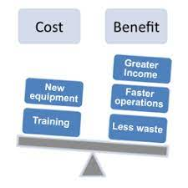
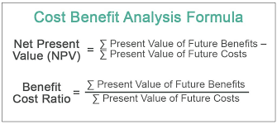
Techniques/Methods of Capital Budgeting
Cost-Benefit Analysis
A cost-benefit analysis is a systematic process that businesses use to analyze which decisions to make and which to forgo. The cost-benefit analyst sums the potential rewards expected from a situation or action and then subtracts the total costs associated with taking that action.

Slide 29
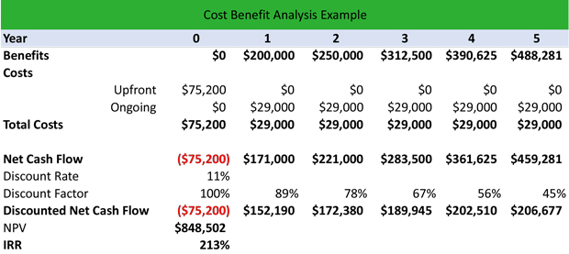
Techniques/Methods of Capital Budgeting
Cost-Benefit Analysis
Costs may include the following.
Direct costs would be direct labor involved in manufacturing, inventory, raw materials, manufacturing expenses.
Indirect costs might include electricity, overhead costs from management, rent, utilities.
Intangible costs of a decision, such as the impact on customers, employees, or delivery times.
Opportunity costs such as alternative investments, or buying a plant versus building one.
Cost of potential risks such as regulatory risks, competition, and environmental impacts.

Slide 30
Techniques/Methods of Capital Budgeting
Cost-Benefit Analysis
Every project will have different underlying principles; benefits might include the following:
Higher revenue and sales from increased production or new product.
Intangible benefits, such as improved employee safety and morale, as well as customer satisfaction due to enhanced product offerings or faster delivery.
Competitive advantage or market share gained as a result of the decision.
An analyst or project manager should apply a monetary measurement to all of the items on the cost-benefit list, taking special care not to underestimate costs or overestimate benefits.
Pros
Requires data-driven analysis
Limits analysis to only the purpose determined in the initial step of the process
Results in deeper, potentially more reliable findings
Delivers insights to financial and non-financial outcomes
Cons
May be unnecessary for smaller projects
Requires capital and resources to gather data and make analysis
Relies heavily on forecasted figures; if any single critical forecast is off, estimated findings will likely be wrong.

Slide 31
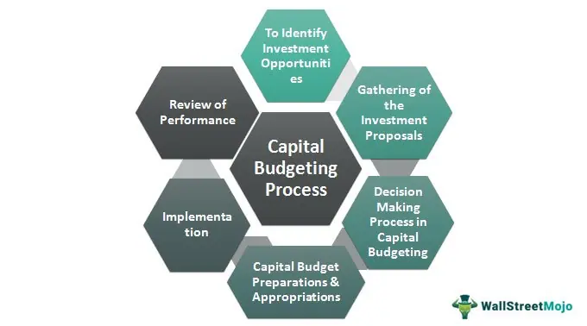
PART 3
Proces of Capital Budgeting

Slide 32
Proces of Capital Budgeting
Identifying and generating projects
Investment proposals are the first step in capital budgeting. Taking up investments in a business can be motivated by a number of reasons. There could be the addition or expansion of a product line. An increase in production or a decrease in production costs could also be suggested.
2. Evaluating the project
It mainly consists of selecting all criteria necessary for judging the need for a proposal. In order to maximize market value, it has to match the company's mission. It is crucial to consider the time value of money here.
In addition to estimating the benefits and costs, you should weigh the pros and cons associated with the process. There could be a lot of risks involved with the total cash inflows and outflows. This needs to be scrutinized thoroughly before moving ahead.

Slide 33
Proces of Capital Budgeting
3. Selecting a Project
Since there is no ‘one-size-fits-all’ factor, there is no defined technique for selecting a project. Every business has diverse requirements and therefore, the approval over a project comes based on the objectives of the organization. The companies need to explore all the options before concluding and approving the project. Besides, the factors like viability, profitability, and market conditions also play a vital role in the selection of the project.
4. Implementation
Once the project is implemented, now come the other critical elements such as completing it in the stipulated time frame or reduction of costs. Hereafter, the management takes charge of monitoring the impact of implementing the project.
5. Performance Review
This involves the process of analyzing and assessing the actual results over the estimated outcomes. This step helps the management identify the flaws and eliminate them for future proposals.

Slide 34
Proces of Capital Budgeting
Factors Affecting Capital Budgeting
Capital Return
Accounting Methods
Structure of Capital
Availability of Funds
Management decisions
Government Policies
Working Capital
Need of the project
Lending terms of financial institutions
Earnings
Taxation Policies
The economic value of the project

Slide 35
Proces of Capital Budgeting
Objectives of Capital Budgeting
The following points present the objectives of the capital budgeting:
Capital Expenditure Control: Organizations need to estimate the cost of investment as it allows them to control and manage the required capital expenditures.
Selecting Profitable Projects: The company will have to select the most appropriate project from the multiple possibilities in front of it.
Identification of Source of funds: The businesses need to locate and select the most viable and apt source of funds for long-term capital investment. It needs to compare the various costs like the costs of borrowing and the cost of expected profits.

Slide 36
Proces of Capital Budgeting – Key Takeaways
The capital budgeting process is the planning process utilized to calculate the potential investments or expenditures whose amount is significant.
It helps estimate the company’s investment in long-term fixed assets like the plant and machinery addition or replacement, new equipment, research, development, etc.
This capital budgeting process is the decision regarding the sources of finance and then calculating the return earned from the investment.
It starts with identifying different investment opportunities. Then, after collecting and calculating other investment proposals and choosing the best profitable investment, the decision for capital budgeting and apportionment is to be taken.

Slide 37
RECAP
Capital Budgeting is defined as the process by which a business determines which fixed asset purchases are acceptable and which are not.
Capital budgeting leads to calculating the profitable capital expenditure.
Determining if replacing any existing fixed assets would yield greater returns is a part of capital budgeting
Selecting or denying a given project is based on its merits.
The process of capital budgeting requires calculating the number of capital expenditures.
An assessment of the different funding sources for capital expenditures is needed.
Payback Period, Net Present Value Method, Internal Rate of Return, and Profitability Index are the methods to carry out capital budgeting.
The process of capital budgeting involves the steps like Identifying the potential projects, evaluating them, selecting and implementing the projects, and finally reviewing the performance for future considerations.
Capital return, accounting methods, structures of capital, availability of funds, and working capital are some of the factors that affect the process of capital budgeting.

