Slide 1
Developing a Project Seminar 1
SMART criterion, developing project idea and name
Project Management

Slide 2
Content
PART (5-10 min.)
Introduction to your project and answering any questions
2. PART (55 min.)
Working together – Project should be SMART (20mins)
Task 1 - Develop a project “My Schedule Today“ (30mins)
Create a groups of up to 3 people for working on the project (5mins)
3. PART (30 min.)
Task 2. Choose a project topic and name (what is appropriate to use as a project - feedback from the tutor) write down ideas, students choose 3 topics and then determine the "+" and "-" of the ideas (advantages and disadvantages, whether to implement as a project) (25mins)
Vevox quiz (5mins)
There will be feedback as needed during the time of the groups working on each section of their project and according to the needs of each group/students)

Slide 3
Introduction
Seminar paper (assignment)
You need to complete an assignment (seminar paper) for max. of 30 points (30% of final grade).
The due date is 15.12.2024 (midnight).
Upload (doc/pdf file) to Information System (homework vaults-will specify it later on)
You need to present your assignment (seminar paper) during the last lecture on 18.12.2024.
It will be a 10-15 minutes presentation in class.
Max. of 5 points (5% of final grade)

Slide 4
Learning and practice objectives
On the end of this seminar you should be able to:
choose an idea suitable for your project
define your project to be SMART
identify each phase of your project and their products

Slide 5
What is a project management
Project management is the planning, organizing, directing, and controlling of company resources for a relatively short-term objective that has been established to complete specific goals and objectives.

Slide 6
What is a project?
Unique product, service, or result
Conforming to specific requirements including costs and resources
PROJECT
Time-bound
Specific objective

Slide 7
What is a project?
Project proposal
Desired results of the project
or aim of project
Project exist as a problem or an idea.
We investigate the current state of the problem and set the aim or desired result of the project
Example:
1. Looking for an accommodation for a family;
2. Improve chances of refugees to find a job;
3. Help microbusinesses to find new channels to distribute and sell their products and services
Example:
1. Build a house/buy and refurbish an apartment;
2. Start training courses for refugees;
3. Establish regular marketplaces in town or online marketplaces

Slide 8
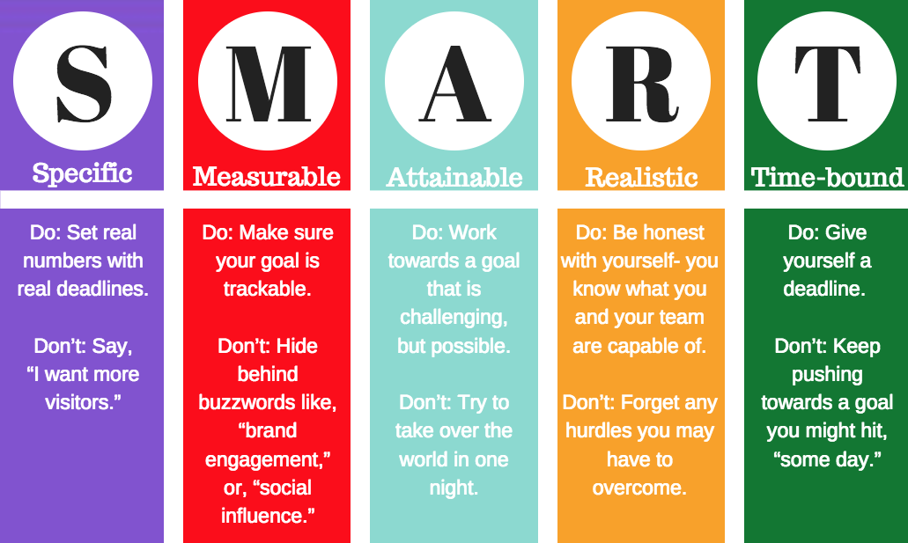
Working together - Project should be SMART
We will define what does SMART mean and working together on examples.

Slide 9
Project should be SMART
Examples:
1. Looking for an accommodation for a family;
2. Improve chances of refugees to find a job;
3. Help microbusinesses to find new channels to distribute and sell their products and services
S Specific – You want to build a house / buy and refurbish an apartment in certain locality
M Measurable – How many training courses do you need to set up and for how many people?
A Attainable – Marketplace example – the size of the place/rent; website – set up, maintenance, costs
R Realistic – Refugee example – qualification needed on the job market / are they able to learn such quailifications?
T Timebound – When we need to reach our goal – we need to move to our new home within one year.

Slide 10
Project triangle
Unique product, service, or result
Conforming to specific requirements including costs and resources
PROJECT
Time-bound
Specific objective

Slide 11
Task 1 – Individual work
Develop a project “My Schedule Today":
Set a goal (quantifiable-SMART)
Time schedule of a day, logic of compiling a sequence of activities (time + activities)
Assign resources to activities (personnel, costs - quantified in a currency)
Identify project risks
Recommendation:
Limited time - 1 day: start 00:01 - end 24:00
All activities are focused on achieving your goal (result / benefit that can be verified)
Costs of all resources (morning breakfast, travelling, activities, shopping, etc.), hidden costs - energy consumption, housing, services, etc.)
Summarize the main findings and the overall budget of the project
Notes:
https://edit.org

Slide 12
Task 2 – Individual work
Choose the name of your project (for your seminar paper)
• 10 minutes to write down ideas
• Select 3 options
• Determine the “pros" and “cons" of the selected options (advantages and disadvantages, whether is it feasible to implement it as a project)
• Choose the final idea
Notes:
https://edit.org

Slide 13
Questions…
Any problems with the idea for your project?

Slide 14
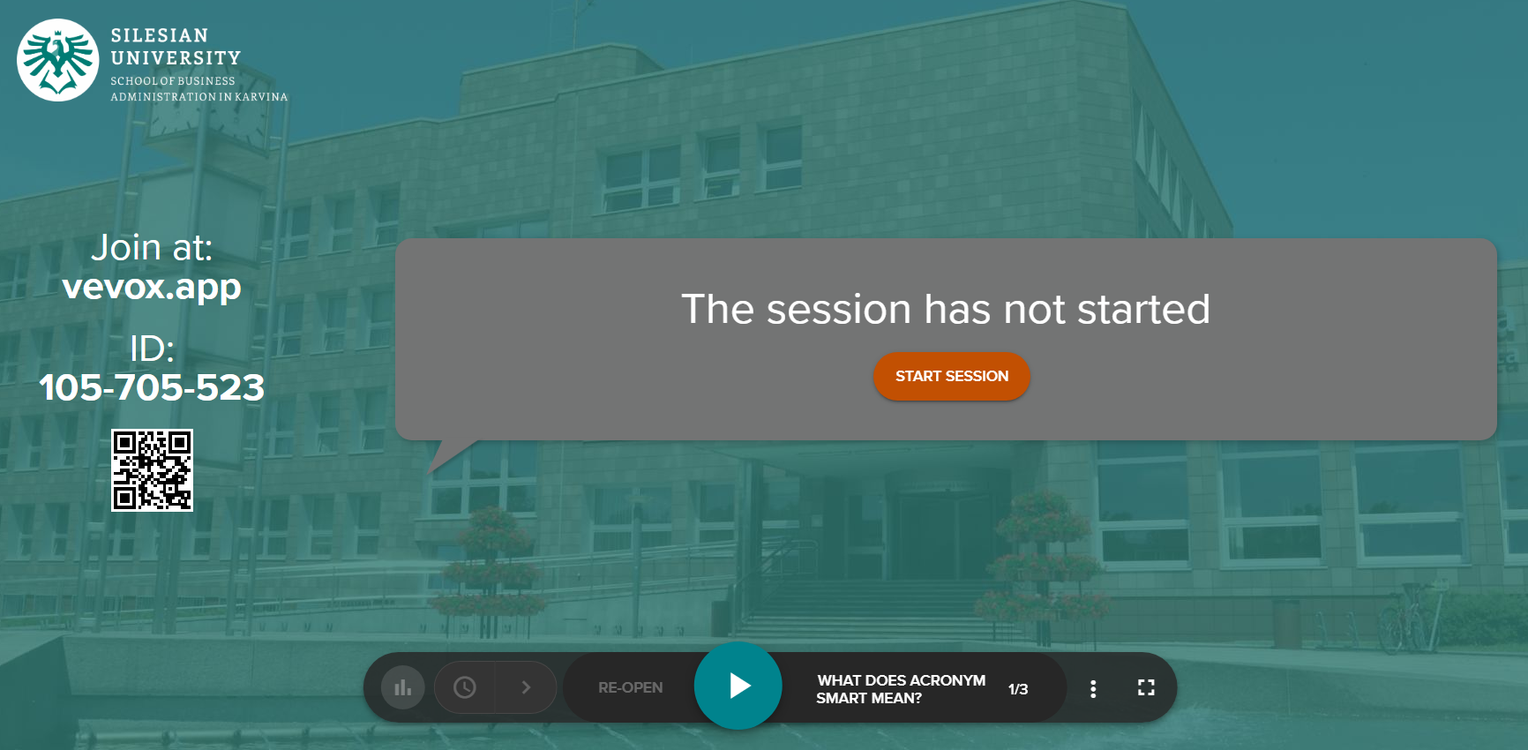
Vevox questions

