Slide 1
Customer Expectations
The Project Product
Project Management
Lucie Reczzkova
B304
Reczkova@opf.slu.cz
Office hours: Wednesday 10-11.30

Slide 2
Learning and practice objectives
On the end of this seminar, you should be able to:
understand what customers expect from your final product
understand how your value proposition meets your customers
understand what quality is still acceptable
understand who is going to assess the quality of your product

Slide 3
Feedback, answering any questions, and discussion
1.6 Organizational structure of the project
1.6.1. Create a diagram of the organizational structure of the project and identify people on each position:
Project sponsor:
Main users of the project:
Main suppliers:
Project supervision for suppliers / users / company:
Project support:
Project manager:
Team manager (s):
Stakeholders of the project:
1.6.2. RACI matrix

Slide 4
Group work – Description of the project product (final project output) points 2.1 - 2.3
2.1 Project product name: (this is, for example, the final product, service, innovation, etc.)
2.2 The purpose of this project product - the purpose that the project product as a whole is to achieve and who will use it.
2.3 Composition - a list of the main products or groups of products to be delivered by the project (e.g. for a car - tires, equipment, model line, etc.)

Slide 5
Group work – Description of the project product (final project output) points 2.4
2.4 Customer expectations for quality - a description of the expected quality of the project product from the user's point of view, including determination of the standard (specific characteristics of product quality, meeting e.g. testing, functionality, time of use, etc.)
You can use Empathy map to help generate ideas
You can use: https://web.mindonmap.com/create to create your own map

Slide 6
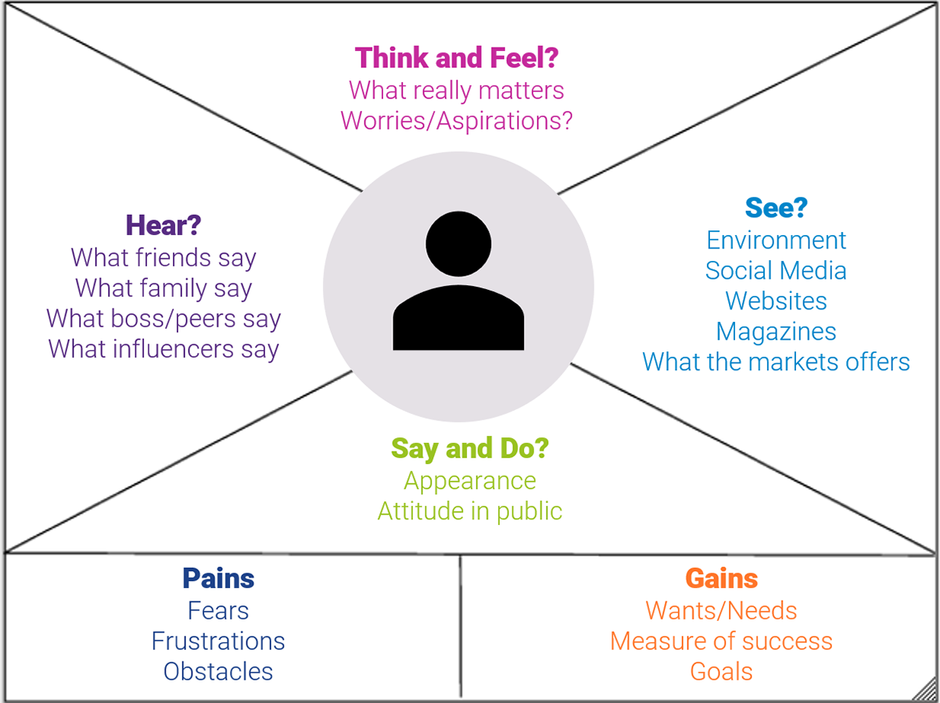
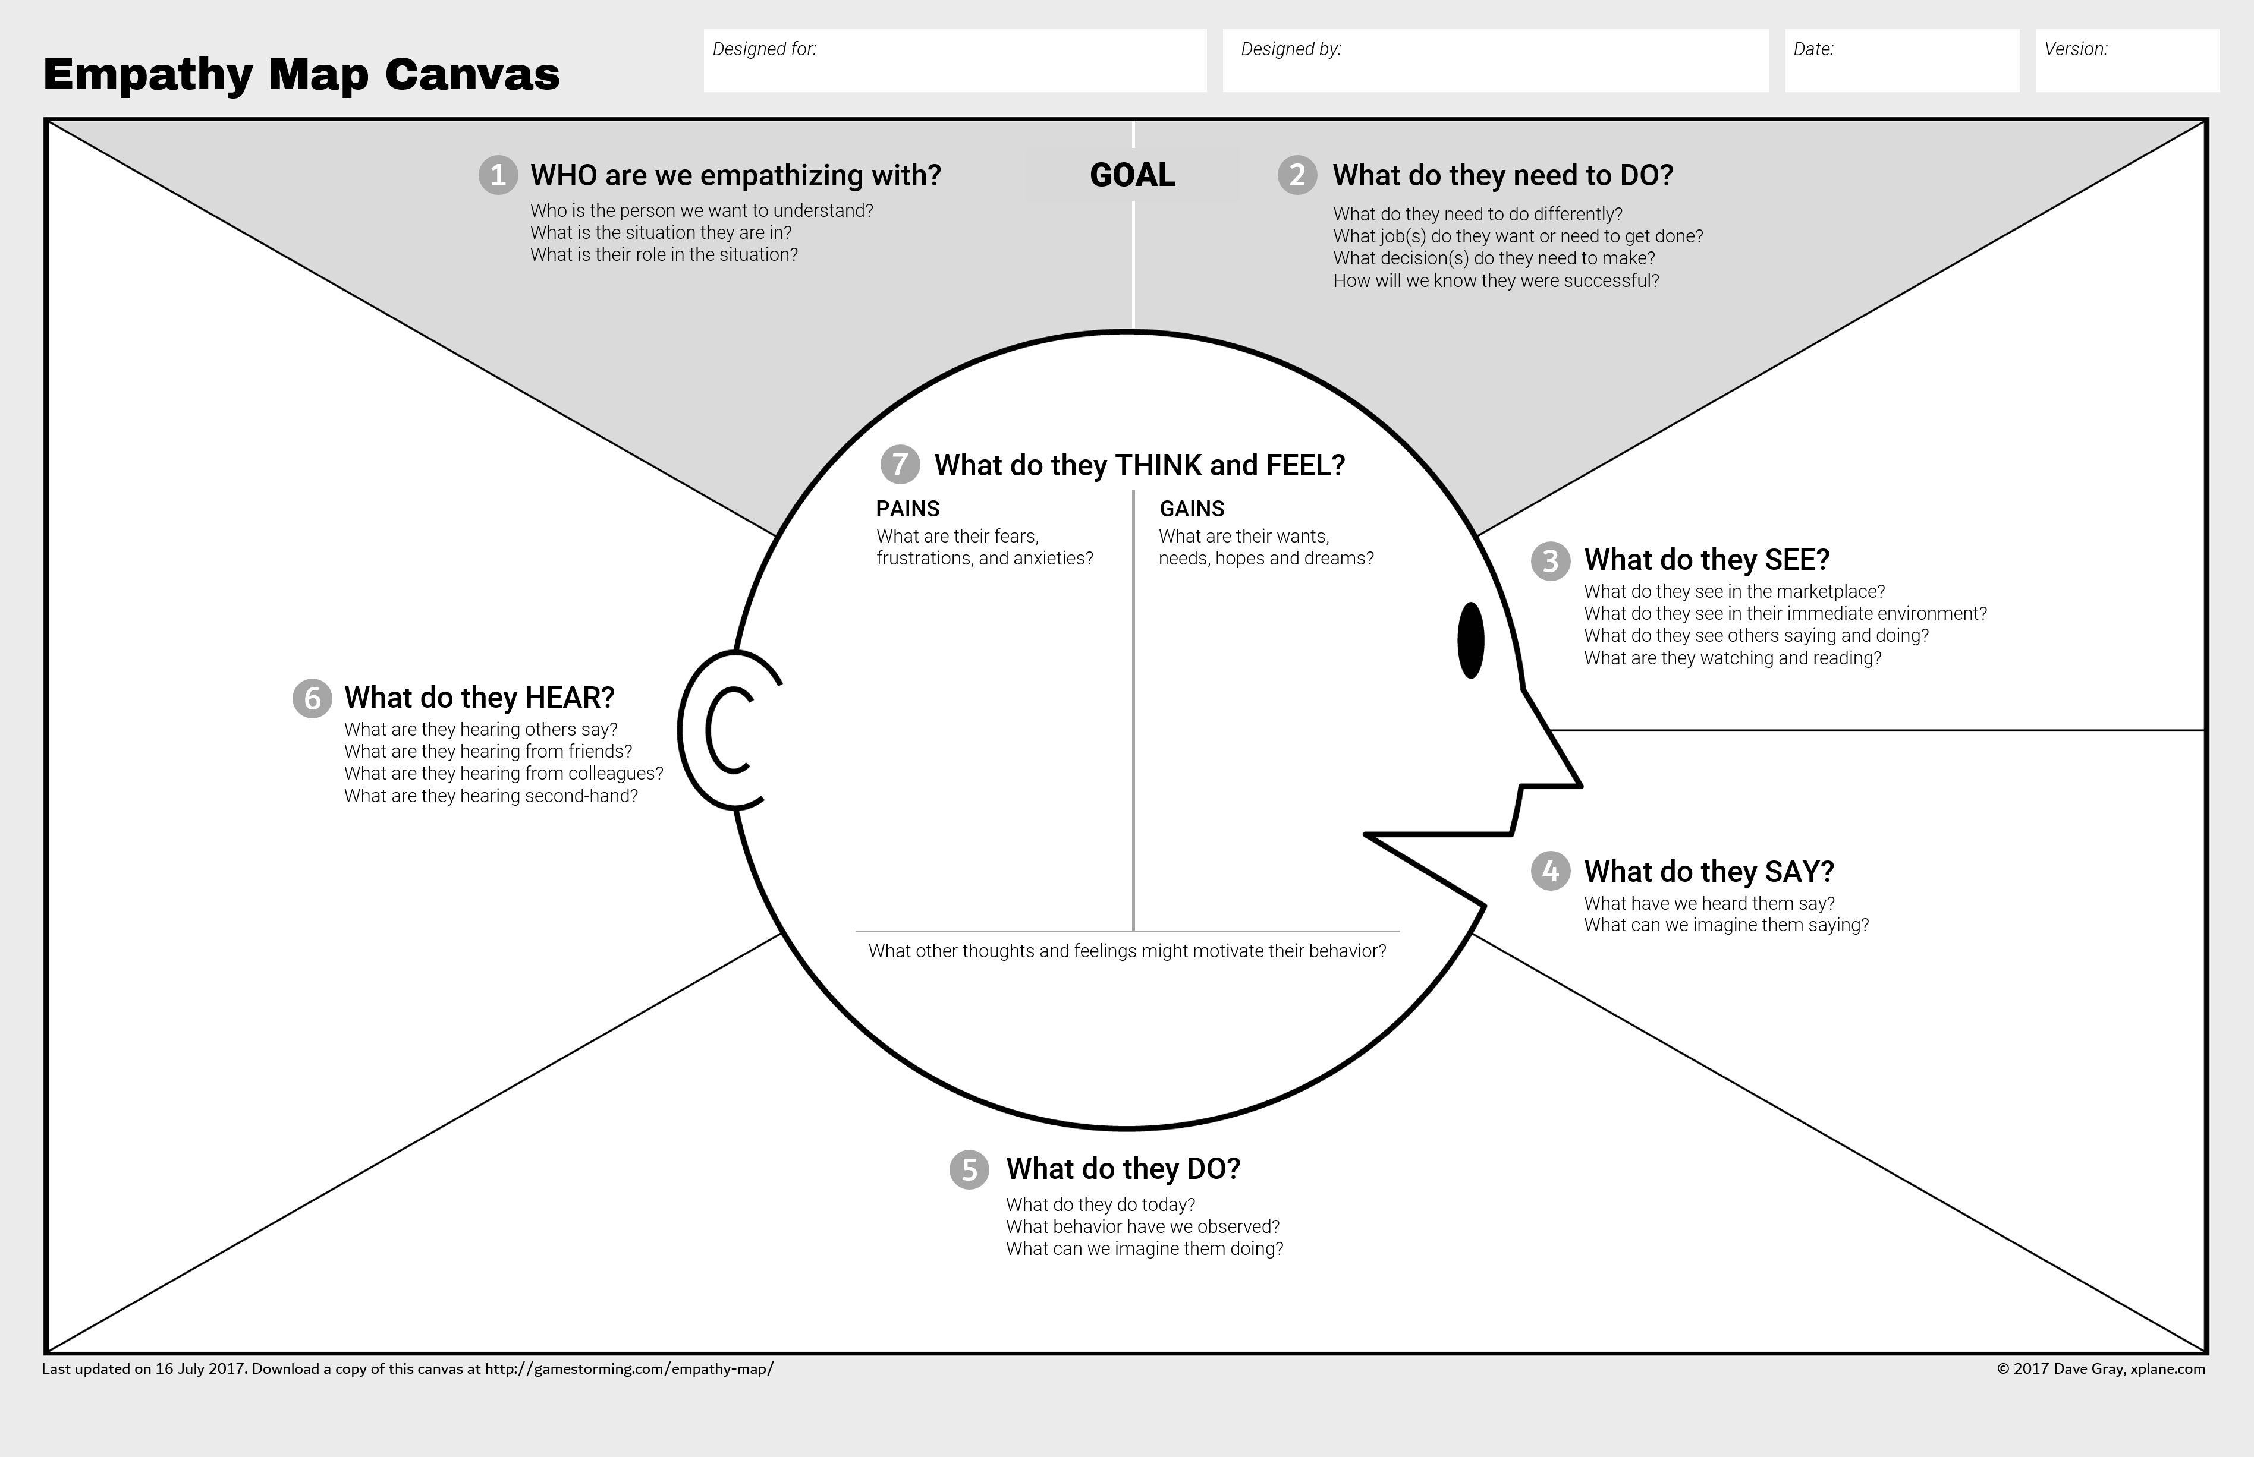
Group work – Description of the project product (final project output) points 2.4

Slide 7
Group work – Description of the project product (final project output) points 2.4

Slide 8
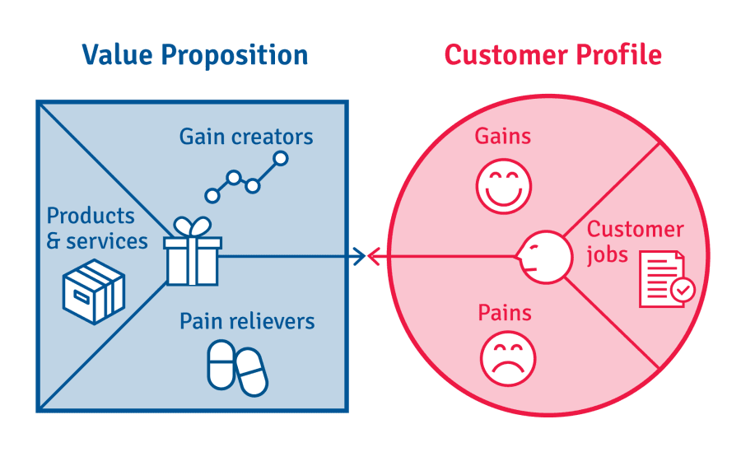
Group work – Description of the project product (final project output) points 2.4

Slide 9
Group work – Description of the project product (final project output) points 2.5
2.5 Acceptance criteria - a prioritized list of measurable criteria to be met in order for the final product of the project to be accepted / accepted.

Slide 10
Group work – Description of the project product (final project output) points 2.6 – 2.7
2.6 Quality tolerances - any tolerances that can be applied to the acceptance criteria
2.7 Responsibility for acceptance - who is responsible for acceptance

Slide 11
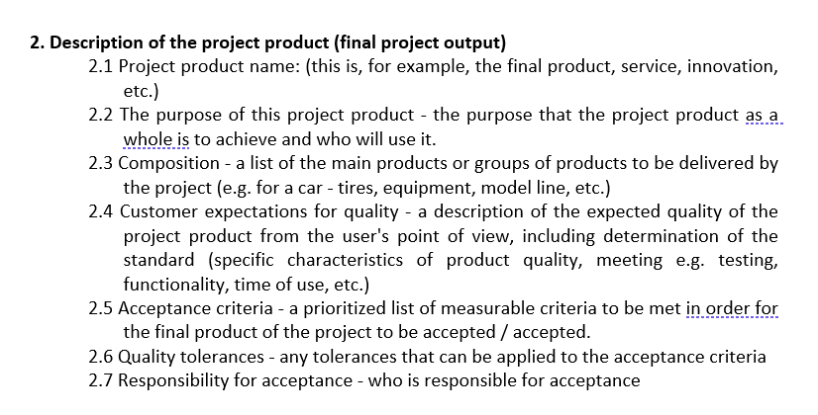
Group work – RACI matrix Point 1.6.2 of the seminar work template

Slide 12
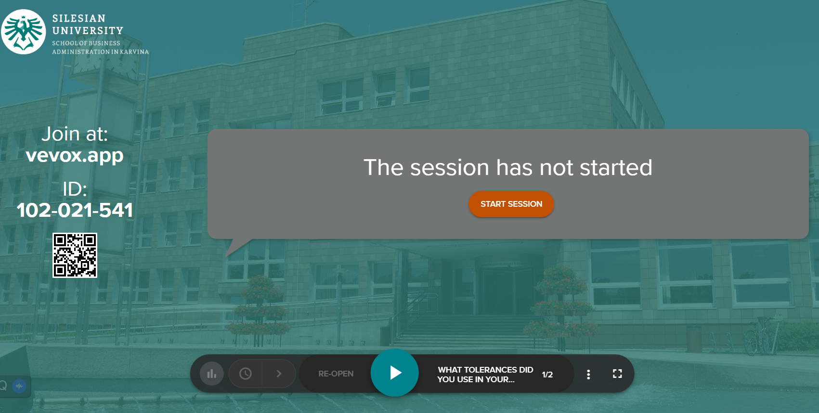
Vevox questions

