Slide 1

IMPLEMENTING A CSR APPROACH
THE IMPLEMENTING CORPORATE SOCIAL RESPONSIBILITY
Ing. Pavel Adámek, Ph.D.
CORPORATE SOCIAL RESPONSIBILITY/PEM-NACSR

Slide 2
IMPLEMENTING A CSR APPROACH
Outline of the lecture
The key potential benefits for organisations implementing CSR
The basic aspects of CSR implementation
CSR implementation framework

Slide 3
IMPLEMENTING A CSR APPROACH
INTRODUCTION
There is no one-size-fits-all method for pursuing a corporate social responsibility (CSR) approach.
Each firm has unique characteristics and circumstances that will affect how it views its operational context and its defining social responsibilities.
Each will vary in its awareness of CSR issues and how much work it has already done towards implementing a CSR approach.
Many firms are already engaged in customer, employee, community and environmental activities that can be excellent starting points for firm-wide CSR approaches.

Slide 4
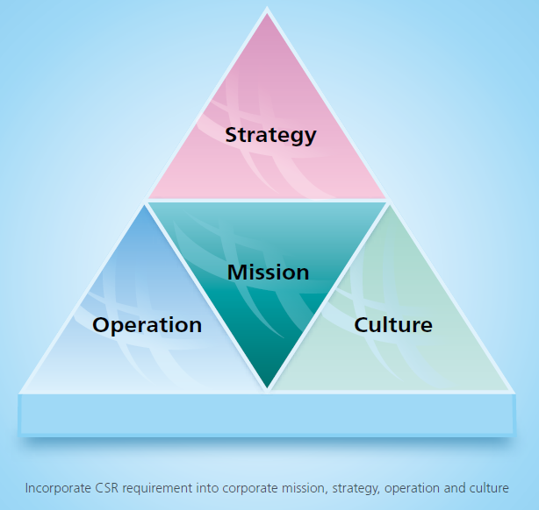
IMPLEMENTING A CSR APPROACH
INTRODUCTION
CSR can be phased in by focusing carefully on priorities in accordance with resource or time constraints. Alternatively, more comprehensive and systematic approaches can be pursued when resources and overall priorities permit or require.
The bottom line is that CSR needs to be integrated into the firm’s core decision making, strategy, management processes and activities.
There are a number of governmental and partnership developed initiatives that have emerged to provide guidance on governmental and societal expectations of business.
  By using these instruments—such as the OECD MNE Guidelines or the UN Global Compact—business users can be confident that they are basing their efforts on internationally-endorsed approaches.

Slide 5
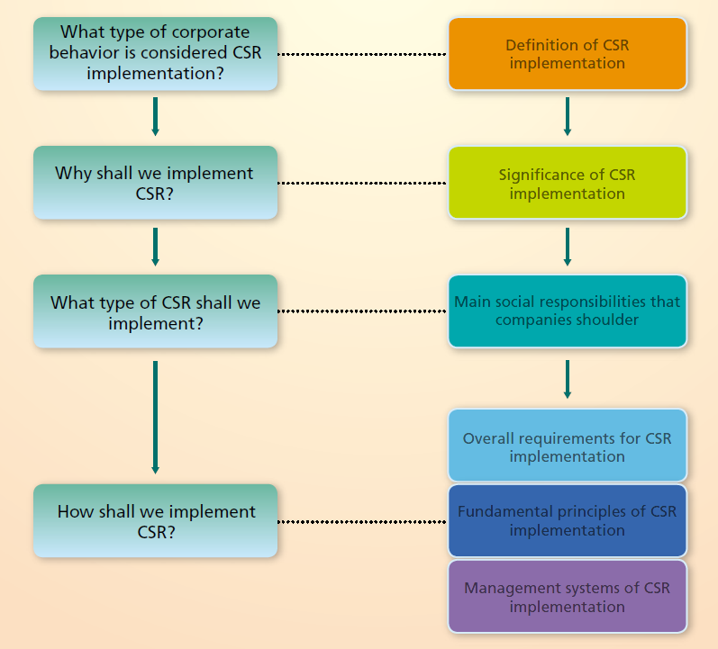
Basic guidance for the implementation of CSR
IMPLEMENTING A CSR APPROACH
IMPLEMENTATION PROCESS

Slide 6
IMPLEMENTING A CSR APPROACH
Example of CSR IMPLEMENTATION
SKODA auto
ŠKODA AUTO is one of the oldest car manufacturers in the world. Its history stretches back to 1895 when Václav Laurin and Václav Klement set up a company that gave rise to the tradition of manufacturing Czech cars, which has continued for over a hundred years. The position of the company in the automotive industry has always been and always will be unmistakable, in a large part because it has been part of the Volkswagen Group for 30 years.
Sustainability report 2019/20 https://www.skoda-auto.com/_doc/c7db8a36-78d3-42a7-9490-29f719f89394

Slide 7
IMPLEMENTING A CSR APPROACH
MEANING OF CSR IMPLEMENTATION
CSR implementation means that the company shall be accountable to stakeholders, future generations and the natural environment.
An enterprise shall be responsible for stakeholders, motivate the passion of the stakeholders such as employees, customers, generating companies, suppliers and communities, give full play to the transmission capacity of the power grid and optimization of energy allocation, and guarantee safer, cleaner, more economical and sustainable energy supply.

Slide 8

IMPLEMENTING A CSR APPROACH
Source: SGCC Guidance for the Implementation of CSR (2008)

Slide 9
IMPLEMENTING A CSR APPROACH
Establishing the Organizational Management System
The CSR organizational management system is viewed as an organizing framework and operating procedure that is to serve and promote corporate commitment in compliance with its social responsibilities in all operational aspects.
The CSR Steering Committee has been set up for defining CSR missions and principles and Implementing a unified management for CSR activities, with SGCC’s President as director general and other top executives as deputy directors.
Committee Members are either the chief of SGCC’s Functional departments, or the head of subsidiaries. CSR Office has been set up under the Steering Committee, with Administration Office handling daily affairs.

Slide 10
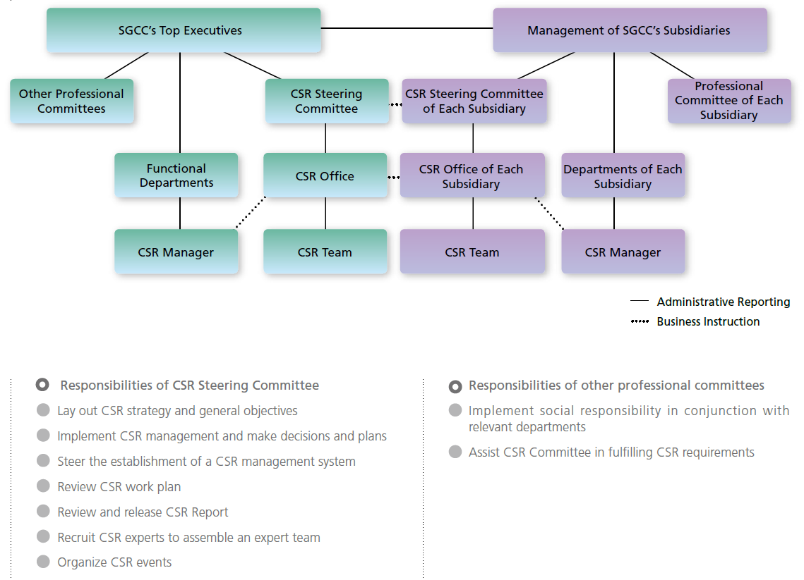
IMPLEMENTING A CSR APPROACH
Establishing the Organizational Management System

Slide 11
IMPLEMENTING A CSR APPROACH
Establishing the Organizational Management System
Responsibilities of CSR Office
Implement decisions and plans
Coordinate establishment and implementation of
CSR management system
Make CSR work plans, propose budget and training programs
Conduct research on CSR key subjects
Develop CSR management tools
Draft CSR Report
Manage CSR website
Communicate with counterparts at home and abroad

Slide 12
IMPLEMENTING A CSR APPROACH
Establishing the Organizational Management System
Responsibilities of other departments on CSR
Identify CSR subjects involved
Promote dialogues and cooperation with stakeholders
Undertake CSR tasks
Organize internal trainings on CSR
Define job responsibilities, the scope of management system and work procedures
Collect CSR statistical indexes
Work out CSR plans
Assess CSR performance

Slide 13
IMPLEMENTING A CSR APPROACH
Establishing the Organizational Management System
Responsibilities of CSR Manager in departments
Assist CSR Office in launching CSR trainings
Gather and Submit CSR subjects
Coordinate efforts to draft programs for stakeholders’ participation
Coordinate efforts to implement CSR work plans
Collect and submit information on CSR implementation

Slide 14

IMPLEMENTING A CSR APPROACH
Establishing the Organizational Management System

Slide 15
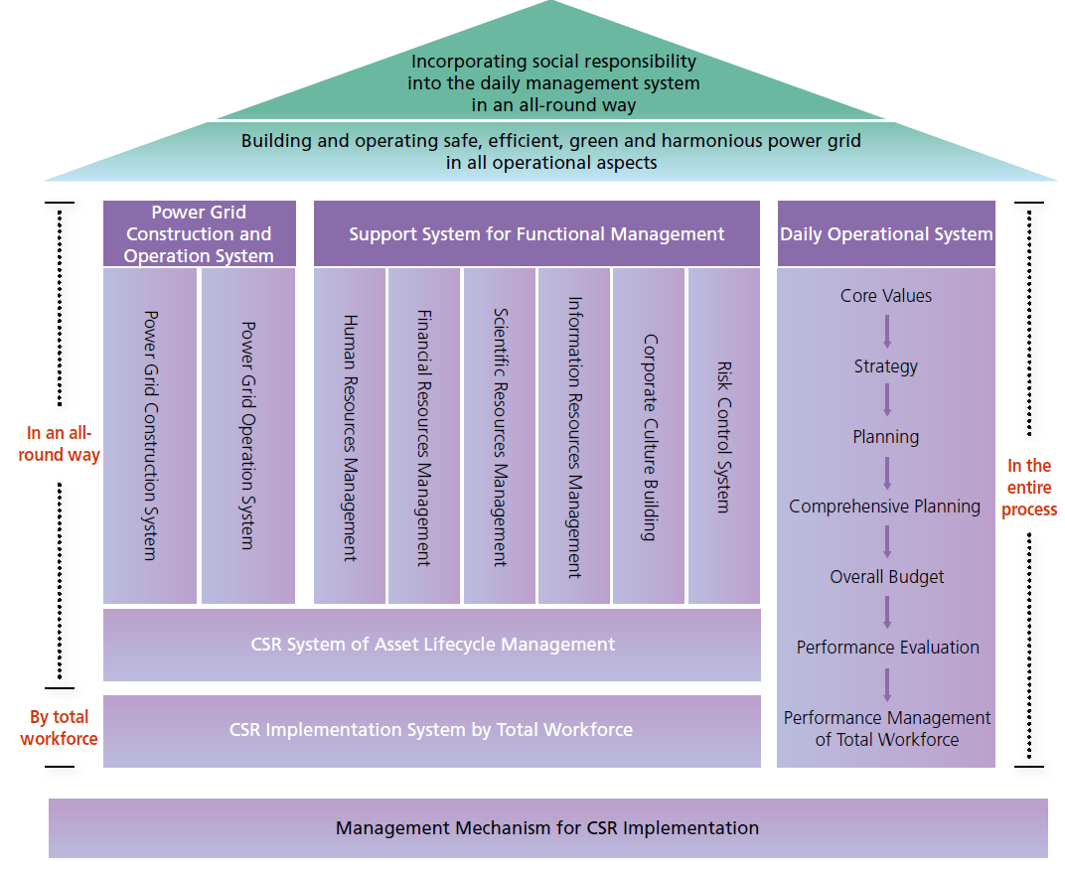
IMPLEMENTING A CSR APPROACH
CSR Daily Management System

Slide 16
IMPLEMENTING A CSR APPROACH
1. The key potential benefits for organisations implementing CSR
Better anticipation and management of an ever-expanding spectrum of risk.
  Effectively managing governance, legal, social, environmental, economic and other risks in an increasingly complex market environment, with greater oversight and stakeholder scrutiny of corporate activities, can improve the security of supply and overall market stability.
Improved reputation management. Organizations that perform well with regard to CSR can build their reputation, while those that perform poorly can damage brand and company value when exposed.
  Reputation, or brand equity, is founded on values such as trust, credibility, reliability, quality and consistency.

Slide 17
IMPLEMENTING A CSR APPROACH
1. The key potential benefits for organisations implementing CSR
Enhanced ability to recruit, develop and retain staff.
  This can be the direct result of pride in the company’s products and practices, or of introducing improved human resources practices, such as “family-friendly” policies (improve employee morale and loyalty).
Improved innovation, competitiveness and market positioning. CSR is as much about seizing opportunity as avoiding risk.
  Drawing feedback from diverse stakeholders can be a rich source of ideas for new products, processes and markets, resulting in competitive advantages. For example, a firm may become certified to environmental and social standards so it can become a supplier to particular retailers.

Slide 18
IMPLEMENTING A CSR APPROACH
1. The key potential benefits for organisations implementing CSR
Enhanced operational efficiencies and cost savings. These flow in particular from improved efficiencies identified through a systematic approach to management that includes continuous improvement.
  For example, assessing the environmental and energy aspects of an operation can reveal opportunities for turning waste streams into revenue streams (wood chips into particle board, for example) and for system-wide reductions in energy use, and costs.
Improved ability to attract and build effective and efficient supply chain relationships. A firm is vulnerable to the weakest link in its supply chain.
  Like-minded companies can form profitable long-term business relationships by improving standards, and thereby reducing risks. Larger firms can stimulate smaller firms with whom they do business to implement a CSR approach.

Slide 19
IMPLEMENTING A CSR APPROACH
1. The key potential benefits for organisations implementing CSR
Enhanced ability to address change.
  A company with its “ear to the ground” through regular stakeholder dialogue is in a better position to anticipate and respond to regulatory, economic, social and environmental changes that may occur. Increasingly, firms use CSR as a “radar” to detect evolving trends in the market.
More robust “social licence” to operate in the community.
  Improved citizen and stakeholder understanding of the firm and its objectives and activities translates into improved stakeholder relations. This, in turn, may evolve into more robust and enduring public, private and civil society alliances (relate closely to CSR reputation).

Slide 20
IMPLEMENTING A CSR APPROACH
1. The key potential benefits for organisations implementing CSR
Access to capital. Financial institutions are increasingly incorporating social and environmental criteria into their assessment of projects.
  When making decisions about where to place their money, investors are looking for indicators of effective CSR management.
Improved relations with regulators. In a number of jurisdictions, governments have expedited approval processes for firms that have undertaken social and environmental activities beyond those required by regulation.
  In some countries, governments use (or are considering using) CSR indicators in deciding on procurement or export assistance contracts.

Slide 21
IMPLEMENTING A CSR APPROACH
1. The key potential benefits for organisations implementing CSR
A catalyst for responsible consumption. Changing unsustainable patterns of consumption is widely seen as an important driver to achieving Sustainable development.
  Companies have a key role to play in facilitating sustainable consumption patterns and lifestyles through the goods and services they provide and the way they provide them.
CSR implementation contributes to raising the capability of corporate strategy management, improving the quality, thinking pattern and work style of employees and inspiring their dedication, innovation and team spirit. It thereof strengthens corporate competence in an all-round way.
In addition, it is devoted to enhancing interaction with stakeholders to win their understanding and support so as to forge a harmonious relationship with stakeholders and shape a good corporate image.

Slide 22

IMPLEMENTING A CSR APPROACH
The CIRCLE OF THE csr AND COMMON GROWTH
Important aspects concern with business activities and stakeholders interests – to realize harmonius interaction and common growth.
Source: SGCC Guidance for the Implementation of CSR (2008)

Slide 23
IMPLEMENTING A CSR APPROACH
2. The basic aspects of CSR implmentation
Well-designed CSR implementation framework integrates economic, social and environmental decision making throughout a firm → from the board of directors to front-line officials and supply-chain partners → and is therefore intimately connected with effective corporate governance.
One way in which all businesses of all sizes, and from all industries, should start the journey towards CSR is by using stakeholder dialogue.
The benefits derived from identifying and conversing with all the groups and individuals that are connected to business are significant as it is these people that can distinguish the weak points, strong points, failures and successes of its social, environmental and economic aspects.

Slide 24

IMPLEMENTING A CSR APPROACH
2. The basic aspects of CSR implmentation

Slide 25
IMPLEMENTING A CSR APPROACH
2. The basic aspects of CSR implmentation
Depending on the size and activities of a company, its stakeholders could include:
  Business Partners (employees, suppliers, distributors, service providers, unions);
  Authorisers (government – legislation and guidance, regulatory agencies, shareholders, investors, professional bodies, board of directors);
  External influencers (consumers, clients, public, media, special interest or pressure groups).
The real value of corporate social responsibility is that the concept can enable a business to approach existing objectives with a fresh perspective and encourage others to view the business from a new, often more favourable angle.

Slide 26
IMPLEMENTING A CSR APPROACH
2. The basic aspects of CSR implmentation
The general measures and starting points in implementation CSR:
initiate stakeholder dialogue;
have a long-term outlook;
identify parts of existing business aims and policies that show social responsibility and build on these;
consider writing some short simple statements of values, aims and targets that you could aim to fulfil in whatever timescales seem appropriate and realistic;
engage with the local community and be more transparent;
consider ways in which you can implement the CSR in your own business;
may consider writing a small report on environmental and social issues that they have addressed;
consider your reputation with local government, consumers and media.

Slide 27
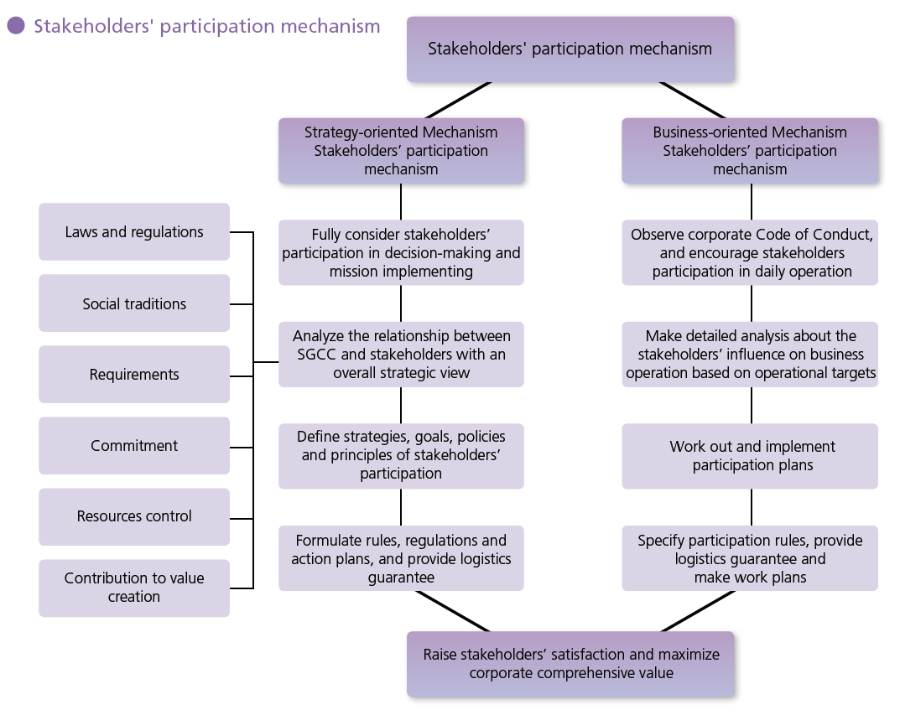
IMPLEMENTING A CSR APPROACH
2. The basic aspects of CSR implmentation

Slide 28
IMPLEMENTING A CSR APPROACH
2. The basic aspects of CSR implmentation
The business you should do:
CSR audit. CSR is all about the interaction a business has with the rest of society.
  This means not just core stakeholders such as customers, employees, investors and suppliers, but includes the wider community. Then ask Does the business interact with these groups in a way that is responsible? Are practices fair, honest and open, and do they build goodwill?
Look at employment practices. Does the company follow enlightened policies on recruitment, training, health, safety and welfare?
Look at marketing practices.
Look at environmental practices.
Look at community involvement.
Benchmark. Look for the best examples you can find (not only in your industry).

Slide 29
IMPLEMENTING A CSR APPROACH
2. The basic aspects of CSR implmentation
The business you should do:
Understand why you need CSR. Your reputation can affect the perception of customers, investors, employees and potential trade partners.
Explain CSR and counter cynicism. Every manager and employee should understand the importance of CSR to the business and to themselves. A properly designed CSR programme will have positive benefits for marketing, HR, production and key business areas. If people understand this, they will take ownership and responsibility.
Explain CSR to your external stakeholders.
Celebrate success as you pass significant CSR milestones.

Slide 30
IMPLEMENTING A CSR APPROACH
2. The basic aspects of CSR implmentation
And the business – you should not do:
Don’t make token gestures.
Don’t apply different standards. Given our global village, moving a dirty process to a less regulated country or applying vastly different standards in different parts of the business can seriously harm your reputation.
Don’t stand still. Issues change with time, look ahead, take the public pulse, see what legislators are up to and update the CSR programme to stay ahead of the game.
Don’t slide and backtrack. Appoint someone or even a team to ensure policies are implemented.
CSR and the issues that drive it are usually irreversible. It is better to stay ahead and on the right side of key issues.

Slide 31
IMPLEMENTING A CSR APPROACH
2. The basic aspects of CSR implmentation
As we begin to understand more about how firms react to pressures for greater CSR, we understand more about their learning stages and how they translate that learning into action.
Simon Zadek (the founder and CEO of AccountAbility) identify the five stages of learning that organisatoion go through „when it comes to developing a sense of corporate responsibility“.
The five stages of CSR learning:
Defensive (to deny Responsibility)
Compliance (to do the minimum required)
Managerial (to begin integrating CSR into management practices)
Strategic (to embed CSR within the strategy planning proces)
Civil (to promote CSR practices industry-wide)

Slide 32
IMPLEMENTING A CSR APPROACH
3. CSR Implementation framework
Strategy implementation’s top 10 checklist:
Commitment of top management
Involve middle manager’s valuable knowledge
Communication is what implementation is all about
Integrate point of view
Clear assignment of responsibilities
Preventive measures against barriers
Emphasize teamwork activities
Respect the individuals´ different characteristics
Take advantage of supportive implementation instruments
Calculate buffer time for unexpected incidents

Slide 33
IMPLEMENTING A CSR APPROACH
3. CSR Implementation framework
The framework is intended to help boards of directors, CEOs, managers, employees and others assess a firm’s effects on society and the challenges and opportunities associated with taking these impacts into account in decision making and business activities.
The CSR implementation framework set out in this guide is built around the “plan, do, check and improve” model.
Plan is the first part and in this phase it is important to decide the organizational working process.
  Clearly define instructions, instruments and approach is crucial in the preparation phase, since this is the starting point and the organization should ask themselves were they are going and not were they are right now. This is done by having a clear vision and the right instructions and instruments to reach there.

Slide 34
IMPLEMENTING A CSR APPROACH
3. CSR Implementation framework
Do is the next step of the process where a numerous of actions needs to be taken. Initially, it is important to conduct a CSR business plan that can either be integrated with the organizations overall goals and vision or it can be separately executed.
  The CSR business plan should contain CSR implementation strategy, commitments and decision making structures. A CSR commitment draft should also be prepared and it should include the different CSR commitments the company decides to undertake.
  A CSR working group with members who are enthusiastic about the project should be out together. As the implementation goes on it is important to keep the employees up to date and give them continuously CSR training.

Slide 35
IMPLEMENTING A CSR APPROACH
3. CSR Implementation framework
Check is the third part of the implementation model and in this part the to measure the targets and recognize performance that has been set up earlier. It is important to report progresses in order to improve the outcome of the CSR implementation process. The usage of reward systems is important to keep employees motivated in the CSR implementation process.
Improve is the final step in model and in this part is the implementation evaluated - important in order to improve the CSR implementation process.
Communication is important in every phase of the implementation. To really emphasize the importance of communication it is shown as an arrow in the model through the entire process.

Slide 36
Honen and Potts implementation guide
IMPLEMENTING A CSR APPROACH
3. CSR Implementation framework
In recognition of the fact that firms are at different levels of sophistication and development with respect to CSR, it is understood that firms may choose to forego a particular aspect or task when it has already been undertaken.

Slide 37
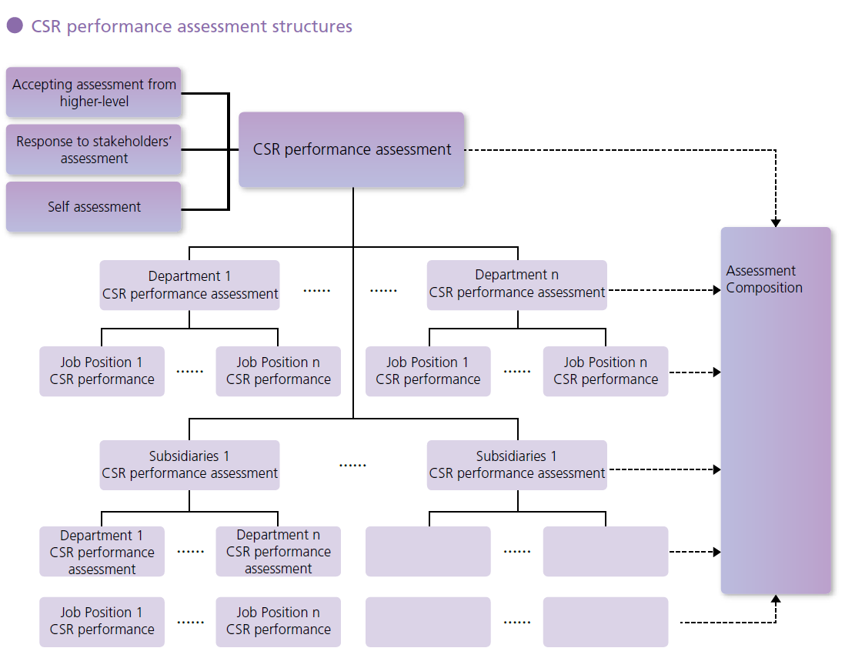
IMPLEMENTING A CSR APPROACH
3. CSR Implementation framework

Slide 38
IMPLEMENTING A CSR APPROACH
summary of the lecture
Implementation is all about communication and communication is important all along the implementation process, not only initially but also along the way in order to better evaluate the process and measure the progress of the implementation.
It is very important that everyone involved in the implementation process is aware of why they are doing things and that they understand the purpose and goal with the process and that the discussion around the CSR implementation is ongoing and open.
Recomended study:
  Chandler, Werther, Jr. „Strategic Corporate Social Responsibility“, chapter 5.

Slide 39

IMPLEMENTING A CSR APPROACH
The Top 100 Companies With The Best CSR (Corporate Social Responsibility) Reputation
https://youmatter.world/en/top-100-companies-best-csr-reputation2019-28108/

