Slide 1

Capital Structure and Financial Leverage
Ing. Žaneta Rylková, Ph.D.
Managerial Economics

Slide 2

Questions
Have you ever seen a financial statement? What did it show?
What basic information do the financial statements provide?
Who are the main recipients of financial statements?
What are company assets?
What are the most usual forms of assets?
What is accounts receivable?
What are company liabilities?
What are the most usual forms of liabilities?

Slide 3
Outline of the lecture
Liquidity
Capital structure
Financial leverage
Optimal capital structure

Slide 4
The ownership structure of the company: the cycle of current assets

Slide 5
Liquidity
The ability of the individual components of assets to convert into cash is known as a liquidity (liquidity, absolute liquidity). (How quickly components convert or transform)
Money: the most liquid part of Assets
Fixed assets (buildings, machinery ...) the least liquid component of assets.

Slide 6
Capital structure
Is the mix of financial funds used to finance the firm.
The value of a firm is defined to be the sum of the value of the firm´s debt and the firm´s equity.
Is the proportion of debt and preference and equity shares on a firm´s balance sheet.
Optimum capital structure is the capital structure at which the weighted average cost of capital is minimum and thereby we get maximum value of the firm.
Raising of capital from different sources and their use in different assets by a company is made on the basis of certain principles that provide a system of capital so that the maximum rate of return can be earned at a minimum cost.

Slide 7
Costs of capital
The cost of each type of capital depends mainly on:
capital maturity - at longer maturities, the investor asks for higher returns and the cost of capital increases,
the degree of risk the investor takes - at higher risk, the investor asks for higher returns and the cost of capital increases,
investment liquidity - with lower liquidity, the investor asks for higher returns and the cost of capital increases,
method of reimbursement of the cost of capital by the company - if they lower the tax base (interest is a cost), they are cheaper, if the company pays them only from net profit (profit shares, dividends), they are more expensive.

Slide 8
Cost of capital
Taking into account the factors, the different types of capital may be ranked in terms of their 'price' to the company as follows:
  the cheapest is external short-term capital
  long-term external capital is more expensive,
  equity is the most expensive.

Slide 9
Cost of debt
They represent interest and other expenses related to the acquisition of foreign capital (bank and other fees, commissions), which are mostly contractually agreed. In the case of the provision of capital in the form of a loan, the company is obliged to return the loan within the set deadline, with the agreed interest.
At the same time, short-term foreign capital is cheaper than long-term capital (it bears lower interest rates).

Slide 10
Cost of debt
Moreover there is a tax effect that the interest on the loan received is a tax-deductible expense for the enterprise, which reduces the size of the tax base and hence the amount of tax paid and thus increases the net profit of the company. Therefore, the actual cost of foreign capital is as follows:
Cost of debt= interest rate (1 – income tax rate)

Slide 11
Principle of financial leverage
An important factor in assessing the impact of “foreign capital” on the business entity's performance, particularly in terms of return on equity, is the effect of the so-called financial leverage on the return on equity. This can be illustrated schematically as shown in the following figure.

Slide 12
Principle of financial leverage
The principle of financial leverage can be characterized by the fact that if the return on total capital is greater than the unit cost of foreign capital, e.g. in the form of an interest rate, the presence of foreign capital increases the return on equity. In this case, we talk about the positive effect of financial leverage.
If the return on total capital is lower than interest rate, the financial leverage is negative, i.e. the return on equity is lower than it would be in the capital structure without the presence of foreign capital.

Slide 13
Principle of financial leverage
The leverage effect (power) expresses a multiple of the return on equity with the share of foreign capital over the return on equity without the share of foreign capital in total capital.

Slide 14
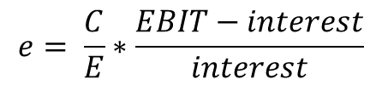
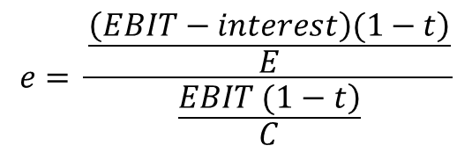

Effect (power) of financial leverage:
$$e= \frac{return on equity with use of debt}{return on equity without debt}$$
$$e= \frac{\frac{\left.\left(EBIT−interest\right)(1−t\right)}{E}}{\frac{\left.EBIT (1−t\right)}{C}}$$
$$e= \frac{C}{E}∗\frac{EBIT−interest}{interest}$$

Slide 15
Effect (power) of financial leverage:
where:
e „power“ effect of financial leverage (how many times the
return on equity with the share of foreign capital increased compared to the return on equity without the presence of
foreign capital)
EBIT operating economic profit
t income tax rate
C total capital
E equity

Slide 16
Effect (power) of financial leverage:

Slide 17
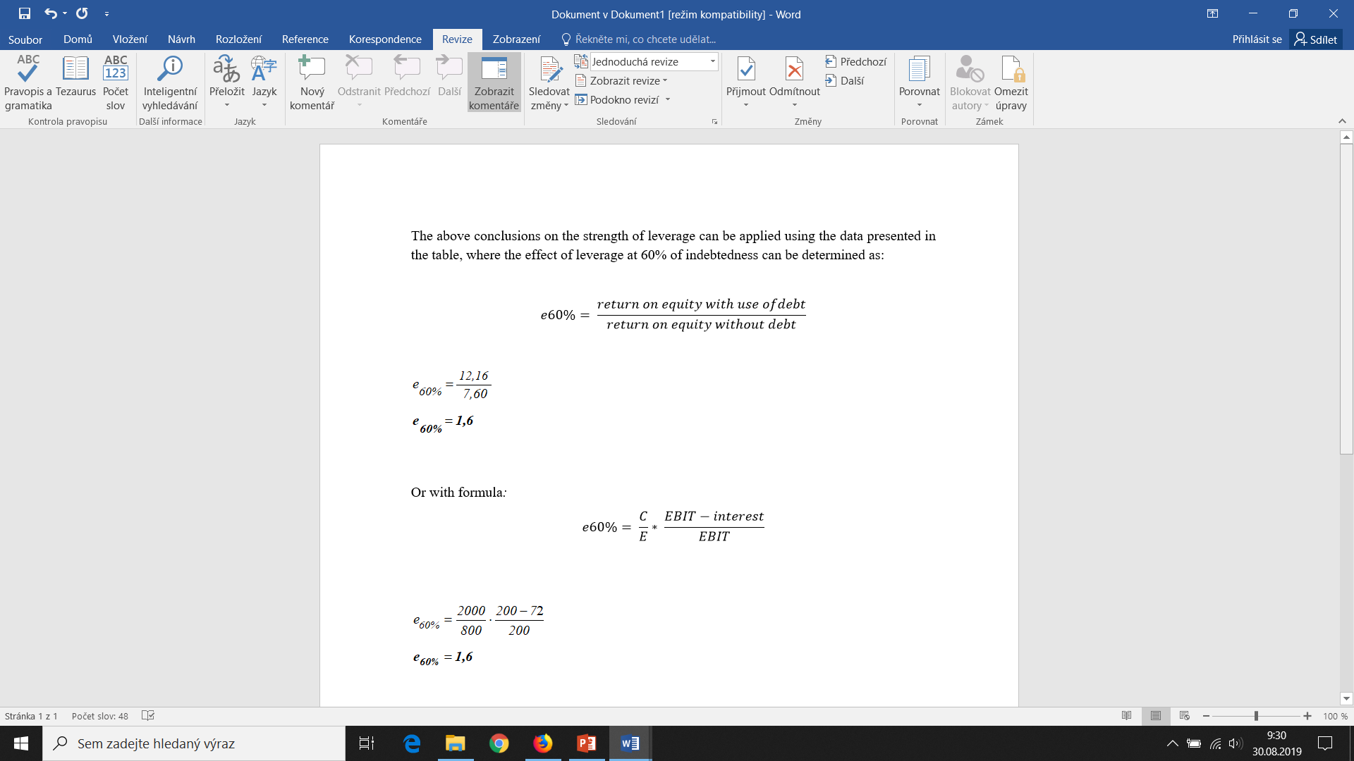
Effect (power) of financial leverage:

Slide 18
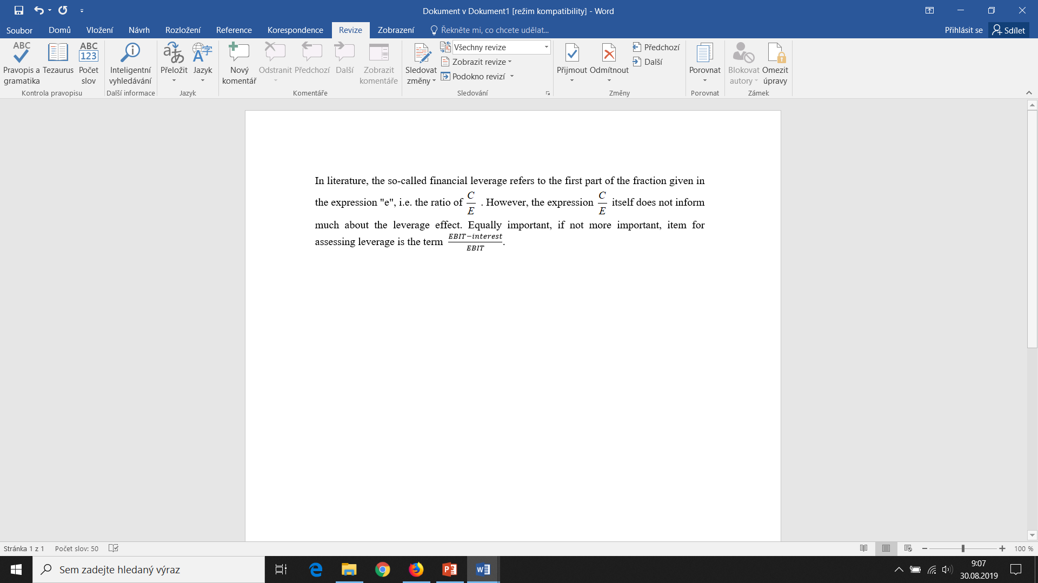
Effect (power) of financial leverage:
The actual interpretation of the presented results is as follows: Due to the use of foreign capital in company “B” to the extent corresponding to 60% of indebtedness, financial leverage increases the return on equity 1.6 times compared to the same operating profit of company “A” which only works with equity.

Slide 19
Negative effect of financial leverage

Slide 20
Negative effect of financial leverage

Slide 21
Reasons to prevent extensive use of foreign capital
Foreign capital increases indebtedness and thus reduces financial stability
Growth in debt is accompanied by an increase in the price of foreign capital (interest rate increase)
High share of foreign capital narrows the management space of maneuver (increased vigilance of creditors)

Slide 22
Cost of equity
Unlike the cost of borrowed capital, there are no fixed payments for equity costs.
The financial concept of EC costs may include dividends (for joint stock companies) or owners' shares in the profits of the business, the cost of raising capital and, in certain circumstances, the costs of winding up the business. Such a view of the costs of EC will want to apply the company management.
However, from the point of view of owners (investors), the costs of EC should be considered to be the returns that these owners could achieve at the same risk if they had invested their capital in another investment opportunity outside the company. It should therefore be the opportunity costs (opportunity costs) associated with leaving another, equally risky investment opportunity outside the enterprise.

Slide 23
Optimal capital structure
In order to include all costs associated with business activities in the assessment of the economic activity of enterprises, indicators designed on the basis of economic value added (EVA) are used in the analysis of enterprises.
In contrast to the classic economic result, which is the output of the Czech Republic's financial statements and which essentially “ignores” the cost of equity, these costs are fully reflected in the EVA indicators and included in the total cost of the business entity.
At that point, the capital structure becomes an important factor in the assessment of the economic activity of the business entity.

Slide 24
Optimal Capital Structure
Optimal capital structure provides the minimum costs of capital employed. It is the result correctly determined ratio between equity and debt.
Total costs of capital:
  k_{O} (or WACC) ∙ C = k_{d} ∙ (1 – t)∙D + k_{e} ∙ E
  k_{O} = k_{d} ∙ (1 – t) ∙ D/C + k_{e} ∙ E/C

Slide 25
Optimal Capital Structure
k_{O} (or WACC) = k_{d} ∙ (1 – t)∙D/C + k_{e} ∙ E/C
where:
k_{O} costs per 1 CZK of total capital
or kO ∙ 100 in %
k_{d} costs per 1CZK of debt befor taxation
or kd ∙100 in %
t tax rate of profit (tax rate)

Slide 26
Optimal Capital Structure
k_{e} costs per 1 CZK of equity after taxation
or ke ∙ 100 in %
C total capital (total market value of company) in CZK
E value of equity in CZK
D value of debt in CZK

Slide 27
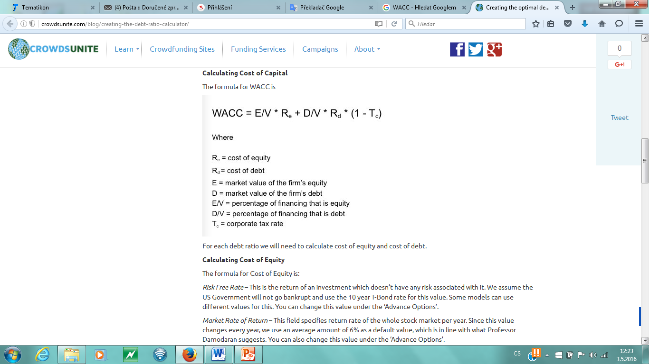
Capital Structure
Capital structure has a bearing on cost of capital WACC
Calculating cost of capital – the formula for WACC is:

Slide 28
Optimal Capital Structure
Optimal capital structure exhibits minimum cost for the given indebtedness.

Slide 29
Optimal Capital Structure

Slide 30
Optimal Capital Structure
  Foreign capital is cheaper than equity capital. Equity capital carries the greatest risk – the dividend is the reward.
  The interest rate increases with the growth of indebtedness.
  That affects the demand on higher dividend.
  Replacement of equity by foreign (debt) capital brings cheapening costs of the total capital up to a certain level of indebtedness; then the total costs of capital are beginning to grow.

