Slide 1

BASIC CONCEPTS OF STRATEGIC MANAGEMENT
Šárka Zapletalová
zapletalova@opf.slu.cz

Slide 2
BASIC CONCEPTS OF STRATEGIC MANAGEMENT
Basic information
Course: Strategic Management PEMNASMA
Tutor: Šárka Zapletalová
Office: building B202
Consultation hours: Thursday 12,30 – 14,30
Contact: zapletalova@opf.slu.cz
Requirements on students (total sum of points 100)
Active participation in seminars and case studies solution – 10% of points
Seminar paper and defence of the seminar paper (no later than 8. 12. 2024) – 10% of points
Continuous test (in the week 4. 11. – 10. 11. 2024) – 20% of points
Final written exam – 60% of points

Slide 3
BASIC CONCEPTS OF STRATEGIC MANAGEMENT
Outline of the lecture
Strategic Management
Strategic Decision Making Process
Strategic Management Process

Slide 4
BASIC CONCEPTS OF STRATEGIC MANAGEMENT
STRATEGIC MANAGEMENT
Strategic management emphasizes long-term performance. Many companies can manager short-term bursts of high performance, but only a few can sustain it over a longer period of time.
To be successful in the long-run, companies must not only be able to execute current activities to satisfy an existing market, but they must also adapt those activities to satisfy new and changing markets.
Strategic management is a broader term that includes not only the stages already identified but also the earlier steps of determining the mission and objectives of an organization within the context of its external environment.

Slide 5
BASIC CONCEPTS OF STRATEGIC MANAGEMENT
Strategic Decision Making
As organizations grow larger and more complex, with more uncertain environments, decisions become increasingly complicated and difficult to make.
Strategic decisions deal with the long-run future of an entire organization and have three characteristics:
  Rare: Strategic decisions are unusual and typically have no precedent to follow.
  Consequential: Strategic decisions commit substantial resources and demand a great deal of commitment from people at all levels.
  Directive: Strategic decisions set precedents for lesser decisions and future actions throughout an organization.

Slide 6
BASIC CONCEPTS OF STRATEGIC MANAGEMENT
Strategy formulation
Strategy formulation is the development of long-range plans for the effective management of environmental opportunities and threats, in light of corporate strengths and weaknesses.
It includes defining the corporate mission, specifying achievable objectives, developing strategies, and setting policy guidelines.
An organization’s mission is the purpose or reason for the organization’s existence. Mission describes what the organization is now.
Vision describes what the organization would like to become

Slide 7
TASK 1: Match the company with their statements:
Statement | Company
1. To be the world`s best quick service restaurant. | A AutoNation
2. To be the most respected global financial services company. | B Avon
3. To become the beauty company most women turn to worldwide. | C Barnes & Noble
4. To provide a global trading platform where practically anyone can trade practically anything. | D CarMax
5. To operate the best speciality retail business in America, regardless of the product we sell. | E Citibank
6. To provide our customers great quality cars at great prices with exceptional customer service. | F Darden Restaurants
7. To nourish and delight everyone we serve. | G eBay
8. To be American` s best run, most profitable automotive retailer. | H Estee Lauder
9. Bringing the best to everyone we touch. | I Facebook
10. To be the world` s largest & best platform for online communities to share & connect. | J Kelly Services
11. To give everyone the power to create and share ideas and information instantly, without barriers. | K KFC
12. To bet he best worldwide provider of higher-value staffing services and the center for quality employment opportunities. | L Manpower
13. To sell food in a fast, friendly environment that appeals to pride-conscious, health-minded consumers. | M McDonald` s
14. To serve our customers, employees, shareholders and society by providing a broad range of staffing services and products. | N Reddit
15. To give the people the power to share and make the world more open and connected. | O Twitter

Slide 8
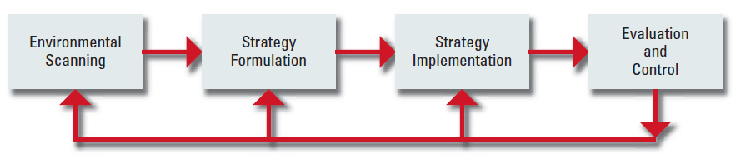
BASIC CONCEPTS OF STRATEGIC MANAGEMENT
Basic Elements of the Strategic Management Process
Strategic management consists of four basic elements:
Environmental scanning
Strategy formulation
Strategy implementation
Evaluation and control
SOURCE: T. L. Wheelen, “Strategic Management Model,” adapted from “Concepts of Management,” presented to Society for Advancement of Management (SAM)

Slide 9
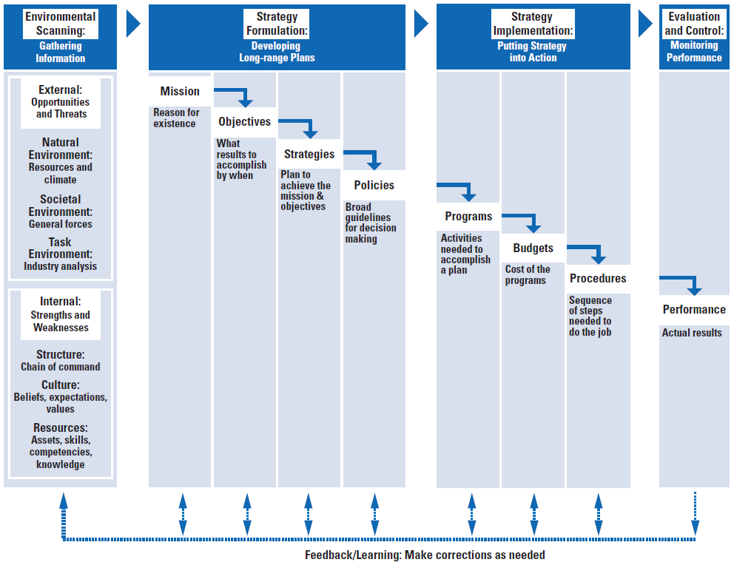
BASIC CONCEPTS OF STRATEGIC MANAGEMENT
Basic Elements of the Strategic Management Process
Strategic Management Model
SOURCE: T. L. Wheelen, “Strategic Management Model,” adapted from “Concepts of Management,” presented to Society for Advancement of Management (SAM)

Slide 10
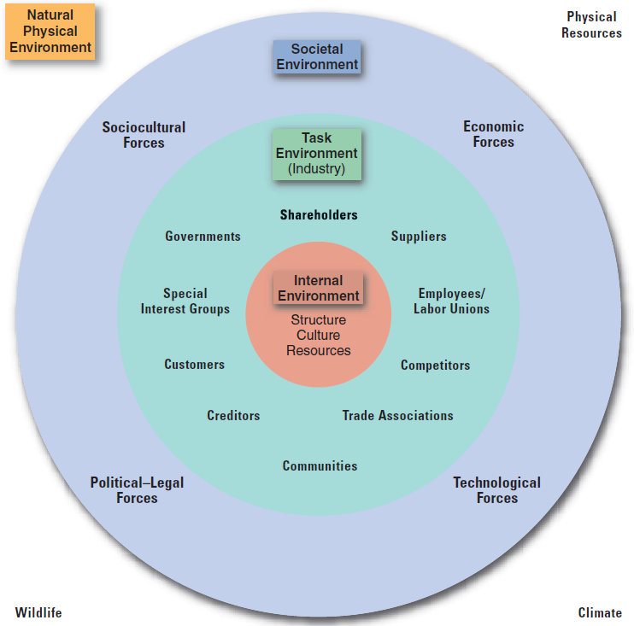
BASIC CONCEPTS OF STRATEGIC MANAGEMENT
Environmental scanning
Company´s environment – general forces and trends within the natural or societal environments or specific factors that affect company

Slide 11
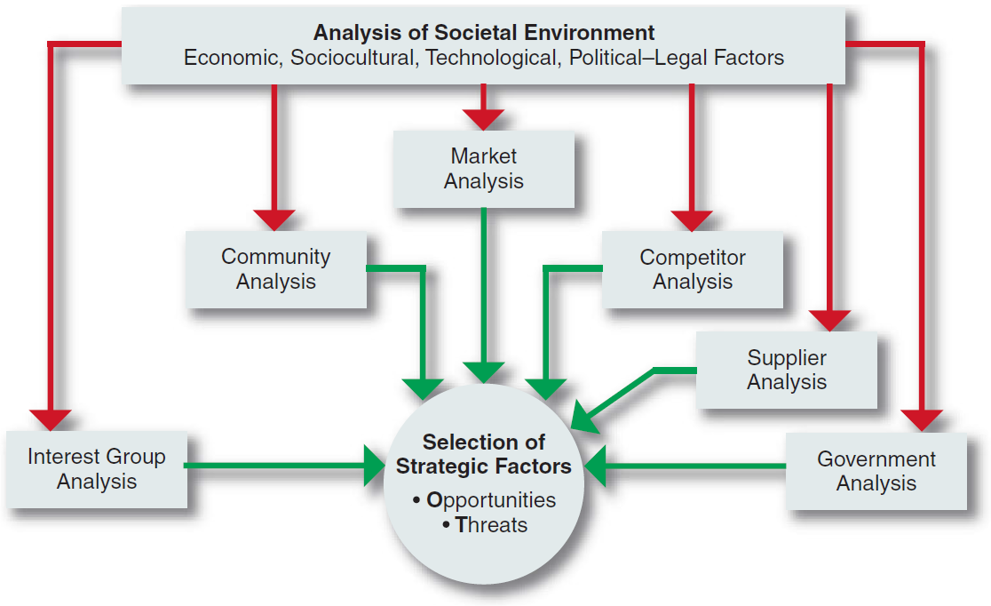
BASIC CONCEPTS OF STRATEGIC MANAGEMENT
Environmental scanning
Environmental scanning is the monitoring, evaluating, and disseminating of information from the external and internal environments to key people within the corporation.
A corporation’s scanning of the environment includes analyses of all the relevant elements in the task environment

Slide 12
BASIC CONCEPTS OF STRATEGIC MANAGEMENT
Identifying External Environmental Variables - macroenvironment
Macroenvironment consists of large-scale fundamental forces that shape opportunities and pose threats to the organization. These forces are largely uncontrollable but must be monitored for purposes of both short- and long-term planning.
These forces affect companies and are as follows:
  Economic forces that regulate the exchange of materials, money, energy, and information.
  Technological forces that generate problem-solving inventions.
  Political–legal forces that allocate power and provide constraining and protecting laws and regulations.
  Sociocultural forces that regulate the values, mores, and customs of society.
PEST Analysis, the scanning of Political-legal environmental forces, Economic, Sociocultural, and Technological
  (It may also be used PESTEL Analysis for Political, Economic, Sociocultural, Technological, Ecological, and Legal forces.)

Slide 13
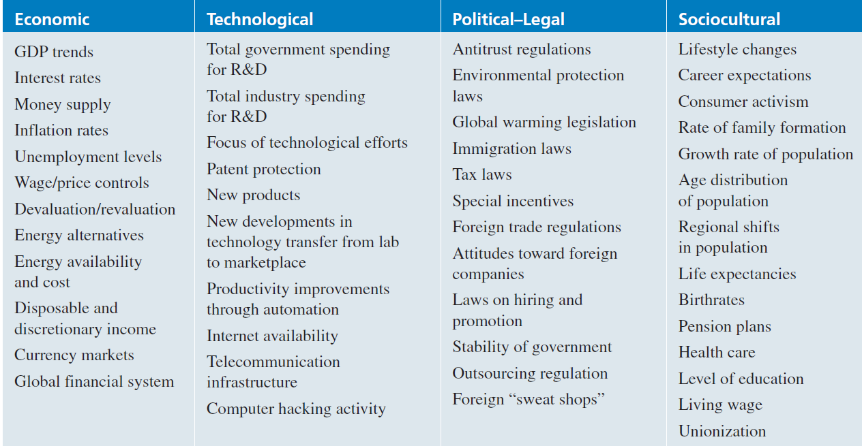
BASIC CONCEPTS OF STRATEGIC MANAGEMENT
Identifying External Environmental Variables
Some Important Variables in the Environment

Slide 14
TASK 2: Pest Analysis
Which factors from macroenvironment affect your university? Apply the PEST analysis.

Slide 15
Environmental Scanning and Industry Analysis
TASK (MARKET) ENVIRONMENT
The task environment includes those elements or groups that directly affect a corporation and, in turn, are affected by it.
  These are governments, local communities, suppliers, competitors, customers, creditors, employees/labor unions, special-interest groups, and trade associations.
A corporation’s task environment is typically the environment within which the firm operates.
  Industry analysis
  Market analysis

Slide 16
BASIC CONCEPTS OF STRATEGIC MANAGEMENT
Industry Analysis
An industry is a group of firms that produces a similar product or service, such as soft drinks or financial services. An examination of the important stakeholder groups, such as suppliers and customers, in a particular corporation’s task environment is a part of industry analysis.
Michael Porter, an authority on competitive strategy, contends that a corporation is most concerned with the intensity of competition within its industry. The level of this intensity is determined by basic competitive forces.
  “The collective strength of these forces,” he contends, “determines the ultimate profit potential in the industry, where profit potential is measured in terms of long-run return on invested capital.”

Slide 17
BASIC CONCEPTS OF STRATEGIC MANAGEMENT
Industry Analysis
In carefully scanning its industry, a corporation must assess the importance to its success of each of six forces:
  threat of new entrants,
  rivalry among existing firms,
  threat of substitute products or services,
  bargaining power of buyers,
  bargaining power of suppliers,
  and relative power of other stakeholders.
The stronger each of these forces, the more limited companies are in their ability to raise prices and earn greater profits.
Although Porter mentions only five forces, a sixth - other stakeholders - is added here to reflect the power that governments, local communities, and other groups from the task environment wield over industry activities.

Slide 18
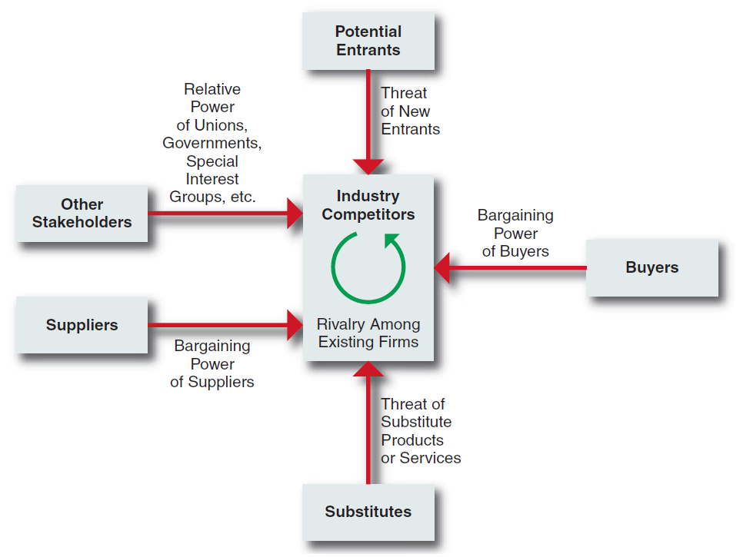
BASIC CONCEPTS OF STRATEGIC MANAGEMENT
Industry Analysis
Forces Driving Industry Competition
SOURCE: Reprinted with the permission of The Free Press, A Division of Simon & Schuster, from COMPETITIVE ADVANTAGE: Techniques for Analyzing Industries and Competitors by Michael E. Porter.

Slide 19
BASIC CONCEPTS OF STRATEGIC MANAGEMENT
Industry Analysis
Threat of New Entrants
New entrants to an industry typically bring to it new capacity, a desire to gain market share, and substantial resources. They are, therefore, threats to an established corporation.
An entry barrier is an obstruction that makes it difficult for a company to enter an industry.
Some of the possible barriers to entry are:
  Economies of scale: Scale economies in the production and sale of microprocessors, for example, gave Intel a significant cost advantage over any new rival.
  Product differentiation
  Capital requirements: The need to invest huge financial resources in manufacturing facilities in order to produce large commercial airplanes creates a significant barrier to entry to any competitor for Boeing and Airbus.

Slide 20
BASIC CONCEPTS OF STRATEGIC MANAGEMENT
Industry Analysis
Some of the possible barriers to entry are:
  Switching costs: Once a software program such as Excel or Word becomes established in an office, office managers are very reluctant to switch to a new program because of the high training costs.
  Access to distribution channels: Small entrepreneurs often have difficulty obtaining supermarket shelf space for their goods because large retailers charge for space on their shelves and give priority to the established firms who can pay for the advertising needed to generate high customer demand.
  Cost disadvantages independent of size: Once a new product earns sufficient market share to be accepted as the standard for that type of product, the maker has a key advantage.
  Government policy: Governments can limit entry into an industry through licensing requirements by restricting access to rawmaterials, such as oil-drilling sites in protected areas.

Slide 21
BASIC CONCEPTS OF STRATEGIC MANAGEMENT
Industry Analysis
Rivalry among Existing Firms
According to Porter, intense rivalry is related to the presence of several factors, including:
  Number of competitors: When competitors are few and roughly equal in size, such as in the auto and major home appliance industries, they watch each other carefully to make sure that they match any move by another firm with an equal countermove.
  Rate of industry growth: Any slowing in passenger traffic tends to set off price wars in the airline industry because the only path to growth is to take sales away from a competitor.
  Product or service characteristics: A product can be very unique, with many qualities differentiating it from others of its kind or it may be a commodity, a product whose characteristics are the same, regardless of who sells it.
  Amount of fixed costs: Because airlines must fly their planes on a schedule, regardless of the number of paying passengers for any one flight, they offer cheap standby fares whenever a plane has empty seats.

Slide 22
BASIC CONCEPTS OF STRATEGIC MANAGEMENT
Industry Analysis
Rivalry among Existing Firms
According to Porter, intense rivalry is related to the presence of several factors, including:
  Capacity: If the only way a manufacturer can increase capacity is in a large increment by building a new plant (as in the paper industry), it will run that new plant at full capacity to keep its unit costs as low as possible—thus producing so much that the selling price falls throughout the industry.
  Height of exit barriers: Exit barriers keep a company from leaving an industry.
  Diversity of rivals: Rivals that have very different ideas of how to compete are likely to cross paths often and unknowingly challenge each other’s position.

Slide 23
BASIC CONCEPTS OF STRATEGIC MANAGEMENT
Industry Analysis
Threat of Substitute Products or Services
A substitute product is a product that appears to be different but can satisfy the same need as another product.
According to Porter, “Substitutes limit the potential returns of an industry by placing a ceiling on the prices firms in the industry can profitably charge.”
To the extent that switching costs are low, substitutes may have a strong effect on an industry.
  Tea can be considered a substitute for coffee. If the price of coffee goes up high enough, coffee drinkers will slowly begin switching to tea. The price of tea thus puts a price ceiling on the price of coffee.
Sometimes a difficult task, the identification of possible substitute products or services means searching for products or services that can perform the same function, even though they have a different appearance and may not appear to be easily substitutable.

Slide 24
BASIC CONCEPTS OF STRATEGIC MANAGEMENT
Industry Analysis
Bargaining Power of Buyers
A buyer or a group of buyers is powerful if some of the following factors hold true:
  A buyer purchases a large proportion of the seller’s product or service
  A buyer has the potential to integrate backward by producing the product itself (for example, a newspaper chain could make its own paper).
  Alternative suppliers are plentiful because the product is standard or undifferentiated (for example, motorists can choose among many gas stations).
  Changing suppliers costs very little.
  The purchased product represents a high percentage of a buyer’s costs, thus providing an incentive to shop around for a lower price.
  A buyer earns low profits and is thus very sensitive to costs and service differences.
  The purchased product is unimportant to the final quality or price of a buyer’s products or services and thus can be easily substituted without affecting the final product adversely.

Slide 25
BASIC CONCEPTS OF STRATEGIC MANAGEMENT
Industry Analysis
Bargaining Power of Suppliers
Suppliers can affect an industry through their ability to raise prices or reduce the quality of purchased goods and services. A supplier or supplier group is powerful if some of the following factors apply:
  The supplier industry is dominated by a few companies, but it sells to many.
  Its product or service is unique and/or it has built up switching costs.
  Substitutes are not readily available (for example, electricity).
  Suppliers are able to integrate forward and compete directly with their present customers (for example, a microprocessor producer such as Intel can make PCs).
  A purchasing industry buys only a small portion of the supplier group’s goods and services and is thus unimportant to the supplier.

Slide 26
TASK 3
Apply the five forces model to McDonald`s in your country.
What does this model tell you about the nature of competition in the industry?

Slide 27
Environmental Scanning and Industry Analysis
Categorizing International Industries
According to Porter, world industries vary on a continuum from multidomestic to global.
Multidomestic industries are specific to each country or group of countries. This type of international industry is a collection of essentially domestic industries, such as retailing and insurance.
  The activities in a subsidiary of a multinational corporation (MNC) in this type of industry are essentially independent of the activities of the MNC’s subsidiaries in other countries.
  Within each country, it has a manufacturing facility to produce goods for sale within that country.
  The MNC is thus able to tailor its products or services to the very specific needs of consumers in a particular country or group of countries having similar societal environments.

Slide 28
Environmental Scanning and Industry Analysis
Categorizing International Industries
Global industries, in contrast, operate worldwide, with MNCs making only small adjustments for country-specific circumstances.
In a global industry an MNC’s activities in one country are significantly affected by its activities in other countries.
MNCs in global industries produce products or services in various locations throughout the world and sell them, making only minor adjustments for specific country requirements.
  Examples of global industries are commercial aircraft, television sets, semiconductors, copiers, automobiles, watches, and tires.

Slide 29
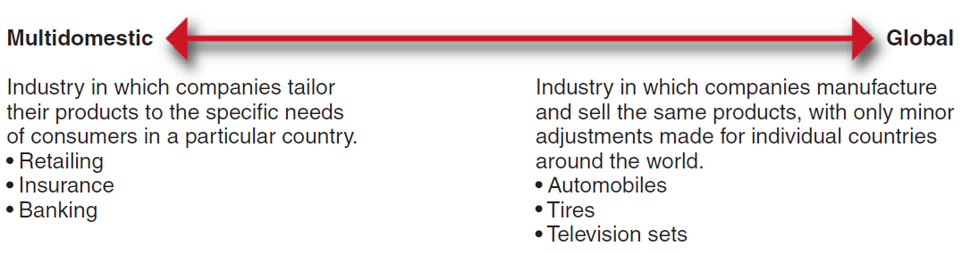
Environmental Scanning and Industry Analysis
Categorizing International Industries
Continuum of International Industries

Slide 30
Environmental Scanning and Industry Analysis
Categorizing International Industries
The factors that tend to determine whether an industry will be primarily multidomestic or primarily global are:
  Pressure for coordination within the MNCs operating in that industry.
  Pressure for local responsiveness on the part of individual country markets.
Between these two extremes lie a number of industries with varying characteristics of both multidomestic and global industries. These are regional industries, in which MNCs primarily coordinate their activities within regions, such as the Americas or Asia.

Slide 31
BASIC CONCEPTS OF STRATEGIC MANAGEMENT
MARKET Analysis
Market consists of individuals and organizations which are interested and willing to buy a particular product to obtain benefits that will satisfy a specific need or want and who have the resources to engage in such a transaction.
In the market we can to find these market subjects: buyers, organizational buyers, competition, publics
Market is usually measured by dollar (euro) sales and/or unit sales for a defined product-market and specified time period. For measurement of market we can use these three measures:
  Market potential is an estimate of the maximum possible sales of a product, a group of products or a service for an entire industry during a specified time period.
  Market size (market capacity) is total sales of product, a group of product or a service of the defined industry during a specified time period.
  Market share is defined as the sales of product, a group of product or a service of the particular company in the defined industry during a specified time period.
Market research is method for monitoring and analyzing of markets, subject of markets, companies etc.

Slide 32
BASIC CONCEPTS OF STRATEGIC MANAGEMENT
INTERNAL SCANNING
Analysts must also look within the corporation itself to identify internal strategic factors - critical strengths and weaknesses that are likely to determine whether a firm will be able to take advantage of opportunities while avoiding threats.
This internal scanning, often referred to as organizational analysis, is concerned with identifying and developing an organization’s resources and competencies.

Slide 33
BASIC CONCEPTS OF STRATEGIC MANAGEMENT
RESOURCES AND CAPABILITIES
Resources are an organization’s assets and are thus the basic building blocks of the organization.
They include tangible assets, such as its plant, equipment, finances, and location, human assets, in terms of the number of employees, their skills, and motivation, and intangible assets, such as its technology (patents and copyrights), culture, and reputation.
Capabilities refer to a corporation’s ability to exploit its resources.
  A capability is functionally based and is resident in a particular function. Thus, there are marketing capabilities, manufacturing capabilities, and human resource management capabilities. When these capabilities are constantly being changed and reconfigured to make them more adaptive to an uncertain environment, they are called dynamic capabilities.

Slide 34
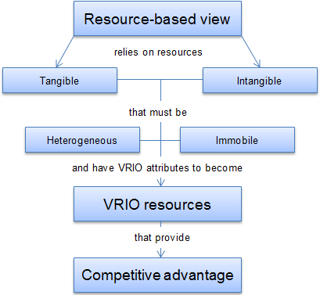
Resources
Prostor pro doplňující informace, poznámky

Slide 35
Resources and Capabilities
Resources
Core Competencies
Activities
Competitive Advantage
Performance
Capabilities
Prostor pro doplňující informace, poznámky

Slide 36
BASIC CONCEPTS OF STRATEGIC MANAGEMENT
Company examples of core competencies
Company | Core competencies | Application examples
Amazon.com | Superior IT capabilities | Online retailing: largest selection of items online
Apple | Superior marketing and retailing experience Superior industrial design in integration of hardware and software | Creation of innovative and category-defining mobile devices and software services
Coca-Cola | Superior marketing and distribution | Leveraging one of the world´s most recognized brands Gloal availability of products
Honda | Superior engineering of small but powerful and highly reliable internal combustion enegines | Motorcycles, cars, sporting boats, snowmobiles, small aircraft

Slide 37
BASIC CONCEPTS OF STRATEGIC MANAGEMENT
RESOURCES AND CAPABILITIES
Barney, in his VRIO framework of analysis, proposes four questions to evaluate a firm’s competencies:
  Value: Does it provide customer value and competitive advantage?
  Rareness: Do no other competitors possess it?
  Imitability: Is it costly for others to imitate?
  Organization: Is the firm organized to exploit the resource?

Slide 38
Applying the VRIO
V
R
I
O
Sustainable Competitive Advantage
Competitive Disadvantage
Competitive Parity
Temporary Competitive Advantage
Temporary Competitive Advantage
Prostor pro doplňující informace, poznámky

Slide 39
BASIC CONCEPTS OF STRATEGIC MANAGEMENT
A Resource-Based Approach
Proposing that a company’s sustained competitive advantage is primarily determined by its resource endowments, Grant proposes a five-step, resource-based approach to strategy analysis.
  Identify and classify the firm’s resources in terms of strengths and weaknesses.
  Combine the firm’s strengths into specific capabilities and core competencies.
  Appraise the profit potential of these capabilities and competencies in terms of their potential for sustainable competitive advantage and the ability to harvest the profits resulting from their use. Are there any distinctive competencies?
  Select the strategy that best exploits the firm’s capabilities and competencies relative to external opportunities.
  Identify resource gaps and invest in upgrading weaknesses.

Slide 40
BASIC CONCEPTS OF STRATEGIC MANAGEMENT
A Resource-Based Approach
Determining the sustainability of an advantage
Just because a firm is able to use its resources, capabilities, and competencies to develop a competitive advantage does not mean it will be able to sustain it.
Two characteristics determine the sustainability of a firm’s distinctive competency(ies): durability and imitability.
Durability is the rate at which a firm’s underlying resources, capabilities, or core competencies depreciate or become obsolete. New technology can make a company’s core competency obsolete or irrelevant.
  For example, Intel’s skills in using basic technology developed by others to manufacture and market quality microprocessors was a crucial capability until management realized that the firm had taken current technology as far as possible with the Pentium chip.

Slide 41
BASIC CONCEPTS OF STRATEGIC MANAGEMENT
A Resource-Based Approach
Determining the sustainability of an advantage
Imitability is the rate at which a firm’s underlying resources, capabilities, or core competencies can be duplicated by others.
To the extent that a firm’s distinctive competency gives it competitive advantage in the marketplace, competitors will do what they can to learn and imitate that set of skills and capabilities.
Competitors’ efforts may range from reverse engineering (which involves taking apart a competitor’s product in order to find out how it works), to hiring employees from the competitor, to outright patent infringement.
A core competency can be easily imitated to the extent that it is transparent, transferable, and replicable.

Slide 42
BASIC CONCEPTS OF STRATEGIC MANAGEMENT
A Resource-Based Approach
Determining the sustainability of an advantage
Transparency is the speed with which other firms can understand the relationship of resources and capabilities supporting a successful firm’s strategy.
  For example, Gillette has always supported its dominance in the marketing of razors with excellent R&D.
  A competitor could never understand how the Sensor or Mach 3 razor was produced simply by taking one apart.
  Gillette’s razor design was very difficult to copy, partially because the manufacturing equipment needed to produce it was so expensive and complicated.

Slide 43
BASIC CONCEPTS OF STRATEGIC MANAGEMENT
A Resource-Based Approach
Determining the sustainability of an advantage
Transferability is the ability of competitors to gather the resources and capabilities necessary to support a competitive challenge.
  For example, it may be very difficult for a winemaker to duplicate a French winery’s key resources of land and climate, especially if the imitator is located in Iowa.
Replicability is the ability of competitors to use duplicated resources and capabilities to imitate the other firm’s success.

Slide 44
TASK 4
Looking inside yourself: What is my competitive advantage?
Write down your own strengths and weaknesses.
Are your strengths and weaknesses different today from what they were five years ago?
Are some of your strengths valuable, rare, and costly to imitate?
What are you doing to make sure your capabilities are dynamic?

Slide 45
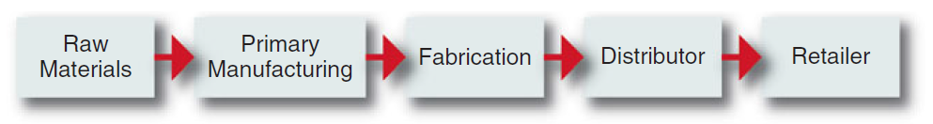
BASIC CONCEPTS OF STRATEGIC MANAGEMENT
Value-Chain Analysis
A value chain is a linked set of value-creating activities that begin with basic raw materials coming from suppliers, moving on to a series of value-added activities involved in producing and marketing a product or service, and ending with distributors getting the final goods into the hands of the ultimate consumer.
The focus of value-chain analysis is to examine the corporation in the context of the overall chain of value-creating activities, of which the firm may be only a small part.
Typical Value Chain for a Manufactured Product

Slide 46
BASIC CONCEPTS OF STRATEGIC MANAGEMENT
Value-Chain Analysis
Industry value chain
The value chains of most industries can be split into two segments, upstream and downstream segments.
  In the petroleum industry, for example, upstream refers to oil exploration, drilling, and moving of the crude oil to the refinery, and downstream refers to refining the oil plus transporting and marketing gasoline and refined oil to distributors and gas station retailers.
In analyzing the complete value chain of a product, note that even if a firm operates up and down the entire industry chain, it usually has an area of expertise where its primary activities lie. A company’s center of gravity is the part of the chain that is most important to the company and the point where its greatest expertise and capabilities lie - its core competencies.
  After a firm successfully establishes itself at this point by obtaining a competitive advantage, one of its first strategic moves is to move forward or backward along the value chain in order to reduce costs, guarantee access to key raw materials, or to guarantee distribution - this process, called vertical integration.

Slide 47
BASIC CONCEPTS OF STRATEGIC MANAGEMENT
Value-Chain Analysis
Corporate value chain
Each corporation has its own internal value chain of activities.
Porter proposes that a manufacturing firm’s primary activities usually begin with inbound logistics (raw materials handling and warehousing), go through an operations process in which a product is manufactured, and continue on to outbound logistics (warehousing and distribution), to marketing and sales, and finally to service (installation, repair, and sale of parts).
Several support activities, such as procurement (purchasing), technology development (R&D), human resource management, and firm infrastructure (accounting, finance, strategic planning), ensure that the primary value chain activities operate effectively and efficiently.

Slide 48
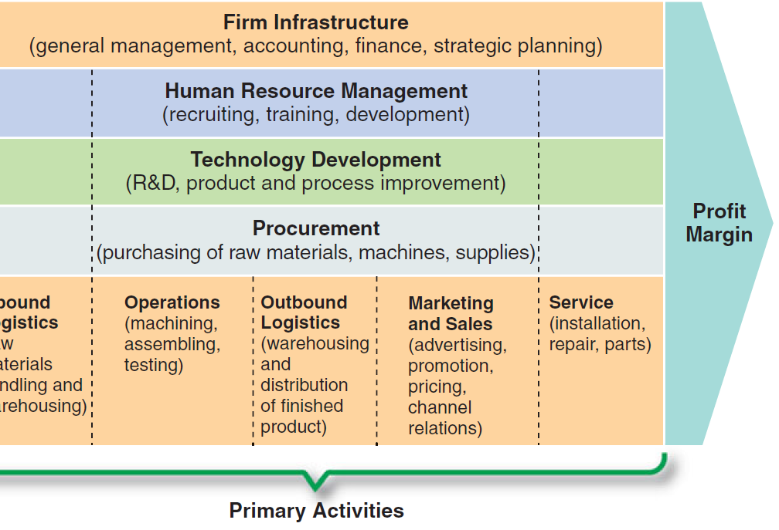
BASIC CONCEPTS OF STRATEGIC MANAGEMENT
Value-Chain Analysis
Corporate value chain
SOURCE: COMPETITIVE ADVANTAGE: Creating and Sustaining Superior Performance by Michael E. Porter.

Slide 49
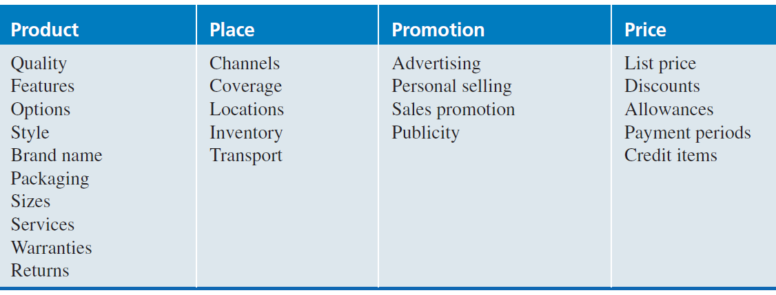
BASIC CONCEPTS OF STRATEGIC MANAGEMENT
Scanning Functional Resources and Capabilities
Strategic Marketing Issues
The marketing manager is a company’s primary link to the customer and the competition. The manager, therefore, must be especially concerned with the market position and marketing mix of the firm as well as with the overall reputation of the company and its brands.
Marketing Mix Variables
SOURCE: KOTLER, PHILIP, MARKETING MANAGEMENT, 11th edition

Slide 50
BASIC CONCEPTS OF STRATEGIC MANAGEMENT
Scanning Functional Resources and Capabilities
Strategic Financial Issues
A financial manager must ascertain the best sources of funds, uses of funds, and control of funds.
  All strategic issues have financial implications. Cash must be raised from internal or external (local and global) sources and allocated for different uses. The flow of funds in the operations of an organization must be monitored.
The concept of financial leverage (the ratio of total debt to total assets) is helpful in describing how debt is used to increase the earnings available to common shareholders.
Capital budgeting is the analyzing and ranking of possible investments in fixed assets such as land, buildings, and equipment in terms of the additional outlays and additional receipts that will result from each investment.

Slide 51
BASIC CONCEPTS OF STRATEGIC MANAGEMENT
Scanning Functional Resources and Capabilities
Strategic Research and Development Issues
The R&D manager is responsible for suggesting and implementing a company’s technological strategy in light of its corporate objectives and policies. The manager’s job, therefore, involves:
  choosing among alternative new technologies to use within the corporation,
  developing methods of embodying the new technology in new products and processes, and
  deploying resources so that the new technology can be successfully implemented.

Slide 52
BASIC CONCEPTS OF STRATEGIC MANAGEMENT
Scanning Functional Resources and Capabilities
Strategic Human Resource (HRM) Issues
The primary task of the manager of human resources is to improve the match between individuals and jobs.
  Research indicates that companies with good HRM practices have higher profits and a better survival rate than do firms without these practices.
A good HRM department should know how to use attitude surveys and other feedback devices to assess employees’ satisfaction with their jobs and with the corporation as a whole.
HRM managers should also use job analysis to obtain job description information about what each job needs to accomplish in terms of quality and quantity.

Slide 53
BASIC CONCEPTS OF STRATEGIC MANAGEMENT
Scanning Functional Resources and Capabilities
Strategic Information Systems/Technology Issues
The primary task of the manager of information systems/technology is to design and manager the flow of information in an organization in ways that improve productivity and decision making.
Information must be collected, stored, and synthesized in such a manner that it will answer important operating and strategic questions.
A corporation’s information system can be a strength or a weakness in multiple areas of strategic management.

Slide 54
SYNTHESIS OF THE EXTERNAL AND INTERNAL FACTORS
1. Synthesis of External Factors – EFAS Table
Synthesis of External Factors
Using key success factors to create an industry matrix - within any industry there are usually certain variables - key success factors - that a company’s management must understand in order to be successful.
  Key success factors are variables that can significantly affect the overall competitive positions of companies within any particular industry.
  An industry matrix summarizes the key success factors within a particular industry. The matrix gives a weight for each factor based on how important that factor is for success within the industry.
  The matrix also specifies how well various competitors in the industry are responding to each factor.
  To generate an industry matrix using two industry competitors (called A and B), complete the following steps for the industry being analyzed:

Slide 55
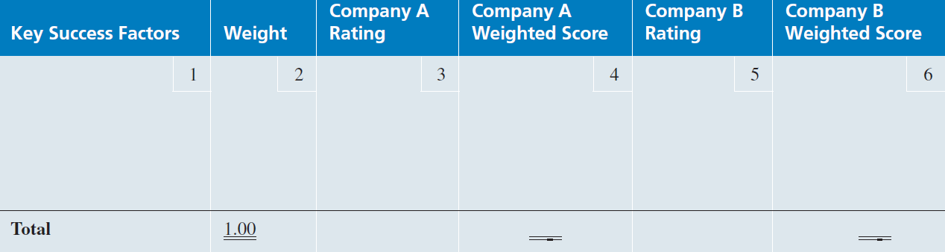
SYNTHESIS OF THE EXTERNAL AND INTERNAL FACTORS
1. Synthesis of External Factors – EFAS Table
Synthesis of External Factors
To generate an industry matrix using two industry competitors (called A and B), complete the following steps for the industry being analyzed:
  In Column 1 (Key Success Factors), list the 8 to 10 factors that appear to determine success in the industry.
  Column 2 (Weight), assign a weight to each factor, from 1.0 (Most Important) to 0.0 (Not Important) based on that factor’s probable impact on the overall industry’s current and future success. (All weights must sum to 1.0 regardless of the number of strategic factors.)

Slide 56
SYNTHESIS OF THE EXTERNAL AND INTERNAL FACTORS
1. Synthesis of External Factors – EFAS Table
Synthesis of External Factors
To generate an industry matrix using two industry competitors (called A and B), complete the following steps for the industry being analyzed:
  In Column 3 (Company A Rating), examine a particular company within the industry.
    for example, Company A. Assign a rating to each factor from 5 (Outstanding) to 1 (Poor) based on Company A’s current response to that particular factor. Each rating is a judgment regarding how well that company is specifically dealing with each key success factor.

Slide 57
SYNTHESIS OF THE EXTERNAL AND INTERNAL FACTORS
1. Synthesis of External Factors – EFAS Table
Synthesis of External Factors
To generate an industry matrix using two industry competitors (called A and B), complete the following steps for the industry being analyzed:
  In Column 4 (Company A Weighted Score), multiply the weight in Column 2 for each factor by its rating in Column 3 to obtain that factor’s weighted score for Company A.
  In Column 5 (Company B Rating), examine a second company within the industry – in this case, Company B.
    Assign a rating to each key success factor from 5.0 (Outstanding) to 1.0 (Poor), based on Company B’s current response to each particular factor.
  In Column 6 (Company B Weighted Score), multiply the weight in Column 2 for each factor times its rating in Column 5.
  The total weighted score indicates how well each company is responding to current and expected key success factors in the industry’s environment.

Slide 58
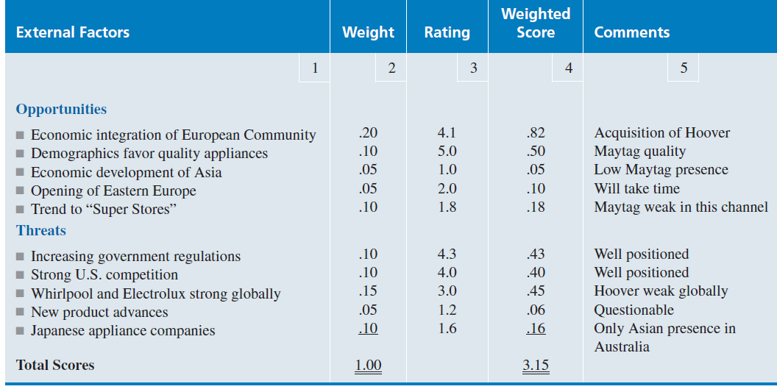
SYNTHESIS OF THE EXTERNAL AND INTERNAL FACTORS
1. Synthesis of External Factors – EFAS Table
Synthesis of External Factors - EFAS
  Using an EFAS (External Factors Analysis Summary) Table is one way to organize the external factors into the generally accepted categories of opportunities and threats as well as to analyze how well a particular company’s management (rating) is responding to these specific factors in light of the perceived importance (weight) of these factors to the company.
Example of External Factor Analysis Summary (EFAS Table)

Slide 59
SYNTHESIS OF THE EXTERNAL AND INTERNAL FACTORS
2. Synthesis of Internal Factors – IFAS Table
Synthesis of Internal Factors
This IFAS (Internal Factor Analysis Summary) Table is one way to organize the internal factors into the generally accepted categories of strengths and weaknesses as well as to analyze how well a particular company’s management is responding to these specific factors in light of the perceived importance of these factors to the company.
Use the VRIO framework (Value, Rareness, Imitability, & Organization) to assess the importance of each of the factors that might be considered strengths.
Except for its internal orientation, this IFAS Table is built the same way as the EFAS Table.

Slide 60
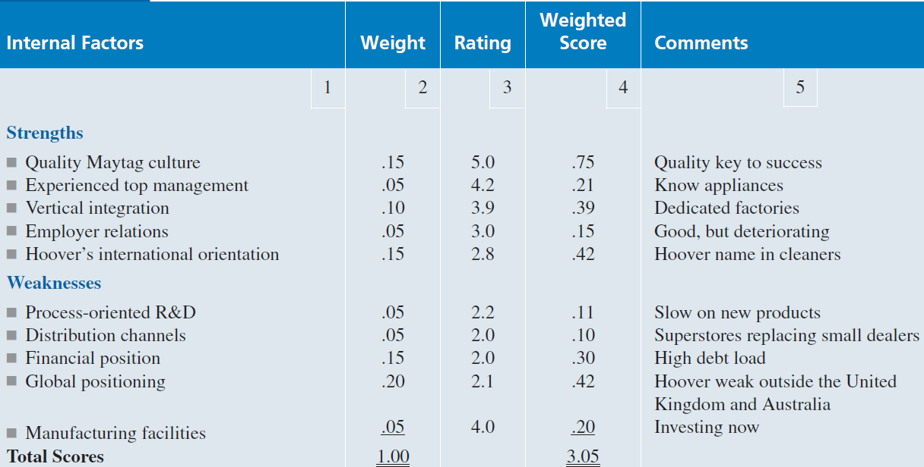
SYNTHESIS OF THE EXTERNAL AND INTERNAL FACTORS
2. Synthesis of Internal Factors – IFAS Table
Synthesis of Internal Factors
Example of InternalFactor Analysis Summary (IFAS Table)

Slide 61
SYNTHESIS OF THE EXTERNAL AND INTERNAL FACTORS
3. Situation Analysis
Strategy formulation, often referred to as strategic planning or long-range planning, is concerned with developing a corporation’s mission, objectives, strategies, and policies.
It begins with situation analysis: the process of finding a strategic fit between external opportunities and internal strengths while working around external threats and internal weaknesses.
  As shown in the Strategic Decision-Making Process is analyzing strategic factors in light of the current situation using SWOT analysis.
  Some of the primary criticisms of SWOT analysis are:
    It generates lengthy lists.
    It uses no weights to reflect priorities.
    It uses ambiguous words and phrases.
    The same factor can be placed in two categories (e.g., a strength may also be a weakness).
    There is no obligation to verify opinions with data or analysis.
    It requires only a single level of analysis.
    There is no logical link to strategy implementation.

Slide 62
SYNTHESIS OF THE EXTERNAL AND INTERNAL FACTORS
3. Situation Analysis
Generating a Strategic Factors Analysis Summary SFAX matrix
The EFAS and IFAS Tables plus the SFAS Matrix have been developed to deal with the criticisms of SWOT analysis.
When used together, they are a powerful analytical set of tools for strategic analysis.
The SFAS (Strategic Factors Analysis Summary) Matrix summarizes an organization’s strategic factors by combining the external factors from the EFAS Table with the internal factors from the IFAS Table.

Slide 63
SYNTHESIS OF THE EXTERNAL AND INTERNAL FACTORS
3. Situation Analysis
Generating a Strategic Factors Analysis Summary SFAX matrix
The SFAS Matrix requires a strategic decision maker to condense these strengths, weaknesses, opportunities, and threats into fewer than 10 strategic factors.
This is done by reviewing and revising the weight given each factor. The revised weights reflect the priority of each factor as a determinant of the company’s future success.
The highest-weighted EFAS and IFAS factors should appear in the SFAS Matrix.

Slide 64
SYNTHESIS OF THE EXTERNAL AND INTERNAL FACTORS
3. Situation Analysis
Generating a Strategic Factors Analysis Summary SFAX matrix – can create following these steps:
  In Column 1 (Strategic Factors), list the most important EFAS and IFAS items.
    After each factor, indicate whether it is a Strength (S), Weakness (W), an Opportunity (O), or a Threat (T).
  In Column 2 (Weight), assign weights for all of the internal and external strategic factors. This means that the weights calculated earlier for EFAS and IFAS will probably have to be adjusted.
  In Column 3 (Rating), assign a rating of how the company’s management is responding to each of the strategic factors.
    These ratings will probably (but not always) be the same as those listed in the EFAS and IFAS Tables.
  In Column 4 (Weighted Score), multiply the weight in Column 2 for each factor by its rating in Column 3 to obtain the factor’s rated score.
  In Column 5 (Duration), indicate short-term (less than one year), intermediate-term (one to three years), or long-term (three years and beyond).
  In Column 6 (Comments), repeat or revise your comments for each strategic factor from the previous EFAS and IFAS Tables. The total weighted score for the average firm in an industry is always 3.0.

Slide 65
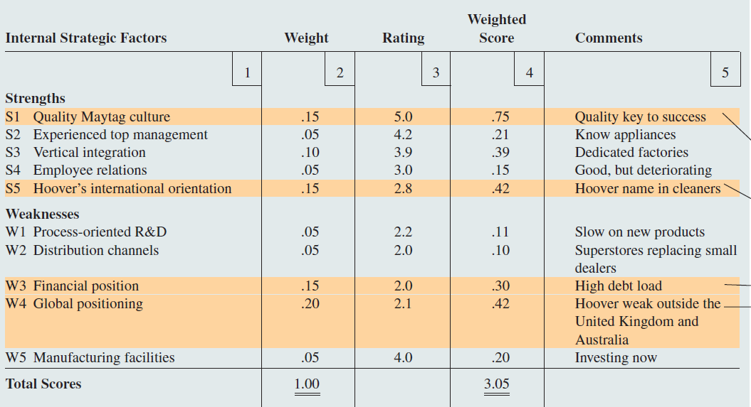
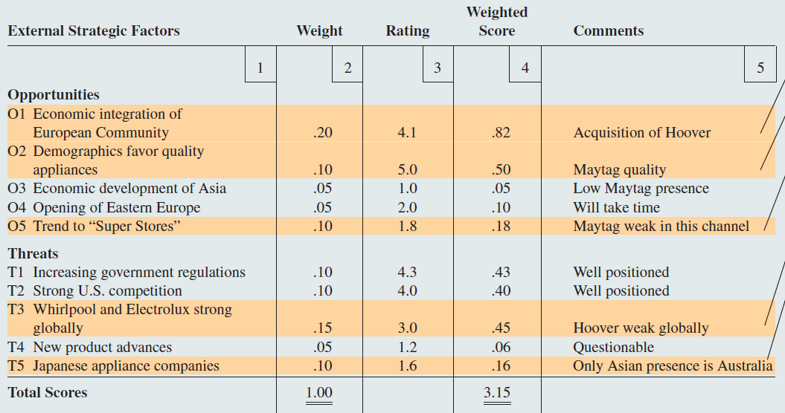
SYNTHESIS OF THE EXTERNAL AND INTERNAL FACTORS
3. Situation Analysis
Summary SFAX matrix

Slide 66
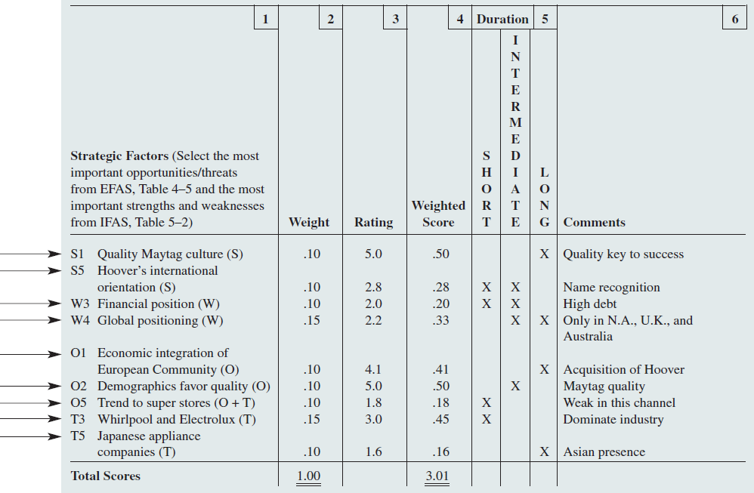
SYNTHESIS OF THE EXTERNAL AND INTERNAL FACTORS
3. Situation Analysis
Generating SFAX matrix

Slide 67
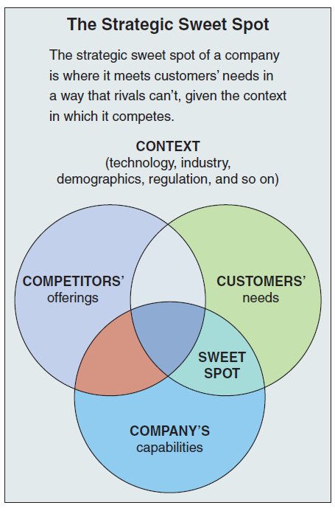
SYNTHESIS OF THE EXTERNAL AND INTERNAL FACTORS
3. Situation Analysis
Finding a Propitious Niche - The strategic sweet spot

Slide 68
SYNTHESIS OF THE EXTERNAL AND INTERNAL FACTORS
3. Situation Analysis
Review of Mission and Objectives
A reexamination of an organization’s current mission and objectives must be made before alternative strategies can be generated and evaluated.
Even when formulating strategy, decision makers tend to concentrate on the alternatives - the action possibilities - rather than on a mission to be fulfilled and objectives to be achieved.
The end result is that we often choose strategies that set our objectives for us rather than having our choices incorporate clear objectives and a mission statement.
  The mission does not provide a common thread (a unifying theme) for a corporation’s businesses, managers may be unclear about where the company is heading. Objectives and strategies might be in conflict with each other. Divisions might be competing against one another rather than against outside competition.

Slide 69
SYNTHESIS OF THE EXTERNAL AND INTERNAL FACTORS
3. Situation Analysis
Generating Alternative Strategies by Using a TOWS Matrix
The TOWS Matrix (TOWS is just another way of saying SWOT) illustrates how the external opportunities and threats facing a particular corporation can be matched with that company’s internal strengths and weaknesses to result in four sets of possible strategic alternatives.
This is a good way to use brainstorming to create alternative strategies that might not otherwise be considered.
It forces strategic managers to create various kinds of growth as well as retrenchment strategies. It can be used to generate corporate as well as business strategies.

Slide 70
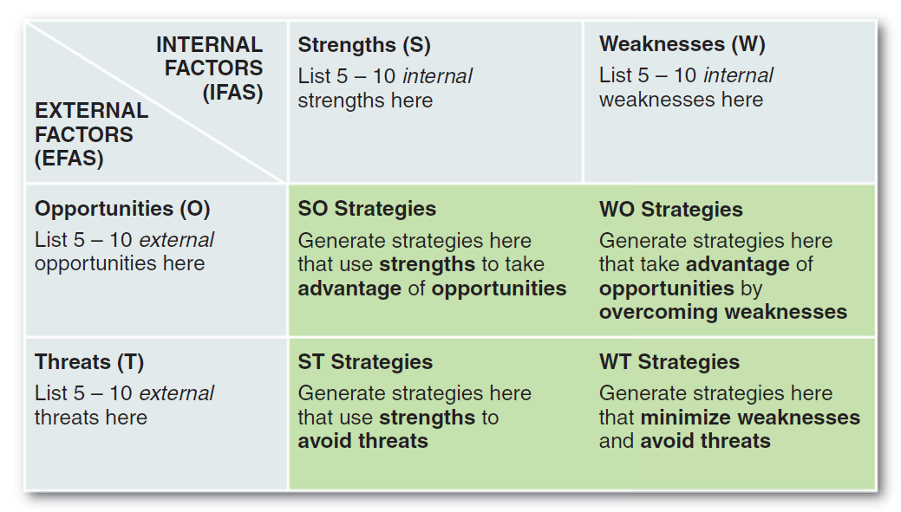
SYNTHESIS OF THE EXTERNAL AND INTERNAL FACTORS
3. Situation Analysis
Generating Alternative Strategies by Using a TOWS Matrix

Slide 71
SYNTHESIS OF THE EXTERNAL AND INTERNAL FACTORS
3. Situation Analysis
Top build a TOWS Matrix, také the following steps:
  In the Opportunities (O) block, list the external opportunities available in the company’s or business unit’s current and future environment from the EFAS Table.
  In the Threats (T) block, list the external threats facing the company or unit now and in the future from the EFAS Table.
  In the Strengths (S) block, list the specific areas of current and future strength for the company or unit from the IFAS Table.
  In the Weaknesses (W) block, list the specific areas of current and future weakness for the company or unit from the IFAS Table.

Slide 72
SYNTHESIS OF THE EXTERNAL AND INTERNAL FACTORS
3. Situation Analysis
Top build a TOWS Matrix, take the following steps:
  Generate a series of possible strategies for the company or business unit under consideration based on particular combinations of the four sets of factors:
    SO Strategies are generated by thinking of ways in which a company or business unit could use its strengths to take advantage of opportunities.
    ST Strategies consider a company’s or unit’s strengths as a way to avoid threats.
    WO Strategies attempt to take advantage of opportunities by overcoming weaknesses.
    WT Strategies are basically defensive and primarily act to minimize weaknesses and avoid threats.

