Slide 1

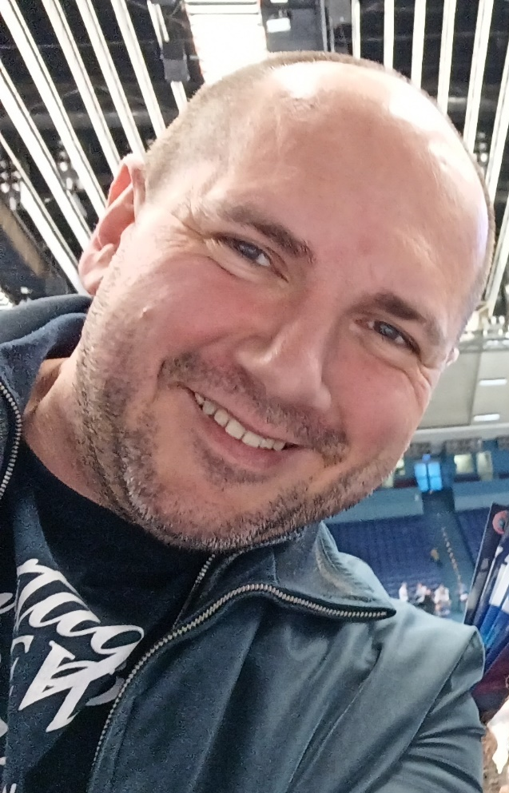
Cesta k cirkulární ekonomice…
Pavel Adámek, Ph.D.
Corporate Social Responsibility Specialist
Guarantor of the master's course CSR

Slide 2

Dnešní zaměření…
Toto téma vás seznámí s přístupy, na nichž je založeno oběhové hospodářství na evropské a národní úrovni, a poskytne základní definici oběhového hospodářství.
Co tedy oběhové hospodářství skutečně znamená? Jaké jsou zásady oběhového hospodářství? Proč by se o ni měla zajímat každá společnost? A nejen podniky...
Na tyto otázky budeme hledat odpovědi. "Příběhy" vám pomohou lépe pochopit praktické důsledky.

Slide 3
Global environmental problems…several examples…that our world is facing today…
Climate Change
Soil Degradation
Global Warming
Overpopulation
Natural Resource Depletion
Microplastic Pollution
Ambient (outdoor) Air Pollution
Generating Unsustainable Waste (The impact of textile production and waste on the environment)
and more…
Změna klimatu
Degradace půdy
Globální oteplování
Přelidnění
Vyčerpání přírodních zdrojů
Znečištění mikroplasty
Znečištění okolního (venkovního) ovzduší
Produkce neudržitelného odpadu (dopad textilní výroby a odpadu na životní prostředí)
a další...

Slide 4
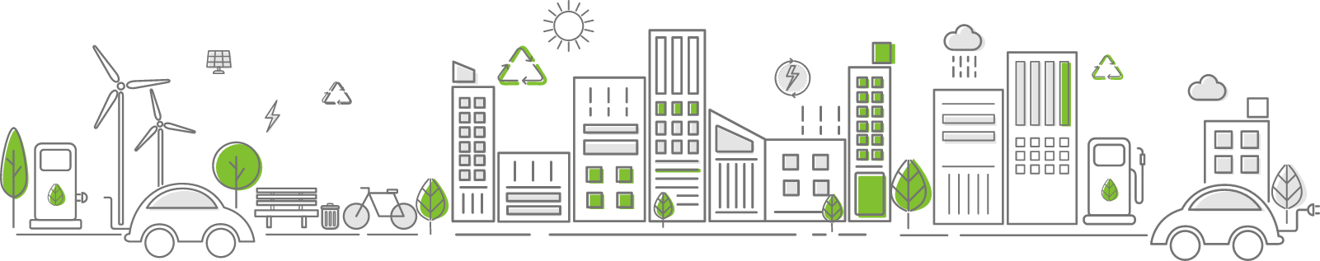
Outline of the module
Circular economy – Definition, Importance, Benefits
European Approach, Circular Economy Action Plan
Stories for grabs

Slide 5
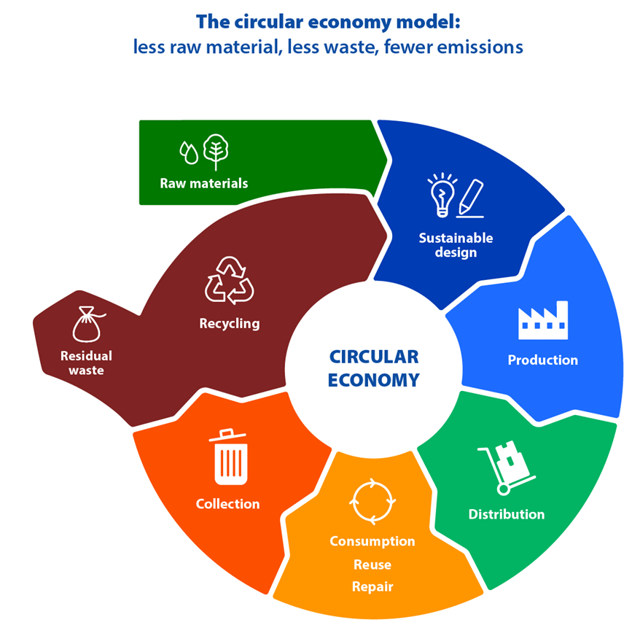
CIRCULAR ECONOMY?
Přechod EU na oběhové hospodářství sníží tlak na přírodní zdroje a vytvoří udržitelný růst a pracovní místa.
Je také předpokladem pro dosažení cíle EU v oblasti klimatické neutrality do roku 2050 a pro zastavení úbytku biologické rozmanitosti.
Evropská komise 11. prosince 2019 oznámila Evropskou zelenou dohodu, která má Evropskou unii do roku 2050 přeměnit na první klimaticky neutrální kontinent.
The European Green Deal – A commitment to future generations

Slide 6
CIRCULAR ECONOMY
Definition…
Importance…
Benefits…
Oběhové hospodářství je model výroby a spotřeby, který zahrnuje sdílení, pronájem, opětovné použití, opravu, renovaci a recyklaci stávajících materiálů a výrobků tak dlouho, jak je to jen možné.
Tímto způsobem se prodlužuje životní cyklus výrobků.
Notes:
When a product reaches the end of its life, its materials are kept within the economy wherever possible thanks to recycling. These can be productively used again and again, thereby creating further value.

Slide 7
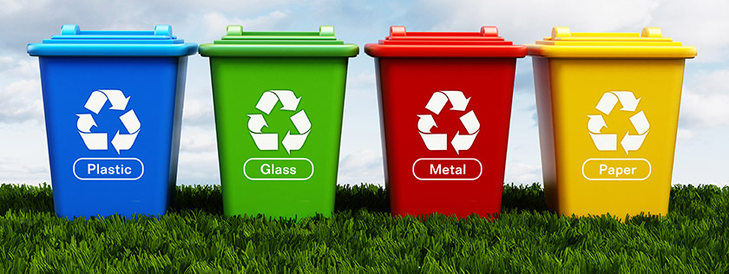
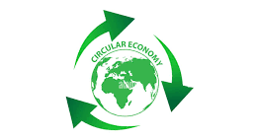
V praxi snižuje množství odpadu na minimum.
Po skončení životnosti výrobku se jeho materiály díky recyklaci pokud možno zachovávají v rámci ekonomiky. Ty mohou být znovu a znovu produktivně využity, čímž se vytváří další hodnota.
CIRCULAR ECONOMY
Definition…
Importance…
Benefits…

Slide 8
Chránit životní prostředí
Opětovné použití a recyklace výrobků by zpomalily využívání přírodních zdrojů, omezily narušení krajiny a stanovišť a pomohly omezit ztrátu biologické rozmanitosti.
Snížení celkových ročních emisí skleníkových plynů. Průmyslové procesy a používání výrobků jsou zodpovědné za 9 % emisí skleníkových plynů v EU.
Obaly jsou stále větším problémem a průměrný Evropan vyprodukuje v průměru téměř 180 kg obalového odpadu ročně.
CIRCULAR ECONOMY
Definition…
Importance…
Benefits…
Notes:
It is estimated that more than 80% of a product's environmental impact is determined during the design phase.
The aim is to tackle excessive packaging and improve its design to promote reuse and recycling.

Slide 9
Snížení závislosti na surovinách
Světová populace roste a s ní i poptávka po surovinách. Nabídka klíčových surovin je však omezená.
Omezené dodávky také znamenají, že některé země EU jsou závislé na jiných zemích, pokud jde o suroviny. Podle údajů Eurostatu dováží EU přibližně polovinu surovin, které spotřebuje
To platí zejména pro kritické suroviny, které jsou potřebné pro výrobu technologií, jež mají zásadní význam pro dosažení cílů v oblasti klimatu, jako jsou baterie a elektrické motory.
CIRCULAR ECONOMY
Definition…
Importance…
Benefits…
Notes:
The total value of trade (import plus exports) of raw materials between the EU and the rest of the world has almost tripled since 2002, with exports growing faster than imports. Regardless, the EU still imports more than it exports. In 2021, this resulted in a trade deficit of €35.5 billion.

Slide 10
Vytváření pracovních míst a úspora peněz spotřebitelů
Přechod na oběhové hospodářství by mohl zvýšit konkurenceschopnost, stimulovat inovace, podpořit hospodářský růst a vytvořit pracovní místa (jen v EU do roku 2030 700 000 pracovních míst).
Přepracování materiálů a výrobků pro oběhové využití by rovněž podpořilo inovace v různých odvětvích hospodářství.
Spotřebitelé budou mít k dispozici trvanlivější a inovativnější výrobky, které zvýší kvalitu života a v dlouhodobém horizontu jim ušetří peníze.
CIRCULAR ECONOMY
Definition…
Importance…
Benefits…

Slide 11
What is the EU doing to become a circular economy?
Odpověď na otázku lze nalézt ve 4 milnících...
2020 představila Evropská komise akční plán oběhového hospodářství, jehož cílem je podpořit udržitelnější design výrobků, snížit množství odpadu a posílit postavení spotřebitelů, například vytvořením práva na opravu. Zaměřuje se na odvětví náročná na zdroje, jako je elektronika a informační a komunikační technologie, plasty, textil a stavebnictví.
2021 Parlament přijal usnesení o novém akčním plánu oběhového hospodářství, v němž požaduje další opatření k dosažení uhlíkově neutrálního, ekologicky udržitelného, beztoxického a plně oběhového hospodářství do roku 2050, včetně přísnějších pravidel recyklace a závazných cílů pro využívání a spotřebu materiálů do roku 2030.

Slide 12
What is the EU doing to become a circular economy?
2022 Komise zveřejnila první balíček opatření k urychlení přechodu na oběhové hospodářství, který je součástí akčního plánu pro oběhové hospodářství. Návrhy zahrnují podporu udržitelných výrobků, posílení postavení spotřebitelů v oblasti ekologického přechodu, revizi regulace stavebních výrobků a vytvoření strategie pro udržitelné textilie.
2022, Komise navrhla nová celoevropská pravidla pro obaly. Jejím cílem je snížit množství obalového odpadu a zlepšit design obalů, například s jasným označováním na podporu opětovného použití a recyklace; a vyzývá k přechodu na biologické, biologicky rozložitelné a kompostovatelné plasty.

Slide 13
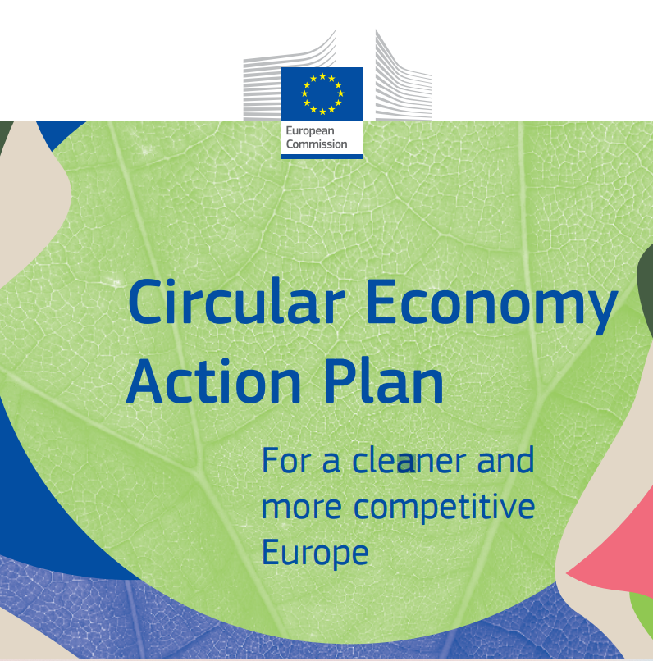
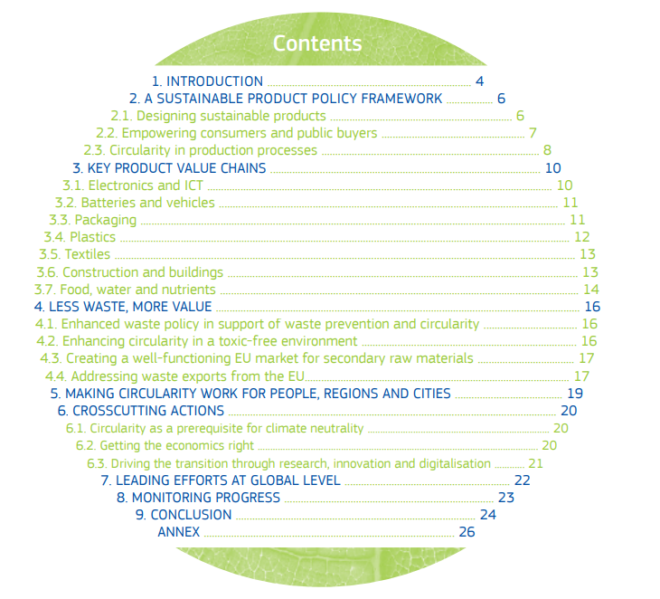
Circular Economy Action Plan - For a cleaner and more competitive Europe

Slide 14
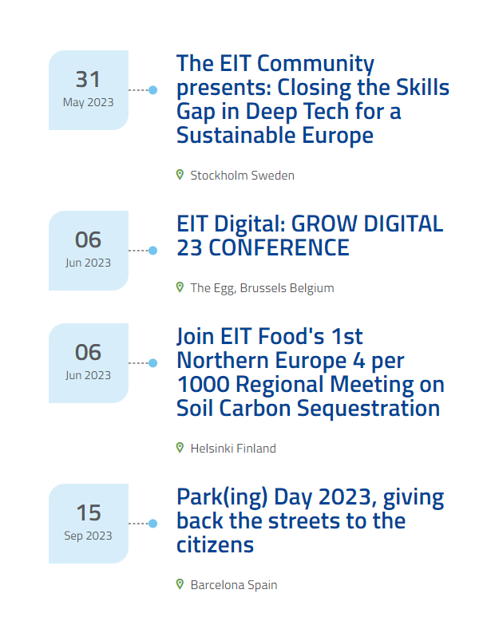
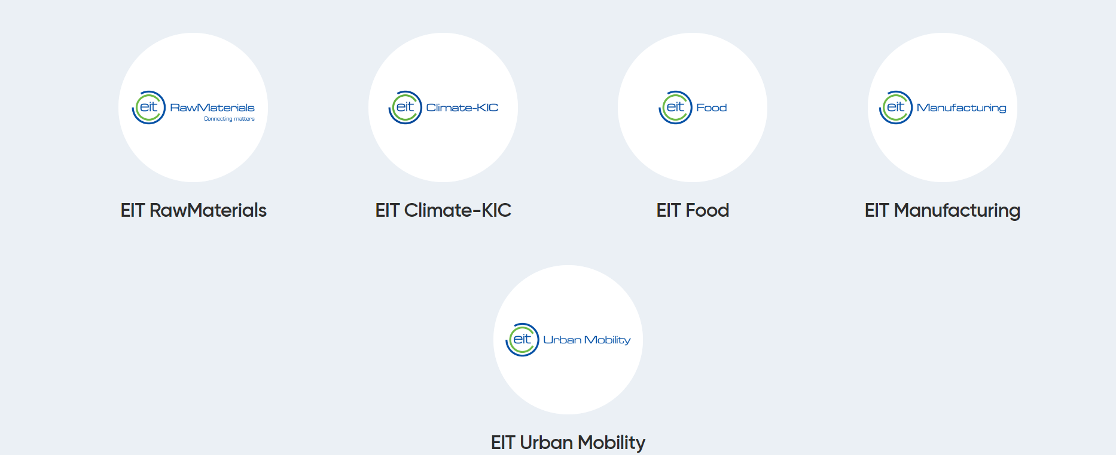
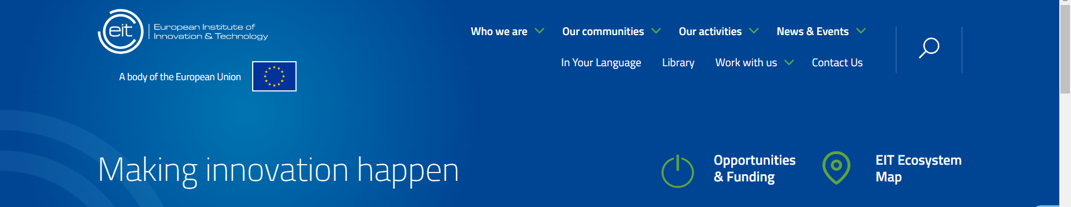
What is the EU doing to become a circular economy?
The European Institute of Technology and Innovation (EIT) brings together EIT Climate-KIC, EIT Food, EIT Manufacturing, EIT RawMaterials and EIT Urban Mobility to develop a multifaceted approach to furthering the field of Circular Economy and supporting the European Commission to achieve its Circular Economy Action Plan.
Notes:
Use the link for European Institute of Technology and Innovation (for additional information).

Slide 15
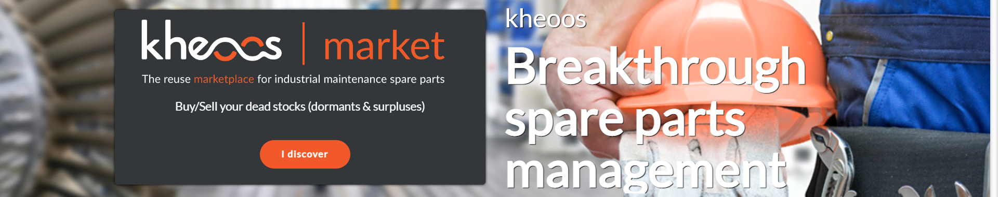
Storries for grabs – start-ups awarded from European Institute of Technology
kheoos is the B-to-B market place for industrial maintenance parts, favouring the connection between manufacturers, distributors, brokers and industrialists.
kheoos is the community platform that allows manufacturers managing maintenance parts to automatically build their customized catalogue and benefit from advanced services to lower their inventory levels, reduce their risk of breakage, find rare pieces and resell their dormant stock.
Notes:
T

Slide 16
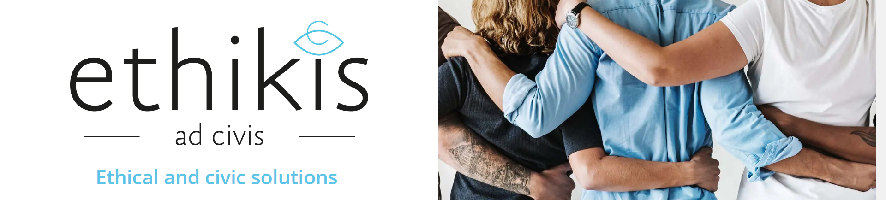

Storries for grabs – start-ups awarded from European Institute of Technology
ethikis, a social enterprise promoting ethical consumption and use, was awarded the prize for their LONGTIME® product label. This label, a certified stamp of approval, informs consumers that the product is durable and long-lasting. This aims to guide consumers towards more informed and responsible decision making when buying products.
Notes:
T

Slide 17
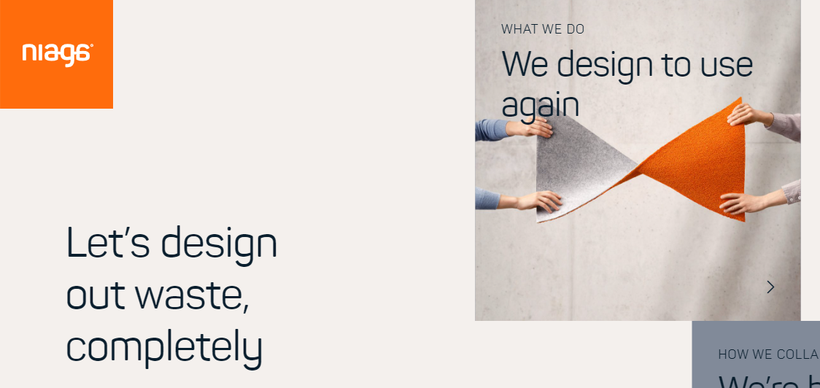

Storries for grabs – start-ups awarded from European Institute of Technology
Niaga’s solution is a scannable tag for products like mattresses and carpets that enables consumers to see exactly what they are made of and, crucially, how to recycle them. In this way, the Niaga® tag helps to keep valuable materials in the loop for future generations and significantly reduce waste.
Notes:
T

Slide 18
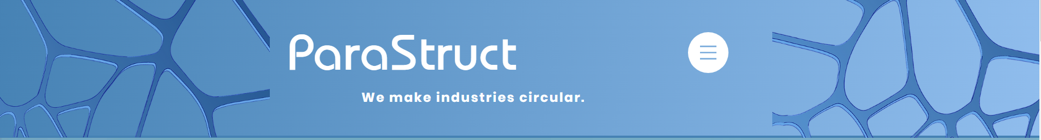
Storries for grabs – start-ups awarded from European Institute of Technology
An Alpine mission to decarbonise construction
Technicians and scientists witnessing the effects of climate change in the Alpine region came together to form the start-up ParaStruct. Their mission is to decarbonise the construction industry and reduce resource inefficiencies with an advanced 3D power-printing technology that enables the recycling of construction waste into high-quality materials for re-use.

Slide 19
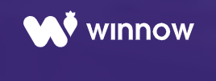
Storries for grabs
British start-up Winnow has developed smart meters that analyse trash. They are used in commercial kitchens to measure what food gets thrown away, and then identify ways to reduce waste.
  Up to a fifth of food purchased can be wasted in some kitchens, and Winnow has managed to cut that in half in hundreds of kitchens across 40 countries, saving its customers over $25 million each year in the process. That is the equivalent of preventing one meal from going to waste every seven seconds. This innovation earned Winnow the Circular Economy Tech Disruptor Award.
Notes:
Play video on Winnow website.

Slide 20
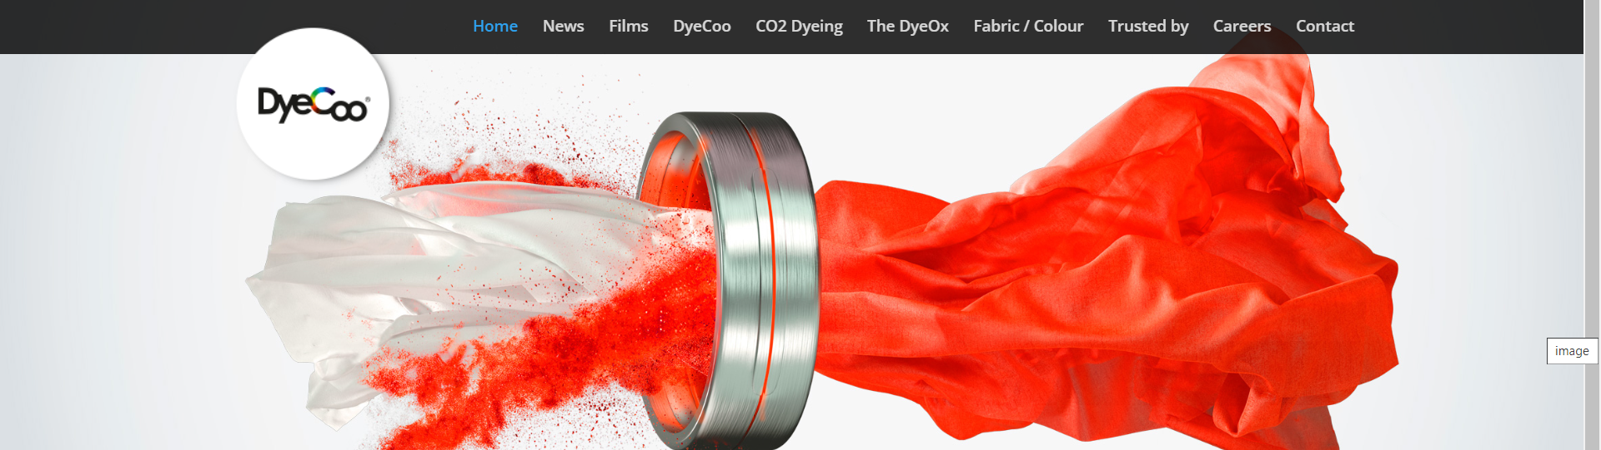
Storries for grabs
DyeCoo, based in Weesp, the Netherlands. Company has developed a process of dyeing cloth that uses no water at all, and no chemicals other than the dyes themselves. It uses highly pressurised “supercritical” carbon dioxide, halfway between a liquid and a gas, that dissolves the dye and carries it deep into the fabric.
  The carbon dioxide then evaporates, and is in turn recycled and used again. 98% of the dye is absorbed by the cloth, giving vibrant colours. And because the cloth doesn’t need to dry, the process takes half the time, uses less energy, and even costs less. The company already has partnerships with major brands like Nike and IKEA.
Notes:
The textiles industry uses vast quantities of water and chemicals and produces huge amounts of toxic waste, which is a major problem in countries like China, India, Bangladesh, Vietnam and Thailand. But Dutch company DyeCoo has developed a process of dyeing cloth that uses no water at all, and no chemicals other than the dyes themselves.

Slide 21
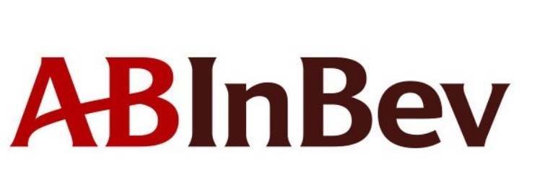
Storries for grabs
ABI takes responsibility for delivering measurable results and lasting change. Their operational and commercial teams develop and deliver circular goals, working across their full value chain to embed circular decision-making across operations, within our product portfolio, and with their ecosystem of partners.
  ABI focus continuously on innovation for circular impact. They are upcycling spent grains into protein-rich drinks, like Canvas, and identifying circular solutions with innovators through their 100+ Accelerator program. In packaging, ABI lead in light-weighting one-way glass and finding new ways to make returnables easy for consumers. They work collaboratively with suppliers and partners to bring infrastructure to local markets, and to recover and recycle material.
  43% of their volume globally is packaged in returnable glass bottles, which are 8 times less carbon-intensive than one-way glass. ABI are also investing in returnable and recycling infrastructure across 6 continents where we operate and have committed to 100% returnable packaging for all products by 2025. ABI know the impact they can have and they challenge themselves to go further.

Slide 22
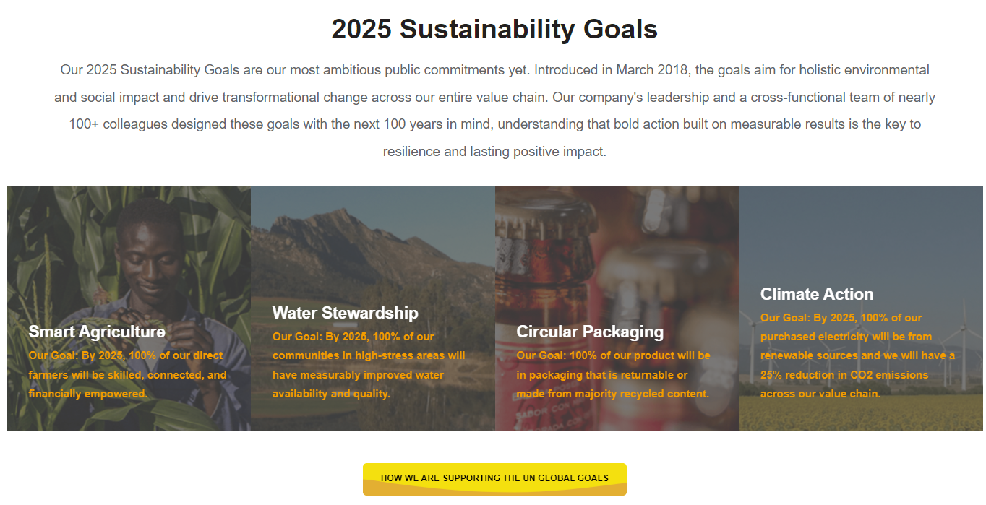
Storries for grabs
Source: https://www.ab-inbev.com/sustainability/
Notes:
See www pages with examples Sustainability Goals

Slide 23
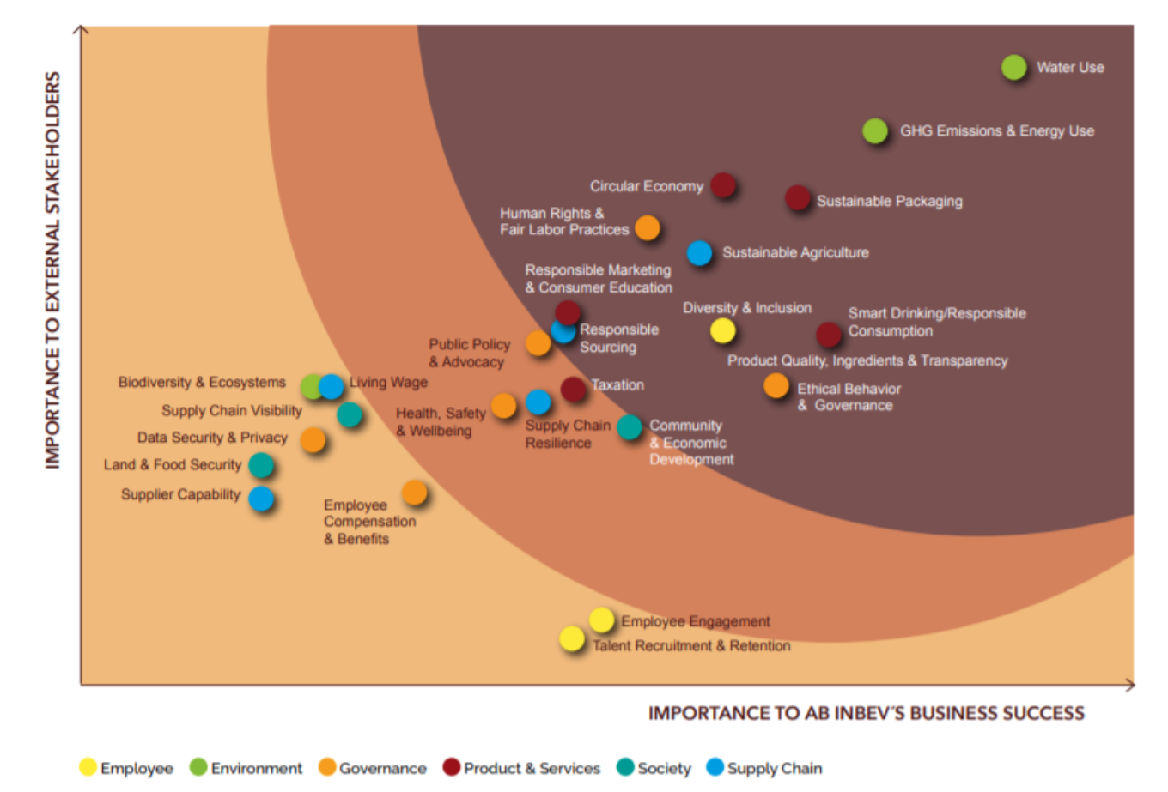
Storries for grabs
Source: https://www.ab-inbev.com/sustainability/

Slide 24
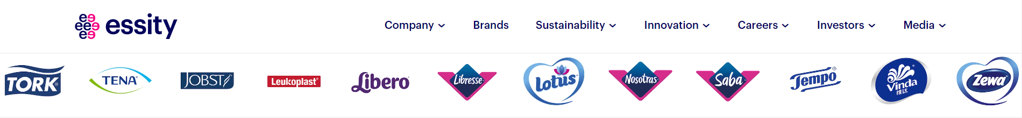
Storries for grabs
Essity is a global leader in sustainable solutions for hygiene and health, dedicated to improving well-being through products and services, essential for everyday life. Sustainability is an integral part of their business focusing on value creation for people, nature and society, critical to success and profitability.
They engage customer channels through our brands using three sustainability platforms:
  Well-being
  More from less
  Circularity
  At least 1/3 of all their innovations should improve society or the environment each year. Materials and energy will be recovered from all waste from all production sites by 2030. In 2017, 62% of all production waste was recovered in materials or energy. All these achievements contribute to a lower environmental footprint for their products.
Notes:
Watch a video and website for additional information in sustainability, circularity.

Slide 25
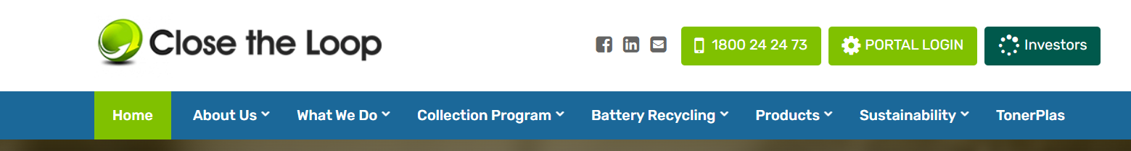
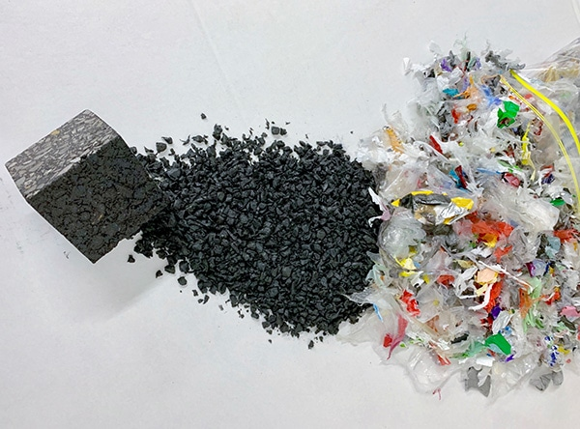
Storries for grabs
This Australian company has spent more than a decade recovering value from old printer cartridges and soft plastics. Their new innovation turns these materials into roads.
The products are mixed in with asphalt and recycled glass to produce a higher-quality road surface that lasts up to 65% longer than traditional asphalt.
In every kilometre of road laid, the equivalent of 530,000 plastic bags, 168,000 glass bottles and the waste toner from 12,500 printer cartridges is used in the mix.
So instead of ending up in landfill, all that waste is given a new life, getting us where we need to go.

Slide 26
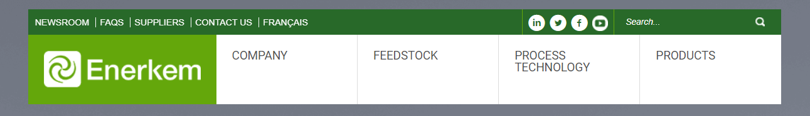
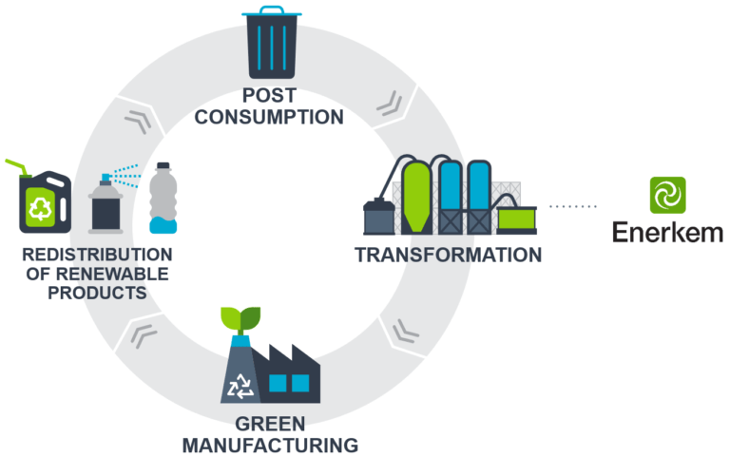
Storries for grabs
Canadian firm Enerkem is the first company in the world to produce renewable methanol and ethanol from non-recyclable, non-compostable municipal solid waste at full commercial scale.
Technology extracts the carbon from trash that can’t be recycled. It then takes five minutes to turn the carbon into a gas that can be used to make biofuels like methanol and ethanol, as well as chemicals which can be used in thousands of everyday products. The city of Edmonton, for example, now reuses 90% of its waste, saving more than 100,000 metric tons of landfill every year.

Slide 27
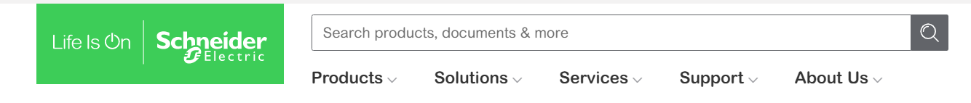
Storries for grabs
French-based Schneider Electric, which specialises in energy management and automation, won the Award for the Circular Economy Multinational.
Employing 142,000 people in more than 100 countries, it uses recycled content and recyclable materials in its products, prolongs product lifespan through leasing and pay-per-use, and has introduced take-back schemes into its supply chain.
Circular activities now account for 12% of its revenues, and will save 100,000 metric tons of primary resources from 2018-2020.

Slide 28
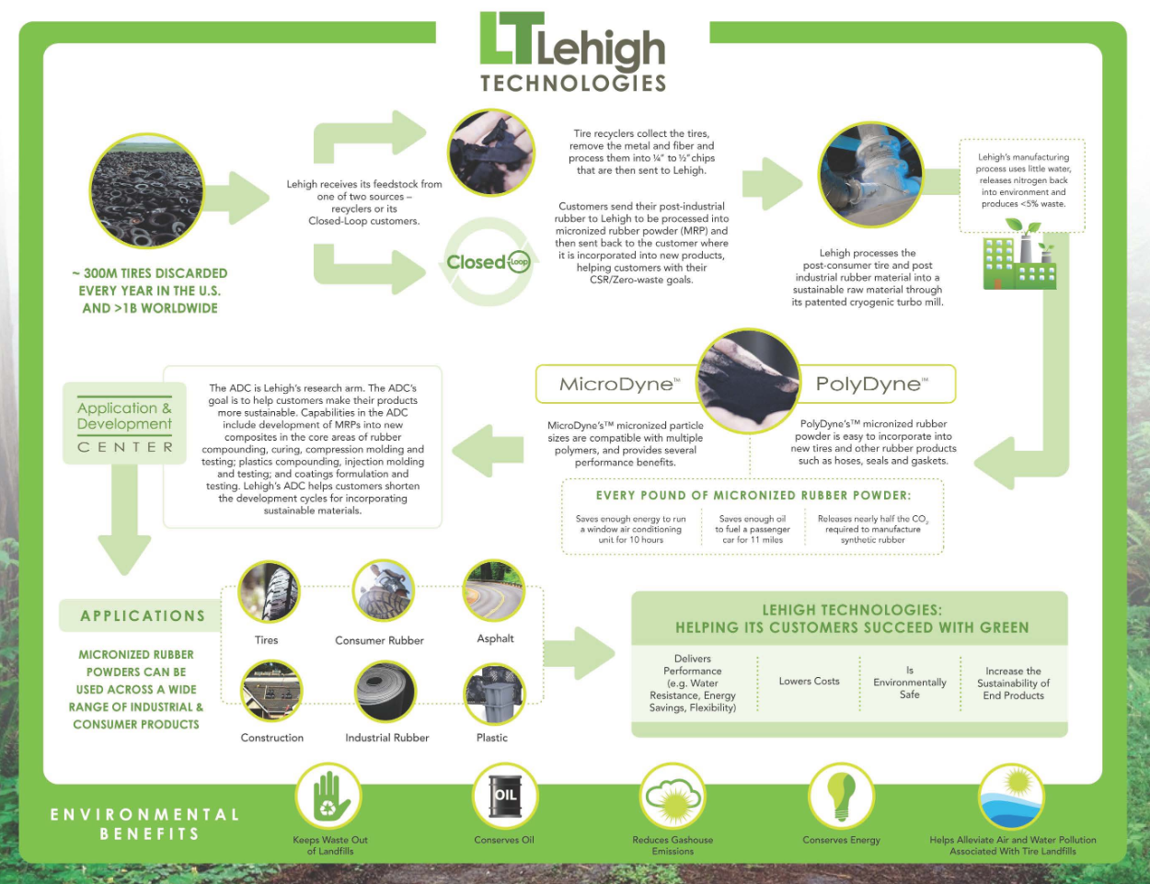
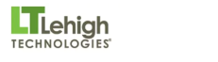
Storries for grabs
This Atlanta firm turns old tyres and other rubber waste into something called micronized rubber powder, which can then be used in a wide variety of applications from tyres to plastics, asphalt and construction material. Five hundred million new tyres have been made using its products, earning it the Award for Circular Economy SME.

Slide 29
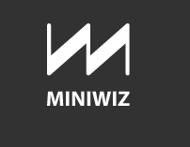
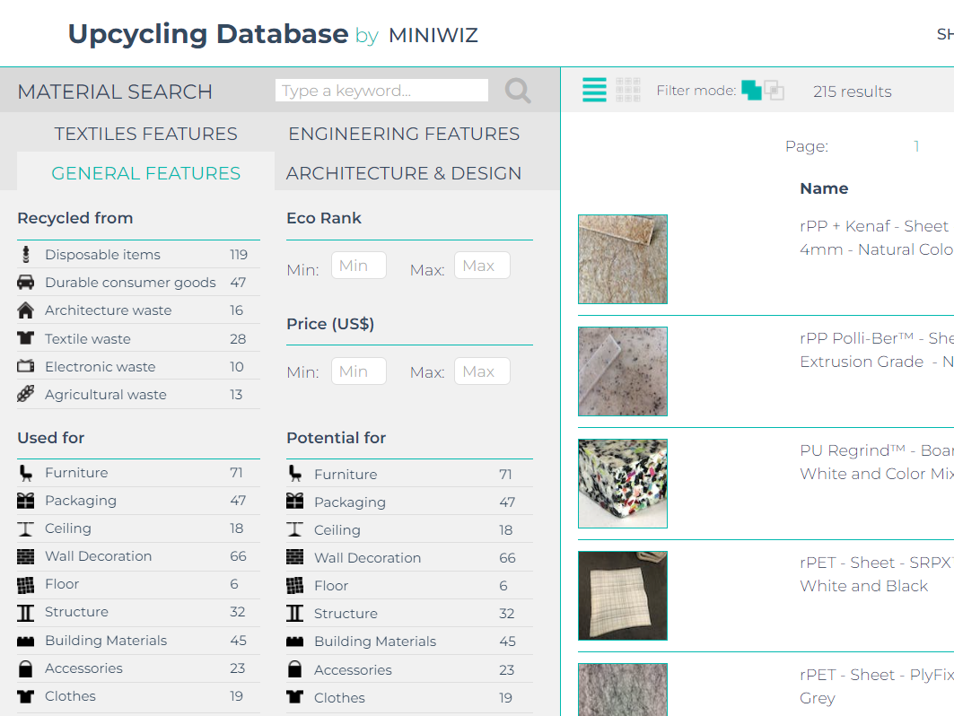
Storries for grabs
For the founder of Miniwiz, Arthur Huang, there is no such thing as trash. He is for upcycling - turning old materials into something new. As he admits, this isn’t a new idea - until the 20th century reusing whatever was lying around was the norm. But he is taking this principle to new levels, with the scientists and engineers in his Miniwiz Trash Lab inventing over 1,000 new sustainable materials and applications.
The Trashpresso machine is the ultimate expression of sustainable upcycling. It is a mobile upcycling plant that can be transported in two shipping containers to its customers. Once there, it turns 50kg of plastic bottles an hour into a low-cost building material, using no water, and only solar power.

Slide 30
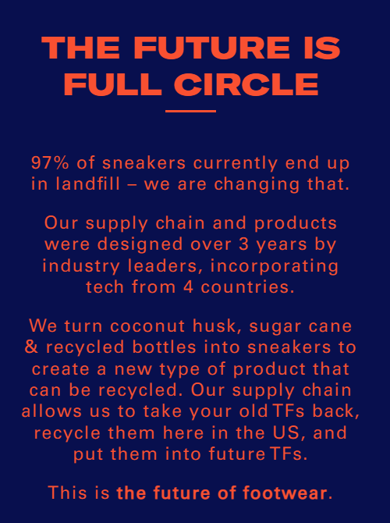
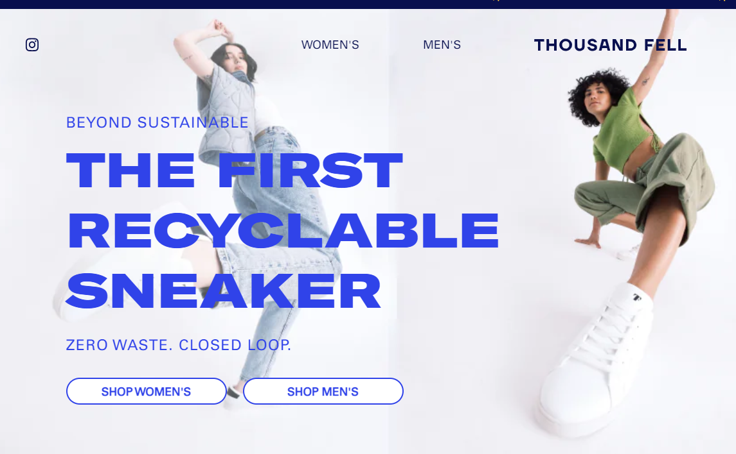
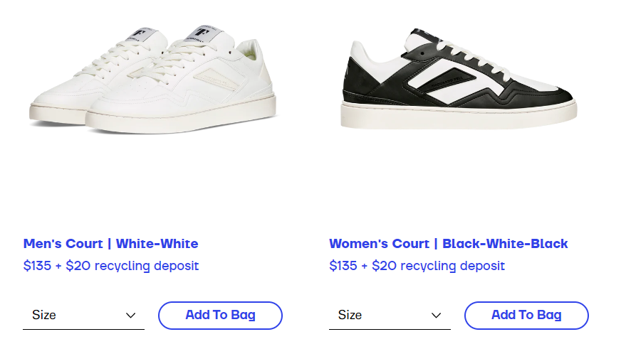
Storries for grabs
Thousand Fell is already making a name for itself as an environmentally-conscious manufacturer with shoes made from sustainable materials such as coconut husk and sugar cane, and even recycled plastic bottles,
Now, in partnership with TerraCycle and UPS, the maker has launched a special recycling incentive. Customers can return old pairs of Thousand Fell shoes back to the manufacturer. Thousand Fell will then recycle the returned footwear and send customers $20 that can be used toward a new pair of shoes.

Slide 31
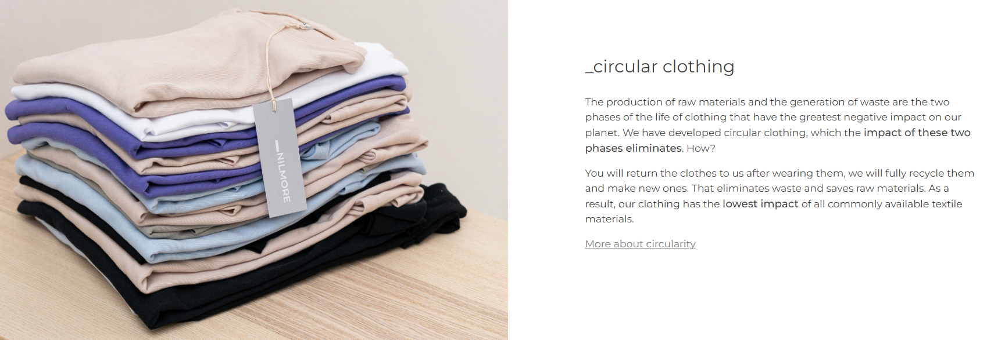
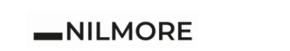
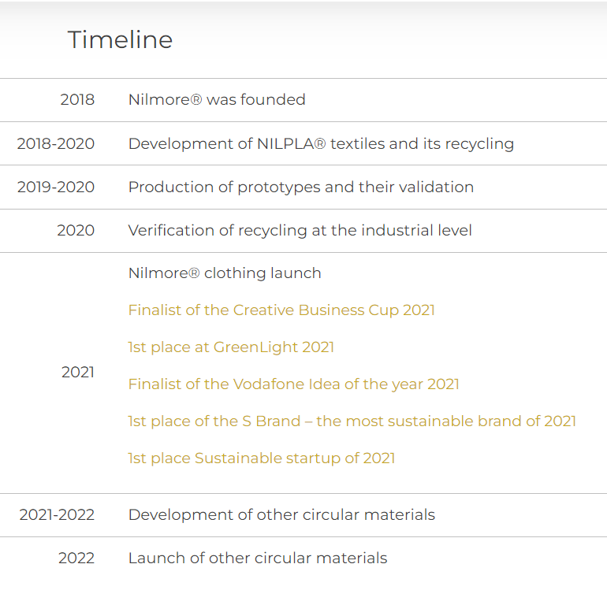
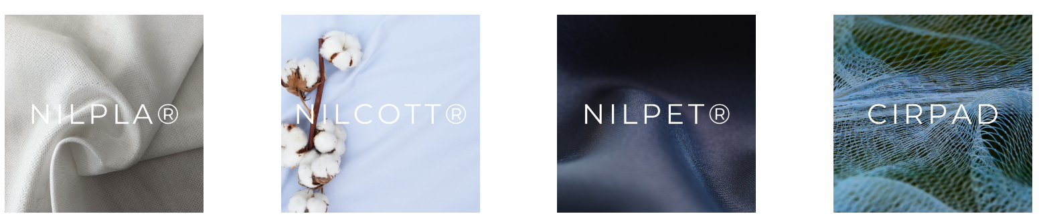
Storries for grabs
Czech company NILMORE _returning clothes for recycling
Do you no longer want our clothes? Is it worn or did it just go out of fashion? You can return it to us through our network of Nilmore® Circular Points. For each returned piece you will receive a 100 CZK discount, which you can use for the next purchase! If you have purchased a product from one of our partners

Slide 32
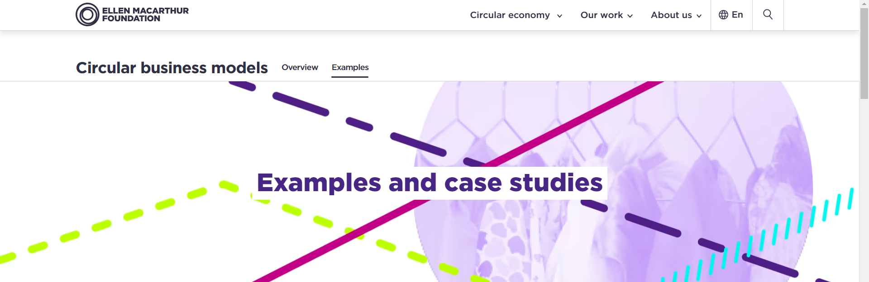
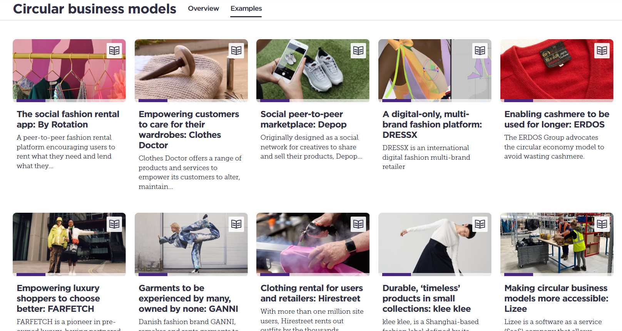
Impact on business concepts in new forms of business models
Circular Business models
(ELLEN MACARTHUR FOUNDATION)
10 Circular Business Model Examples (Circular value chains through data / Circular product design / Use, reuse, share, and repair )
10 Examples of Circular Economy Solutions (Industrial symbiosis / The Danish deposit and return systém for recycling cans and bottles / Denmark´s first circular soucial housing project / Recycling of artificial turf / Closed loop in reuse packaging-as-service / Re-using old bricks to build a greener future)
Circulars Awards Program

Slide 33
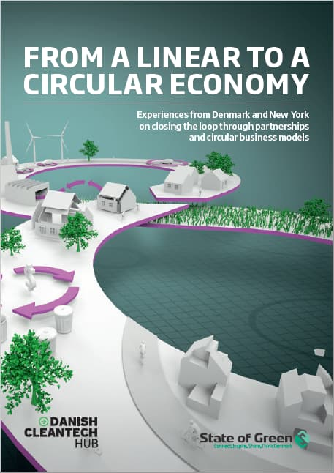
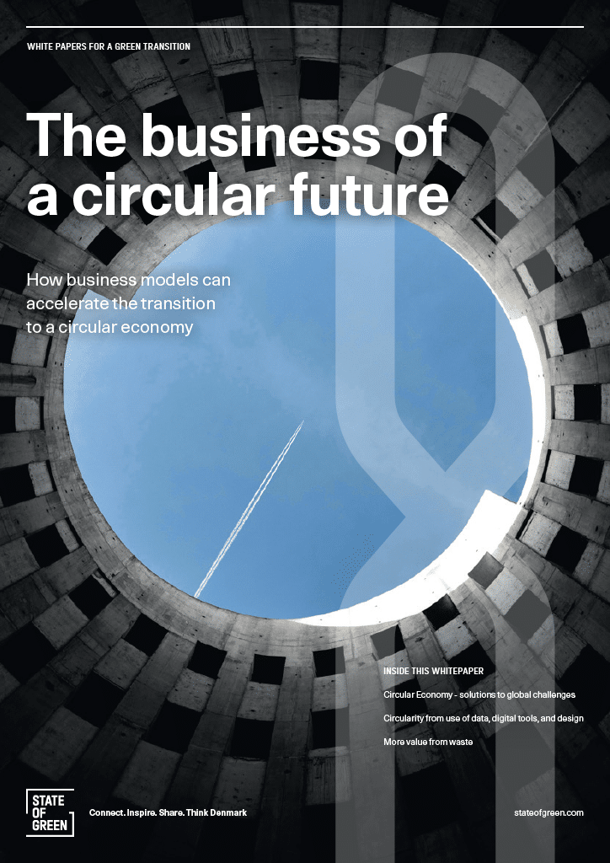
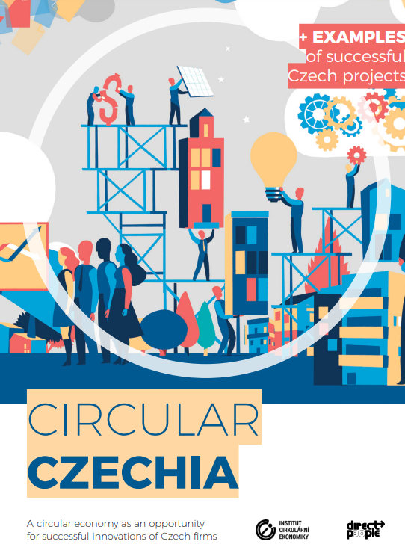
Explore publication…
Experiences from Denmark and New York on closing the loop through partnerships and circular business models
How business models can accelerate the transition to a circular economy
A circular economy as an opportunity
for successful innovations of Czech firms

Slide 34
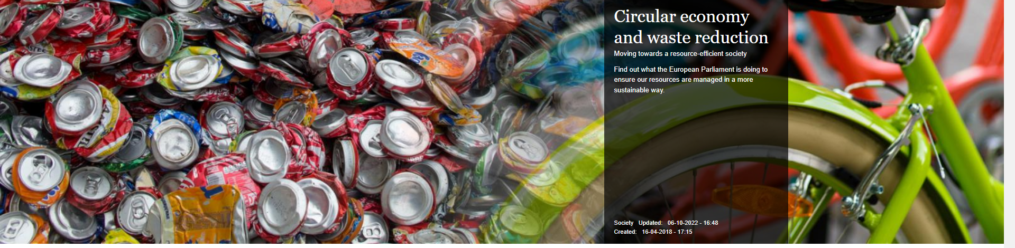
Explore …
European Parliament/News/Priorities/Circular economy
Circular economy and waste reduction
Moving towards a resource-efficient society
Find out what the European Parliament is doing to ensure our resources are managed in a more sustainable way.
https://www.europarl.europa.eu/news/en/headlines/priorities/circular-economy

Slide 35
What are you taking away from today's module?

Slide 36
Use the infographic and try to draw it!
Show it ☺

Slide 37
Thank you…
Name: Pavel Adámek, Ph.D.
Corporate Social Responsibility Specialist
Guarantor of the master's course CSR
E-mail address: adamek@opf.slu.cz

